Slide 1
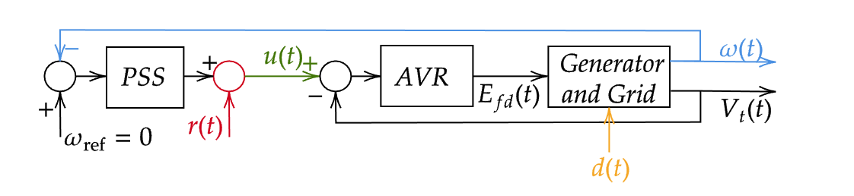
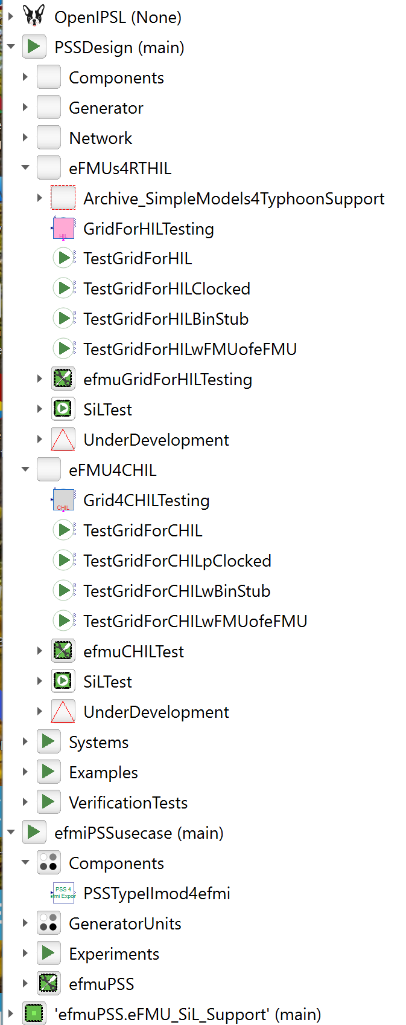
stm32
Unitrol
Gen + Grid
4
eFMU: efmuPSS
eFMU: Grid4HIL
stm32
Unitrol
3
Plant for Hardware-in-the-Loop Testing with Actual Unitrol 1020 and external PSS
eFMU: efmuPSS
Typhoon-HIL
stm32
eFMU: CHILTest
Plant for Controller HIL using Nucleo Board with PSS/Controller model
2
Model of Unitrol
eFMU: efmuPSS
stm32
1
PSS / Controller FMU
eFMU: efmuPSS

Slide 2
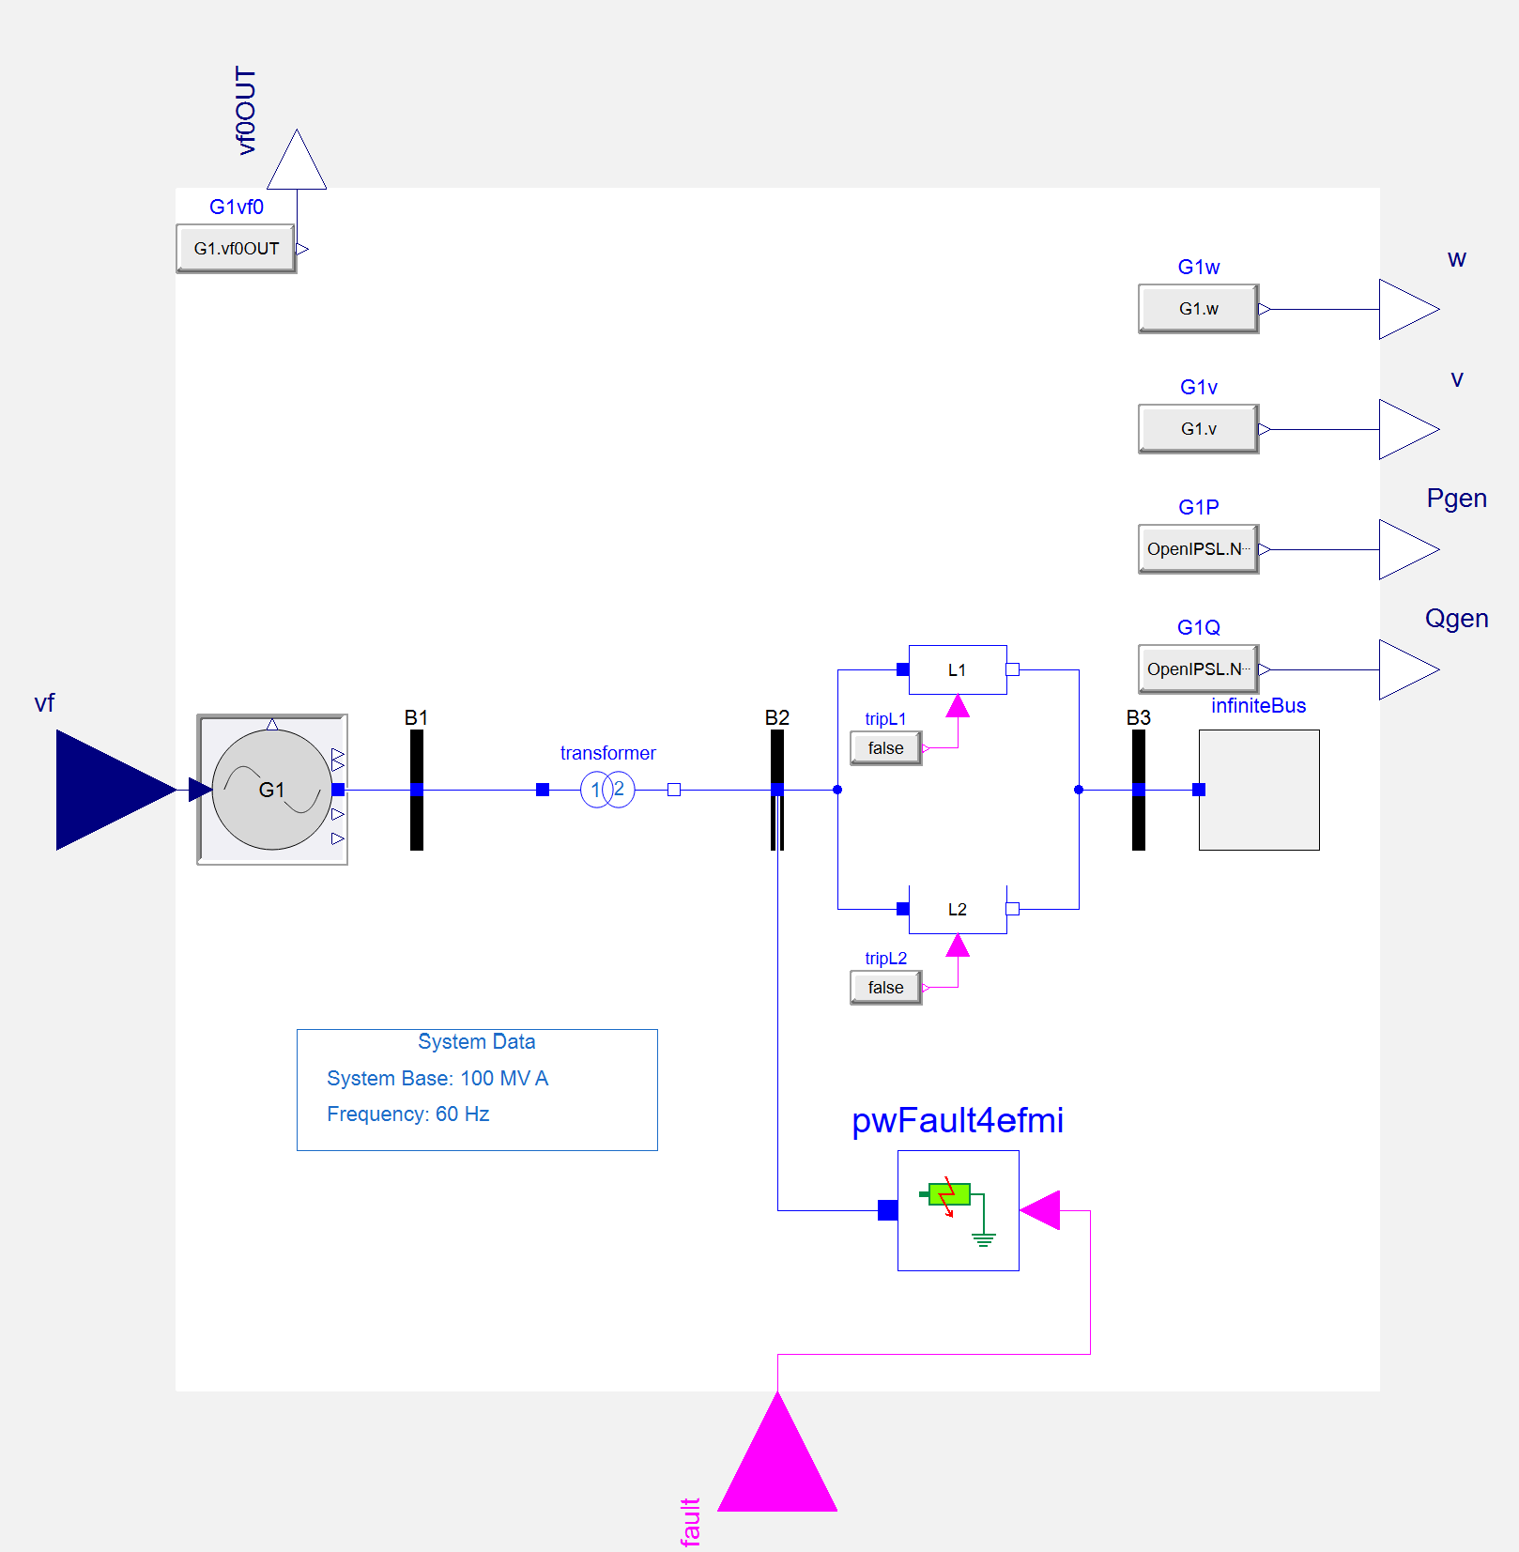
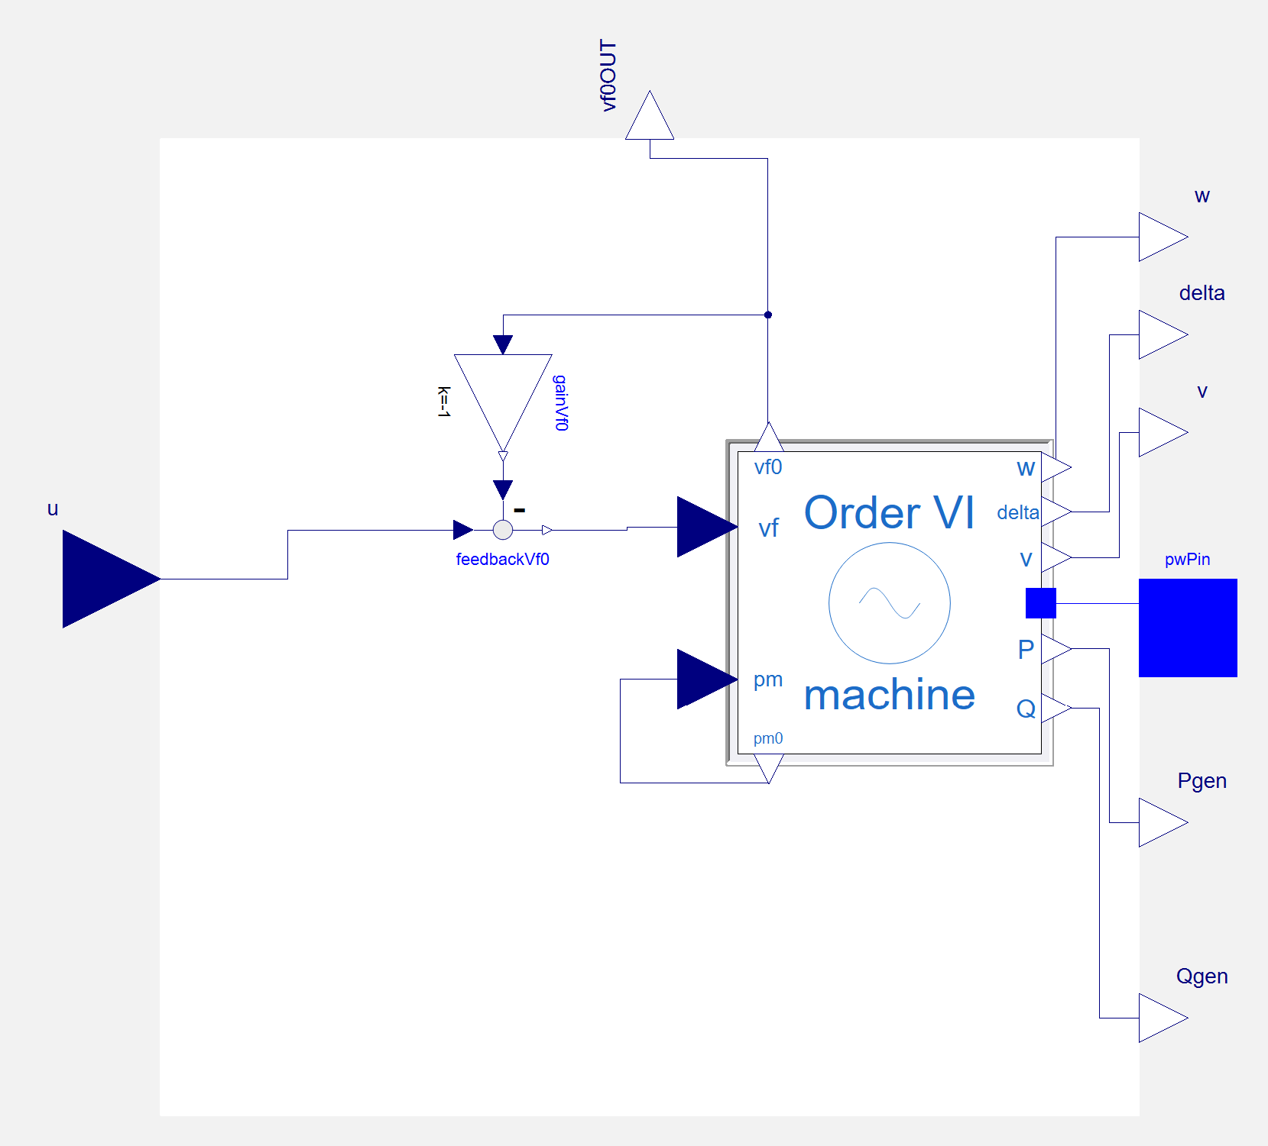
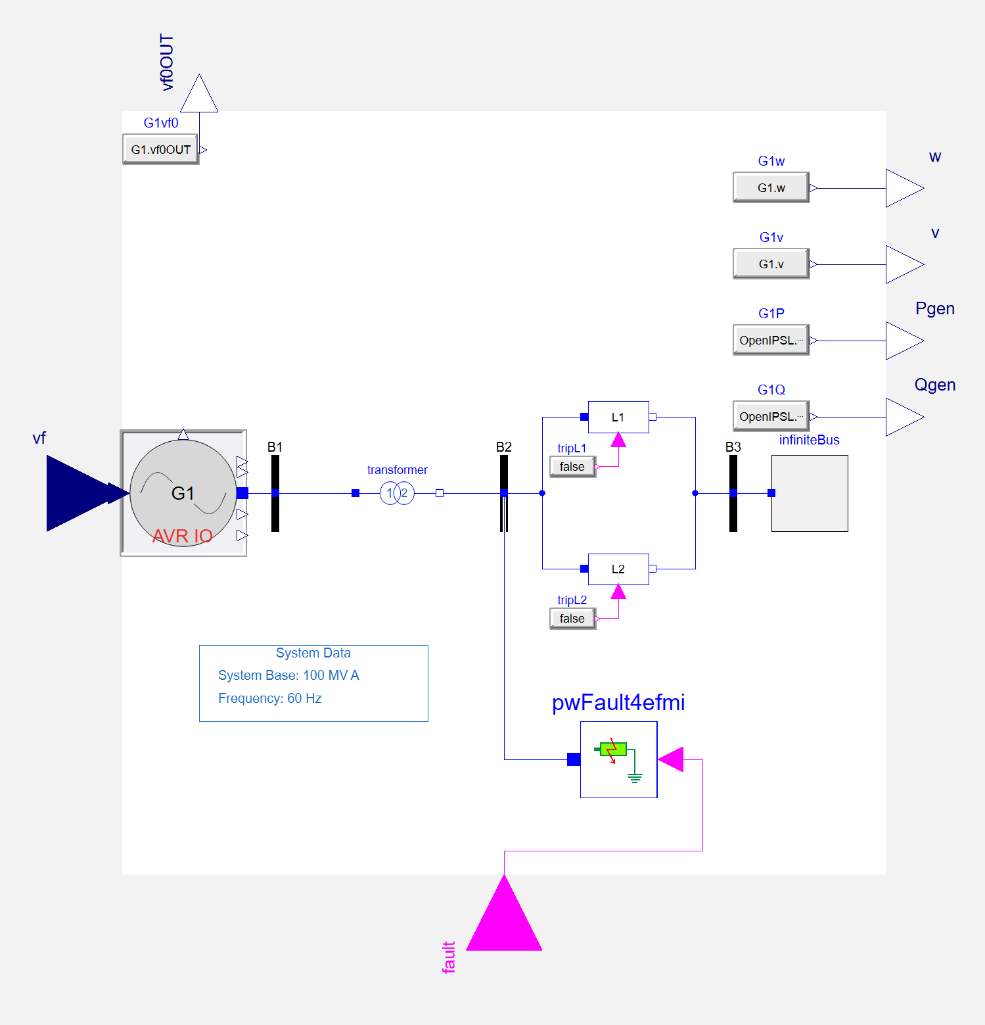
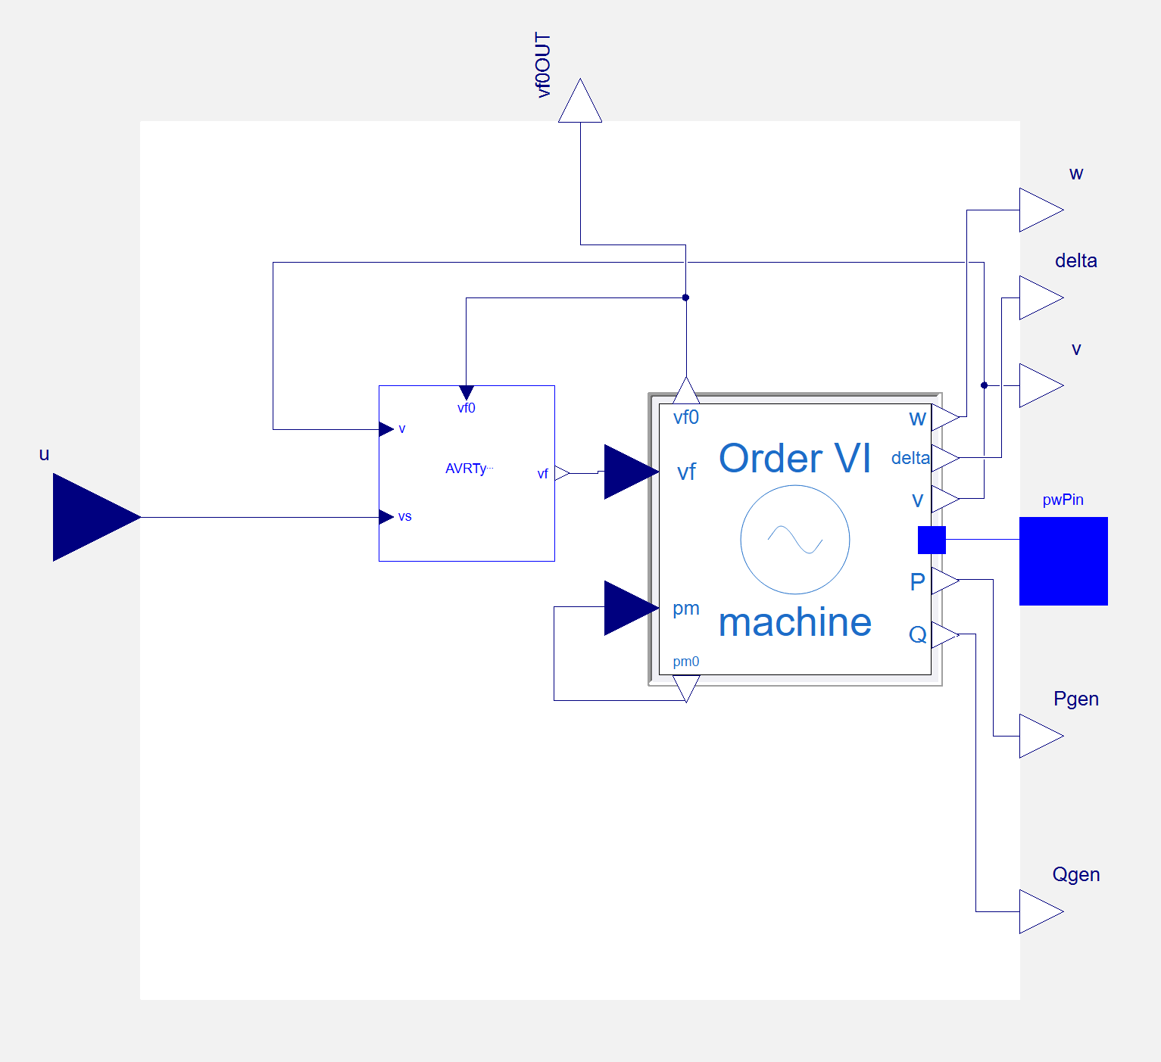
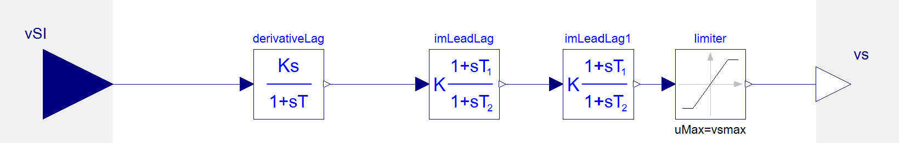
eFMU: Grid4HIL
eFMU: CHILTest
eFMU: efmuPSS

Slide 3
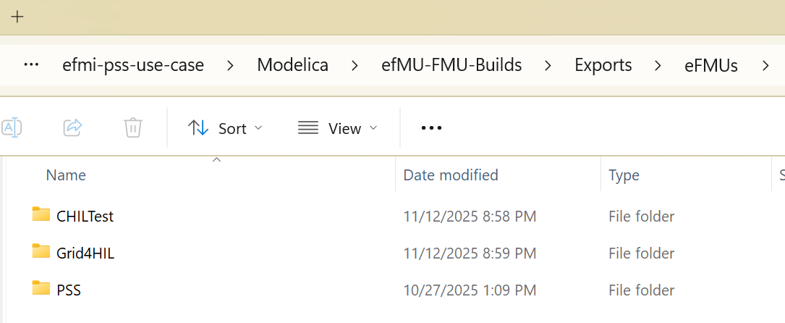
eFMU: Grid4HIL
https://github.com/ALSETLab/efmi-pss-use-case
eFMU: CHILTest
eFMU: efmuPSS

Slide 4
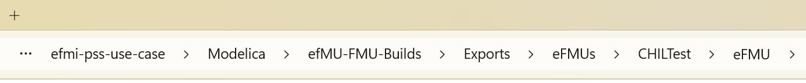
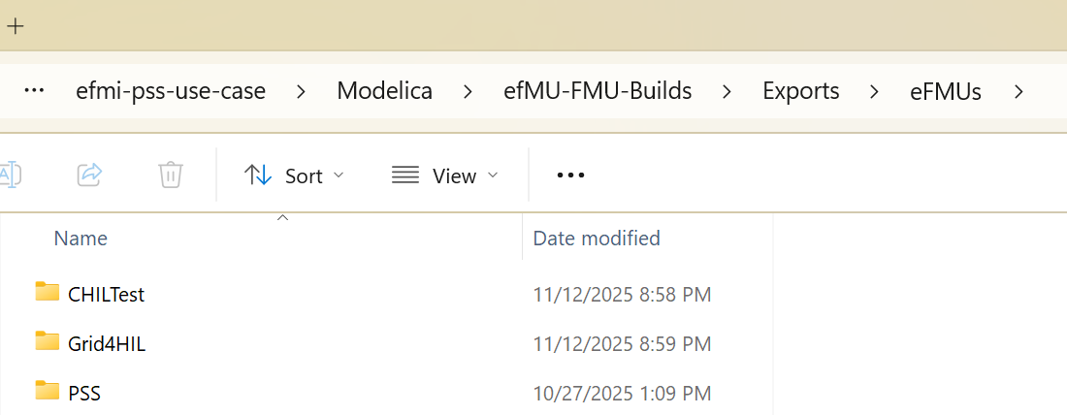
eFMU: Grid4HIL
eFMU: CHILTest
eFMU: efmuPSS

