Slide 1
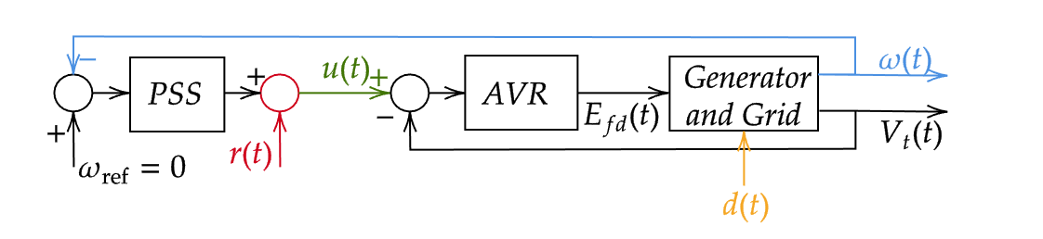
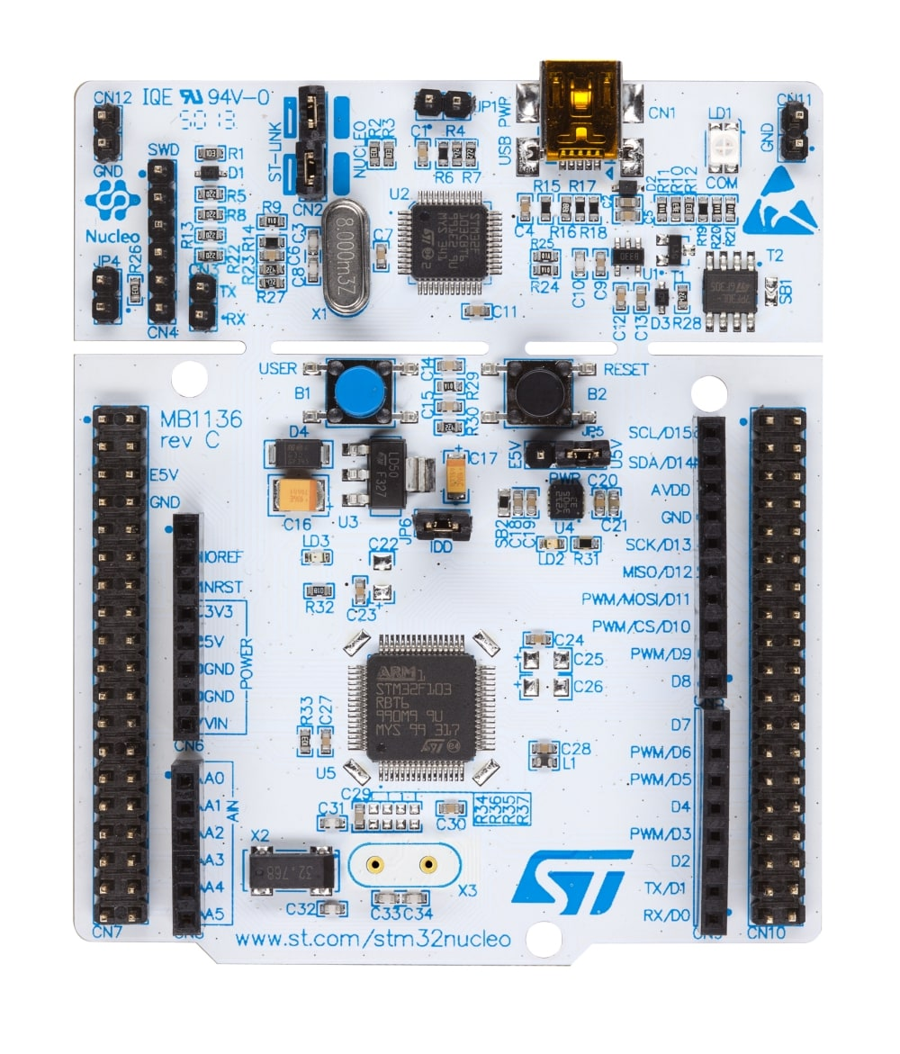
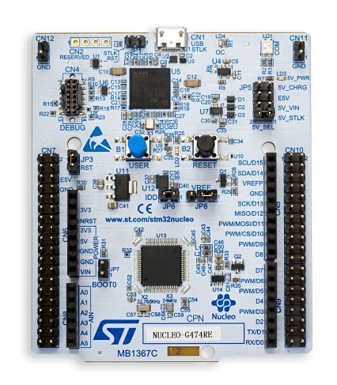
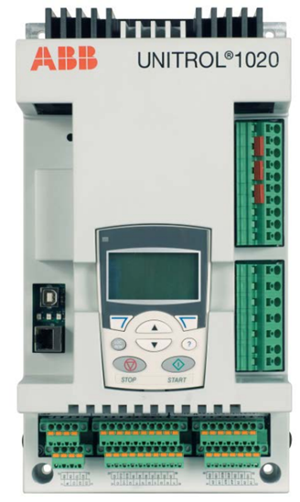
eFMU Deployment (1/2)
1
All in Simulator : Dymola
Software in the Loop Testing:
  Green eFMU is generated for the PSS controller and the production code is tested within the simulator.
Controller Hardware-in-the-Loop Test
  Green eFMU is deployed in Nucleo board
  Red eFMU – CHILTest – is deployed in another Nucleo board
eFMU: efmuPSS
2
stm32
stm32
Analog IO
Model of Unitrol
eFMU: efmuPSS
eFMU: CHILTest
efmuPSS in F303RE
CHILTest in G474RE

Slide 2
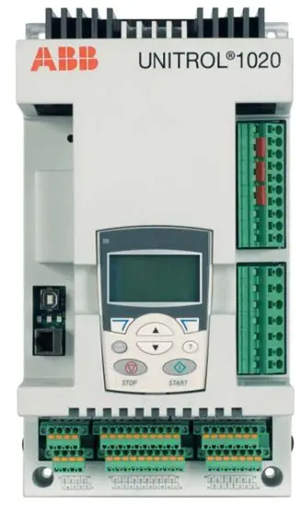

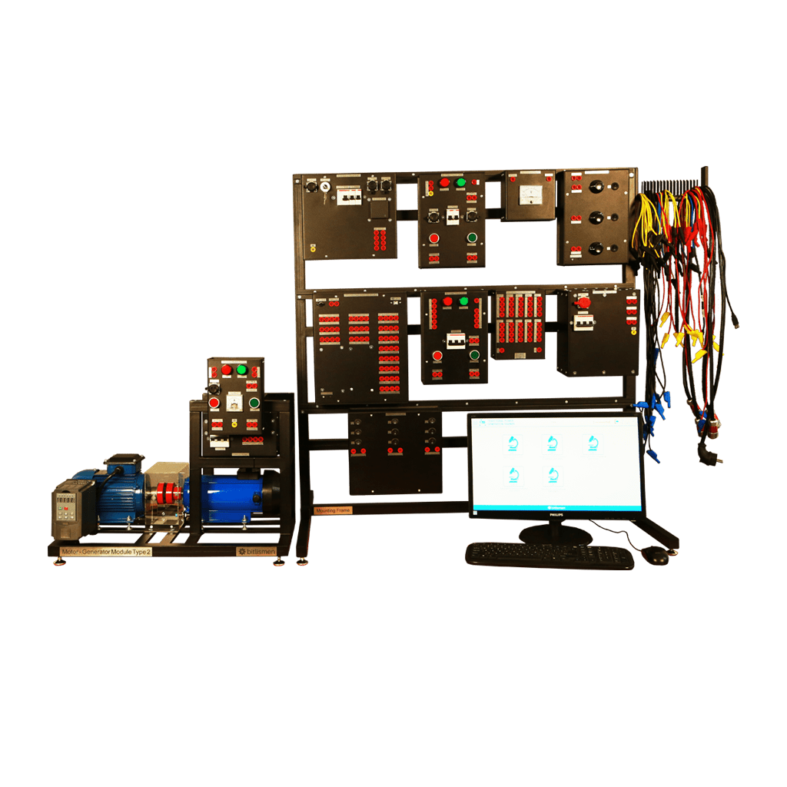
eFMU Deployment (2/2)
3
stm32
Unitrol
Typhoon-HIL
Hardware-in-the-loop Experiment
  Green eFMU is deployed in Nucleo board
  Magenta eFMU – Grid4HIL – is deployed in another Nucleo board
  An Unitrol is a “real-world” generator excitation control system receives the input from the PSS via analog input, and the Unitrol is interfaced with the Typhoon-HIL real-time simulator using a HIL-Connect box for signal conditioning.
Controller Deployment in the field
  We won’t do this yet; we need a fully physical generator setup to test it…
eFMU: efmuPSS
eFMU: Grid4HIL
4
stm32
Unitrol
Gen + Grid
eFMU: efmuPSS
stm32
Unitrol
Gen + Grid
4
eFMU: efmuPSS
eFMU: Grid4HIL
stm32
Unitrol
3
eFMU: efmuPSS
Typhoon-HIL

Slide 3
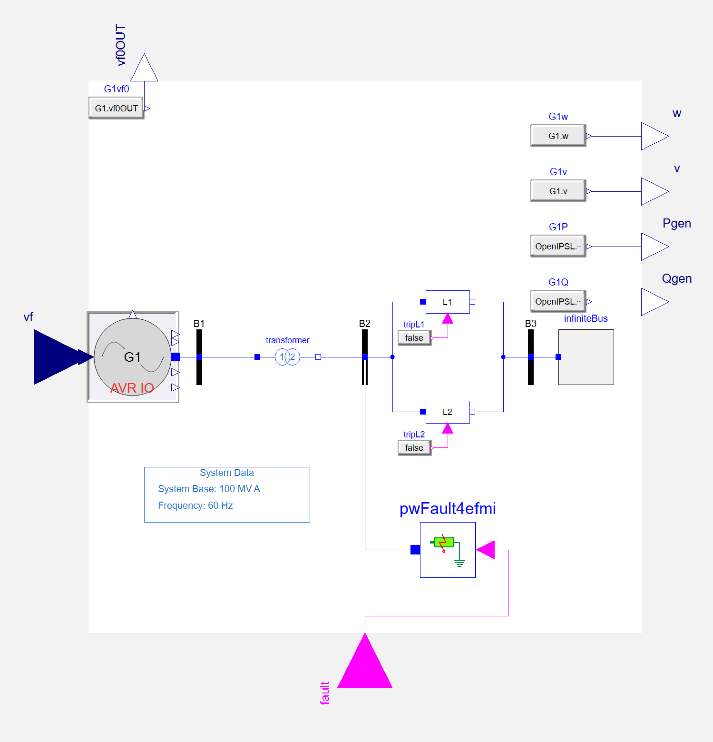
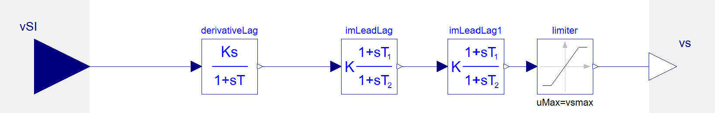
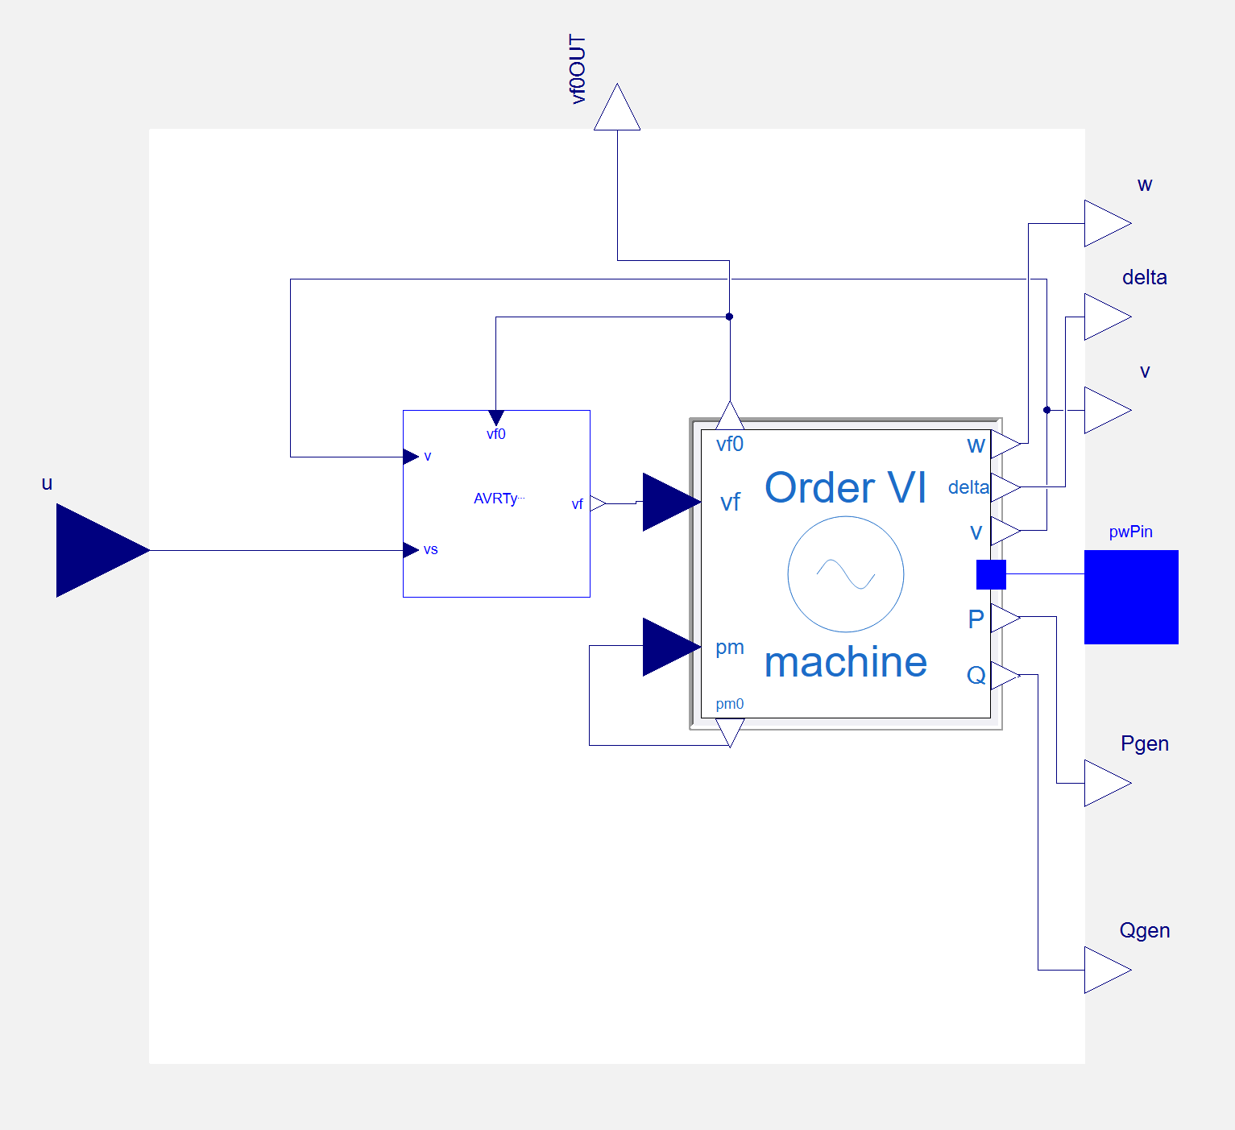
CHIL Test
Analog Output
from B to A
eFMU: efmuPSS
eFMU: CHILTest
Analog Output
from A to B
Analog IO
efmuPSS in F303RE
CHILTest in G474RE

Slide 4
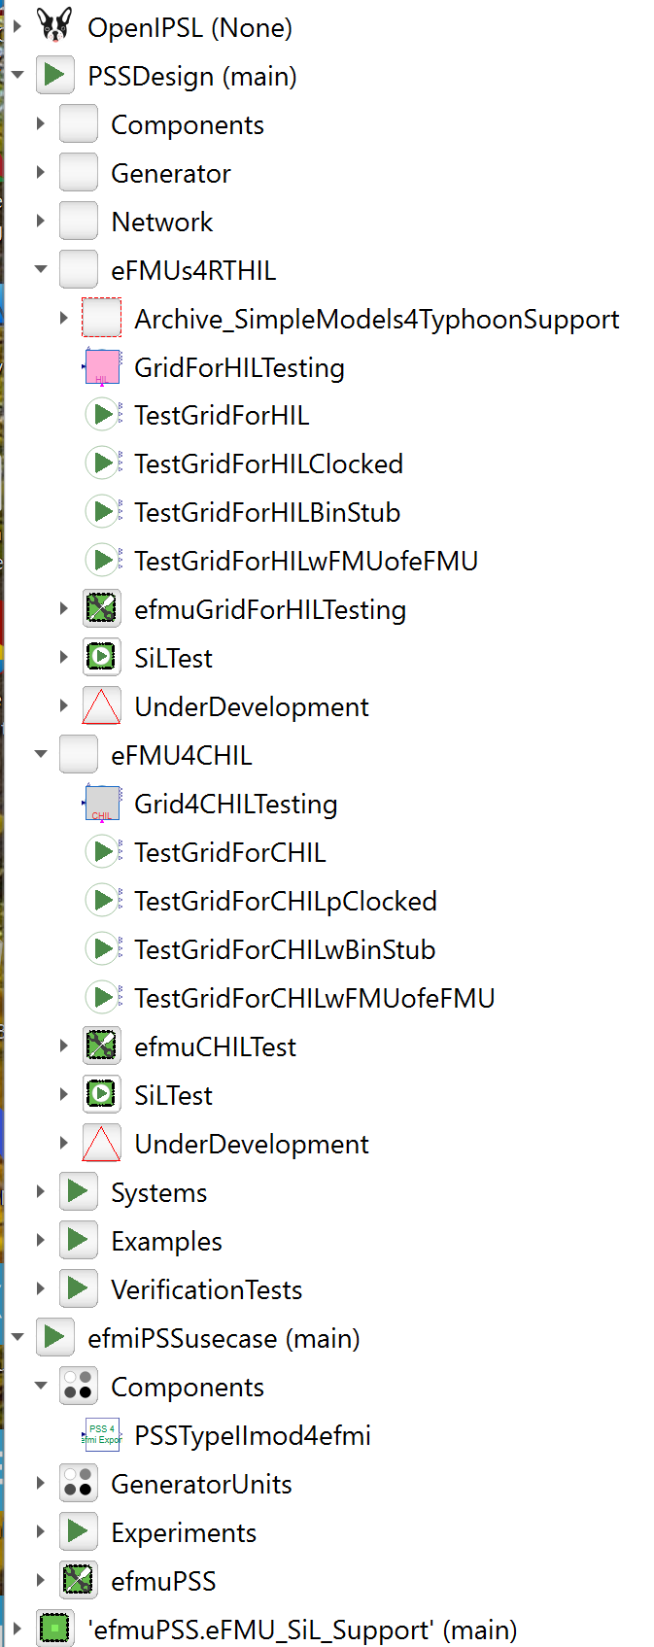
Plant for Hardware-in-the-Loop Testing with Actual Unitrol 1020 and external PSS
eFMU: efmuPSS
eFMU: Grid4HIL
Plant for Controller HIL using Nucleo Board with PSS/Controller model
Model of Unitrol
eFMU: efmuPSS
eFMU: CHILTest
PSS / Controller FMU

Slide 5
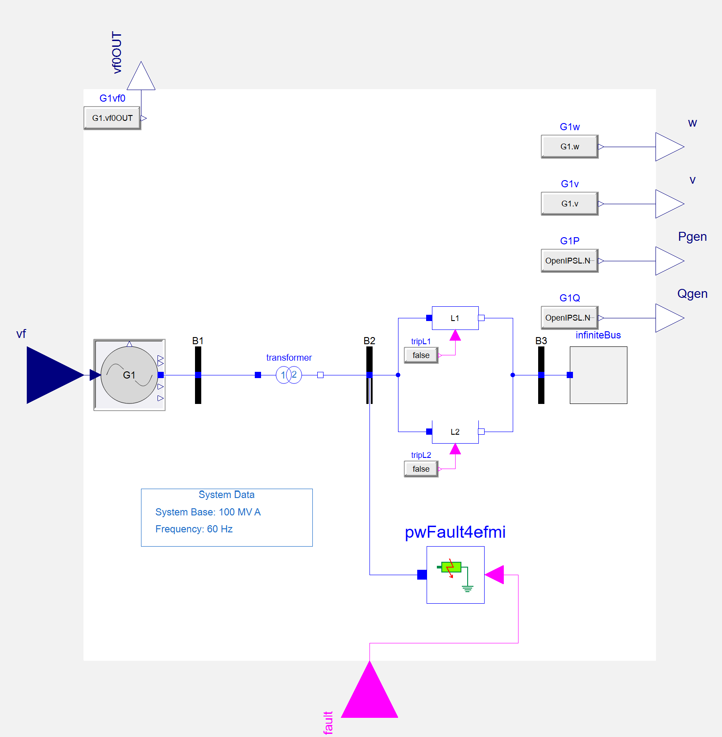
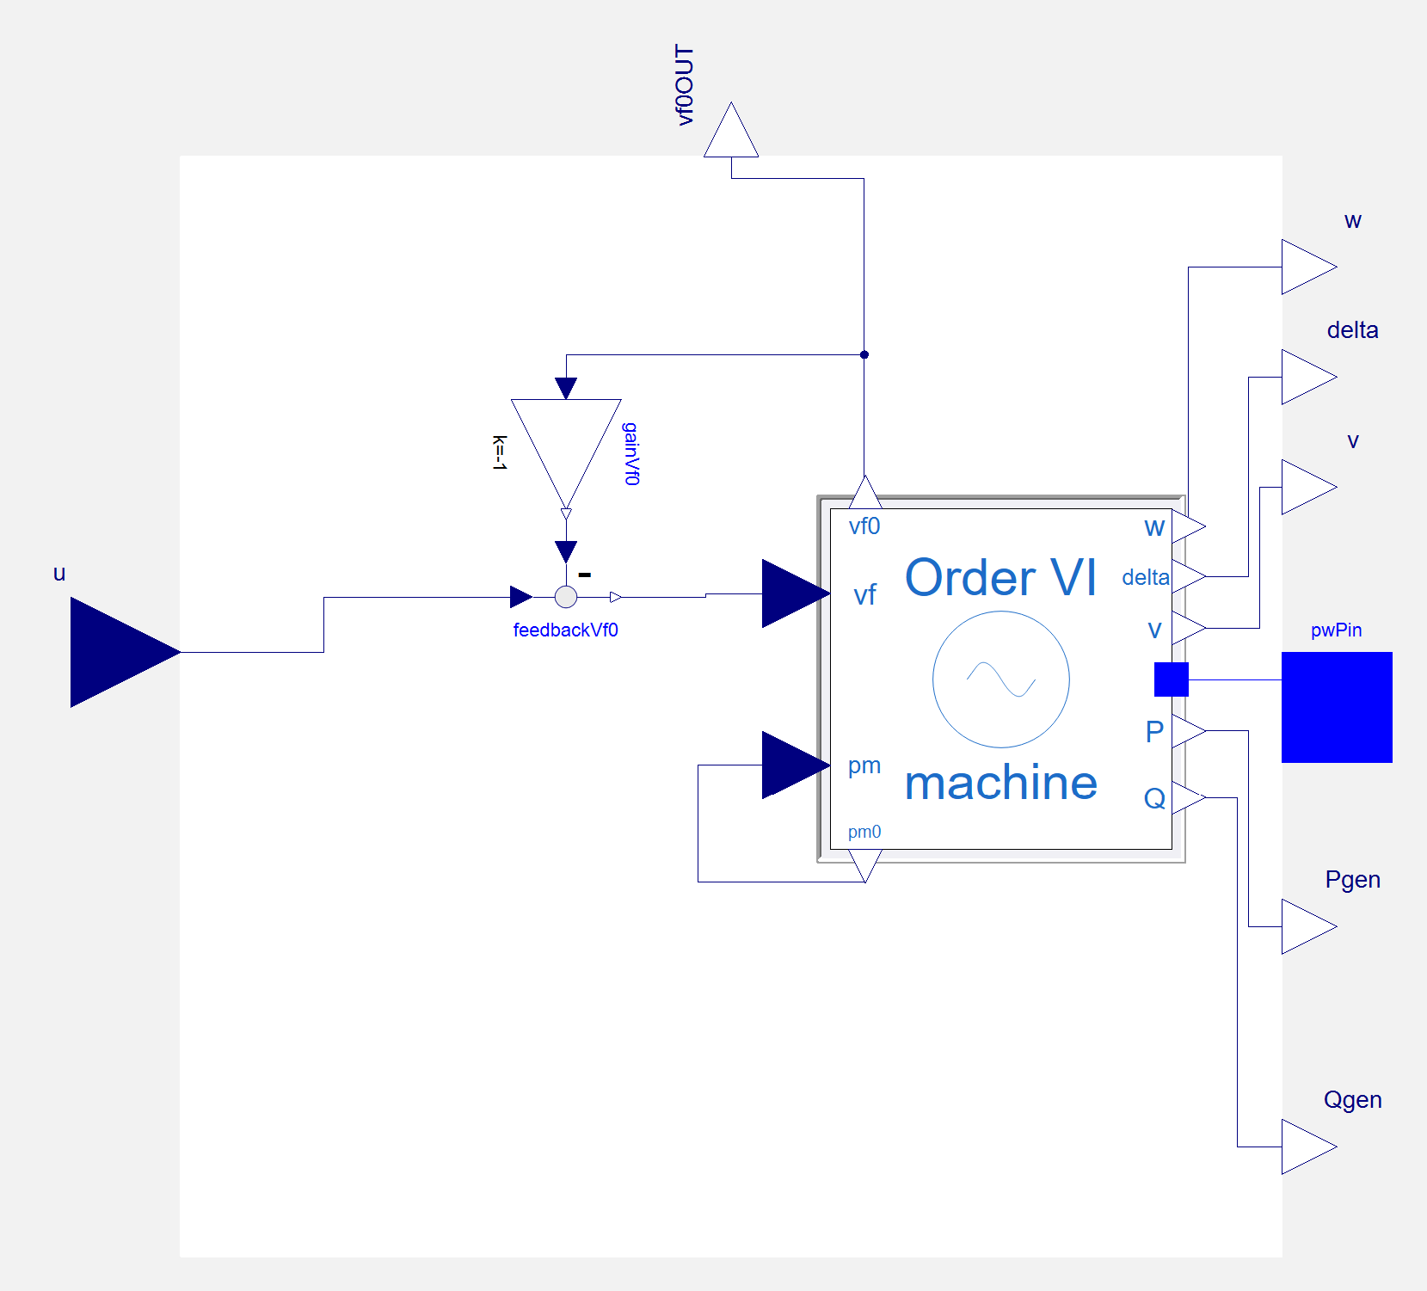
eFMU: Grid4HIL
eFMU: CHILTest
eFMU: efmuPSS

Slide 6
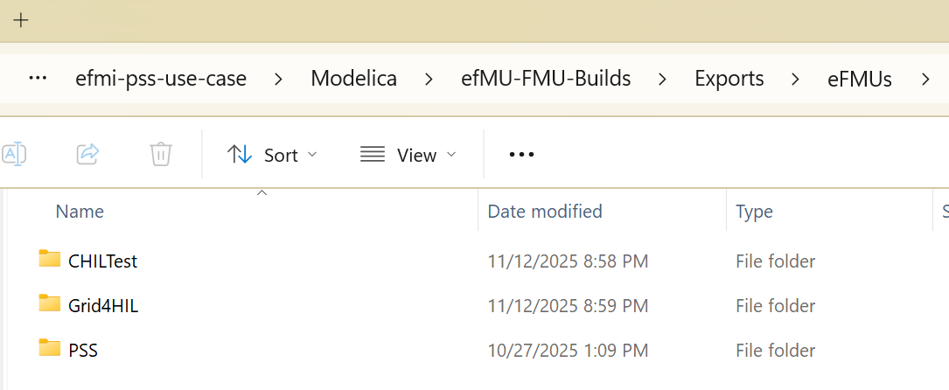
eFMU: Grid4HIL
https://github.com/ALSETLab/efmi-pss-use-case
eFMU: CHILTest
eFMU: efmuPSS

Slide 7
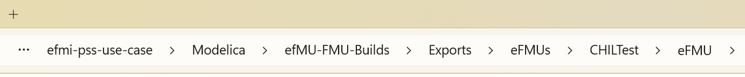
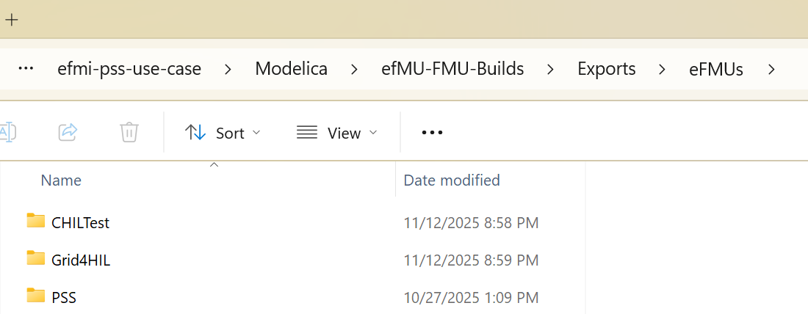
eFMU: Grid4HIL
eFMU: CHILTest
eFMU: efmuPSS

