Slide 1
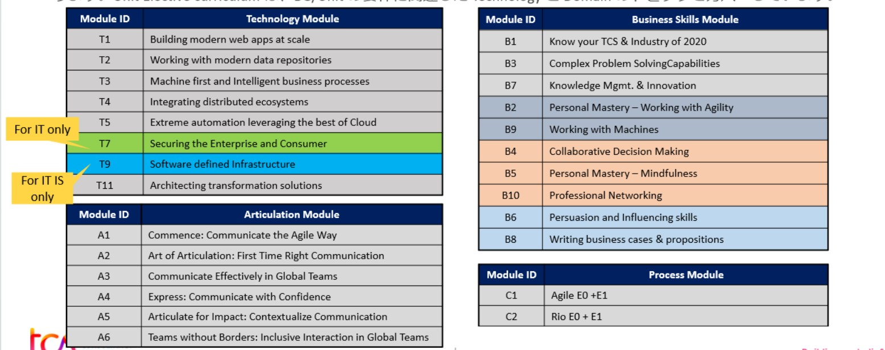

Slide 2
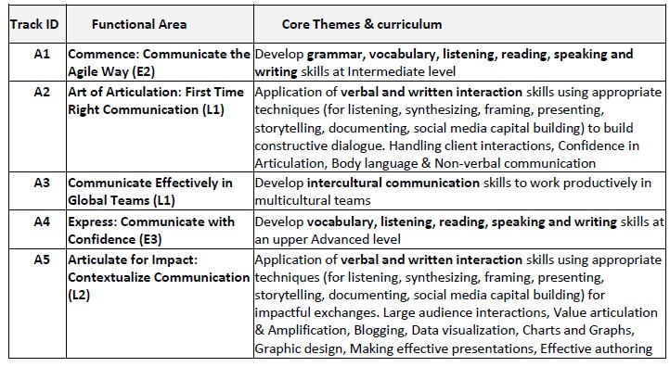
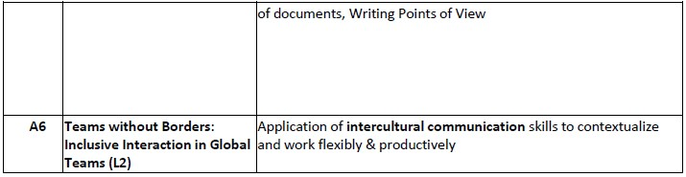

Slide 3
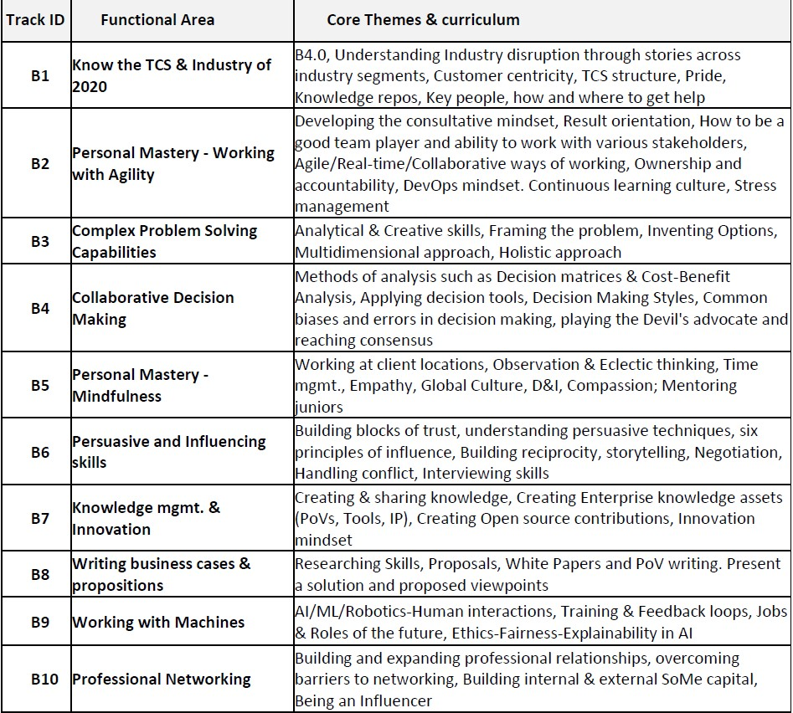

Slide 4
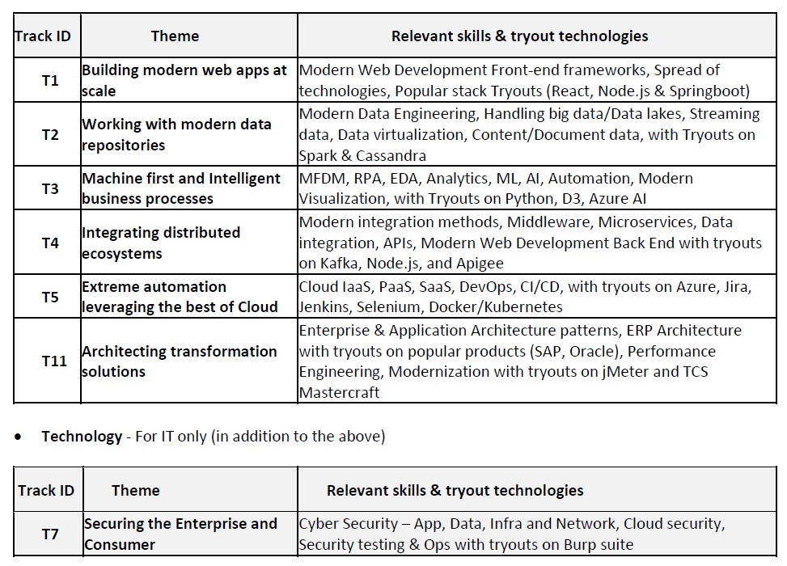

Slide 5
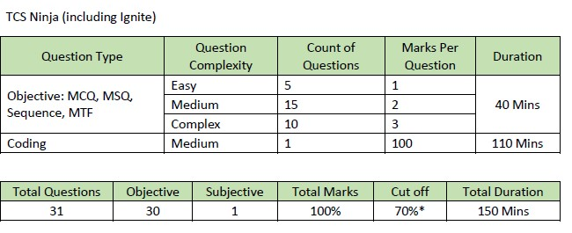
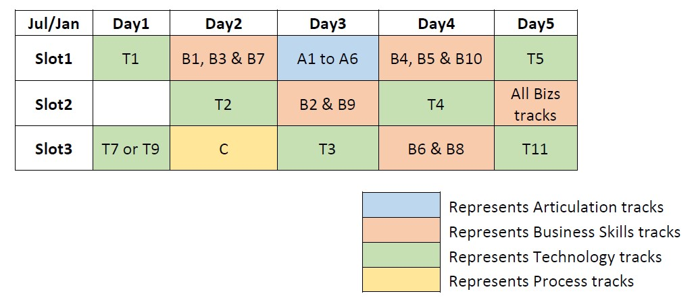

Slide 6
Which tracks u chose? Best choice for tracks? Thinking of T2 and T3 which is better?
How are the assessment rounds? Their difficulty level?
Will tech track have both mcq and coding rounds? Better way to learn tech tracks
Do we have to complete any internal assessment before the July or Nov assessment?
Is the content in iEvolve enough to learn everything or do we need to have any further learning for better understanding? If required, what might be best sources ?! ( YouTube, Linkedin Learning, O’Reilly ,Udemy )
How is the panel interview? What type of questions asked? Either related to track or any other technology related? Any HR round?

Slide 7
Will our present project have any effect on interview round and questions based on them?
Ur views on roles in TCS!! ( Developer, Support, Testing etc., )
How to get roles in future? Best choice for tracks? Thinking of T2 and T3 which is better?
How to increase T factor?
What is depth and width?
Milestone event? Will all our done courses be tested again for .99 milestones?
How to get Udemy for freshers? Will some tracks need them? Did u face any learning linked to Udemy?
Which technologies or certifications are useful in future ? ( AWS, Azure, Data science )

