Slide 1
Treatment Pathway Analysis in ATLAS
Visualize sequences of treatments over time • Compare pathways across populations & subgroups
Notes:
Sources: OHDSI logo image: https://www.ohdsi.org/wp-content/uploads/2014/06/cropped-OHDSI-logo-with-text-horizontal-colored.png

Slide 2
Session goals
What you should be able to do by the end
Training goals
Examine how patients move through sequences of treatments over time
Use ATLAS Cohort Pathways to visualize patterns of care (e.g., first-line → second-line)
Compare pathway patterns across target cohorts
Export/communicate pathway results for collaboration
Agenda
1) Pathways concepts & terminology
2) Designer walkthrough (targets, event cohorts, settings)
3) Reading the sunburst + tables
4) Comparing across populations
5) Hands-on exercise + best practices
Prerequisites (recommended)
You can create/find Cohort Definitions (target cohorts) and Concept Sets (for treatments) in ATLAS.
You have access to a configured WebAPI/CDM source to execute analyses.
Notes:
Sources: Cohort Pathways overview (ATLAS documentation): https://github.com/OHDSI/atlas-wiki/blob/master/Cohort%20Pathways.md

Slide 3
What is a treatment pathway?
In ATLAS: sequences of “event cohorts” observed within a target cohort
Core building blocks
Target cohort
  Who are we studying? (e.g., new users of first-line therapy)
Event cohorts
  What events define the pathway steps? (treatments, procedures, etc.)
Sequence rules
  How steps are ordered over time (first observed, next observed, …)
Aggregation
  Individual sequences are summarized into population patterns (sunburst + tables).
A simplified example (1 person)
Start (index) → Tx A → Tx B → Tx C
ATLAS aggregates many such sequences into a population-level pattern.
Questions you can answer
What are the most common first treatments?
How often do patients escalate/switch/add therapies?
Do patterns differ between cohorts (or strata)?
Notes:
Sources: Cohort Pathways description (sequence of transitions between Event Cohorts within Target Cohorts; events include treatments/medicines): https://docs.finngen.fi/working-in-the-sandbox/which-tools-are-available/atlas/detailed-guide/cohort-pathways ; Cohort Pathways overview (ATLAS wiki): https://github.com/OHDSI/atlas-wiki/blob/master/Cohort%20Pathways.md

Slide 4
Pathways in the ATLAS analysis toolbox
How it relates to Characterization and Incidence Rates
Characterization | Incidence Rates | Cohort Pathways
Summarize proportions/distributions of features in a target cohort. Useful for: baseline descriptions, covariate balance, subgroup breakdowns. | Estimate outcome rates within a target cohort (optionally stratified). Useful for: outcome frequency, time-at-risk questions. | Review the sequence of clinical events (including treatments) that occur within one or more populations. Useful for: treatment escalation/switch patterns.
Notes:
Sources: ATLAS User Process Guide (descriptions of Characterization / Incidence Rates / Cohort Pathways): https://labs.icahn.mssm.edu/msdw/wp-content/uploads/sites/350/2021/09/ATLAS-User-Process-Guide-1.pdf

Slide 5
End-to-end workflow
From cohorts → pathway design → results → sharing
1. Define cohorts | 2. Create Pathway | 3. Execute | 4. Review | 5. Share
Target cohort (Event cohorts for treatments) | Select targets Select event cohorts Set analysis settings | Run against CDM Track generations | Sunburst visualization Tables & counts Compare cohorts | Export design/results Versioning & messages
What makes “treatment pathways” work well
Make event cohorts mutually interpretable (e.g., drug classes)
Align index date & follow-up rules with your question
Keep an eye on event cohort count (too many → unreadable plots)
Use export/versioning for reproducible collaboration
Notes:
Sources: Treatment pathways visualization formats (sunburst/sankey) mentioned in OHDSI community materials: https://www.ohdsi.org/wp-content/uploads/2022/09/OHDSI-Community-Call-05-09-2022-TreatmentPatterns-package.pdf

Slide 6
Cohort Pathways: Designer walkthrough
What you configure before you run
Key inputs
Target cohort(s): the population you want to study.
Event cohorts: the treatments/events you want to see in sequence.
Analysis settings: options controlling how pathways are constructed (we’ll treat these as “knobs,” not focus on every detail).
Execution: run the analysis and review generations (historical results).
Utilities: import/export for sharing designs.
Versioning + messages: track changes; validation checks surface issues.
Mental model: tabs as a checklist
Design
Executions
View reports
Utilities
Versions
Messages
Tip: start small (3–8 event cohorts). Add complexity only if the visualization stays readable.
Notes:
Sources: Cohort Pathways documentation (ATLAS wiki): https://github.com/OHDSI/atlas-wiki/blob/master/Cohort%20Pathways.md

Slide 7
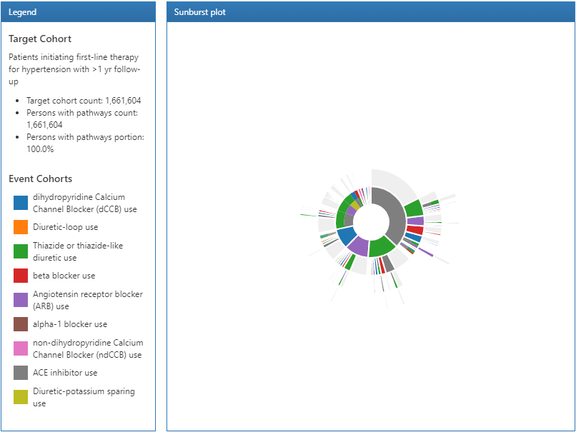
Reading the sunburst plot
How to interpret the pathway visualization
How to read it
Each ring outward represents the next step in the sequence.
Slice size ≈ how common that path is among the target cohort.
Colors map to event cohorts (treatments).
Use the legend to track which treatment each color represents.
Clicking a segment shows the path details: the sequence, the count, and the percent.
Notes:
Sources: Screenshot used on slide (ATLAS Pathways results): https://ohdsi-korea.github.io/TheBookOfOhdsiKorea/images/Characterization/atlasPathwaysResults.png

Slide 8
Comparing pathways across populations
Two practical approaches: side-by-side visuals + quantitative exports
Approach A: side-by-side in ATLAS
Add multiple target cohorts to the same Pathway analysis.
ATLAS shows a separate pathway result per target cohort.
Compare: dominant first step, branching, and depth (how many steps patients traverse).
Approach B: export for deeper comparison
Use CSV export to compare counts/percentages across cohorts, time windows, or sites.
Bring results into R/Python/Excel for: differences, plots, or statistical summaries.
Keep versioning notes so comparisons stay reproducible.
Illustrative comparison
Percent of patients reaching each step (example only)
Use this idea with exported pathway tables to quantify differences.
Notes:
Sources: Cohort Pathways guide (how to create a pathway analysis with target/event cohorts): https://docs.finngen.fi/working-in-the-sandbox/which-tools-are-available/atlas/detailed-guide/cohort-pathways ; The chart data are illustrative only and do not come from a real data set. An illustrative chart with example values was removed when this deck was moved to the plain format.

Slide 9
Tabular views: what the tables mean
The Tabular view (confirm these summaries against your ATLAS version)
1) Sequence table (sunburst “raw”)
Lists each step-by-step sequence (e.g., Step1 → Step2 → Step3), with counts at each node.
3) Event cohort presence
Shows whether each treatment/event cohort appears anywhere in the pathway (regardless of step).
2) Step distribution (ignores parent)
Summarizes what happens in Step 1, Step 2, Step 3… regardless of how patients got there.
4) Distinct event count per person
Counts people with 0, 1, 2, 3… distinct event cohorts observed (how “complex” care is).
Notes:
Sources: Cohort Pathways overview (ATLAS wiki): https://github.com/OHDSI/atlas-wiki/blob/master/Cohort%20Pathways.md

Slide 10
Reproducibility: export, SQL, versions, messages
Make pathway work shareable and auditable
What to use (and why)
Export / Import
  Share a pathway design across teams or environments.
View SQL
  Understand what ATLAS is executing; useful for debugging or review.
Versions
  Every save can create a version; use this to compare iterations and reproduce results.
Messages / validation
  Built-in checks warn about potential design issues before execution.
Practical checklist
Name cohorts & event cohorts clearly (they appear in legends/tables).
Keep a short “analysis note” per version: question + parameters + date.
Export the design alongside key results (CSV/table exports).
If results look odd: inspect SQL + confirm cohort logic.
Notes:
Sources: ATLAS User Process Guide (mentions Cohort Pathways and exporting/reporting utilities): https://labs.icahn.mssm.edu/msdw/wp-content/uploads/sites/350/2021/09/ATLAS-User-Process-Guide-1.pdf

Slide 11
Exercise: build a treatment pathway analysis
A guided practice you can run in your ATLAS environment
Scenario (adapt to your dataset)
Target cohort: patients initiating a first-line therapy (new users), with ≥ 1 year follow-up.
Event cohorts: 5–8 treatment classes you want to track (e.g., antihypertensive classes or medication groups relevant to your question).
Steps
Create/confirm the Target Cohort and Event Cohorts (treatments) are available.
ATLAS → Cohort Pathways → “New” → select Target Cohort(s).
Add Event Cohorts (start with fewer; expand only if readable).
Choose analysis settings (defaults are fine for first run).
Executions → Generate → View reports → inspect the sunburst and the Tabular view.
Add a second target cohort (optional) to compare patterns.
Export results + save a version note capturing your question and settings.
Notes:
Sources: Cohort Pathways step-by-step guide (targets + event cohorts; run and review): https://docs.finngen.fi/working-in-the-sandbox/which-tools-are-available/atlas/detailed-guide/cohort-pathways

Slide 12
Best practices & common pitfalls
Make pathway results interpretable and actionable
Best practices
Start with a clear question (initiation, escalation, switching, combinations).
Keep event cohorts mutually exclusive when possible (or document overlaps).
Limit event cohorts (readability matters).
Validate coding: concept set coverage + ingredient vs brand mapping.
Use versioning/export so results can be reproduced across runs and sites.
Pitfalls
Too many event cohorts → unreadable sunburst and noisy tables.
Index/follow-up misalignment (e.g., insufficient observation time) changes the apparent pathway depth.
Comparing across cohorts without aligning definitions/parameters can mislead.
“First observed” ≠ “first prescribed” if data capture is incomplete — interpret with caution.
Notes:
Sources: OHDSI community slide deck comparing ATLAS Cohort Pathways vs TreatmentPatterns (exploratory; limited settings): https://www.ohdsi.org/wp-content/uploads/2022/09/OHDSI-Community-Call-05-09-2022-TreatmentPatterns-package.pdf

Slide 13
Further learning
Where to go next
Recommended references
ATLAS wiki: Cohort Pathways overview and tutorial links.
Finngen ATLAS sandbox guide: practical “click-by-click” walkthrough.
ATLAS User Process Guide (PDF): broader ATLAS reporting/export tips.
OHDSI forums: Q&A and troubleshooting for Pathways.
Suggested next exercise
Run the same pathway definition across two CDM sources (or time periods), export results, and compare differences in: dominant first step, pathway depth, and “distinct event count” distribution.
Notes:
Sources: ATLAS wiki (Cohort Pathways): https://github.com/OHDSI/atlas-wiki/blob/master/Cohort%20Pathways.md ; Finngen Cohort Pathways guide: https://docs.finngen.fi/working-in-the-sandbox/which-tools-are-available/atlas/detailed-guide/cohort-pathways ; ATLAS User Process Guide (PDF): https://labs.icahn.mssm.edu/msdw/wp-content/uploads/sites/350/2021/09/ATLAS-User-Process-Guide-1.pdf ; OHDSI forums (Pathways FAQ): https://forums.ohdsi.org/t/cohort-pathways-in-atlas-faq/9511

