Slide 1

Treatment Pathway Analysis in ATLAS
Visualize sequences of treatments over time • Compare pathways across populations & subgroups
Notes:
[Sources] - OHDSI logo image: https://www.ohdsi.org/wp-content/uploads/2014/06/cropped-OHDSI-logo-with-text-horizontal-colored.png - User-provided transcript ("Atlas Survey 4" demo) supplied in chat (foundation for content) [/Sources]

Slide 2
OVERVIEW
Session goals
What you should be able to do by the end
Training goals
Agenda
• Examine how patients move through sequences of treatments over time
• Use ATLAS Cohort Pathways to visualize patterns of care (e.g., first-line → second-line)
• Compare pathway patterns across cohorts and (optionally) stratified views
• Export/communicate pathway results for collaboration
1) Pathways concepts & terminology
2) Designer walkthrough (targets, event cohorts, settings)
3) Reading the sunburst + tables
4) Comparing across populations
5) Hands-on exercise + best practices
Prerequisites (recommended)
You can create/find Cohort Definitions (target cohorts) and Concept Sets (for treatments) in ATLAS.
You have access to a configured WebAPI/CDM source to execute analyses.
Notes:
[Sources] - User-provided transcript (Atlas Survey 4 demo) – describes Pathways designer flow (targets/event cohorts/settings/execution/import-export/versioning/messages) - Cohort Pathways overview (ATLAS documentation): https://github.com/OHDSI/atlas-wiki/blob/master/Cohort%20Pathways.md [/Sources]

Slide 3
CONCEPTS
What is a treatment pathway?
In ATLAS: sequences of “event cohorts” observed within a target cohort
Core building blocks
A simplified example (1 person)
Target cohort
• Who are we studying? (e.g., new users of first-line therapy)
Event cohorts
• What events define the pathway steps? (treatments, procedures, etc.)
Sequence rules
• How steps are ordered over time (first observed, next observed, …)
Aggregation
• Individual sequences are summarized into population patterns (sunburst + tables).
Start
(index)
Tx A
Tx B
Tx C
ATLAS aggregates many such sequences into a population-level pattern.
Questions you can answer
What are the most common first treatments?
How often do patients escalate/switch/add therapies?
Do patterns differ between cohorts (or strata)?
Notes:
[Sources] - Cohort Pathways description (sequence of transitions between Event Cohorts within Target Cohorts; events include treatments/medicines): https://docs.finngen.fi/working-in-the-sandbox/which-tools-are-available/atlas/detailed-guide/cohort-pathways - Cohort Pathways overview (ATLAS wiki): https://github.com/OHDSI/atlas-wiki/blob/master/Cohort%20Pathways.md [/Sources]

Slide 4
WHERE IT FITS
Pathways in the ATLAS analysis toolbox
How it relates to Characterization and Incidence (from the survey demo)
Characterization
Incidence Rates
Cohort Pathways
Summarize proportions/distributions of features in a target cohort.
Useful for: baseline descriptions, covariate balance, subgroup breakdowns.
Estimate outcome rates within a target cohort (optionally stratified).
Useful for: outcome frequency, time-at-risk questions.
Review the sequence of clinical events (including treatments) that occur within one or more populations.
Useful for: treatment escalation/switch patterns.
Notes:
[Sources] - User-provided transcript (Atlas Survey 4 demo) – positions Characterization, Incidence Rates, and Pathways as the three functions shown in Survey 4 - ATLAS User Process Guide (descriptions of Characterization / Incidence Rates / Cohort Pathways): https://labs.icahn.mssm.edu/msdw/wp-content/uploads/sites/350/2021/09/ATLAS-User-Process-Guide-1.pdf [/Sources]

Slide 5
WORKFLOW
End-to-end workflow
From cohorts → pathway design → results → sharing
1. Define cohorts
2. Create Pathway
3. Execute
4. Review
5. Share
Target cohort
(Event cohorts for treatments)
Select targets
Select event cohorts
Set analysis settings
Run against CDM
Track generations
Sunburst visualization
Tables & counts
Compare cohorts
Export design/results
Versioning & messages
What makes “treatment pathways” work well
• Make event cohorts mutually interpretable (e.g., drug classes)
• Align index date & follow-up rules with your question
• Keep an eye on event cohort count (too many → unreadable plots)
• Use export/versioning for reproducible collaboration
Notes:
[Sources] - User-provided transcript – Pathways designer tabs discussed: target populations, event cohorts, analysis settings, execution, report, import/export, versioning, messages - Treatment pathways visualization formats (sunburst/sankey) mentioned in OHDSI community materials: https://www.ohdsi.org/wp-content/uploads/2022/09/OHDSI-Community-Call-05-09-2022-TreatmentPatterns-package.pdf [/Sources]

Slide 6
DESIGNER
Cohort Pathways: Designer walkthrough
What you configure before you run
Key inputs
Mental model: tabs as a checklist
Target cohort(s): the population you want to study.
Event cohorts: the treatments/events you want to see in sequence.
Analysis settings: options controlling how pathways are constructed (we’ll treat these as “knobs,” not focus on every detail).
Execution: run the analysis and review generations (historical results).
Utilities: import/export for sharing designs.
Versioning + messages: track changes; validation checks surface issues.
Definition
Execution
Reporting
Utilities
Versions
Messages
Tip: start small (3–8 event cohorts). Add complexity only if the visualization stays readable.
Notes:
[Sources] - User-provided transcript – Pathways module described with: target populations, event cohorts, analysis settings, execution (with versions), import/export, versioning, messaging/validation - Cohort Pathways documentation (ATLAS wiki): https://github.com/OHDSI/atlas-wiki/blob/master/Cohort%20Pathways.md [/Sources]

Slide 7
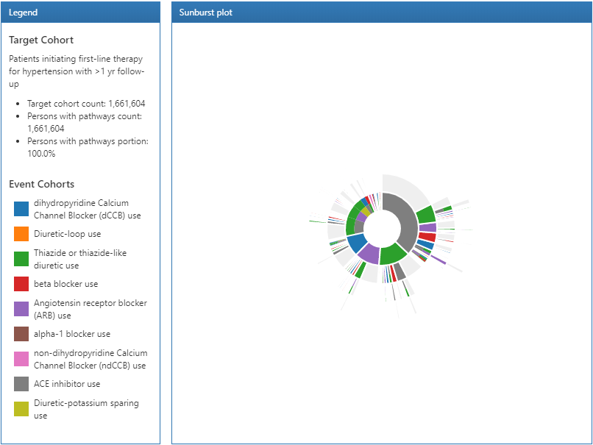
REPORTING
Reading the sunburst plot
How to interpret the pathway visualization
How to read it
• Each ring outward represents the next step in the sequence.
• Slice size ≈ how common that path is among the target cohort.
• Colors map to event cohorts (treatments).
• Use the legend to track which treatment each color represents.
• Click-through in ATLAS reveals details for a selected segment (who followed that path).
Notes:
[Sources] - Screenshot used on slide (ATLAS Pathways results): https://ohdsi-korea.github.io/TheBookOfOhdsiKorea/images/Characterization/atlasPathwaysResults.png - User-provided transcript – explains Pathways visualization and click-through to see details [/Sources]

Slide 8
COMPARISON
Comparing pathways across populations
Two practical approaches: side-by-side visuals + quantitative exports
Approach A: side-by-side in ATLAS
Illustrative comparison
• Add multiple target cohorts to the same Pathway analysis.
• ATLAS shows a separate pathway result per target cohort.
• Compare: dominant first step, branching, and depth (how many steps patients traverse).
Percent of patients reaching each step (example only)
Approach B: export for deeper comparison
• Use CSV export to compare counts/percentages across cohorts, time windows, or sites.
• Bring results into R/Python/Excel for: differences, plots, or statistical summaries.
• Keep versioning notes so comparisons stay reproducible.
Use this idea with exported pathway tables to quantify differences.
Notes:
[Sources] - User-provided transcript – Pathways supports multiple target cohorts; also highlights export/import + versioning for collaboration - Cohort Pathways guide (how to create a pathway analysis with target/event cohorts): https://docs.finngen.fi/working-in-the-sandbox/which-tools-are-available/atlas/detailed-guide/cohort-pathways [/Sources] [Notes] - Chart data is illustrative (example only), not taken from a real dataset. [/Notes]

Slide 9
TABLES
Tabular views: what the tables mean
Four complementary summaries (as described in the demo)
1) Sequence table (sunburst “raw”)
2) Step distribution (ignores parent)
Lists each step-by-step sequence (e.g., Step1 → Step2 → Step3), with counts at each node.
Summarizes what happens in Step 1, Step 2, Step 3… regardless of how patients got there.
3) Event cohort presence
4) Distinct event count per person
Shows whether each treatment/event cohort appears anywhere in the pathway (regardless of step).
Counts people with 0, 1, 2, 3… distinct event cohorts observed (how “complex” care is).
Notes:
[Sources] - User-provided transcript – explicitly describes the four pathway tables and what each represents - Cohort Pathways overview (ATLAS wiki): https://github.com/OHDSI/atlas-wiki/blob/master/Cohort%20Pathways.md [/Sources]

Slide 10
GOVERNANCE
Reproducibility: export, SQL, versions, messages
Make pathway work shareable and auditable
What to use (and why)
Practical checklist
Export / Import
• Share a pathway design across teams or environments.
View SQL
• Understand what ATLAS is executing; useful for debugging or review.
Versions
• Every save can create a version; use this to compare iterations and reproduce results.
Messages / validation
• Built-in checks warn about potential design issues before execution.
Name cohorts & event cohorts clearly (they appear in legends/tables).
Keep a short “analysis note” per version: question + parameters + date.
Export the design alongside key results (CSV/table exports).
If results look odd: inspect SQL + confirm cohort logic.
Notes:
[Sources] - User-provided transcript – Pathways tabs include import/export, view SQL, versions, and messaging/validation - ATLAS User Process Guide (mentions Cohort Pathways and exporting/reporting utilities): https://labs.icahn.mssm.edu/msdw/wp-content/uploads/sites/350/2021/09/ATLAS-User-Process-Guide-1.pdf [/Sources]

Slide 11
HANDS-ON
Exercise: build a treatment pathway analysis
A guided practice you can run in your ATLAS environment
Scenario (adapt to your dataset)
Target cohort: patients initiating a first-line therapy (new users), with ≥ 1 year follow-up.
Event cohorts: 5–8 treatment classes you want to track (e.g., antihypertensive classes or medication groups relevant to your question).
Steps
Create/confirm the Target Cohort and Event Cohorts (treatments) are available.
ATLAS → Cohort Pathways → “New” → select Target Cohort(s).
Add Event Cohorts (start with fewer; expand only if readable).
Choose analysis settings (defaults are fine for first run).
Execute → open Reporting → inspect sunburst + tables.
Add a second target cohort (optional) to compare patterns.
Export results + save a version note capturing your question and settings.
Notes:
[Sources] - Cohort Pathways step-by-step guide (targets + event cohorts; run and review): https://docs.finngen.fi/working-in-the-sandbox/which-tools-are-available/atlas/detailed-guide/cohort-pathways - User-provided transcript – Pathways designer flow and reporting emphasis [/Sources]

Slide 12
WRAP-UP
Best practices & common pitfalls
Make pathway results interpretable and actionable
Best practices
Pitfalls
• Start with a clear question (initiation, escalation, switching, combinations).
• Keep event cohorts mutually exclusive when possible (or document overlaps).
• Limit event cohorts (readability matters).
• Validate coding: concept set coverage + ingredient vs brand mapping.
• Use versioning/export so results can be reproduced across runs and sites.
• Too many event cohorts → unreadable sunburst and noisy tables.
• Index/follow-up misalignment (e.g., insufficient observation time) changes the apparent pathway depth.
• Comparing across cohorts without aligning definitions/parameters can mislead.
• “First observed” ≠ “first prescribed” if data capture is incomplete — interpret with caution.
Notes:
[Sources] - User-provided transcript – emphasizes Pathways as exploratory visualization + tables; highlights importance of exports and versioning - OHDSI community slide deck comparing ATLAS Cohort Pathways vs TreatmentPatterns (exploratory; limited settings): https://www.ohdsi.org/wp-content/uploads/2022/09/OHDSI-Community-Call-05-09-2022-TreatmentPatterns-package.pdf [/Sources]

Slide 13
RESOURCES
Further learning
Where to go next
Recommended references
ATLAS wiki: Cohort Pathways overview and tutorial links.
Finngen ATLAS sandbox guide: practical “click-by-click” walkthrough.
ATLAS User Process Guide (PDF): broader ATLAS reporting/export tips.
OHDSI forums: Q&A and troubleshooting for Pathways.
Suggested next exercise
Run the same pathway definition across two CDM sources (or time periods), export results, and compare differences in: dominant first step, pathway depth, and “distinct event count” distribution.
Notes:
[Sources] - ATLAS wiki (Cohort Pathways): https://github.com/OHDSI/atlas-wiki/blob/master/Cohort%20Pathways.md - Finngen Cohort Pathways guide: https://docs.finngen.fi/working-in-the-sandbox/which-tools-are-available/atlas/detailed-guide/cohort-pathways - ATLAS User Process Guide (PDF): https://labs.icahn.mssm.edu/msdw/wp-content/uploads/sites/350/2021/09/ATLAS-User-Process-Guide-1.pdf - OHDSI forums (Pathways FAQ): https://forums.ohdsi.org/t/cohort-pathways-in-atlas-faq/9511 [/Sources]

