Slide 1
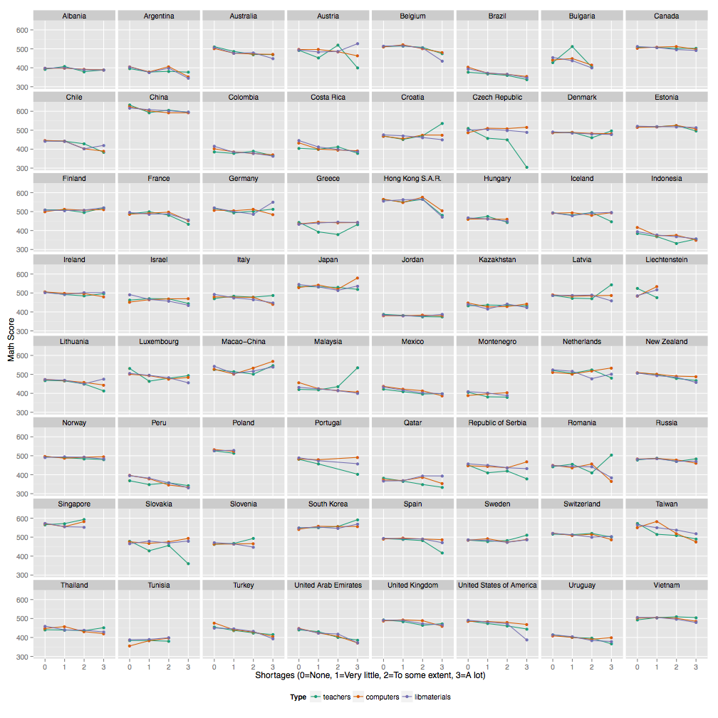
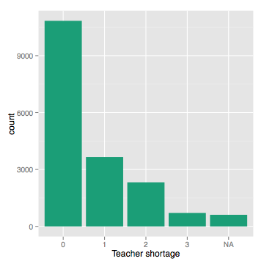
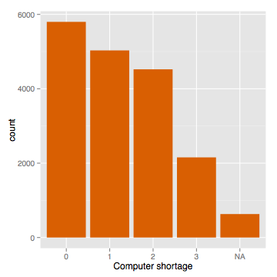
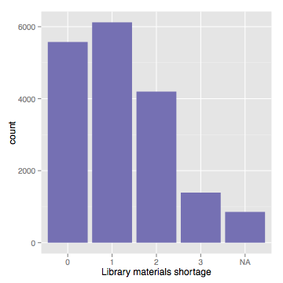
Teachers, computers and library materials at schools matter
Math scores drop with shortages of teachers, computers and library materials in most countries.
Math teacher shortage are rare, computer shortages are very common, as are library materials.
Some countries are exceptions.

