Slide 1

Headline and article semantic consistency
ASSIGNMENT 14, GROUP 17
TF-IDF + cosine similarity compared with sentence embeddings + cosine similarity
Anurag Rai
MT/AI/10016/26
Ankit Singh
MT/AI/10022/26

Slide 2
Real-world problem
Why headline consistency matters
The problem
Headlines provided by online news sources and social media may misrepresent the facts presented within the article. The headlines can have numerous identical words from the article, but they can change a figure, entity, place, or claim.
The practical question
Can a system flag a headline whose meaning is not supported by its paired news text?
Project objective
Develop an AI-based system that compares a headline with its article text and predicts whether they are semantically consistent or inconsistent.

Slide 3
Research question and hypothesis
RQ
Does a sentence-embedding approach identify headline–article consistency more effectively than a traditional TF-IDF similarity approach?
H1
H2
Sentence embeddings will outperform TF-IDF on the official test because they capture semantic similarity beyond exact word overlap.
Edited headlines will receive lower consistency scores than their supported originals.

Slide 4
Dataset Description
Dataset: Fake News Challenge (FNC-1)
The FNC-1 dataset contains headline–article pairs, with each pair assigned an original stance label.
The processed training dataset contains 49,972 pairs before reserving article groups for the challenge.
The official test set contains 25,413 pairs:
  6,367 Consistent
  19,046 Inconsistent
Original Stance Labels
Binary Label Mapping
The training-side data was divided by article group into:
Fit: 31,957 pairs, used to fit the TF-IDF vectorizer and prepare model inputs.
Validation: 7,670 pairs, used to choose each model’s decision threshold.
Challenge holdout: 350 original article groups, kept aside for the modified-headline challenge
Original stance | Project label
Agree, Discuss | Consistent (1)
Disagree, Unrelated | Inconsistent (0)
Stance | Description
Agree | The article supports the headline’s claim.
Disagree | The article contradicts the headline’s claim.
Discuss | The article discusses the topic without clearly confirming or contradicting the headline.
Unrelated | The article is not relevant to the headline.

Slide 5
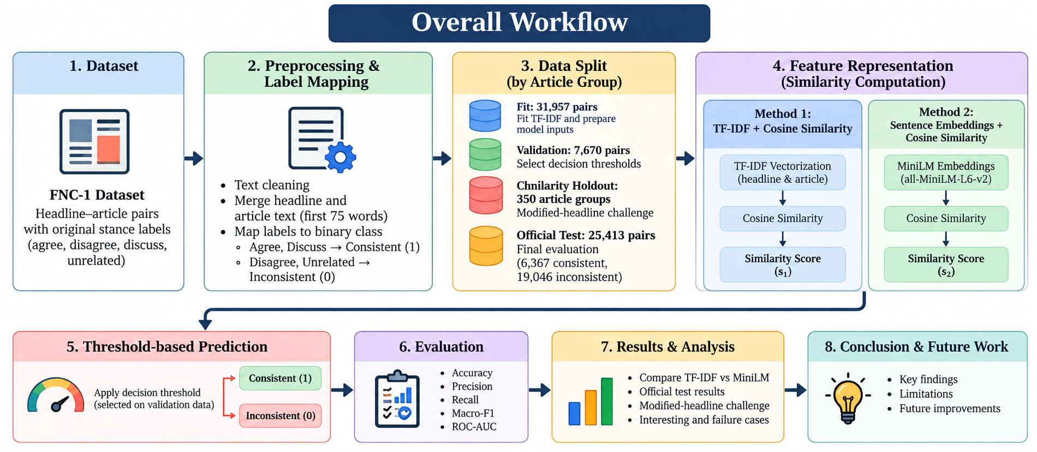
Methodology
Method 1 — TF-IDF + Cosine Similarity
Converts the headline and article into word-based TF-IDF vectors using unigrams and bigrams.
Fits the vectorizer using the fit split only.
Calculates cosine similarity between the two vectors.
This method relies largely on word overlap, so it may miss matches expressed with different wording.
Method 2 — Sentence Embeddings + Cosine Similarity
Encodes the headline and article with the pretrained all-MiniLM-L6-v2 sentence-transformer.
Uses the encoder frozen, with a 128-token input limit.
Calculates cosine similarity between the normalized embeddings.
This method can capture semantic relationships beyond exact word overlap, but it does not directly verify factual claims.
Threshold selection and evaluation
Each model’s threshold was selected on the validation split to maximize Macro-F1, using consistent-class F1 to break ties.
The selected thresholds were approximately 0.0308 for TF-IDF and 0.4118 for MiniLM.
A score at or above the threshold predicts consistent; a lower score predicts inconsistent.
The models were evaluated on the preserved official test set using Accuracy, Precision, Recall, Macro-F1, and ROC-AUC.
The separate modified-headline challenge was used to assess whether the similarity scores detect edits to key facts.
Both methods use the headline and the first 75 words of the article as the model input.
https://github.com/ALT3RNATOR/MTech-AIML-Project_17_HeadlineConsistency

Slide 6
Experimental Setup
The data was partitioned by body_id to keep article groups separate across fitting, validation, official testing, and the modified-headline challenge.
The notebooks check for body_id overlap between partitions to reduce leakage.
Modified-headline challenge design
350 original headlines from agree examples.
150 numeric-edit candidates, paired with 150 originals.
200 additional original-only examples.
The edited headlines were manually reviewed before accepting their labels.
The official test set and the challenge set are kept separate from model fitting and threshold tuning.
Partition | Rows
Fit/training | 31,957
Validation | 7,670
Official test | 25,413
Challenge candidates before manual review | 500

Slide 7
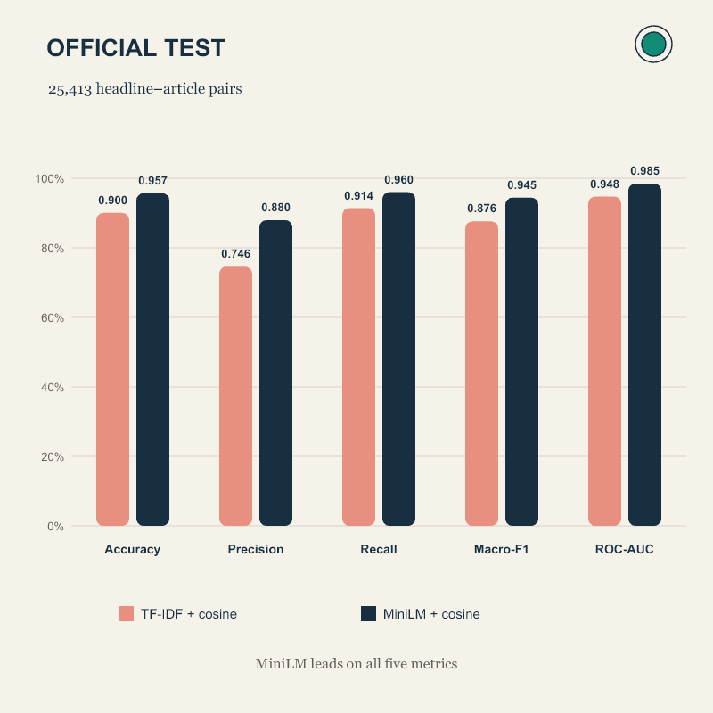

Official-Test Results
The official test set contains 25,413 headline–article pairs. Both models used the thresholds selected on validation: 0.0308 for TF-IDF and 0.4118 for MiniLM.
MiniLM scored higher on all five metrics. Both methods achieved strong ROC-AUC, while MiniLM had better overall classification performance at its validation-selected threshold.
Interpretation: The official-test results support the hypothesis that sentence embeddings are more effective than TF-IDF for this dataset and evaluation setup.
Method | Accuracy | Precision | Recall | Macro-F1 | ROC-AUC
TF-IDF + cosine | 0.917 | 0.798 | 0.899 | 0.894 | 0.948
Embeddings + cosine | 0.956 | 0.893 | 0.939 | 0.943 | 0.985

Slide 8
Modified-Headline Challenge and Failure Cases
Objective: Test whether the models detect subtle numerical changes in headlines that otherwise match their articles.
The challenge used 350 original consistent headlines and 150 numeric-edit candidates. Each candidate changed a number in the headline when the original number appeared in the article text and the changed number did not.
After manual review, 132 edits were approved and 18 were rejected, leaving 482 examples for scoring: 350 originals and 132 approved edits.
Both models performed much worse on this challenge than on the official test. Although MiniLM rejected more approved edits than TF-IDF, it still rejected only 6.82%.
The paired-flip rate was low for both: it measures how often a model accepts an original headline and rejects its edited version.
These results show that strong overall test performance does not guarantee sensitivity to subtle factual changes.
The challenge metrics apply to the 482 scored examples, not all 500 initial candidates; the 132 edits were manually approved.
Metric | TF-IDF + cosine | MiniLM + cosine
Accuracy | 71.37% | 70.54%
Precision | 72.65% | 72.91%
Recall | 97.14% | 94.57%
Macro-F1 | 44.30% | 46.79%
ROC-AUC | 43.27% | 47.73%
Edited-headline rejection rate | 3.03% | 6.82%
Paired original/edit flip success | 2.27% | 1.52%

Slide 9
Conclusion, Limitations, and Future Work
Conclusion
MiniLM + cosine outperformed TF-IDF + cosine on all five official-test metrics.
Both models struggled to detect subtle numerical edits in the modified-headline challenge.
Strong official-test performance did not translate into reliable factual-edit detection.
Limitations
The challenge contained 132 manually approved numeric edits and did not cover all types of misleading headlines.
Challenge articles came from FNC-1, so performance on new news sources is unknown.
Cosine similarity measures relatedness; it does not directly verify factual support.
Future work
Expand reviewed edits to include people, places, dates, events, and numbers.
Test the models on articles from independent news sources.
Evaluate a fact-verification or Natural Language Inference (NLI) model, such as DeBERTa-NLI.
Tune decision thresholds on validation data and reserve a separate test set for final evaluation.

Slide 10
THANK you

