Slide 1
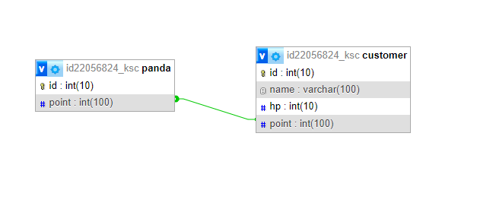



STRUCTURE OF THE MEMBERSHIP SYSTEM
Owned By
Access
Panda System Database
email : varchar(100)
Internet
Private Database (KSC)
Membership System Database

