Slide 1
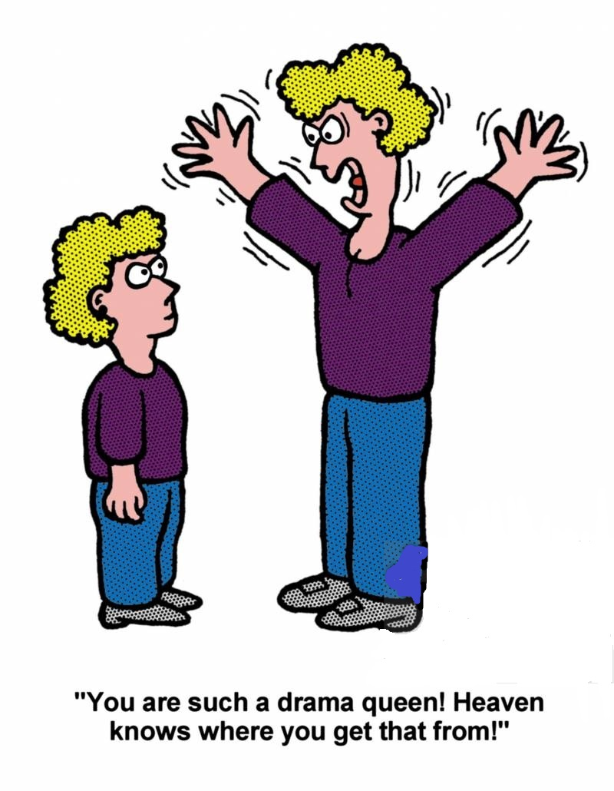

Slide 2

Inheritance

Slide 3
What is Inheritance ?
the act of inheriting property.
the reception of genetic qualities by transmission from parent to offspring.
the acquisition of a possession, condition, or trait from past generations.

Slide 4
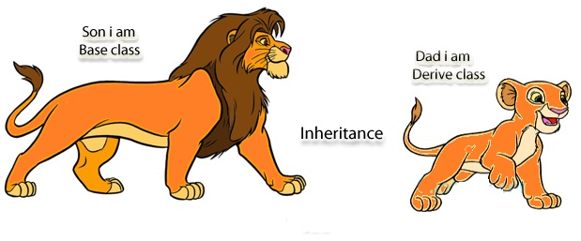

Slide 5
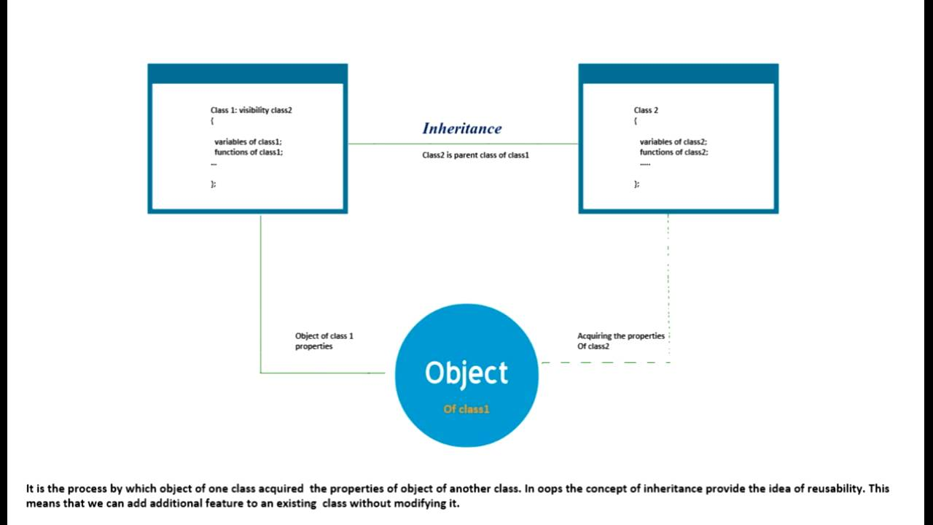
USING CONCEPT OF
INHERITANCE IN JAVA

Slide 6
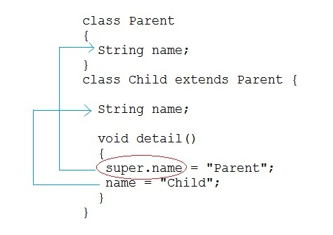
Simple program
to understand
inheritance

Slide 7
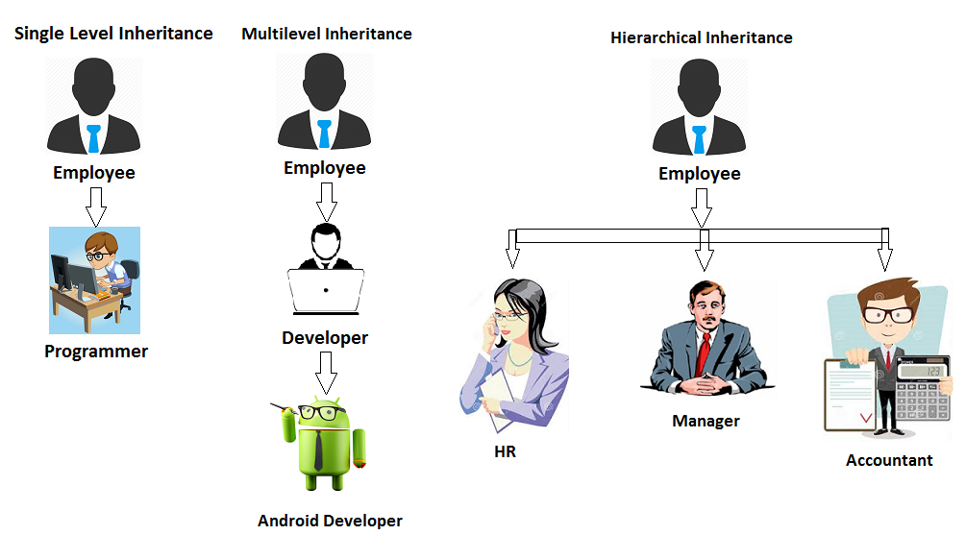

Slide 8




Slide 9


