Slide 1

DATA SCIENCE CONSULTING Session 6
February 19th, 2019

Slide 2

Agenda
1. Feed back on the Steering Committee
2. Reminder of the agenda
3. Topic extraction synthesis
4. Semi-supervised learning : generalities
5. Semi-supervised learning : self learning
6. Conclusion

Slide 3
Feedback on steering committee presentation
General remarks
Make sure to introduce the team
Be sure to know who you are talking to (client?)
Make sure each team members has a role during the presentation
Don't speak to fast
Restate the context
Structure of the presentation
Structure/plan should be stated clearly at the beginning of the presentation
Don’t hesitate to define the rules in the beginning – e.g. 5 min. of Q&A in the end of the presentation
Spend more time on added value/ results than on methodology for this type of auditory
Content of the presentation
Bring forward your results, give precise but meaningful examples (list of topics, word clouds, example of comment, etc..)
But don’t try to show more than what you actually have, be straightforward about what you discovered and what remains to be done
Key message of slides : should describe concisely the content of your slide (but avoid key messages with no content/message, such as : 'our results', 'decisions to be made' )
State clearly the content / scope of your deliverables and be realistic !
If you plan to deliver a dashboard/data viz tool, present a mock up
Can be good to identify next steps in case the client wants to go further with the project
Be careful with name dropping of data science terms, make sure they are used appropriately and not too many times (you do not want to lose your auditory)
Be careful also not to get too technical about your methodology, your presentation should be understandable by a general public

Slide 4
Agenda
1. Feed back on the Steering Committee
2. Reminder of the agenda
3. Topic extraction synthesis
4. Semi-supervised learning : generalities
5. Semi-supervised learning : self learning
6. Conclusion
Notes:
dzd

Slide 5




Planning & key steps of the course
9 weeks
08/01
15/01
29/01
05/02
12/02
19/02
05/03
12/03
19/03
Session 1
Kick-off
Session 2
Session 3
Session 4
Session 5 Steer Co
Session 6
Session 7 Restitution prep.
Session 8 Restitution prep.
Session 9 Final presentation
Caption
Regular sessions: Synthetic status update on the progress made and foreseen objectives to be prepared
Steering Committees: Complete pres. of the progress made, results; difficulties and foreseen next steps to be prepared

Slide 6

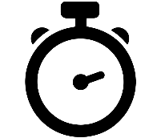
Presentation of the achievements so far
Restitution by one group
5’

Slide 7
Agenda
1. Feed back on the Steering Committee
2. Reminder of the agenda
3. Topic extraction synthesis
4. Semi-supervised learning : generalities
5. Semi-supervised learning : self learning
6. Conclusion

Slide 8



Wrapping up topic extraction (1/2)
Implementation
Limitations
Data preparation
Keywords appear in multiple topics
Topics are tricky to interpret
Topic allocation is not humanely correct
More generally, comments/reviews are so heterogeneous (length, topics, sentences) ; data cleaning exacerbates data heterogeneity
Test on one clean data source to avoid data sources incompatibility
Minimal amount of nouns
Stemming and lemmatization
Why does LDA fail?
Topic distribution is irregular among comments
Co-occurences (words appearing together in documents) are highly biased since many words appear more than others (parcs, water, cottage...)
Where to go next?
Topics seem to be way more subtle: only one word can represent a topic (« cottage »), the combination of two words in a row can also define a topic (« center parcs »)
Test a model that make use of words appearing consecutively
Fine-tuning model
Progressions
Number of topics
Alpha & eta for topic & word distributions
Iterations and other parameters
Corrections
Interpretation / Validation
Topics interpretation
Unicity and exhaustivity of topics
Topic allocation follows intuition

Slide 9
Wrapping up topic extraction (2/2)
Also we face problems extracting topics in our reviews, we can see that there is a clear limited number of underlying topics
We must find a way to guide or algorithm toward those topics
We will see two different methods to achieve that today
But first let’s make sure that we all agree on the main topics found in the reviews
Document
Topic 1
Topic 2
Topic 3

Slide 10

Hands-on: group pairing
30’
Find interpretable topics in all your reviews
Group 1 & Group 7
(Lund, Sundar, Wang, Lin, Perez)
(Dionet, Kim, Ranilovic, Bonnet, Fleutot)
Group 3 & Group 5
(Sasportes, Schneider, Vigie, Pick, Mai)
(Stocker, Vanagt, Kamoun, Sellem, Exbrayat)
Group 9 & Group 11
(Conrad, Dulac, Aubert, Blanc, Lancien)
(Prunier, Rollin, Viggiano, Chabalier, Nordin)
Group 2 & Group 10
(Mayer, Fournier, Monnot, Matalon, Deborne)
(Tirman, Frin, Fachot, Rivet, Elaissaoui)
Group 4 & Group 6
(Laks, Gruand, Miny, Xoual, Baudoin)
(Laval, Payan, Guillou, Sinturel, Maupeou)
Group 8 & Group 12
(Huynh, Petropoulos, Brosse, Salamitou, Taleb)
(Boisredon, Lantry, Zvedzin, Donnat)

Slide 11
Presentation of the achievements so far
Restitution of work by group pairs
Group 1 & Group 7
(Lund, Sundar, Wang, Lin, Perez)
(Dionet, Kim, Ranilovic, Bonnet, Fleutot)
Group 3 & Group 5
(Sasportes, Schneider, Vigie, Pick, Mai)
(Stocker, Vanagt, Kamoun, Sellem, Exbrayat)
Group 9 & Group 11
(Conrad, Dulac, Aubert, Blanc, Lancien)
(Prunier, Rollin, Viggiano, Chabalier, Nordin)
Group 2 & Group 10
(Mayer, Fournier, Monnot, Matalon, Deborne)
(Tirman, Frin, Fachot, Rivet, Elaissaoui)
Group 4 & Group 6
(Laks, Gruand, Miny, Xoual, Baudoin)
(Laval, Payan, Guillou, Sinturel, Maupeou)
Group 8 & Group 12
(Huynh, Petropoulos, Brosse, Salamitou, Taleb)
(Boisredon, Lantry, Zvedzin, Donnat)
20’

Slide 12
Agenda
1. Feed back on the Steering Committee
2. Reminder of the agenda
3. Topic extraction synthesis
4. Semi-supervised learning : generalities
5. Semi-supervised learning : self learning
6. Conclusion

Slide 13
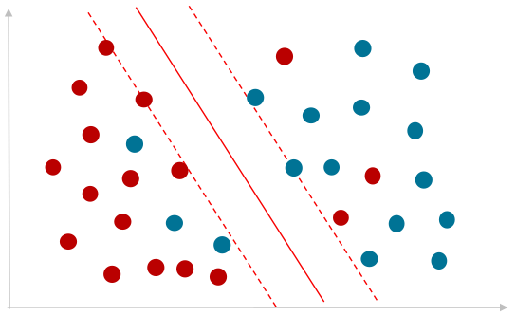
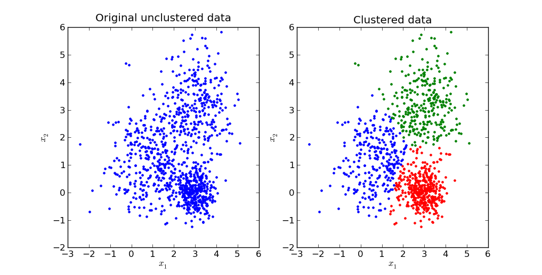
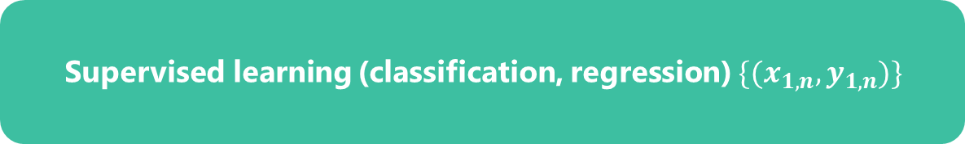
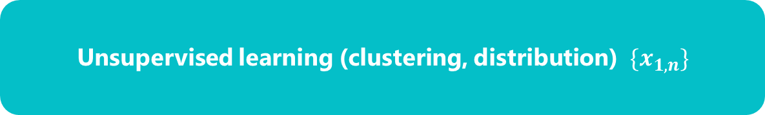
Semi supervised learning
Labeled data
Supervised learning (classification, regression) $\{(x_{1,n}, y_{1,n})\}$
Unsupervised learning (clustering, distribution) $\{x_{1,n}\}$

Slide 14
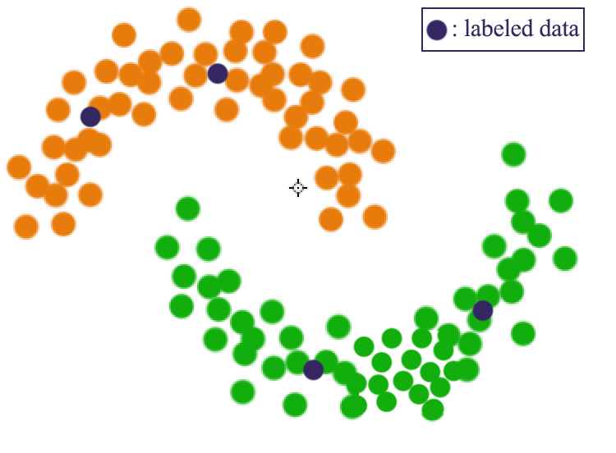
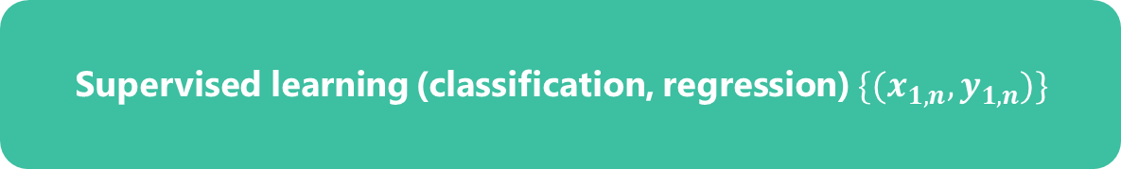
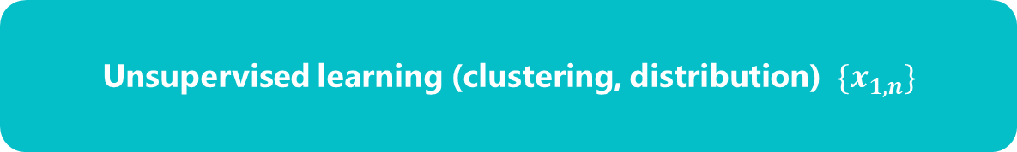
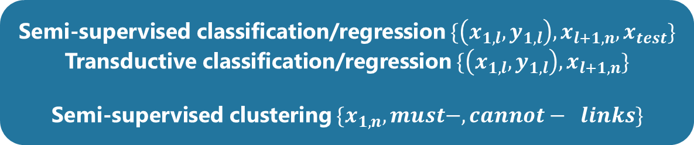
Semi supervised learning
Supervised learning (classification, regression) $\{(x_{1,n}, y_{1,n})\}$
Semi-supervised classification/regression $\{\left(x_{1,l}, y_{1,l}\right), x_{l+1, n}, x_{test}\}$
Transductive classification/regression $\{\left(x_{1,l}, y_{1,l}\right), x_{l+1, n}\}$
Semi-supervised clustering $\{x_{1,n}, must−, cannot− links\}$
Unsupervised learning (clustering, distribution) $\{x_{1,n}\}$

Slide 15
Semi supervised learning
Labeled data
Unlabeled data

Slide 16

Semi supervised learning
“
We expect unsupervised learning to become far more important in the longer term. Human and animal learning is largely unsupervised: we discover the structure of the world by observing it, not by being told the name of every object.
LeCun, Bengio, Hinton & Nature, 2015
”
Usages:
Large amounts of unlabeled data, small amounts of labelled data
Labeling/annotating data is expensive
As supervised learning methods that can use information in the input distribution
Motivations in our project:
We want to be able to input human understanding in the algorithm
LDA was done on a limited number of reviews
We want to be able to take advantage of well labeled reviews

Slide 17
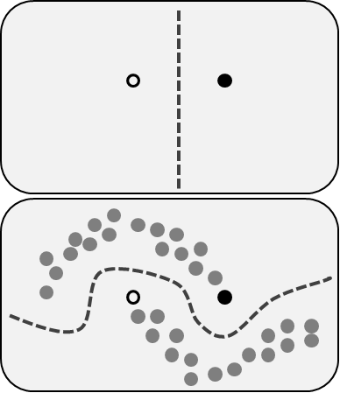
Semi supervised learning: an approach to optimize supervised learning when few labeled data is available
Idea
Illustration
Uses labeled AND unlabeled data to learn
Its hypotheses:
Continuity: a neighbor of a labeled data should be labeled the same way
Separability: data that are « far » away should be labeled differently
Manifold : Subspace describing the data in a much lower dimension that the input space
Few labeled data is available, the model is very simple
Using the unlabeled data « close » to the labeled data provides more information. Note that it is an approximation and it can be wrong!
Trade-off
What is the threshold ratio labeled/unlabeled that encourages us to use semisupervised?
Then how much unlabeled data should I use in supervised learning?
It depends on your data, but semisupervised approach makes sense when there is a structure in the data that
Is not captured by labeled data
Has predictive power (it separates classes)
Implementation
Different methods: generative models, graph-based models...

Slide 18
Hands-on: Semi Supervised learning
30’
Manuel labelisation

Slide 19
Hands-on: Semi supervised learning
5’
Restitution by 1 group

Slide 20
Agenda
1. Feed back on the Steering Committee
2. Reminder of the agenda
3. Topic extraction synthesis
4. Semi-supervised learning : generalities
5. Semi-supervised learning : self learning
6. Conclusion

Slide 21

Self Training (1/3)
1
Label a part of the data set
2
Split labeled data into train and test
3
Train a model
4
Test the model
Labeled data set
Train
Train
SVM
RF
XgBoost
…
Output : A predictive model that has been trained and tested on the labeled data set
Test
Test
Unlabeled data set
5
Test the predictive model on the unlabeled data set
6
Label the PPV
Unlabeled data set
Positive pred. values (PPV)
Positive pred. values (PPV) and the most negative values
True +
False +
Negative pred. values (NPV)
7
Measure performance → One ratio could be:
Confusion matrix could also be used to assess the performance of the predictive model
Output : a prediction for each document
True +
PPV

Slide 22
Self Training (2/3)
Main assumption:
One’s own high confidence predictions are correct.
Early mistakes could reinforce themselves.
Convergence is not guaranteed and theorical framework is unclear
Strengths
Weaknesses
The simplest semi-supervised learning method.
A wrapper method, applies to existing (complex) classifiers.
Often used in real tasks like natural language processing.

Slide 23
Self Training (3/3)
Steps:
Compute LDA to find interpretable topics
Label reviews manualy➔topics became labels
Build one classifier per label
Binary classification of unlabeled reviews (1 has the label 0 does not have the label)
Include high confidence reviews in training base
Repeat

Slide 24
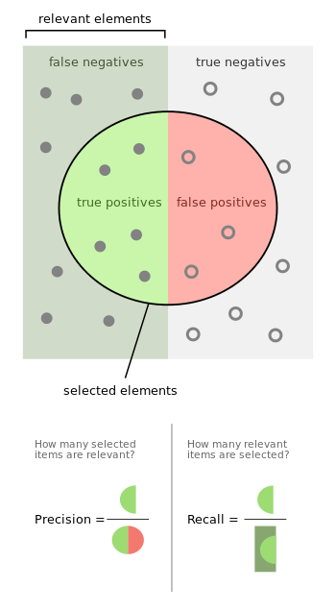


Measure the performance of a classifier
Confusion matrix
Precision and recall
 | Actual = True | Actual = False
Predicted = True | TP | FP
Predicted = False | FN | TN
Accuracy
$$Accuracy=\frac{\# correct predictions}{all predictions}=\frac{TP+TN}{TP+FP+FN+TN}$$
Which metric in our case?
Both recall and precision make sense. A combination of the two, like F-beta scores seems adequate. Which beta?
$$F_{β}=\frac{(1+β^{2})(precision ∗recall)}{(β^{2}∗precision+recall)}$$

Slide 25
Hands-on: Semi Supervised learning
30’
Build a classifier using the data labeled by hand and test semi supervised approaches

Slide 26
Hands-on: Semi supervised learning
15’
Restitution by 1 group

Slide 27
Agenda
1. Feed back on the Steering Committee
2. Reminder of the agenda
3. Topic extraction synthesis
4. Semi-supervised learning : generalities
5. Semi-supervised learning : self learning
6. Conclusion

Slide 28


Today we learned
Feedback on steering commitee
Semi supervised learning
Self learning and propagation
Identify KPIs
Fill a Benefits & Costs matrix
The governance bodies
Latent Semantic Analysis
Non-negative Matrix Factorization
Latent Dirichlet Allocation
Word2vec
Graph-of-word (bonus)

Slide 29
THANK YOU!

