Slide 1
Parameters
Images from SEM DIC Challenge Sample14
Subset size: [64 64] px
Subset spacing: 8 px
Reference-to-deformed (per spec for images)
I.e. “cumulative”
Only two images given for a particular disp. field
Mean +/- St.d across y-dir for each px in x-dir
Every eighth error bar shown for visual clarity

Slide 2
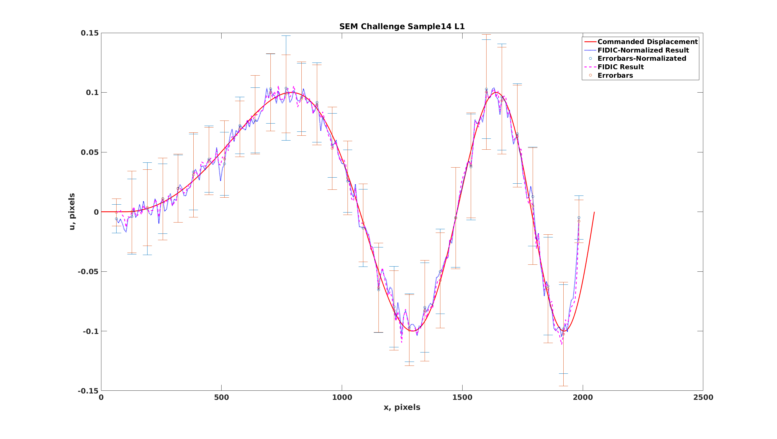
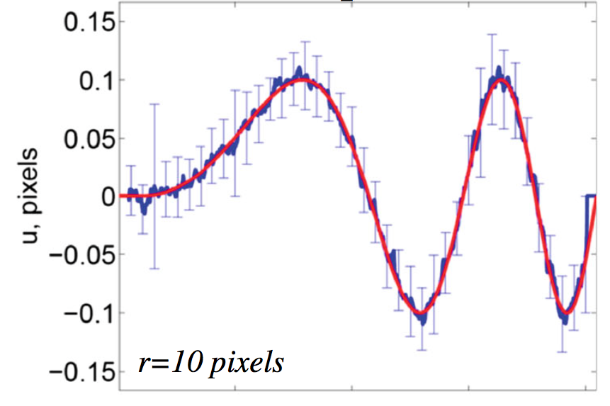
FM Testing FIDIC (Low)
Blaber et al. 2015

Slide 3
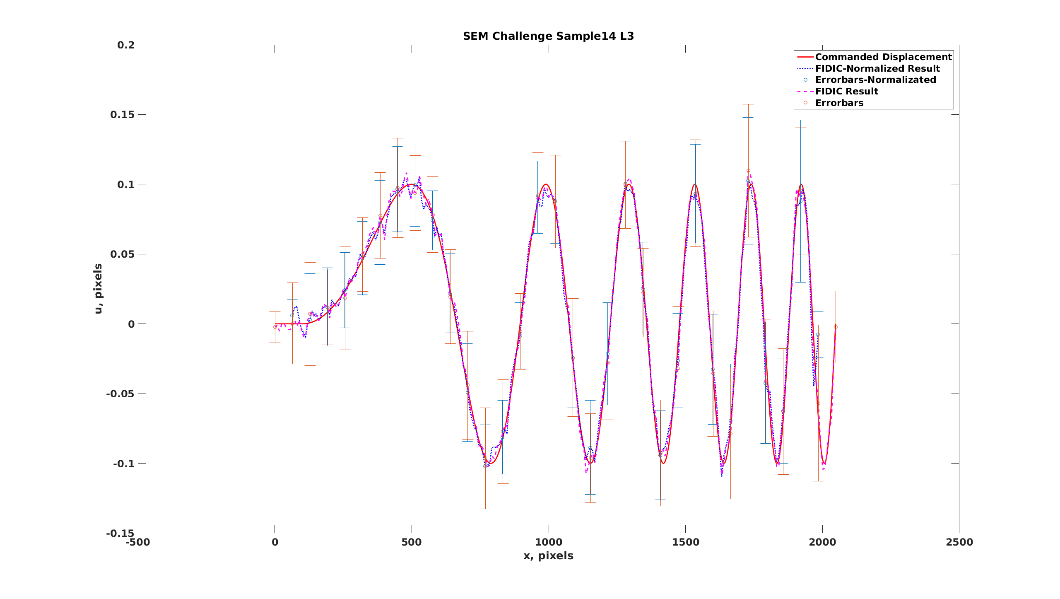
FM Testing FIDIC (Mid)

Slide 4
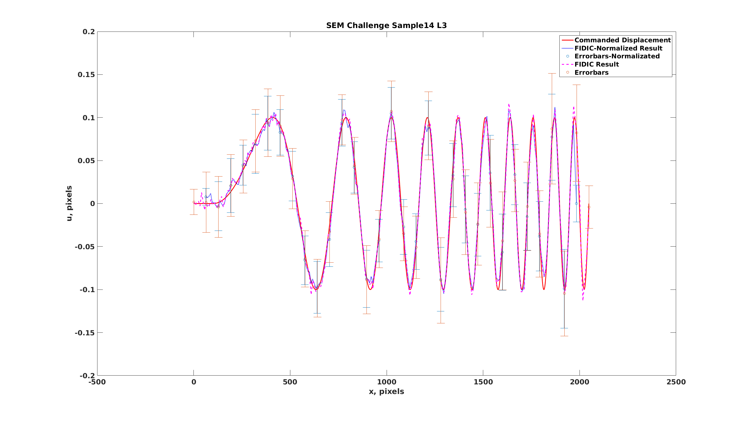
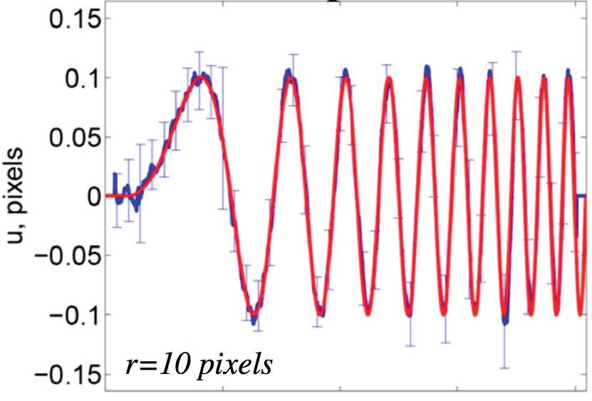
FM Testing FIDIC (High)
Blaber et al. 2015

