Slide 1
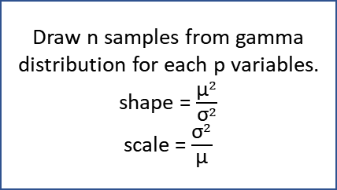
Latin hypercube sampling:
n most different combinations of
variables quantiles
p variables
raw data
Draw n samples from gamma distribution for each p variables.
shape = $\frac{{\text{µ}}^{2}}{{\text{σ}}^{2}}$
scale = $\frac{{\text{σ}}^{2}}{\text{µ}}$
If > 5 data points
Calculate mean (µ) and sd (σ)
If < 5 data points
Existing points resampled n times
Repeat N times
Model

