Slide 1
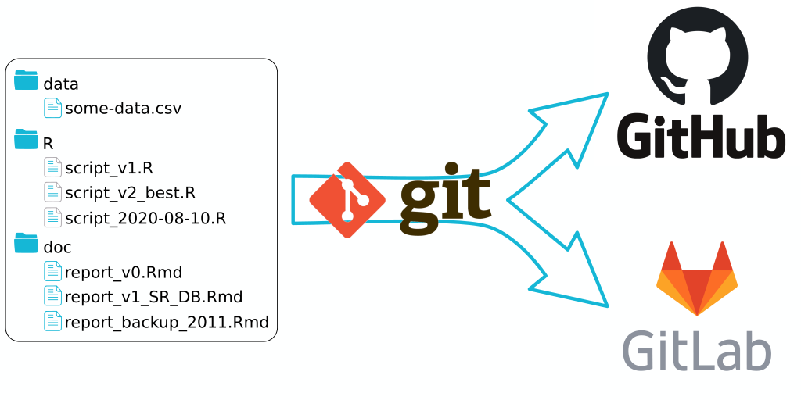
Git: versioning painkiller for the busy agronomist
Antoine Languillaume – PPS Lunch meeting 21-04-21
Credit : Thinkr.fr

Slide 2
Science, Data Analysis, Modeling needs Code

Slide 3

How to keep track of the changes in our code ?

Slide 4
Usual Disclaimer: This is not a geek-only seminar
Notes:
Yes we are talking about technology and IT But Open to everybody: The technology will be handled by junior staff.
But senior staff need to be aware of its benefit. Conversation guide to git.
Will not dive into technicalities

Slide 5
Problems: git will solve for you

Slide 6
Problems: git will solve for you
Keep track of your research project
Collaborate efficiently with others
Disseminate your work

Slide 7
Problems: git will solve for you
Keep track of your research project
Collaborate efficiently with others
Disseminate your work

Slide 8
Problems: git will solve for you
Keep track of your research project
Collaborate efficiently with others
Disseminate your work

Slide 9
Keep track of your changes

Slide 10

file-1.py
file-1a.py
file-2b.py
file-final.py
file-final-bis3.py

Slide 11
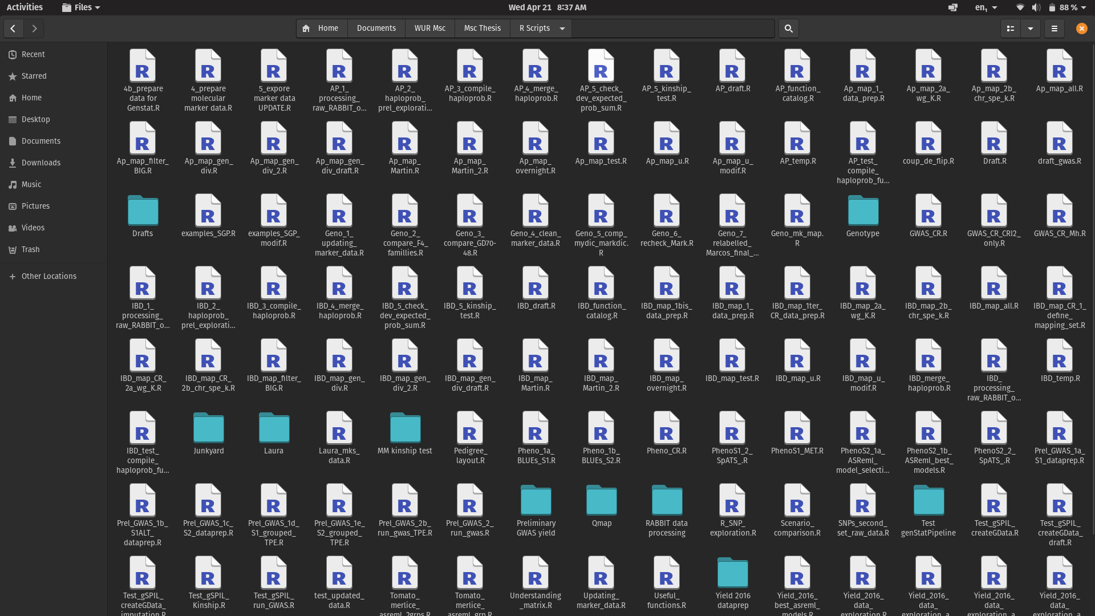

Slide 12
There is a better way...
Git allows you to take snapshots of your work
Snapshot == COMMIT

Slide 13
Saving copies
Making commits
file-1.py
file.py

Slide 14
Saving copies
Making commits
file-1.py
file.py
Commit
file-1a.py
file.py

Slide 15
Saving copies
Making commits
file-1.py
file.py
file-1a.py
file.py
Commit
file-2b.py
file.py

Slide 16
Saving copies
Making commits
file-1.py
file.py
file-1a.py
file.py
file-2b.py
file.py
Commit
file-final.py
file.py

Slide 17
Saving copies
Making commits
file-1.py
file.py
file-1a.py
file.py
file-2b.py
file.py
file-final.py
file.py
Commit
file-final-bis3.py
file.py

Slide 18
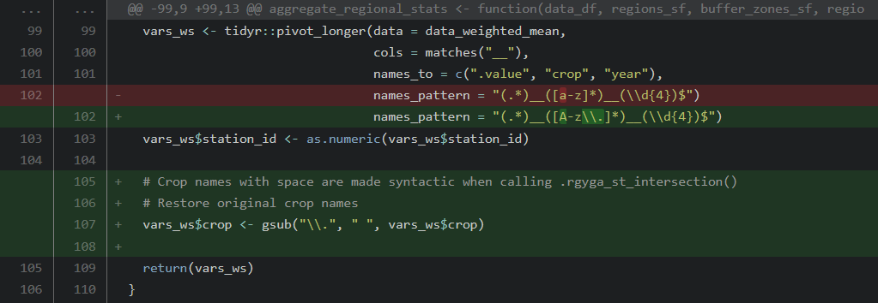

Slide 19
Edmund Blackadder
edmund.blackadder@bbc.uk
19/02/1993 – 3.02 pm
Author + email
Date
Message
Suppress warnings from extract_area()
Set calling handler sentinel scanning warning and promoting them to error if not corresponding to the matching pattern. This is probably not due to raster::extract() directly but more likely to
furrr::future_map() calling raster::extract().

Slide 20
Edmund Blackadder
edmund.blackadder@bbc.uk
19/02/1993 – 3.02 pm
Author + email
Date
Message
Suppress warnings from extract_area()
Set calling handler sentinel scanning warning and promoting them to error if not corresponding to the matching pattern. This is probably not due to raster::extract() directly but more likely to
furrr::future_map() calling raster::extract().

Slide 21
Edmund Blackadder
edmund.blackadder@bbc.uk
19/02/1993 – 3.02 pm
Author + email
Date
Message
Suppress warnings from extract_area()
Set calling handler sentinel scanning warning and promoting them to error if not corresponding to the matching pattern. This is probably not due to raster::extract() directly but more likely to
furrr::future_map() calling raster::extract().

Slide 22
Edmund Blackadder
edmund.blackadder@bbc.uk
19/02/1993 – 3.02 pm
Author + email
Date
Message
And ...
476a3f0bcb6ae281dc59fa3ba05abbf78c6c197e
Suppress warnings from extract_area()
Set calling handler sentinel scanning warning and promoting them to error if not corresponding to the matching pattern. This is probably not due to raster::extract() directly but more likely to
furrr::future_map() calling raster::extract().

Slide 23
476a3f0bcb6ae281dc59fa3ba05abbf78c6c197e
Commit SHA (or HASH) == unique identifier

Slide 24
Time travel
476a3f0b: Delete parallelization attempt
5oc78jk8: Upscale analysis to all countries
d289e8ce : Accept foreign crop names
Notes:
Working on Monday anecdote

Slide 25
Time travel
Monday: all good !
Notes:
Working on Monday anecdote

Slide 26
Time travel
Times goes by ....
Monday: all good !
Notes:
Working on Monday anecdote

Slide 27
Time travel
Monday: all good !
Wednesday: Meeting with supervisor,
Code is broken, I can’t reproduce my results !
Notes:
Working on Monday anecdote

Slide 28
Time travel
Monday: all good !
Notes:
Working on Monday anecdote

Slide 29
Non-linear development : BRANCH(es)
master

Slide 30
Non-linear development : BRANCH(es)
experiment
master

Slide 31
Non-linear development : BRANCH(es)
experiment
MERGE
master

Slide 32
Collaborate efficiently with others

Slide 33

+
X
n collaborators

Slide 34
PLEASE NO !

Slide 35

Instead use a REMOTE

Slide 36

Instead use a REMOTE

Slide 37

Instead use a REMOTE

Slide 38

Instead use a REMOTE

Slide 39

Instead use a REMOTE

Slide 40

REPO: github.com/jacinda/save-world.git

Slide 41
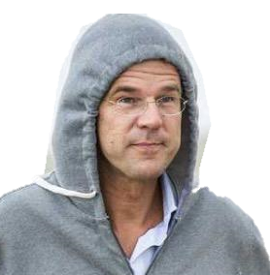
Repo owner

Slide 42
CLONE
Repo owner

Slide 43
RuttjevanOrange01
premie@gov.nl
20/04/2021 – 2.02 pm
Commit
Add plans to build dams
We have excellent engineers who can help with rising sea-level.
Repo owner

Slide 44
PUSH
Repo owner

Slide 45
Repo owner

Slide 46

Repo owner

Slide 47
Repo owner
PULL

Slide 48
Repo owner

Slide 49
Disseminate your work

Slide 50
Provided your work is hosted on a public remote:
Others can use it (no need for a dedicated website)
Contribute to it

Slide 51
Provided your work is hosted on a public remote:
Others can use it (no need for a dedicated website)
Contribute to it

Slide 52
Let’s have a look

Slide 53

Never think you are alone

Slide 54
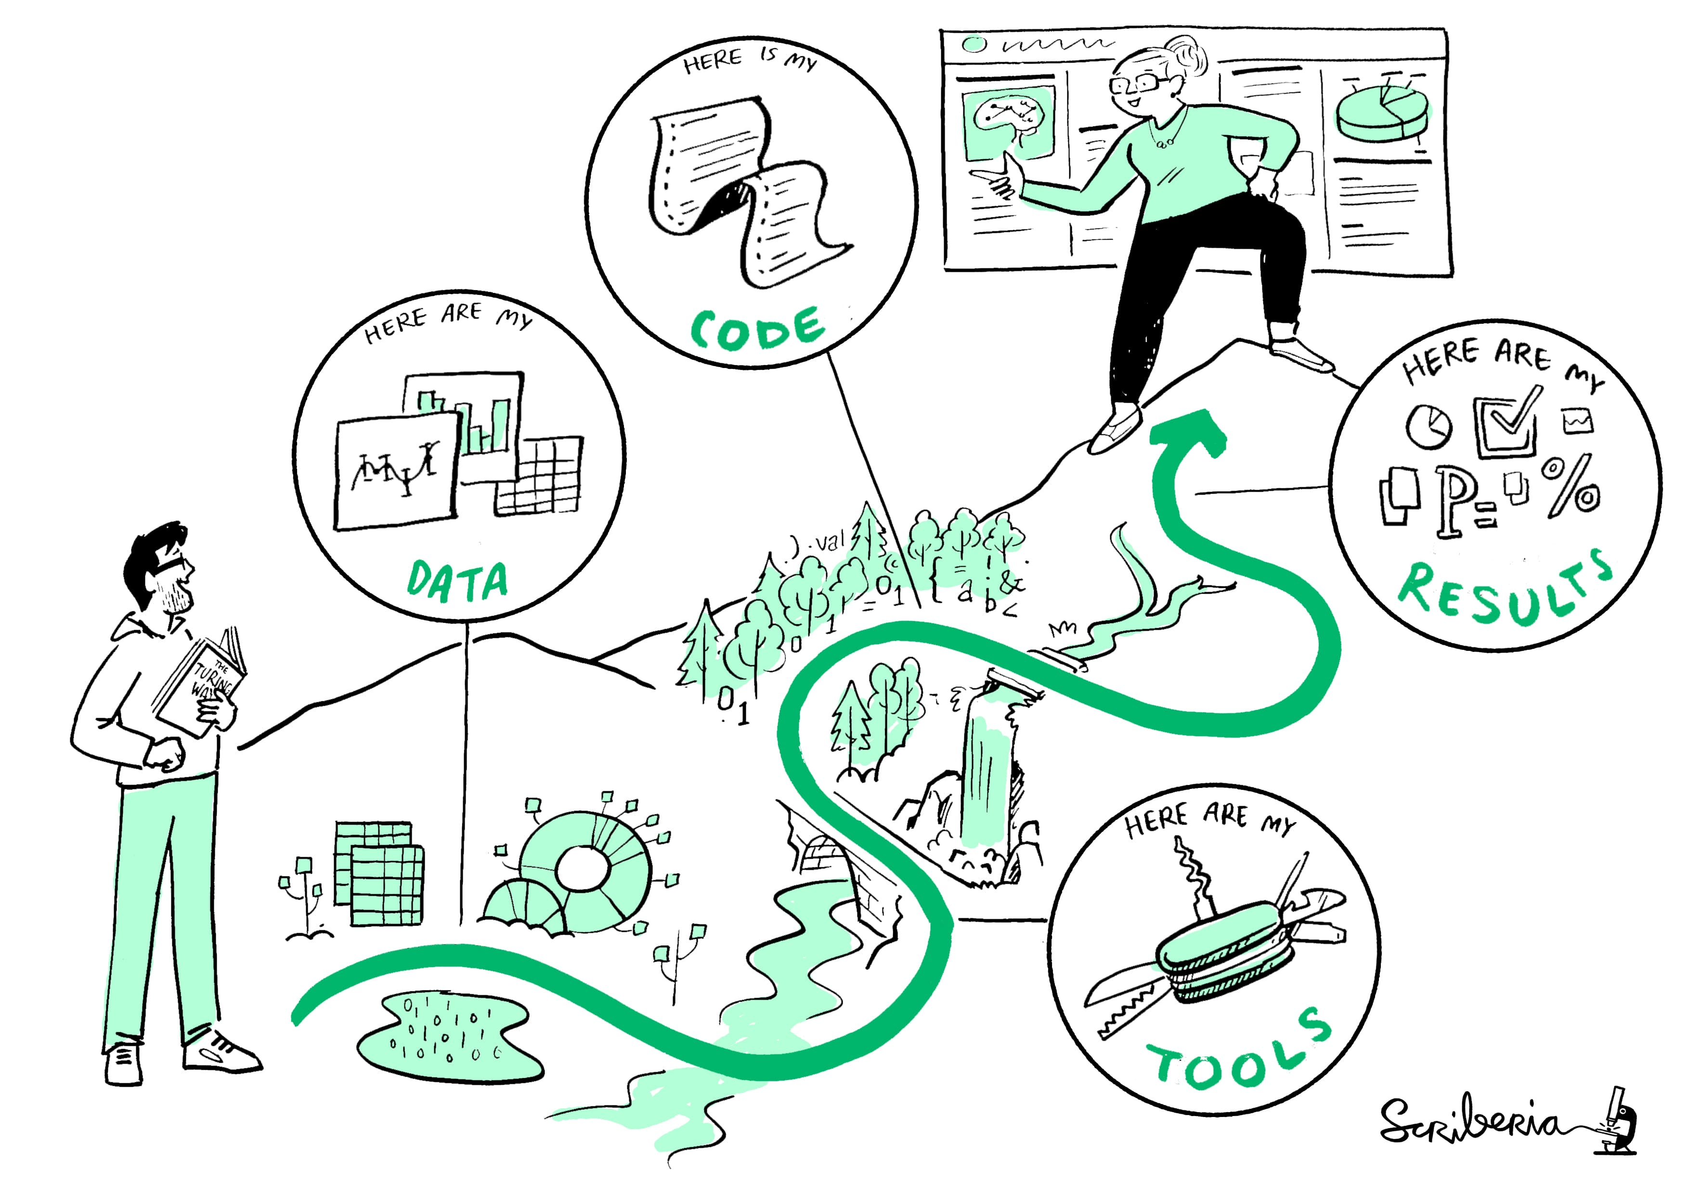
The Turing way: Guide for Reproducible Research

Slide 55
“Listen young millennial... Your github thingy will not make you Professor, papers will “

Slide 56
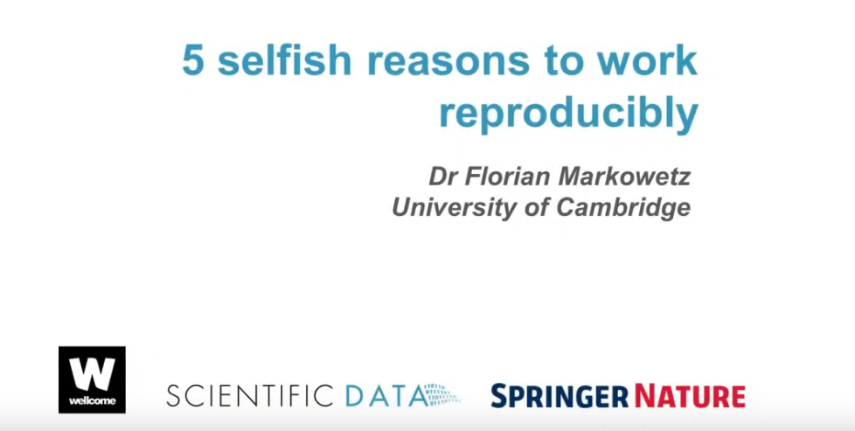

Slide 57
Thanks for your indulgence
All credits for slide design goes to @alicebartlett
Speaker Deck: slides

