Slide 1
Progress with Digital Object Identifiers in INTERMAGNET
Simon Flower [1], Kirsten Elger [2] and Damian Ulbricht [2]
(1) British Geological Survey, UK Research and Innovation, Edinburgh, UK, (2) GeoForschungsZentrum (GFZ) Helmholtz Centre, Potsdam, Germany.
Notes:
Abstract: INTERMAGNET is a global network of geomagnetic observatories. The members of INTERMAGNET are the institutes that own and operate these observatories. Each institute has its own needs and priorities when it comes to the publication of data. As a network operator, INTERMAGNET's priorities are to promote and publicise the data collected by it's members, ensuring that the institutes responsible for collecting geomagnetic data are the organisations that receive acknowledgement for the work. Using the DOI system to achieve these objectives has been challenging. We present progress on the use of DOIs within INTERMAGNET and discuss some of the remaining challenges.

Slide 2
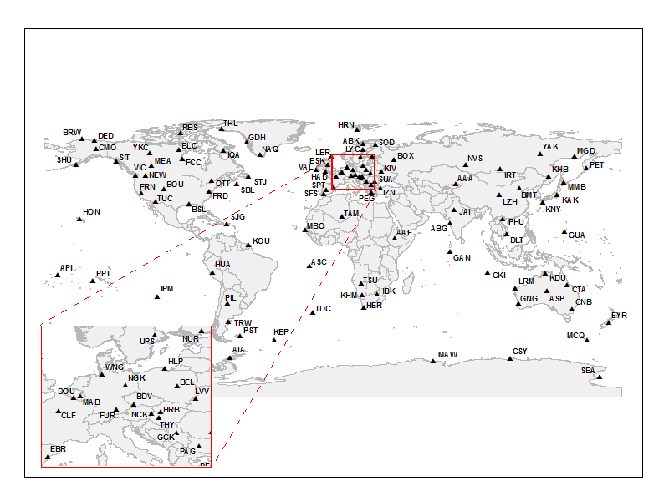
http://doi.org/10.5880/INTERMAGNET.2013
DOI for 2013 definitive data publication
Goals:
Allow citation of contributing institutes
View the contributing observatories
Ensure license conditions are clear
Access the (immutable) data

Slide 3
http://doi.org/10.5880/INTERMAGNET.2013
Difficulties:
Gathering the metadata (and ensuring it is correct)
Getting agreement from many contributing institutes
Different things important to different people
EG Visibility of agency, layout of observatory information, ...

Slide 4
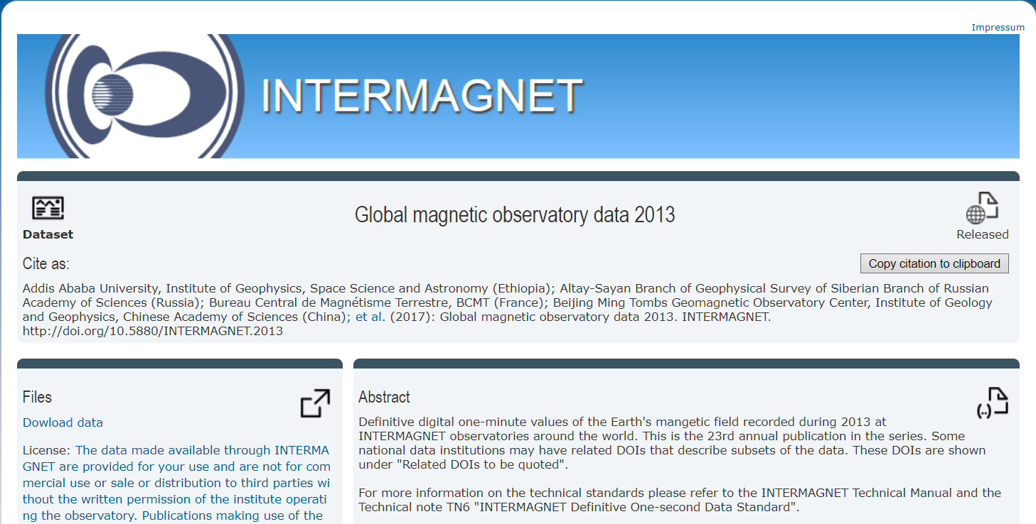
http://doi.org/10.5880/INTERMAGNET.2013

Slide 5
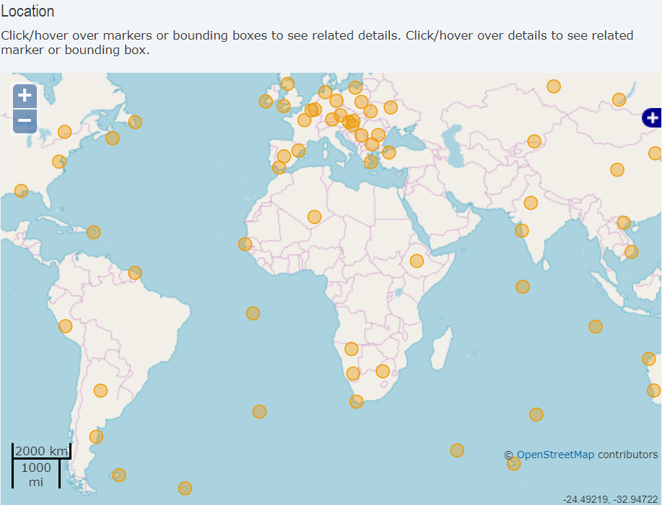
View the contributing observatories
<default:geoLocation>
<default:geoLocationPoint>
<default:pointLongitude>-57.89</default:pointLongitude>
<default:pointLatitude>-51.7</default:pointLatitude>
</default:geoLocationPoint>
<default:geoLocationPlace>
Port Stanley (PST) maintained by: British Geological Survey
</default:geoLocationPlace>
</default:geoLocation>

Slide 6
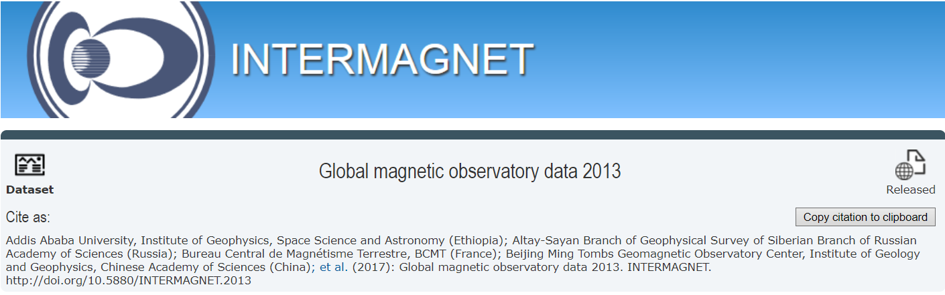
Allow citation of contributing institutes
<default:creators>
<default:creator>
<default:creatorName>
Addis Ababa University, Institute of Geophysics,
Space Science and Astronomy (Ethiopia)
</default:creatorName>
</default:creator>
…
</default:creators>
<default:publisher>INTERMAGNET</default:publisher>

Slide 7
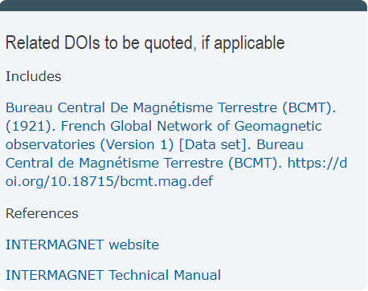
Allow citation of contributing institutes
<default:relatedIdentifiers>
<default:relatedIdentifier relatedIdentifierType="DOI“
relationType="HasPart">
doi:10.18715/BCMT.MAG.DEF
</default:relatedIdentifier>
<default:relatedIdentifier relatedIdentifierType="URL“
relationType="References">
http://www.intermagnet.org/publication-software/
technicalsoft-eng.php
</default:relatedIdentifier>
</default:relatedIdentifiers>

Slide 8
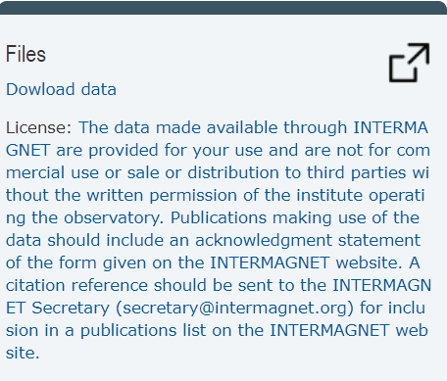

Ensure license conditions are clear
<default:rightsList>
<default:rights rightsURI="http://intermagnet.org/data-
donnee/data-eng.php#conditions">
The data made available through INTERMAGNET are provided for
your use and are not for commercial use or sale or
distribution to third parties without the written permission
of the institute operating the observatory. Publications
…
</default:rights>
</default:rightsList>

Slide 9
Access the (immutable) data
Contents of INTERMAGNET 2013 Definitive Data USB stick made available as a .tar.gz file
Can be downloaded by ftp
Stored at GFZ library / information service – ensures data can never be changed

Slide 10
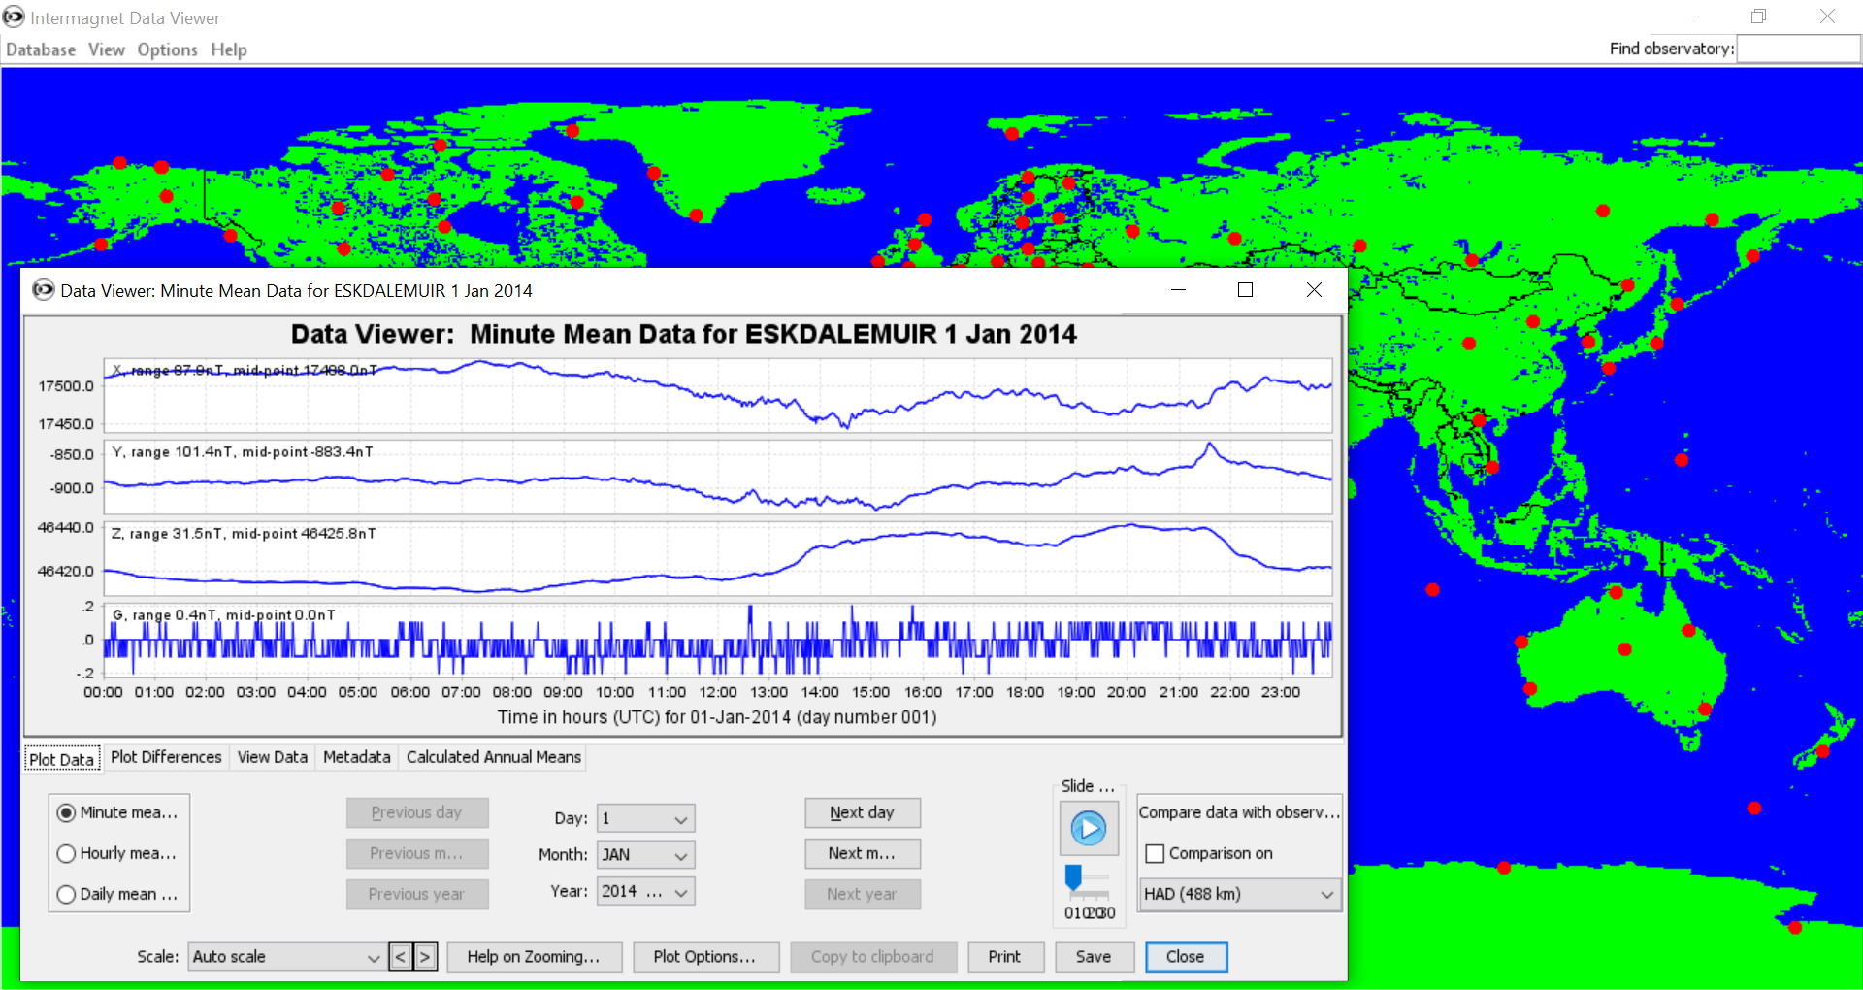
Access the (immutable) data

Slide 11
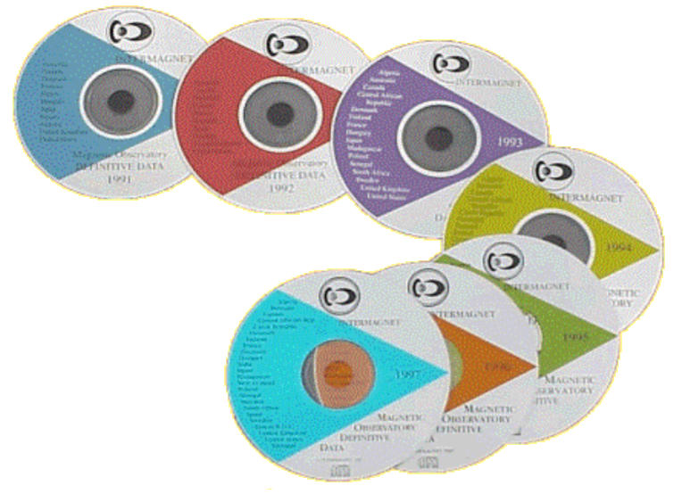
Future plans
DOI for 2014 definitive data publication
DOI for 2015 publication
DOIs for 1991 to 2013
INTERMAGNET geomagnetic reference data set
Then we need to tackle preliminary data
Notes:
DOIs the future of publication

Slide 12
http://doi.org/10.5880/INTERMAGNET.2013
DOI for INTERMAGNET 2013 definitive data publication

