Slide 1
A Metadata System for Geomagnetism
Simon Flower
Jürgen Matzka
Notes:
This work is being funded through EPOS – this is why it’s being presented at an EPOS meeting
However the scope of the work covers the global geomagnetism community
This work, now funded by EPOS, is the continuation of work in INTERMAGNET between BGS and GFZ over the past 2-3 years

Slide 2
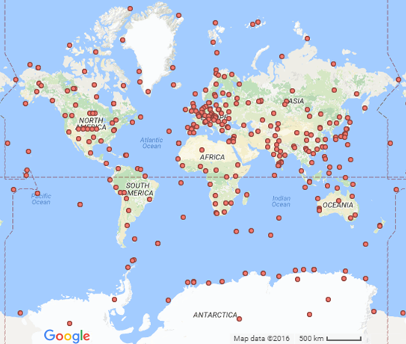
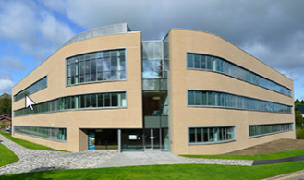
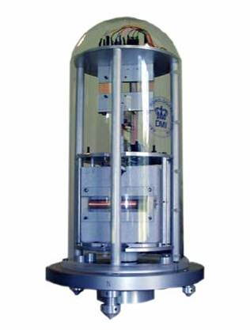

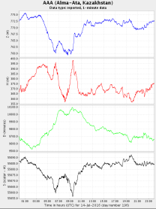
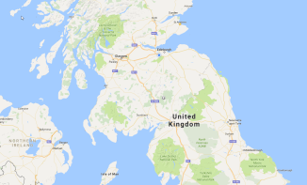

Geomagnetic Observatory Metadata: What we record
Institutes
Instruments
People
Data
Locations
180 active, 360 inactive observatories
200 contacts in 125 institutions
Many instruments creating thousands of data sets
Notes:
These figures are from the World Data Centre metadata database
The data that we need to collect is sufficiently large and complex to need a data management tool, which we don’t have at the moment
INTERMAGNET figures: 61 institutes, 132 active observatories, 17 former observatories

Slide 3



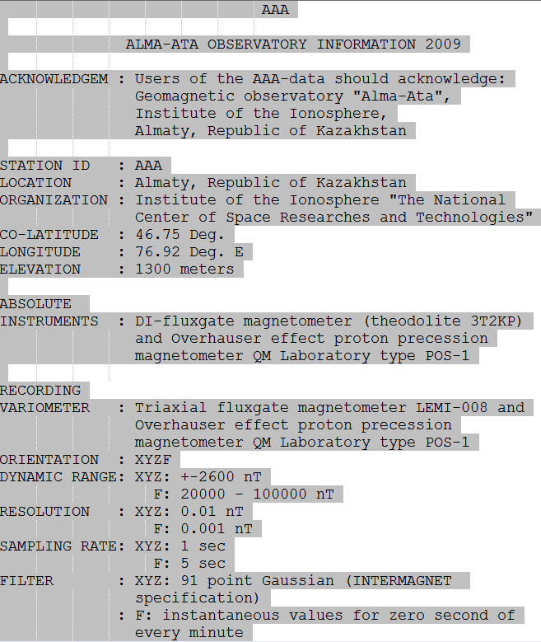



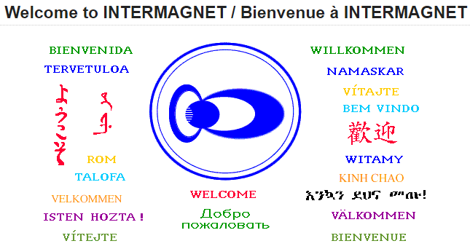
Geomagnetic Observatory Metadata: How we record it
World Data Centre:
INTERMAGNET:
?
Other bodies:
Notes:
World Data Centre – metadata is held in an Access databasend updated manually when contacts email us changes
The Access database is well designed, but difficult to make accessible:
It’s hard to add code that will allow the data to be distributed by web service
It’s hard to design a system that will allow observatory operators to input metadata themselves
INTERMAGNET – metadata for the annual DVD is compiled annually from text files
metadata for the web site is in XML files which are updated when contacts email us
Held in disparate ways: XML files on web site, unstructured text on DVD
There are almost certainly other places where geomagnetic metadata is collected – metadata which could be merged into a central metadata system, provided it is suitably designed
There’s a lot of manual work to get what we need.
There are a lot of bits of metadata in different places, sometimes with conflicting contents
Very little is easily accessible, particularly for use by computer

Slide 4
Geomagnetic Observatory Metadata: Problems with the current arrangements
Difficult for data providers to update
Data held in several unconnected systems -Inconsistent
Difficult to use with computer programs -Unstructured
Difficult to query – much of it not available publically

Slide 5
Geomagnetic Observatory Metadata: Design goals
A single database for the whole community
Easy for data providers to understand and update
Easy for users to query and obtain data
Contains information needed for the INTERMAGNET website, INTERMAGNET data DVD, World Data Centre web site (amongst others)
Ideal: Be able to create a yearbook
Conform to metadata standards (such as ISO 19115) to allow our data to be understood by users outside our community
We need to ensure both these things
Notes:
I think that the ‘gold standard’ for a geomagnetic metadata system is that we would have enough information to allow us to create the digital equivalent of a yearbook from the metadata for any of the digital data sets that we are collecting. We won’t get to this level with the first version of the system, but the idea of being able to recreate a yearbook from the metadata should continue to be an aspiration.
ISO 19115 is a standard for geographic metadata. INSPIRE is a related standard that is mandatory in Europe

Slide 6
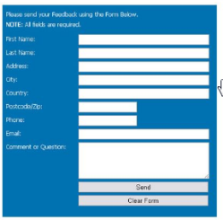


Geomagnetic Observatory Metadata: Implementation
Self service data entry
Web services
Tools to create DVD metadata
Other clients
Feed to INTERMAGNET web site
Geomagnetic metadata database
Tools for database administration
Feed to EPOS data portal
Notes:
An easy to use data entry service will be provided. This will allow data providers to update entries for their own institutes and observatories
Feeds will be provided to satisfy the specific requirements of a number of clients (INTERMAGNET and EPOS shown in the diagram – others expected to follow). The basic design will be flexible, allowing new clients to be added as needed.
Tools will be available to allow the operators of the database to enter and delete data.
The system will initially be implemented at the British Geological Survey. It will be designed to be flexible in it’s implementation, so that it could be moved to another institute, if required.

Slide 7
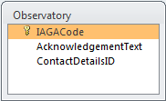
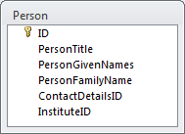
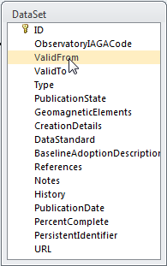
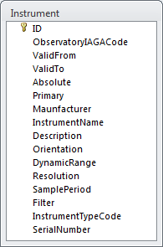
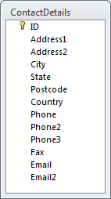
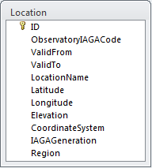
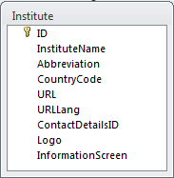
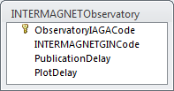
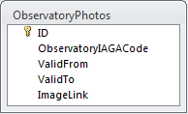
Geomagnetic Observatory Metadata: Implementation: The schema
Notes:
Designed to capture these things about an observatory:
What institute or institutes does it belong to and is it supported by
What is it’s location
Who are the contacts for the observatory
What instruments are / have been in operation at the observatory
What data sets has the observatory produced
Is the observatory a member of INTERMAGNET
All these attributes may vary over time – the metadata allows for this
This is a subset of the information held in the schema – for a more detailed description, contact me

Slide 8
Geomagnetic Observatory Metadata: Status
First version of metadata schema designed and available to you (on request) to comment on
Work progressing to ensure compliance with international metadata standards
Notes:
An easy to use data entry service will be provided. This will allow data providers to update entries for their own institutes and observatories
Feeds will be provided to satisfy the specific requirements of a number of clients (INTERMAGNET and EPOS shown in the diagram – others expected to follow). The basic design will be flexible, allowing new clients to be added as needed.
Tools will be available to allow the operators of the database to enter and delete data.
The system will initially be implemented at the British Geological Survey. It will be designed to be flexible in it’s implementation, so that it could be moved to another institute, if required.

Slide 9
For more information, including details of the metadata schema
Simon Flower: smf@bgs.ac.uk
Notes:
To be a success, this metadata system needs to be taken up by the community. Please help the design by requesting and commenting on the draft schema.

