Slide 1

European Plate Observing System
A. Thomson, S. Flower, P. Hejda
https://www.epos-ip.org/tcs/geomagnetic-observations
INTERMAGNET Meeting, ZAMG Vienna, 2nd – 4th July, 2018

Slide 2

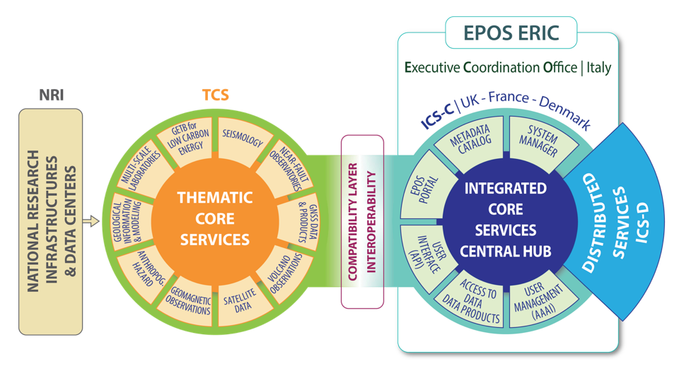
EPOS Architecture for Implementation

Slide 3
TCS Geomagnetic Observations
Technical Implementation
3 parts:
EGMODA (European Geomagnetic Model and Data Archive)
Existing services: INTERMAGNET, WDC for geomagnetism Edinburgh, IMAGE
Existing international efforts: main and crustal field modelling under IAGA auspices (IGRF, WDMAM,…)
ESGI (European Service of Geomagnetic Indices)
Existing services: ISGI and ISGI-Collaborating Institutes: Service on Rapid Magnetic Variations (Ebro Obs.), Kp service; IMAGE
EMTDAMO (European Service of Magnetotelluric Data and Models)
Under development with unified format and metadata

Slide 4
Legal and Governance Framework
On EPOS level:
ERIC (European Research Infrastructure Consortium) – legal entity. Members of ERIC are states.
On TCS level:
Consortium (without legal subjectivity). Members are Institutions (legal entities)
Bodies
Consortium Board (it can also include members by right - with speaking but no voting rights - if for example an important component of the TCS is not a legal entity but a network.
Director
Advisory Bodies: User Committee and Data Providers Committee

Slide 5
Supplier Letter
The geomagnetic community is used to act through consensus. Data providers submitted their data to data centers for decades without any written confirmation that they would do it and everybody bore the costs of its activities.
EPOS differs from this. The development of services is supported by an H2020 grant and the European Commission requires confirmation that the system will be supplied with data.
The Supplier Letter is not just a necessary evil. It clarifies the issues of data ownership and data licensing and thus prevents potential future problems.

Slide 6
Your collaboration is needed:
1- Supplier Letter
In accordance with the EPOS Data Policy, the Supplier allows EPOS to distribute the data and/or data products and/or software and/or services (named DDSS in the following)
The Supplier confirms that it has full ownership rights to the DDSS
In case of no Licence already affixed to DDSS, the Supplier allows the relevant EPOS Service Provider to affix the Creative Commons 4.0 CC:BY license. The license will be affixed on behalf of the Supplier, and by no means will this be deemed as waiver to any of its Ownership Rights.
In return, the Supplier may benefit from EPOS Users authentication system’s feedback, in order to be informed about its DDSS usage and statistics.

Slide 7
TCS Geomagnetic Observations
Technical Implementation - Progress
Service description | Lead organisation | Delivery due
Geomagnetic observatory data (INTERMAGNET, WDC) | BGS/NERC | Sep-17
Variometer data (IMAGE + Baltic extensions) | FMI | Sep-17
Geomagnetic indices (ISGI) | EOST | Sep-17
Geomagnetic events | EOST / EBRE | Sep-17
IMAGE electrojet indices (IE/IL/IU) | FMI | Sep-17
IGRF and WMM (global magnetic models) | BGS/NERC | Sep-17
Magnetic survey data | BGS/NERC | Sep-18
Magnetotelluric time-series | LTU | Sep-18
Historical data (e.g. Helsinki and SMA network ) | FMI | Sep-18
Substorm events | FMI | Sep-18
Magnetotelluric transfer functions | LTU | Sep-18
Ground variations | BGS/NERC | Sep-18
Lithospheric conductivity models | LTU | Sep-19
European regional magnetic model (MagNetE) | BGS/NERC | Sep-19
World Digital Magnetic Anomaly Map (WDMAM) | BGS/NERC | Sep-19
Notes:
Here are the DDSS numbers for each of the services – I didn’t want to put this in the presentation as DDSS is ‘EPOS speak’!
DDSS number Service description
WP13-DDSS-001 Geomagnetic observatory data
WP13-DDSS-002 Variometer data (IMAGE + Baltic extensions)
WP13-DDSS-006 Geomagnetic indices
WP13-DDSS-007 Geomagnetic events
WP13-DDSS-008 IMAGE electrojet indices (IE/IL/IU)
WP13-DDSS-012 IGRF and WMM (global magnetic models)
WP13-DDSS-003 Magnetic survey data
WP13-DDSS-004 Magnetotelluric time-series
WP13-DDSS-005 Historical data (e.g. Helsinki and SMA network )
WP13-DDSS-009 Substorm events
WP13-DDSS-010 Magnetotelluric transfer functions
WP13-DDSS-011 Ground variations
WP13-DDSS-013 Lithospheric conductivity models
WP13-DDSS-014 European regional magnetic model (MagNetE)
WP13-DDSS-015 World Digital Magnetic Anomaly Map (WDMAM)

Slide 8
How the Geomagnetic Community benefits?
EPOS has provided funds for needed IT activities that will benefit the whole Geomagnetism community (e.g. Metadata + Web services/API )
Existing services and collaborations under IAGA (INTERMAGNET/WDC/IMAGE/ISGI/…; IGRF/WDMAM/…) will extend their influence and usefulness to the end-user community, particularly to non-Geomagnetism scientists (interoperability)
The MT Community is organising itself with common formats and metadata structures
Data providers and services/models developers and operators will be given full recognition
Create opportunities for new science, arising from combining our geomagnetic data with data from other domains

Slide 9

Thank you

Slide 10
Supplier Letter - wording
In accordance with the EPOS Data Policy, the Supplier allows EPOS to distribute the data and/or data products and/or software and/or services, hereinafter referred to as “DDSS”, identified in the Annex A.
The Supplier confirms that :
To the best of its knowledge and belief it has full ownership rights to the DDSS and/or it has full rights to distribute the DDSS or to allow their distribution by a third party;
It is not under any obligation or disability at law, contract or otherwise, which would in any manner, or to any extent, prevent or restrict it from entering into and fully performing, this Letter Of Intent;
The release of the DDSS in accordance with the terms of this Letter of Intent does not and will not contravene any laws;
It has taken reasonable steps to maximize the quality of the DDSS.

Slide 11
Supplier Letter - wording
The Supplier allows :
The relevant EPOS Service Provider to affix the Creative Commons 4.0 CC:BY license on any Data or Data Product provided with no license information. The license will be affixed on behalf of the Supplier, and by no means will this be deemed as waiver to any of its Ownership Rights.
The relevant EPOS Service Provider to affix the relevant license on any Software provided with no license information. The license will be affixed on behalf of the Supplier, and by no means will this be deemed as waiver to any of its Ownership Rights.
EPOS-ERIC to distribute the DDSS without delays as soon as they are made available.
In return, the Supplier may benefit from EPOS Users authentication system’s feedback, in order to be informed about its DDSS usage.

