Slide 1
1-sec Definitive Data collection
2014..2018
(situation 2019-07-08)
Definitive 2014
Provided 38 IMOs
Accepted 36 IMOs
Definitive 2015
Provided 36 IMOs
Accepted 12 IMOs (USGS only)
Definitive 2016
Provided 36 IMOs
Accepted 11 IMOs (USGS only)
Definitive 2017
Provided 7 IMOs (ABK, BDV, EBR, LYC, TUC, UPS, WIC)
Accepted 0 IMOs
Definitive 2018
Provided 4 IMOs (ABK, LYC, UPS, WIC)
Accepted 0 IMOs

Slide 2
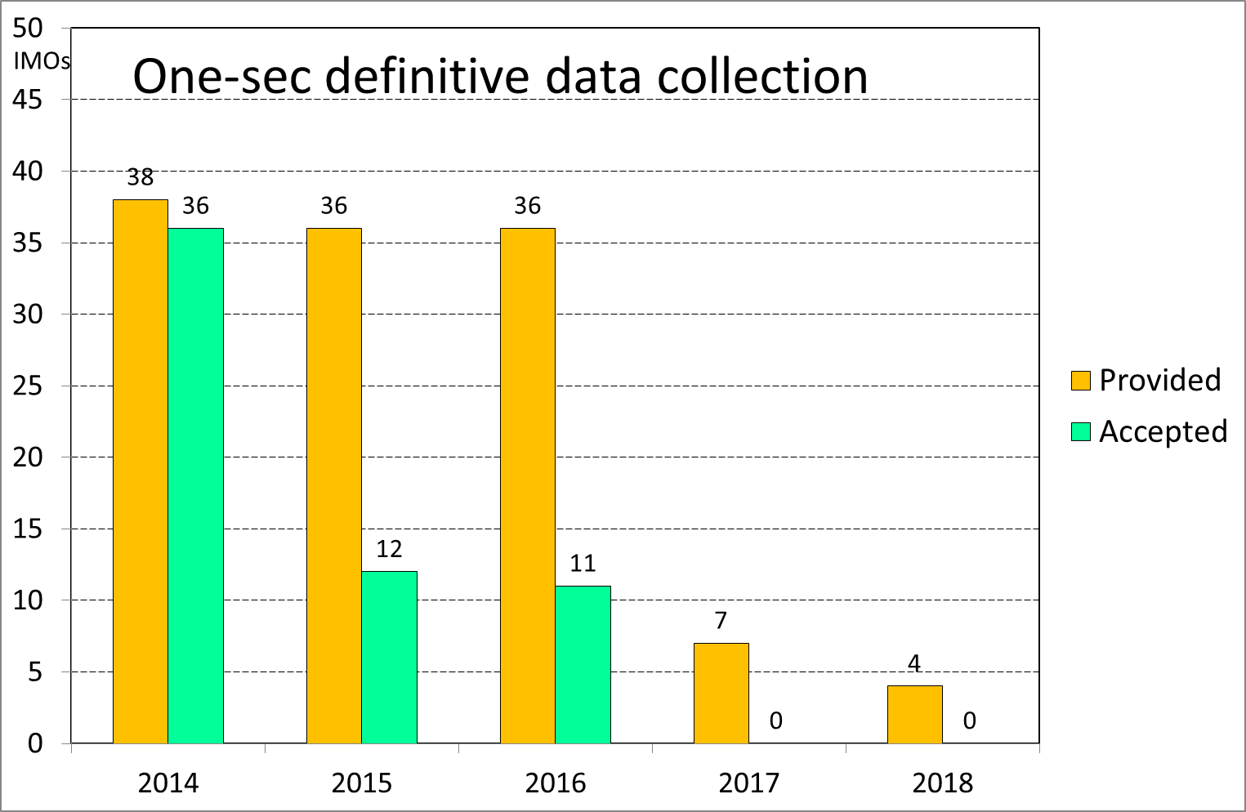

Slide 3
Comparison of definitive data collection
1-min vs. 1-sec
 | 1-minute | 1-second
Requested data format | IAF | 2014 – IAGA 2002 2015 forwards – CDF Since 2015 format ImagCDF is obligatory, however a dozen or so IMOs still provides 1-sec in IAGA 2002 format (USGS observatories).
Additional files requires | yearmean.imo imoyyyy.blv readme.imo readme country country/institute map about screen | NO additional files required
Software for data control | Java browser IMCDVIEW (still developed for over 15 years) Check1min.exe MagPy | Autoplot gm_convert MagPy DataCheck1s.jar (for IAGA 2002) iaga2002_to_iaf21.exe (for IAGA 2002)
Where are available accepted data? | INTERMAGNET web (it means publicly available) | On Paris ftp server / step2 only. It means that are available for those who know login and password.
Checking definitive data | Two-stage cross checking system In 1-st stage definitive sets are checked by volunteers data checkers In 2-nd stage a data are checked by chair of DD subcommittee, if accepted stamped and copied by copied to INTERMAGNET web | There is not system of control like for 1-minute. The data are checked by chair of DD Subcom. The accepted data are not stamped and copied to INTERMAGNET web. So far, there were relatively well checked 1-sec 2014, i.e. 1-sec provided in IAGA 2002. 2015 onwards are practically checked USGS data only, which are still delivered in IAGA 2002 format. Main problems to be solved: Creation control system, for example similar to 1-min control system Finding people who will have time for such activity

