Slide 1
Geomagnetic Metadata
A metadata system for the global observatory community

Slide 2
What is Metadata?
Information about data, EG:
Kelly, G.S.; Viljanen, A.; Beggan, C.D.; Thomson, A.W.P.. 2017 Understanding GIC in the UK and French high-voltage transmission systems during severe magnetic storms. Space Weather, 15 (1). 99-114. https://doi.org/10.1002/2016SW001469
Several pieces of metadata appear in this citation (metadata) to a journal publication (data):
A list of authors
A title for an article
A title for a publication
Some references
Notes:
There’s nothing conceptually novel about metadata. It’s been around of a long time.

Slide 3
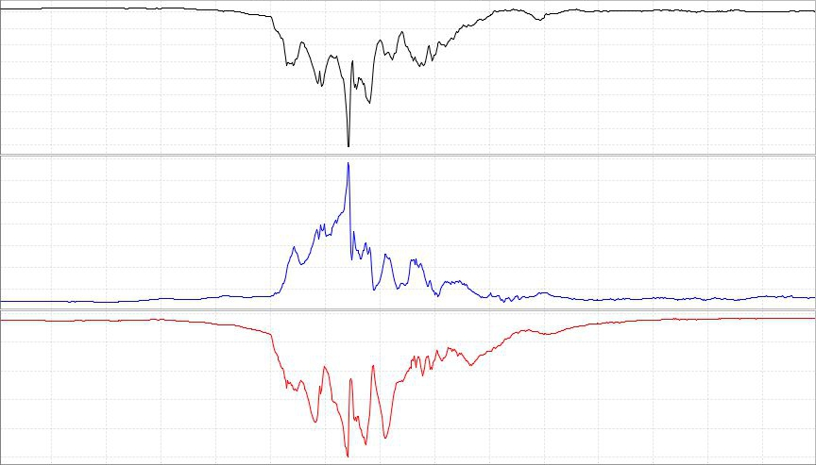
Why do we need it
Data on its own

Slide 4
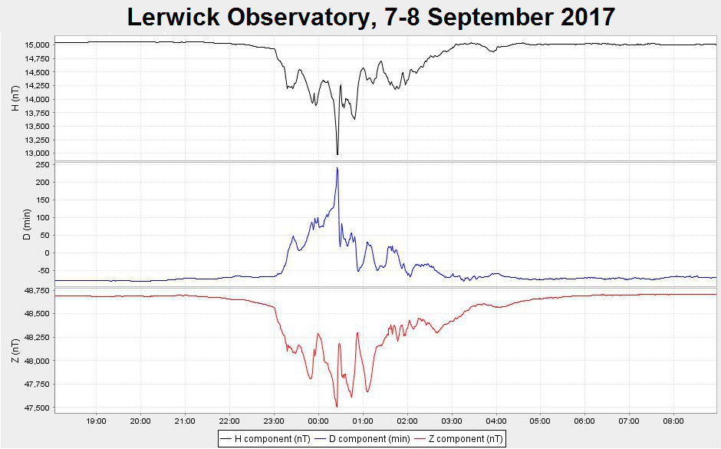
Why do we need it
Data with metadata

Slide 5
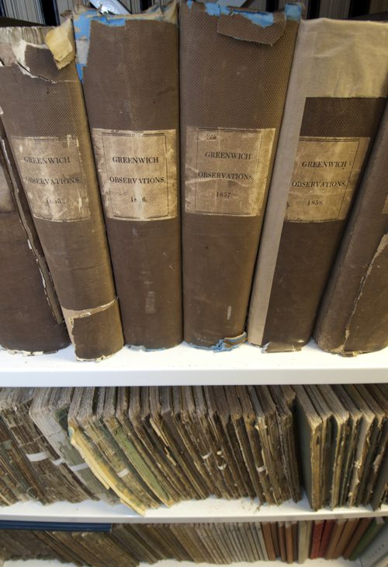
Why do we need it
We won’t always be around to explain our work in person.
Are we doing as good a job to record our work in the digital age as was done by observatories creating yearbooks?

Slide 6
Why do we need international standards
Format IAGA-2002 |
Source of Data Danish Meteorological Institute |
Station Name Narsarsuaq |
IAGA CODE NAQ |
Geodetic Latitude 61.160 |
Geodetic Longitude 314.560 |
Elevation 4 |
Reported XYZF |
Sensor Orientation DIF |
Digital Sampling 0.01 seconds |
Data Interval Type Filtered 1-minute (00:30 - 01:29) |
Data Type Definitive |
DATE TIME DOY NAQX NAQY NAQZ NAQF |
2001-03-13 00:00:00.000 072 10800.11 -6100.23 53381.51 54801.12
2001-03-13 00:01:00.000 072 10800.31 -6100.20 53381.51 54801.12
2001-03-13 00:02:00.000 072 10801.11 -6101.23 99999.00 54801.12
2001-03-13 00:03:00.000 072 10803.12 -6100.23 99999.00 54801.12
Standards (like IAGA-2002) allow us to exchange data.
It’s no different with metadata.
International metadata standards (like ISO19115) allow us to exchange metadata outside our community

Slide 7
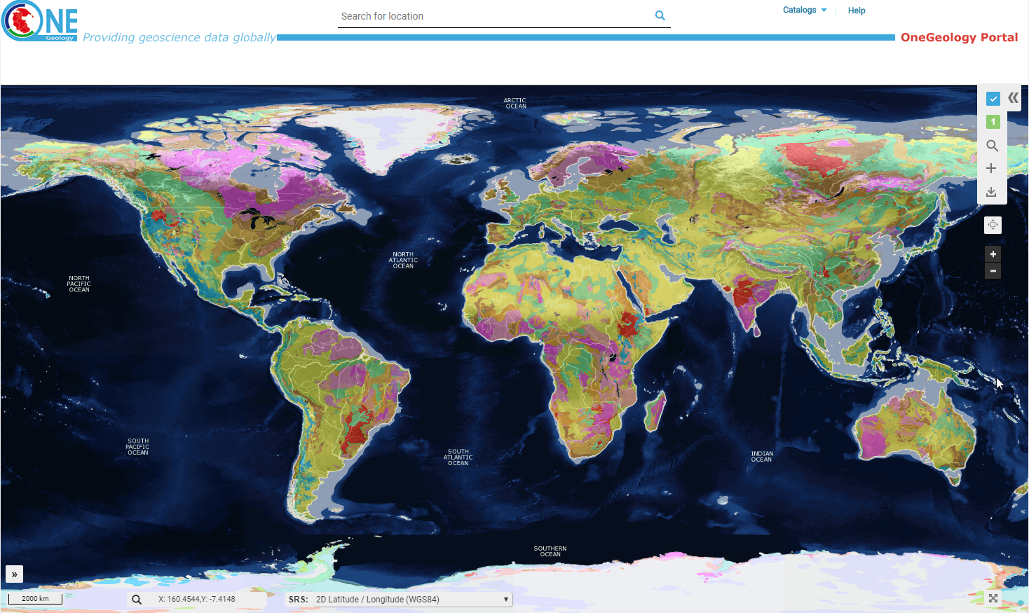
Why do we need international standards
Then we can do things like this (OneGeology)
Notes:
Without agreed standards for metadata, collaborations like OneGeology would not be possible.
INTERMAGNET and IAGA have provided good standards, well accepted by the community, for data. We have not had any standards for metadata in our community.

Slide 8
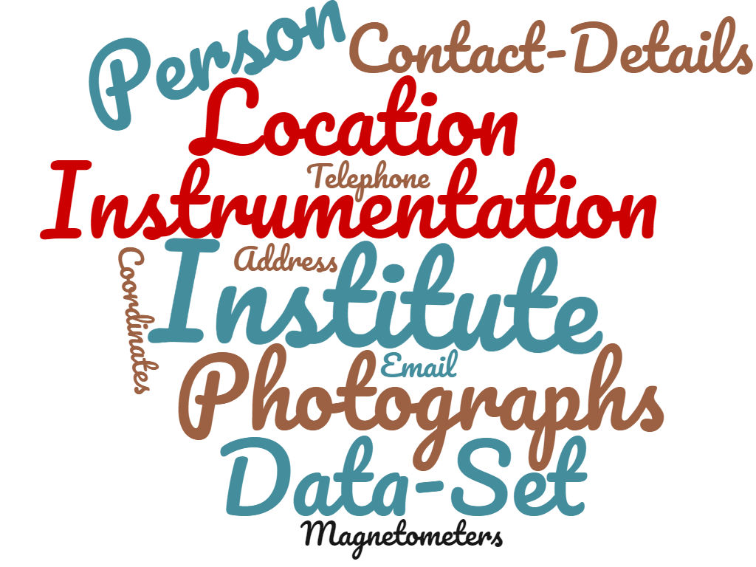
What does our community want to record for the future?
Notes:
This is just a start – the bare minimum – but still complex to implement across the global community.
A more ambitious goal would be to recreate digitally the level of metadata recorded in a yearbook.

Slide 9

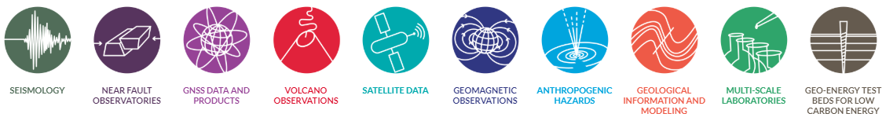
Oversight of the work
Funded by the European Horizon 2020 project EPOS (European Plate Observing System)
Peer reviewed by the community
Peer reviewed by database experts
Notes:
We have been using money provided by EPOS to fund this work.
A community review panel was initiated at the previous IAGA workshop in 2016. Those signing onto this panel (around 30 people) were asked for their comments on the design of the metadata. These comments were worked into the design.
BGS database experts reviewed the database design to ensure it meets the required standards for a relational database (data only represented in one place in the schema, suitable primary keys in each table, field naming conventions adhered to, suitable dictionaries in place, field contents validated against dictionaries where possible, …)

Slide 10

Implementation
A set of tables in a relational database
(About 30 tables and 15 dictionaries)
Hosted on BGS ORACLE servers
All text can be held in multiple languages (“internationalised”)
All entities have validity dates
Notes:
The first step (completed in 2017) was to design a schema to hold the metadata. This slide describes how we implemented the database schema.
Example validity dates:
An instrument (e.g. flxugate) can be shown to be active at an observatory between two dates
A person can be shown to be the contact for an observatory between two dates
The location of an observatory can be shown to be valid between two dates

Slide 11
Implementation – Key entities
Address | Data repository
Data set | Institute
Instrument | INTERMAGNET GIN
INTERMAGNET Membership | Location
Observatory | Observatory Photo
Person

Slide 12
Progress
http://geomag.bgs.ac.uk/im_mdata/imag_reports/contacts/
{"Stewart_Duff": {"addresses": [{"lang": "en", "address1": "U.S. Geological Survey", "address2": "Box 25046 MS 966", "address3": "Denver Federal Center", "city": "Denver", "state": "Colorado 80225", "country": "United States of America"}], "name": "Duff Stewart", "tel": "1-303-273-8485", "fax": "1-303-273-8506", "institute": "USGS", "emails": ["dcstewart@usgs.gov"]}, "Hitchman_Adrian": {"addresses": [{"lang": "en", "address1": "Geomagnetism", "address2": "Geoscience Australia", "address3": "Cnr Jerrabomberra Av and Hindmarsh Dr", "city": "Symonston", "country": "Australia", "postcode": "ACT 2609"}], "name": "Adrian Hitchman", "tel": "61-2-6249 9111", "fax": "61-2-6249 9986", "institute": "GA", "emails": ["geomag@ga.gov.au"]}, "Shevtsov_Boris": {"addresses": [{"lang": "en", "address1": "Mirnaya str. 7", "address2": "Paratunka, Kamchatka reg, Elizovskiy dist", "country": "Russia", "postcode": "684034"}], "name": "Boris Shevtsov", "tel": "+7-41531-33193", "fax": "+7-41531-33718", "institute": "IKIR", "emails": ["ikir@ikir.ru"]}, "Schwarz_Gerhard": {"addresses": [{"lang": "en", "address1": "Geological Survey of Sweden", "address2": "Documentation of Geomagnetism", "address3": "Box 670", "city": "Uppsala", "country": "Sweden", "postcode": "75128"}], "name": "Gerhard Schwarz", "tel": "+46 18 179344", "fax": "+46 18 179210", "institute": "SGU", "emails": ["gerhard.schwarz@sgu.se"]}, "Crosthwaite_Peter": {"addresses": [{"lang": "en", "address1": "Geomagnetism", "address2": "Geoscience Australia", "address3": "GPO Box 378", "city": "Canberra", "country": "Australia", "postcode": "ACT 2601"}], "name": "Peter Crosthwaite", "tel": "61-2-6249 9321",
First version of the database schema designed and reviewed
Database implemented on BGS corporate servers
Data made available on public facing servers
First application nearly complete (real-time feed for INTERMAGNET website metadata)
Notes:
The example shown is the first application written that uses the metadata. This application will allow a simple web request to retrieve metadata needed by the INTERMAGNET web site:
Contact details
List of definitive data (CD/DVD) contributions
List of institutes
List of observatories, locations and instruments
Currently only the contact details work, but this proves the concept:
Web request received in Edinburgh DMZ
Application sends request to ORACLE server in Keyworth DMZ
Data from main ORACLE server in Keyworth SAN is forwarded to Keyworth DMZ
This was complex to get working (technically and because of security policy). Having proved the concept we can quite quickly move forward with the remaining metadata reports needed by the INTERMAGNET web site and with other applications that will use the metadata.
Database “views” allow us to create complex combinations of the individual tables that comprise the metadata database (the example shown uses several tables). There is a great deal of flexibility in the combinations of data that we can produce from the database.

Slide 13


Working securely
Web service request
DMZ
DMZ
Database
Web server
BGS Nottingham
BGS Edinburgh
Database

Slide 14
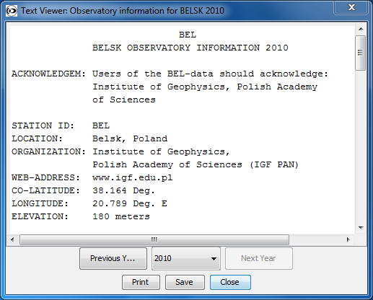
Future Plans
Finish the work to supply INTERMAGNET website metadata
Creation of Digital Object Identifiers for INTERMAGNET
Filling of metadata from existing sources (hard work because much of the metadata is not structured):
INTERMAGNET CD-ROMs and DVD
World Data Centres
Notes:
The creation of digital object identifiers requires metadata to fully describe the dataset that the identifier identifies. For the INTERMAGNET DVDs this includes information such as the lists of observatories and institutes contributing to each CD/DVD. This is currently available in human readable forms (such as READNE files), but not in machine readable form (ie XML). A large part of the work in creating the DVDs will be to collect this metadata. Storing it in the metadata database makes it easily re-usable for other purposes if people have a need for it.
The picture shows a README file from the INTERMAGNET DVD (Belsk, 2010). These files are now relatively well structured (although still requiring programming effort to read). Earlier files were less structured and more varied in their contents.

