Slide 1
Simon Flower, BGS
Progress on transfer of the Intermagnet archive from NRCan to BGS

Slide 2
I have not included an audio narration with this presentation, as I think the presentation is self-explanatory. If anything is unclear, please get in contact: mailto:smf@bgs.ac.uk
Simon Flower, BGS
Progress on transfer of the Intermagnet archive from NRCan to BGS

Slide 3
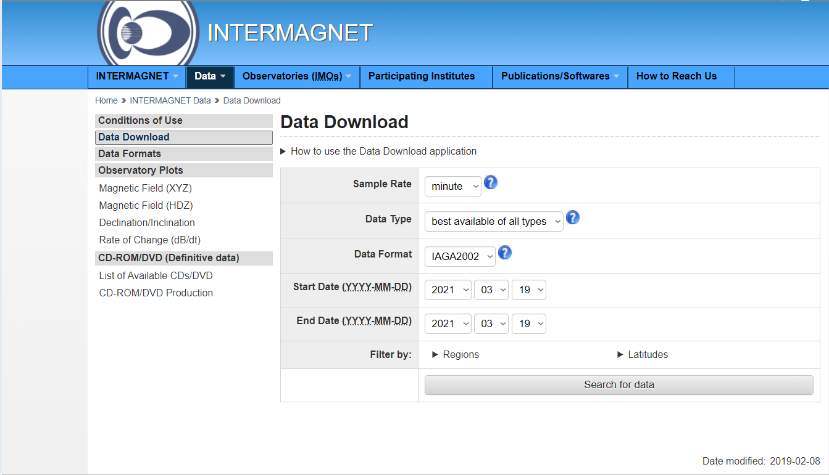
Summary
BGS are working to move the Intermagnet data archive from NRCan. Archive and real-time data and the associated services will transfer during 2021. BGS will provide services to:
Receive data from the other 4 GINs
Replace the data download application on the Intermagnet web site
Allow users ftp access to the data
Make statistics available to data providers

Slide 4
Progress: IT infrastructure and security
100%
Task | Progress
Agree with BGS IT infrastructure managers to host the size of data associated with the Intermagnet archive | Complete
Agree with BGS IT infrastructure managers a secure way to allow rsync data to be received by BGS from Intermagnet GINs | Complete
Develop a model for deploying Intermagnet Internet applications using BGS “Kubernetes” infrastructure | Complete

Slide 5
Progress: Receiving data from GINs
50%
Task | Progress
Write software to receive rsync data from the four other GINs | Complete
Deploy rsync software in BGS Kubernetes infrastructure | In progress
Liaise with four other GINs to receive real-time data | Not started
Liaise with NRCan to receive historic data archive | Not started
Receive definitive data from Paris GIN | No work needed (NRCan will continue to clone definitive data from the Paris GIN and convert this from IAF to IAGA2002. They will then put this IAGA2002 data into the rsync stream from NRCan to BGS)

Slide 6
Progress: Distributing data to users
70%
Task | Progress
Update BGS software for INTERMAGNET data distribution | Complete
Deploy data distribution software in BGS Kubernetes infrastructure | Complete
Update BGS Intermagnet ftp server | Complete
Deploy Intermagnet ftp server in BGS Kubernetes infrastructure | In progress
Provide plots of recent geomagnetic activity | In progress (being implemented by staff at Sodankylä Geophysical Observatory)
Try the data distribution application: https://imag-data-staging.bgs.ac.uk/GIN_V1/GINForms2

Slide 7
Progress: Working with data providers
80%
Task | Progress
Implement Intermagnet data embargo period across GIN software products | In progress
Create, store and make available statistics of data usage to data providers | Complete
Try the data statistics viewer: https://imag-data-staging.bgs.ac.uk/GIN_V1/GINStatistics

