Slide 1
Canadian Hazard Information Service (CHIS)
Infrastructure and Development Group

Slide 2
Organizational chart
Canadian Hazard Information Service (CHIS)
The service conducts monitoring and provides hazard information and products on an ongoing basis and in response to emergency situations involving earthquakes, tsunamis, volcanic eruptions, landslides, geomagnetic storms and radiological / nuclear incidents.
Department of Natural Resources Canada (NRCan)
Land and Mineral Sector (LMS)
Hazard, Adaptation, and Operations Branch (HOAB)
Canadian Hazard Information Service (CHIS)
David McCormack
Infrastructure and Development
Geomagnetism Canada
Space Weather Canada
Earthquakes Canada
Seismic Network Operations
Nuclear Emergency Response (NER)
Canadian Crustal Deformation Service (CCDS)
Earthquake Early Warning (EEW)
(A) Charles Blais
Benoit St-Louis
David Boteler
David McCormack
Lorne McKee
Laurel Sinclair
Yuan Lu
Henry Seywerd

Slide 3
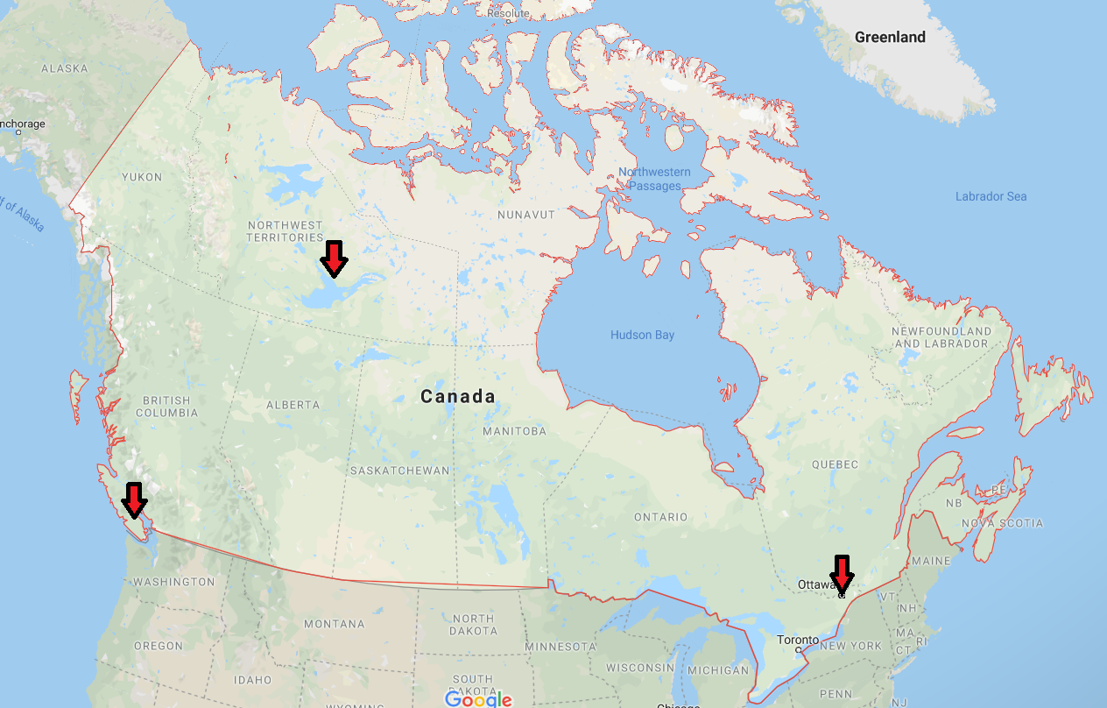
Offices
7 Observatory Cr, Ottawa (data centre #1)
2617 Anderson Rd, Ottawa
Sidney (data centre #2)
Yellowknife

Slide 4
24x7 operations
Space Weather Canada
Duty Forecaster on-call
Earthquakes Canada
Seismologist on-call East
Seismologist on-call West
IT Operations
Geek On Duty
Nuclear Emergency Response
NER team

Slide 5
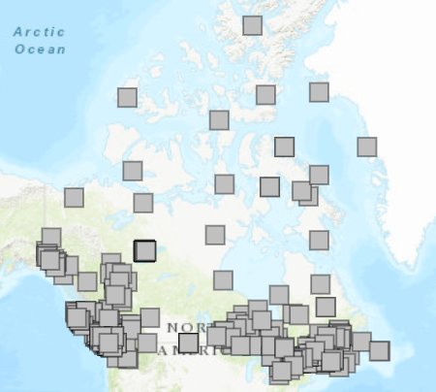
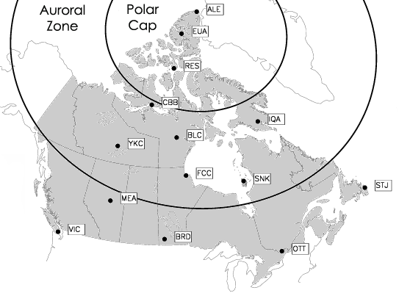
Sensor Networks
Seismic
Geomagnetic
* not mentioned are CCDS (West coast) and riometer

Slide 6
Automated Notification Services (Alerts)
Space Weather
Space Weather Canada (https://spaceweather.gc.ca)
Twitter:
@SpaceWeatherCA (https://twitter.com/SpaceWeatherCA)
@MeteoSpatialeCA (https://twitter.com/MeteoSpatialeCA)
Space Weather Bulletin (email)
MASAS-X (Public Safety Situational Awareness System)
Earthquakes
Earthquakes Canada (http://www.earthquakescanada.nrcan.gc.ca)
Twitter:
@CANADAquakes (https://twitter.com/CANADAquakes)
@CANADAseisme (https://twitter.com/CANADAseisme)
MASAS-X (Public Safety Situational Awareness System)
Email, Fax, Phone, and SMS alerts tailored to the client needs (ex: railways, infrastructure)

Slide 7
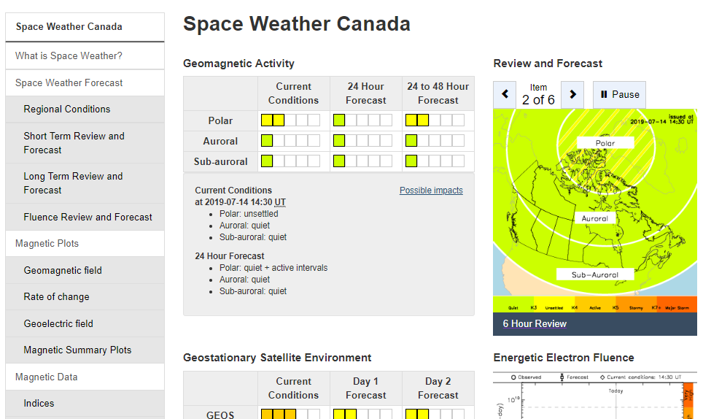
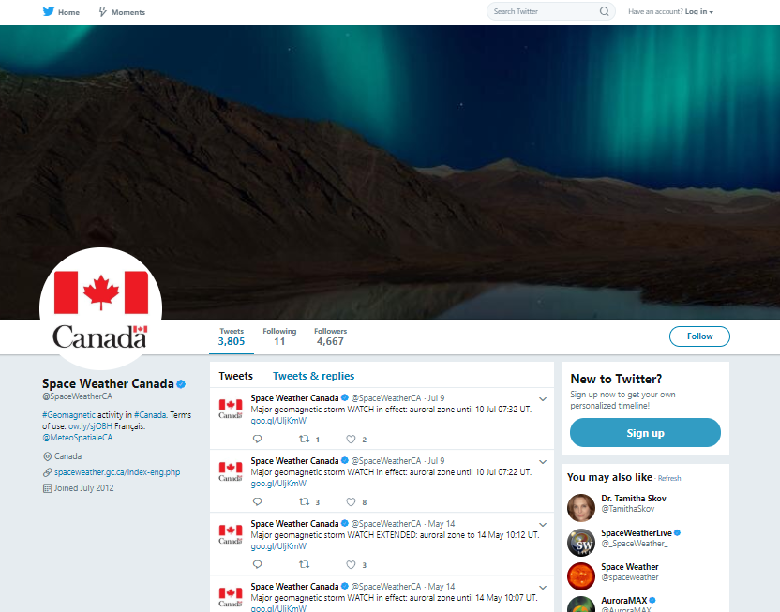
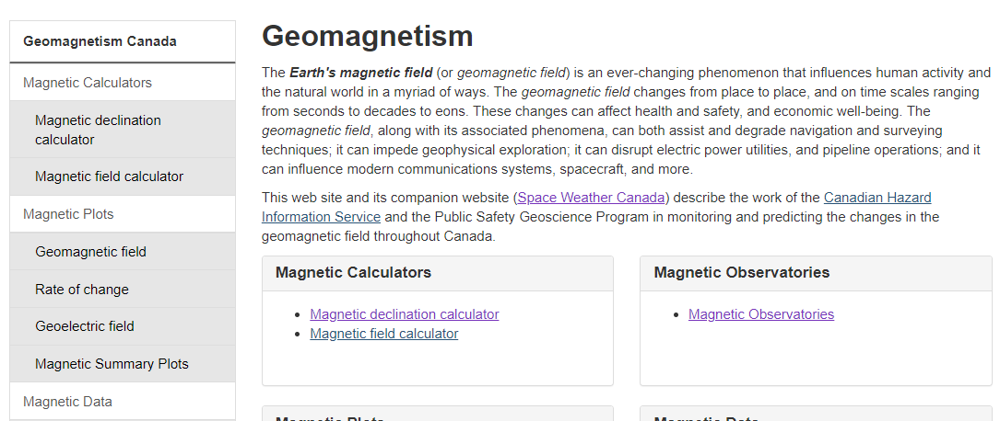
Space Weather and Geomagnetism

Slide 8
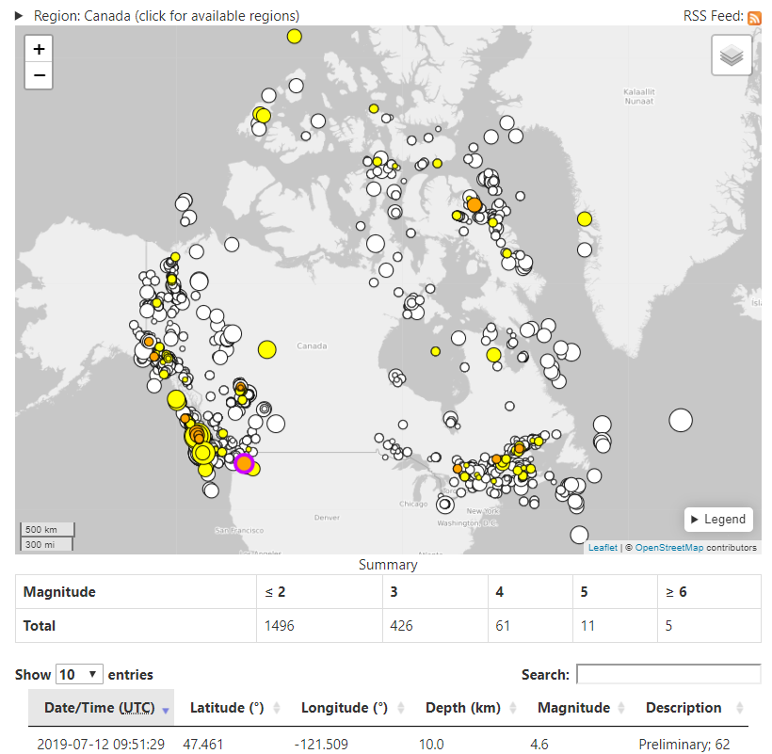
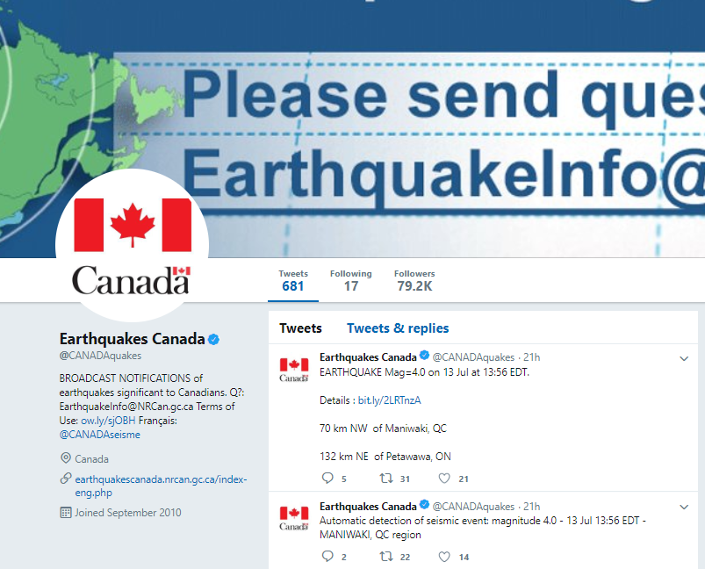
Earthquakes Canada

Slide 9
Responsibilities
Shared responsibilities
Shared responsibilities
Geomagnetic Instruments
Dissemination
Earthquake Alerts
Space Weather
Alerts
Web Sites
Twitter
RSS
And more
Clients
External data
Processing
Earthquake Detection
Space Weather Forecasting
Crustal Deformation
And more
Seismic Instruments
Acquisition
GPS Instruments
communications
Archiving

Slide 10
Tools of interest
Showing tools to the people present

