Slide 1
Step by Step –
How to build module for x-series
Take Brocade 8Gb FC Dual-port HBA for IBM System x as example.
The driver is for 2008R2.
The previous module is K9MS85A.

Slide 2

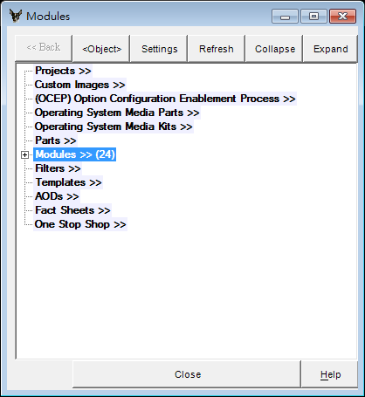
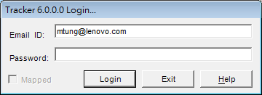
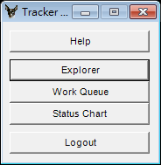
Let’s Open the Traker first.
1. Open local tracker
2. Login
3 .Press Explorer
This is the explorer.

Slide 3
Now, we need to get module name for our new module.

Slide 4
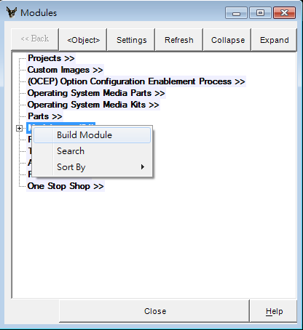
1. Choice Build module

Slide 5
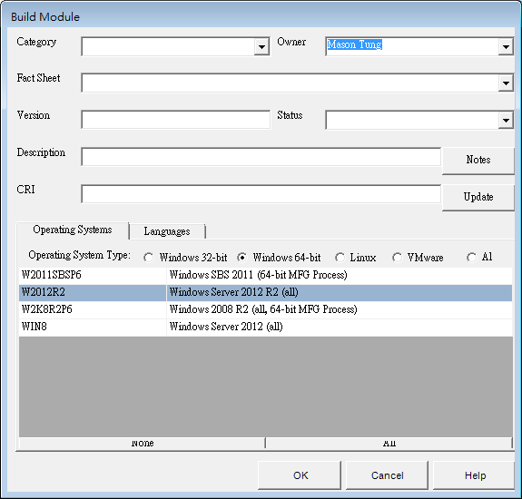
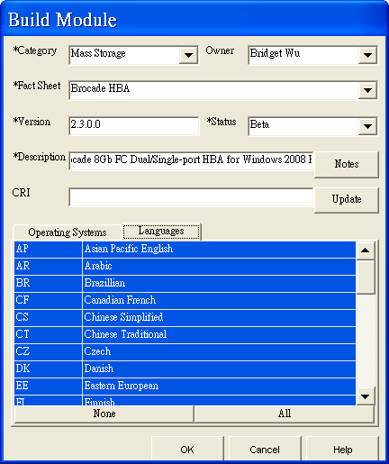
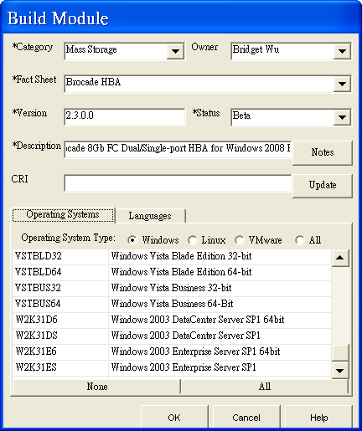
2. Fill in the data needed.
Choice All.
Only choice your target OS.
Press Ok when you finish all blank
How to know your Fact Sheet?

Slide 6
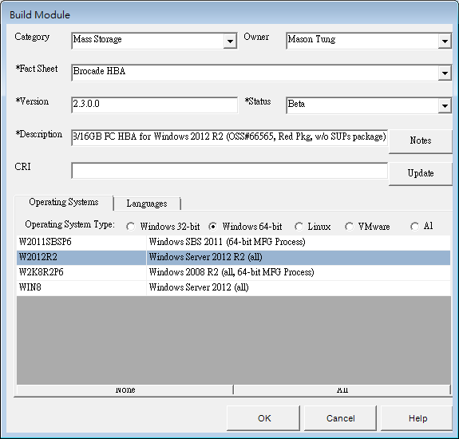
2. Fill in the data needed.
Only choice your target OS(es).

Slide 7
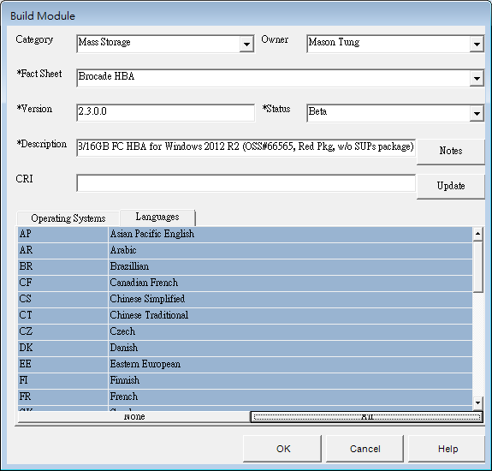
Choice All.
Press Ok when you finish all blank

Slide 8
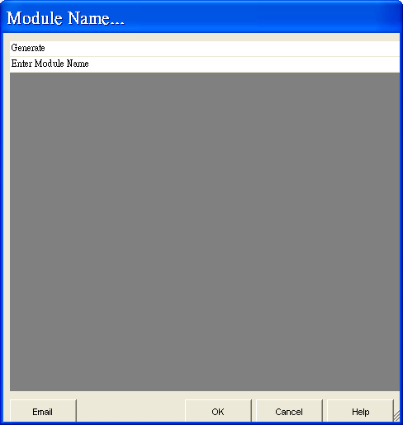
3.Choice Generate

Slide 9
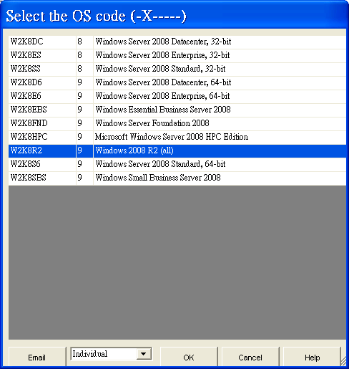
4.Choice your main OS and Press OK

Slide 10
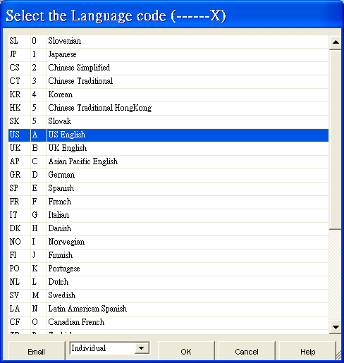
5.Choice US English
Press Ok, Tracker will start generate a module name for you

Slide 11
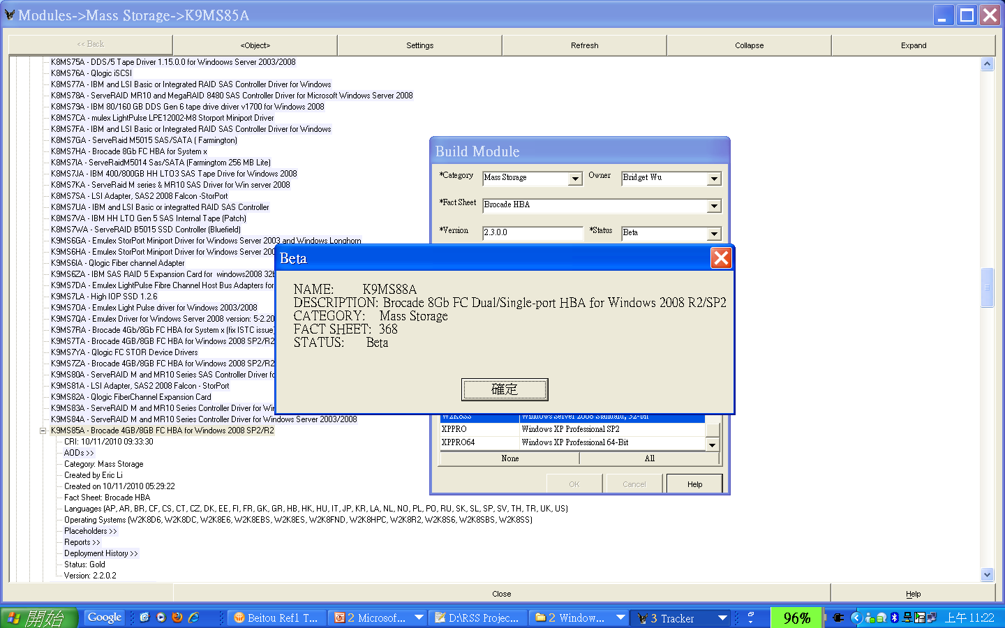
Congratulations!
The new module name
is K9MS88A

Slide 12
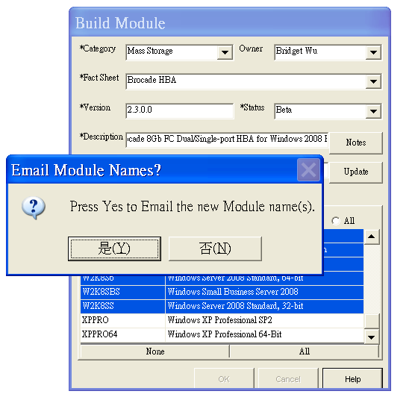
Press Yes, Tracker will email you.

Slide 13
OK! Time to create the source for the new module

Slide 14
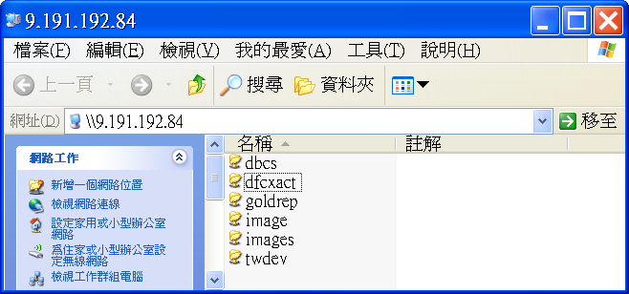
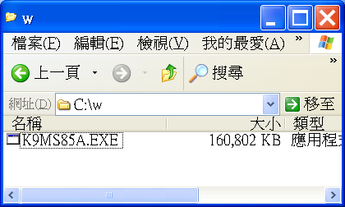
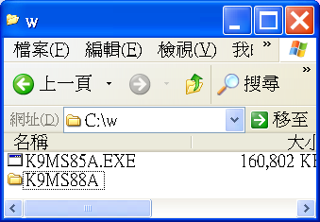
1. Go to Server\image
Find the previous version of new module and
copy to your C:\w
EX: K9MS85A is the previous for K9MS88A
Create a new folder under C:\w use the new module new as the folder name. Extract the file with Password

Slide 15
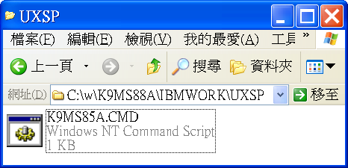
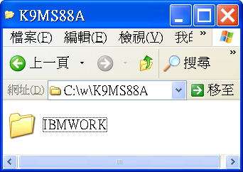
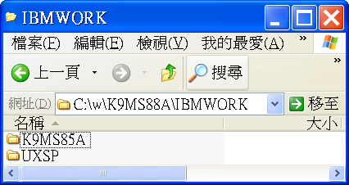
1.Rename the cmd to K9MS88A
2.Open the file and replace all K9MS85A to K9MS88A
*Make sure you replace all K9MS85A
with K9MS88A .
Rename the module name to K9MS88A, and put the new driver under this folder
There will be a cmd file inside

Slide 16
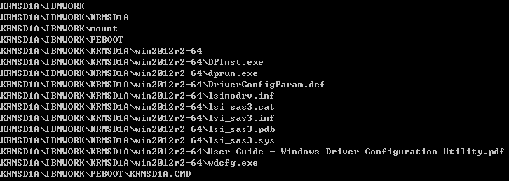



Module Content
Ex.
  KRMSD1A
  KRVD53A

Slide 17
Module Content
Folders
  Script Folder
    PEBOOT
      Storage Controller
    DOWORK0
    DOWORK1
    DOWORK2
    OS
      Network, VGA, HBA, CNA, …
  Driver Folder
    Module Name
      Contain driver files

Slide 18
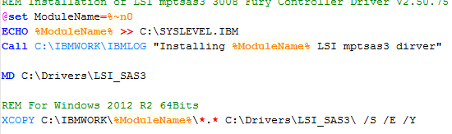
Module Content
Folders
  Script Folder
    PEBOOT
      Storage Controller
    DOWORK0
    DOWORK1
    DOWORK2
    OS
      Network, VGA, HBA, CNA, …
  Driver Folder
    Module Name
      Contain driver files
  Ex.
    KRMSD1A
    KRVD53A
KRMS1DA.cmd
KRVD53A.cmd

Slide 19
It’s time to build the module

Slide 20
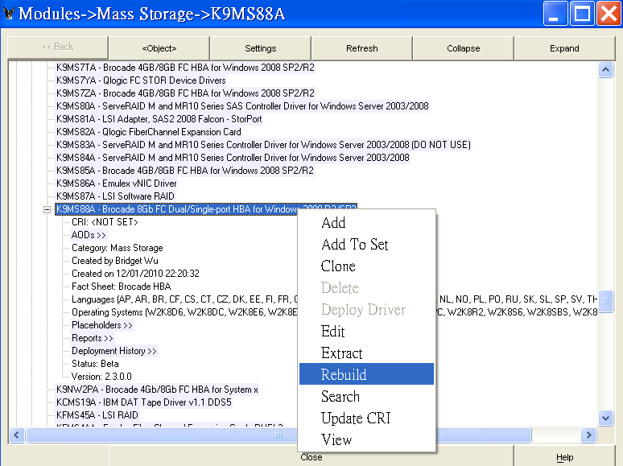
1.Open Tracker and find the new module, click right bottom of mouse then choice Rebuild
There might be some error messages popping up. It doesn’t matter…

Slide 21
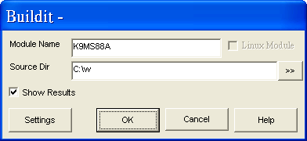
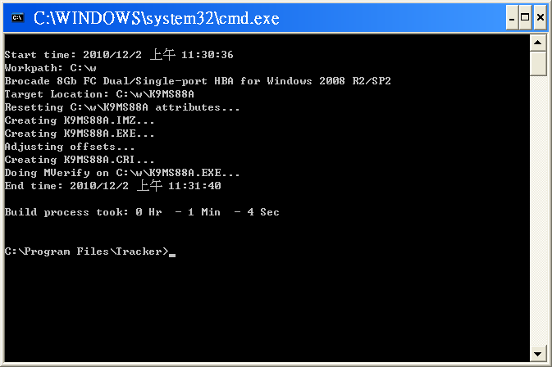
2. Indicate the source dir as C:\w
3. When you saw the message above means
that module build process is successful done.

Slide 22


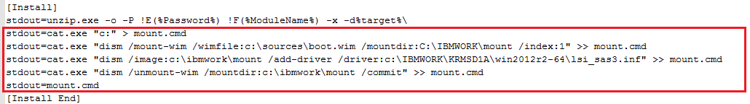
Mannual Modify CRI
RAID controller Modules
  Modify “Module Type”
  Insert the driver into boot.wim from BaseOS module
    There must be a empty folder “mount” in module
    Be careful aboout driver path

Slide 23

Mannual Modify CRI
All modules
  Add “Preloadzip=No”

Slide 24
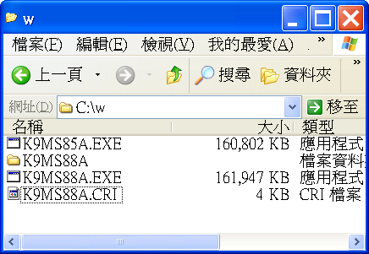
4. Now you can find the new module under your C:\w.
Move it to Server\image for testing.
[Hint]: you can move .exe to Server\image first,
but wait after final build then update CRI.

Slide 25
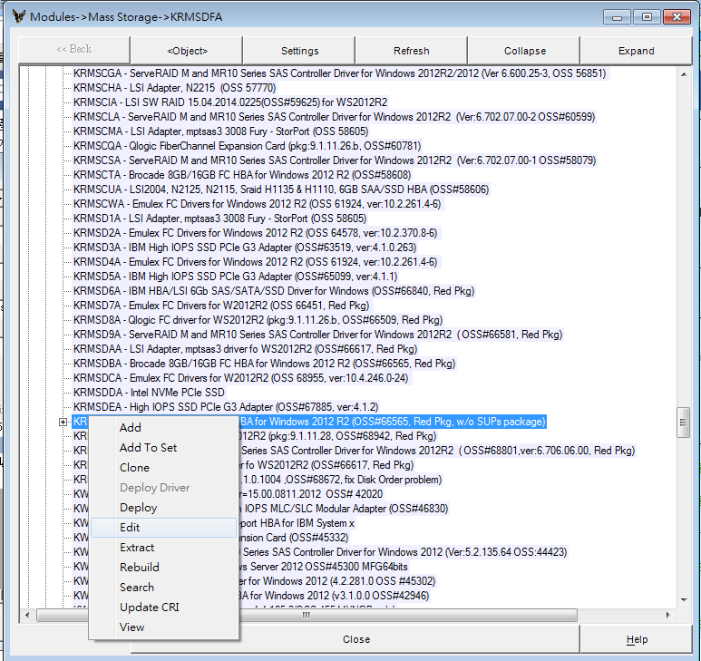

Slide 26
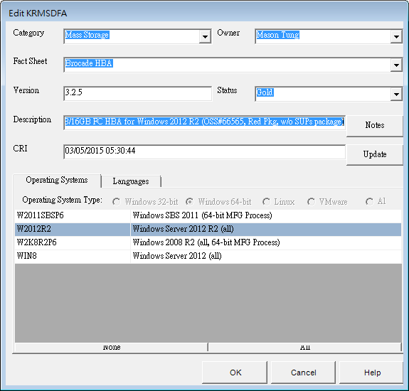
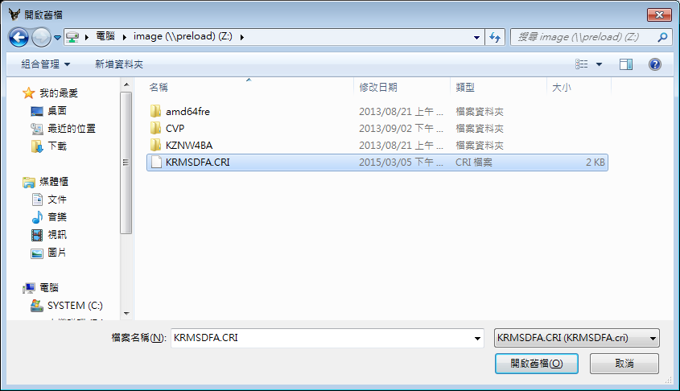

Slide 27
Appendix

Slide 28
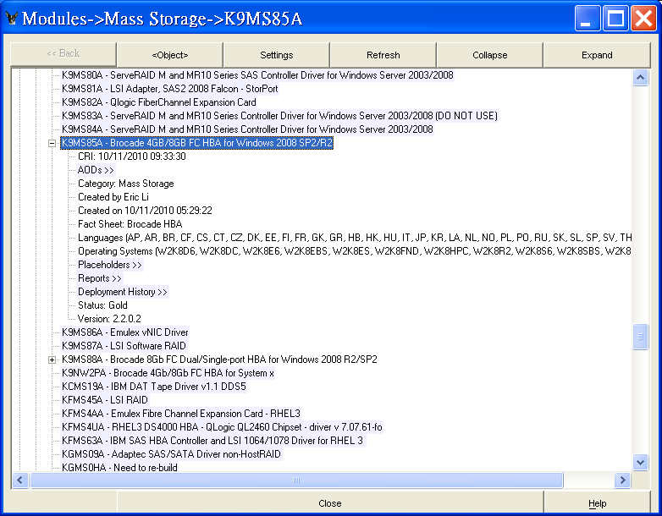
The previous version for this new module is K9MS85A, so look into it find the
related information.

Slide 29
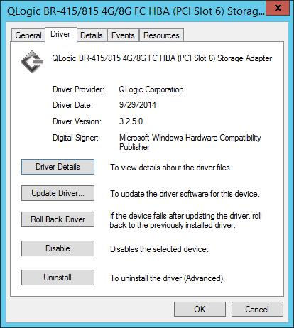
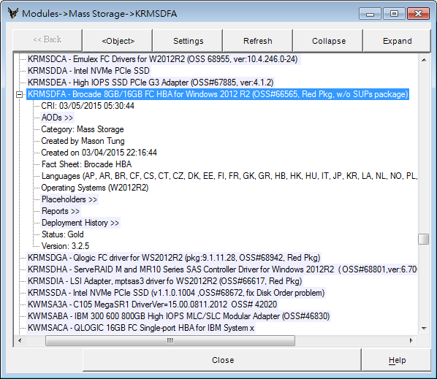

Version
Description
  Package Version, OSS#
Status
Internal test
Released, cannot be changed
Can be deployed

Slide 30
OS Code
64-bit
  W2012R2
    KRMSDFA
  Win8 (W2012)
    KWMSCZA
  W2008R2P6
    KZMSBNA
32-bit
  W2008R2
    K9MSA0A

