Slide 1
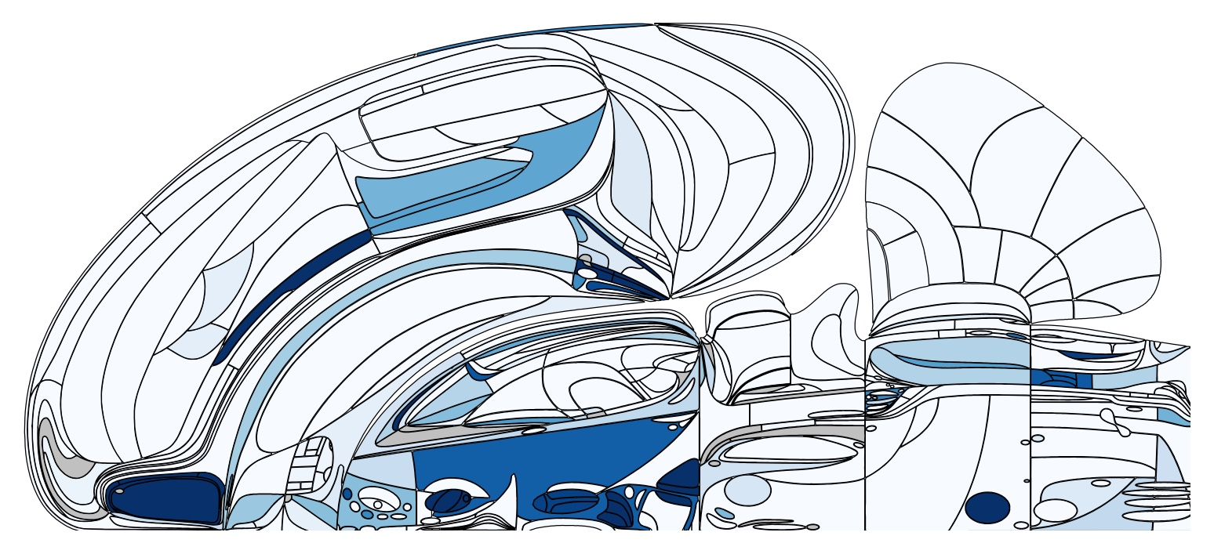
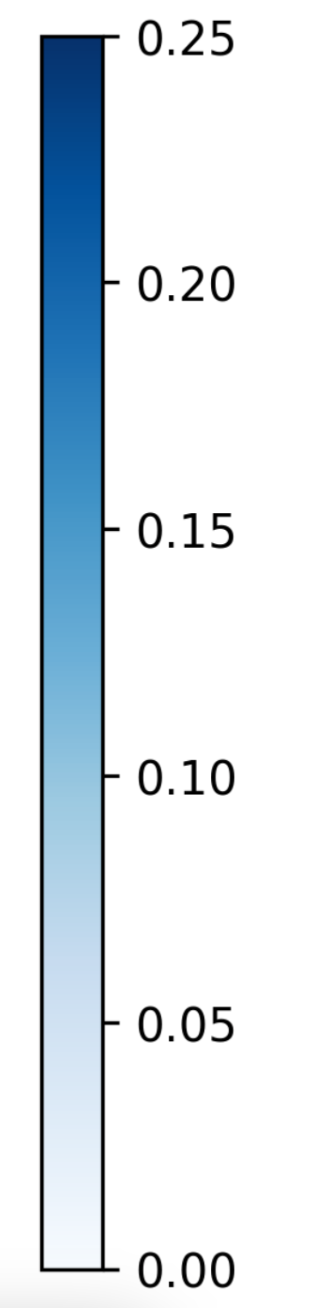
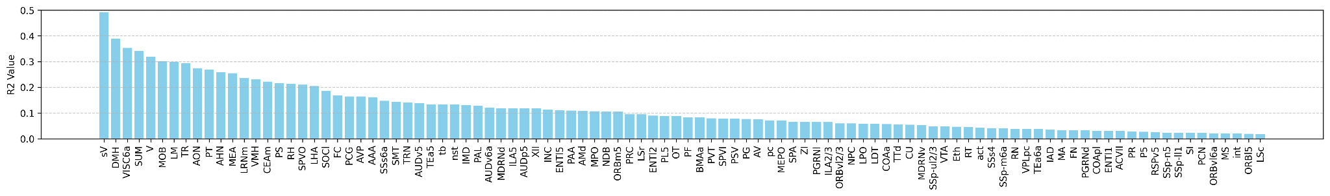
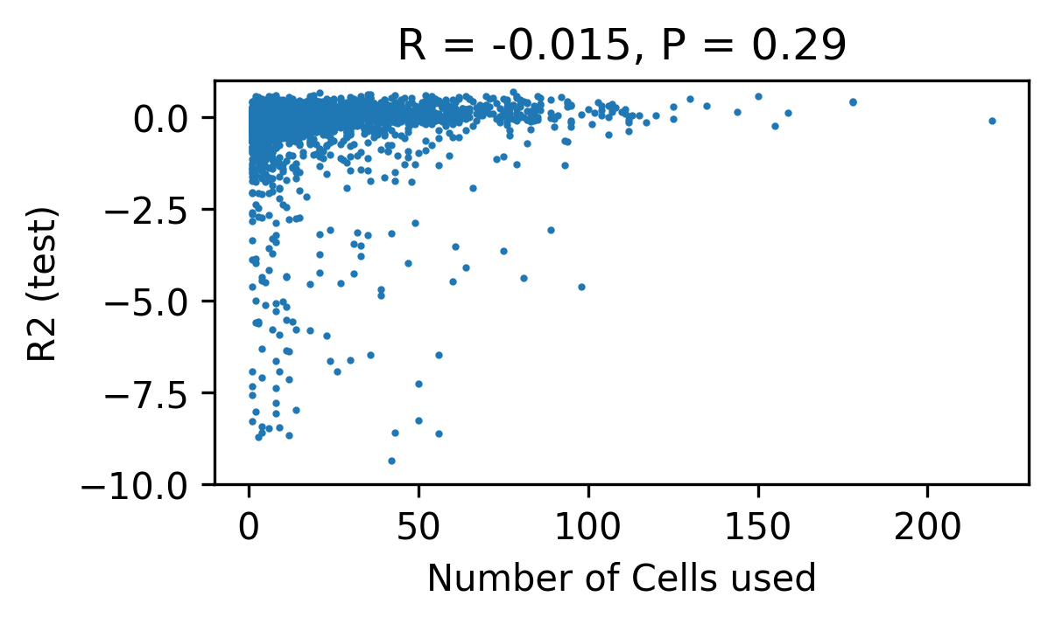
Decoding Whisker Motion Energy from Neuronal Activity Across the Brain
Y. LIAO¹, J. GONZALEZ² (presenting author), Z. S. CHEN³
¹Ctr. of Data Sci., New York Univ., New York City, NY; ²Dept. of Psychiatry, New York Univ. Grossman Sch. of Medicine, New York, NY, USA, New York, NY; ³New York Univ. Grossman Sch. of Med., New York, NY
Abstract
A growing body of evidence suggests that breathing and whisking rhythms play a significant role in brainwide activity, extending well beyond early sensory areas. While these rhythms have been proposed to contribute to cognitive processes such as timing task execution and decision-making, their underlying mechanisms remain poorly understood. In this study, we aim to address this gap by utilizing the open dataset from the International Brain Laboratory. Specifically, we investigate how the phase of these orofacial rhythms influences the performance of a controlled decision-making task in mice. Additionally, we analyze single-unit neuronal recordings to uncover the brain-wide neuronal patterns that support such coordination.
R²
Methods
Used 538 probe insertions from the IBL dataset with at least one region had ≥30 well-isolated units.
Cleaned whisker motion energy via percentile-clipping, log transform, z-scoring, and removal of extreme values.
Preprocessed spikes with square-root transform, Gaussian smoothing (σ=1), and binning at the median whisker-camera sampling interval; whisker energy was interpolated to these bins.
Split design matrix with 30 neural lags contiguously into 80/20 split and standardized features using training statistics.
Fit a ridge regression (α=5) with a chunked normal-equations solver for memory efficiency.
Inverse-transformed predictions back to the raw whisker-motion scale.
Evaluated performance using test-set R² and Pearson correlation.
Conclusion
Top predictor is sensory root of trigeminal nerve (sV, R² = 0.49)
Olfactory (MOB, AON), visual (V, LM), and visceral (VISC6a) regions show R² = 0.27-0.49
Limbic regions (MEA, CEA) encode whisking (R² ≈ 0.22-0.25)
Hypothalamic nuclei (DMH, SUM, AHN) achieve R² > 0.25, indicating whisking encoding.

