Slide 1

Version Control System
Batch 19 | Bootcamp Frontend Web Devlopment

Slide 2


Frontend Developer
Rizky Ramadhan
at Telkom Indonesia (2021 - present)
Mentor
Tech Content Creator
2022 - present
Frontend Dev @Telkom Indonesia
Tech Content Creator
Frontend Mentor
at dibimbing.id (2022 - present)
LinkedIn:
/in/rizkykyra

Slide 3
Outline
Git
Git branch
Git Workflow

Slide 4
Git Reset
When you want to revert the changes that you just made and go back to the files that you had.
- Hard reset
- Soft reset

Slide 5
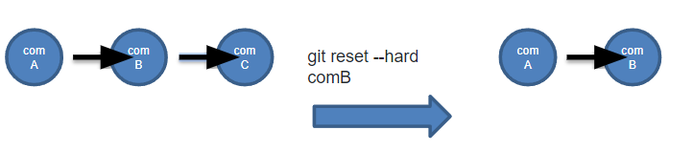
Git Reset – Hard Reset
Removes changes on reset commits as well as uncommitted changes.
git reset --hard HEAD (going back to HEAD)
git reset --hard HEAD~1 (going back onecommits before HEAD)
git reset --hard HEAD~2 (going back two commits before HEAD)
git reset --hard [commit] (going back to commit)

Slide 6
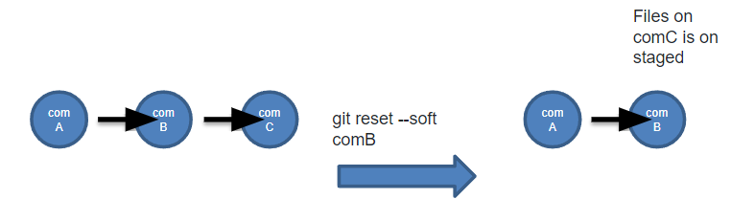
Git Reset – Soft Reset
Make changes on reset commits on stage.
git reset --soft HEAD (going back to HEAD)
git reset --soft HEAD~1 (going back onecommits before HEAD)
git reset --soft HEAD~2 (going back two commits before HEAD)
git reset --soft [commit] (going back to commit)

Slide 7
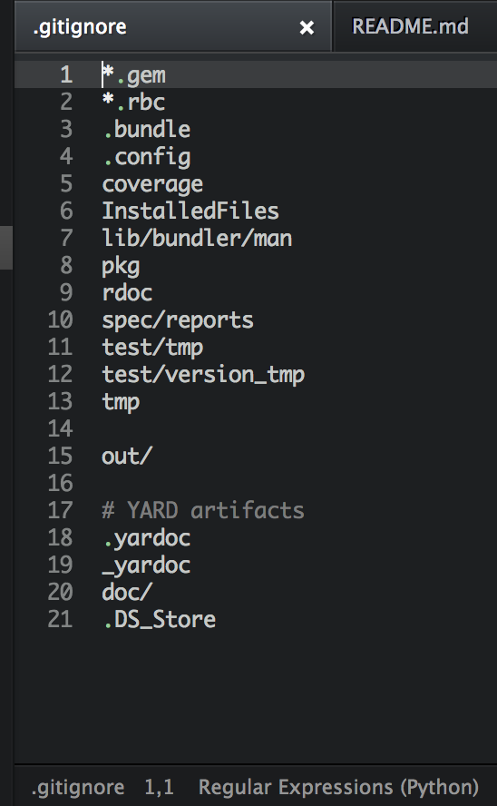
.gitignore
Specifies intentionally untracked files that Git should ignore.

Slide 8
Git Tagging
To tag specific points in a repository’s history as being important. Typically, people use this functionality to mark release points (v1.0, v2.0).
git tag –a [tagname] –m “[message]”
git tag –a v1.4 –m “version 1.4”
To push tag to remote repository:
git push origin v1.4 -> push specific tag
git push origin --tags -> push all tags that are not already on the remote repository

Slide 9

Basic git Workflow
feature
main / master

Slide 10
Basic git Workflow
Create branch from master/main
feature
main / master

Slide 11
Basic git Workflow
Commit on feature branch
feature
main / master

Slide 12
Basic git Workflow
Merge to master/main
feature
main / master

Slide 13
Ice Breaking

Slide 14
Git Branches
git checkout –b [branchname] -> Create the branch on your local machine and switch in this branch
git push origin [branchname] -> Push the branch to remote repository
git branch –a -> See all available branch on local machine

Slide 15
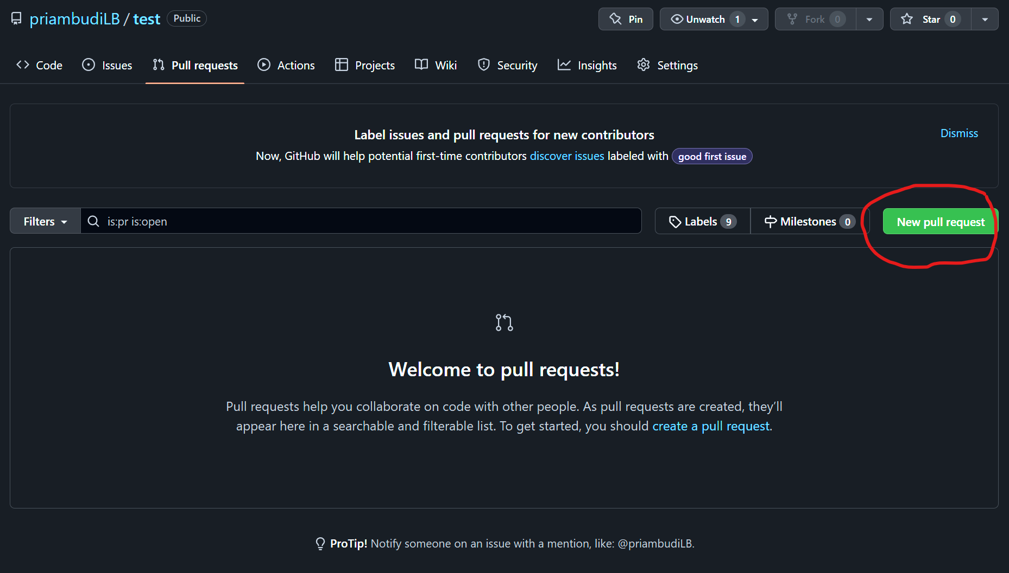
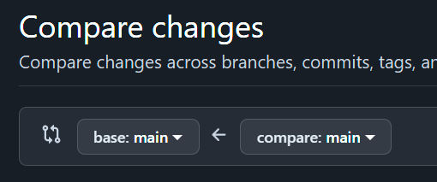
Git merge branch

Slide 16
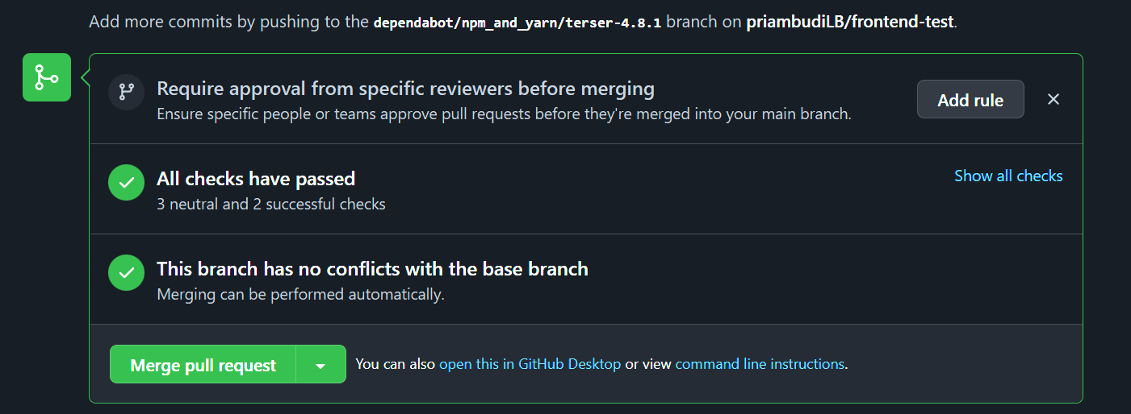
Git merge branch

Slide 17
Git workflow - basic
feature
main / master

Slide 18
Git workflow - basic
feature
feature
feature
main / master

Slide 19
Git workflow – basic develop
feature
develop
main / master

Slide 20
Assignment

Slide 21
Terima
Kasih.
Let’s discuss! ======================= reference: developer.mozilla.org

