Slide 1


Collaborative Platform for Software Developers
UNIVERSITY “POLITEHNICA” OF BUCHAREST
FACULTY OF ENGINEERING IN FOREIGN LANGUAGES ELECTRONIC ENGINEERING, TELECOMINICATIONS AND INFORMATION TECHNOLOGIES – APPLIED ELECTRONICS
Student: Ionuț-Alin Constantin
Coordonator: ȘL Dr.Ing. Iuliana MARIN

Slide 2

Table of Contents
1. Introduction
2. Advantages and disadvantages of storing projects
3. Design
4. Implementation
5. Functionalities

Slide 3





1.Introduction
Goals of the project:
Project Management
Security
Collaboration

Slide 4

2. Advantages and disadvantages of storing projects

Slide 5
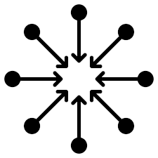



Advantages of storing projects
Centralized Access
Enhanced Collaboration
Data Security
Scalability
Provides scalability, allowing projects to grow and expand without physical space limitations.
Allows for centralized access to project-related information.
Promotes seamless collaboration among team members.
Offer robust security measures to protect project data.

Slide 6
Disadvantages of storing projects
Dependency on Technology
Data Loss Risks
Cybersecurity Threats
Introduces a dependency on technology infrastructure.
While digital storage offers enhanced security measures, there is still a risk of data loss due to hardware failures, software glitches, or human errors.
Storing projects digitally exposes them to potential cybersecurity threats, such as hacking or malware attacks.

Slide 7

3.Design

Slide 8
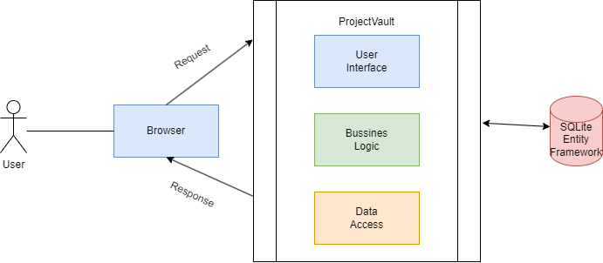
Monolithic architecture
The monolithic architecture is an age-old software architectural technique where the entire application is built as a single unit in a tightly coupled system of modules, components and services running in one runtime process.

Slide 9
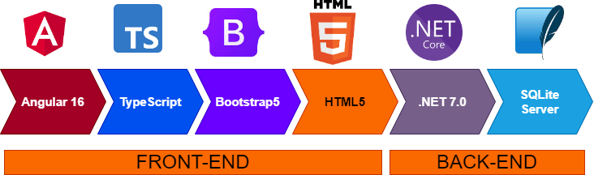
4. Implementation
In building the web application's frontend architecture, I opted for the industry-leading Angular 16 as well as TypeScript, Bootstrap5, HTML5 and CSS and for backend I chose to use .Net 7.0, Entity Framework and SQLite Server.

Slide 10

5. Functionalities

Slide 11

Upload projects
Cloudinary is a leading cloud-based media management platform that offers powerful features for transforming and managing project assets.

Slide 12
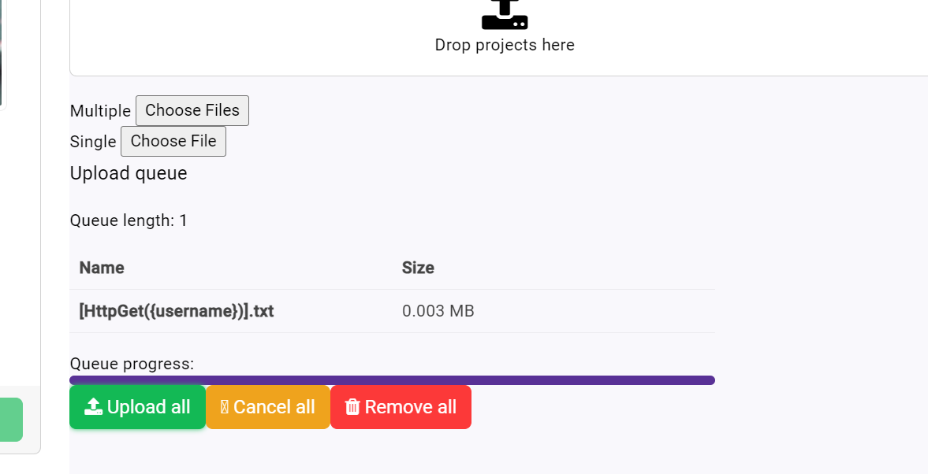
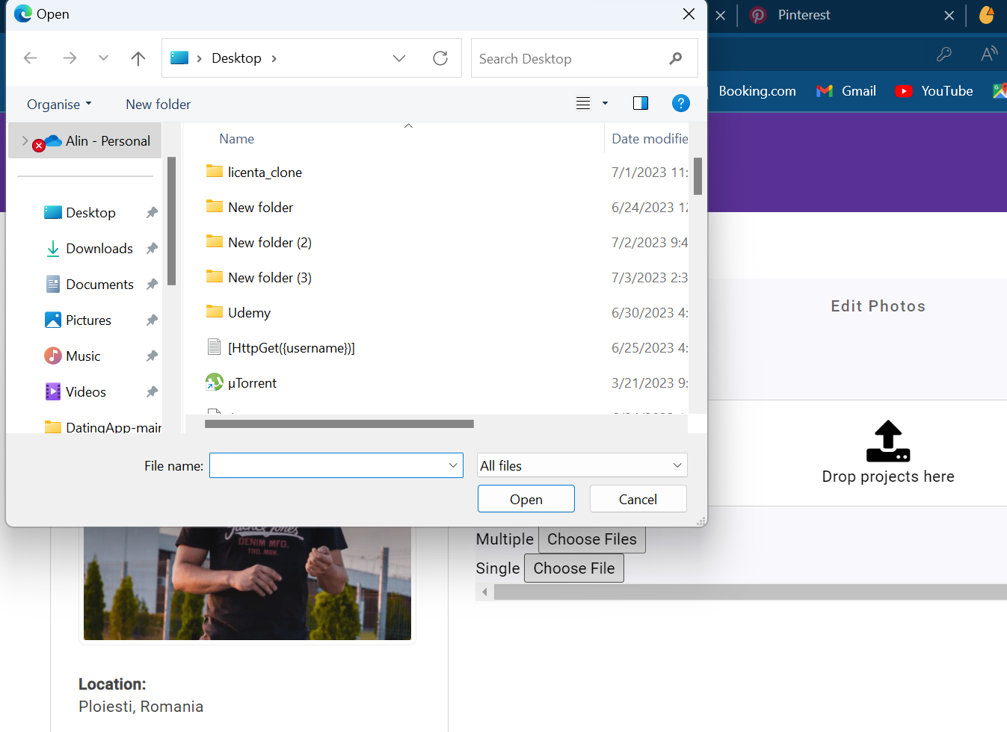
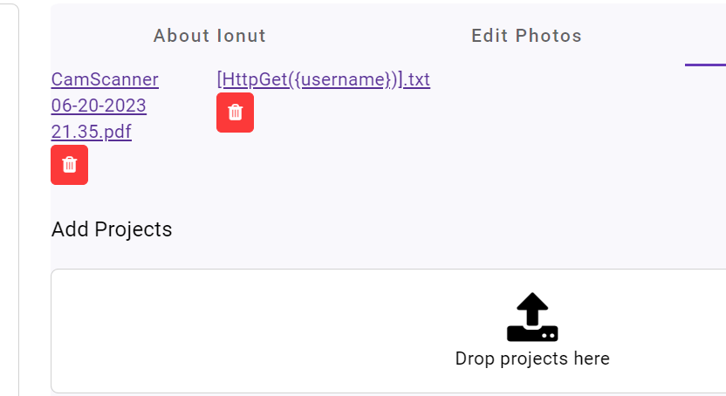

Slide 13
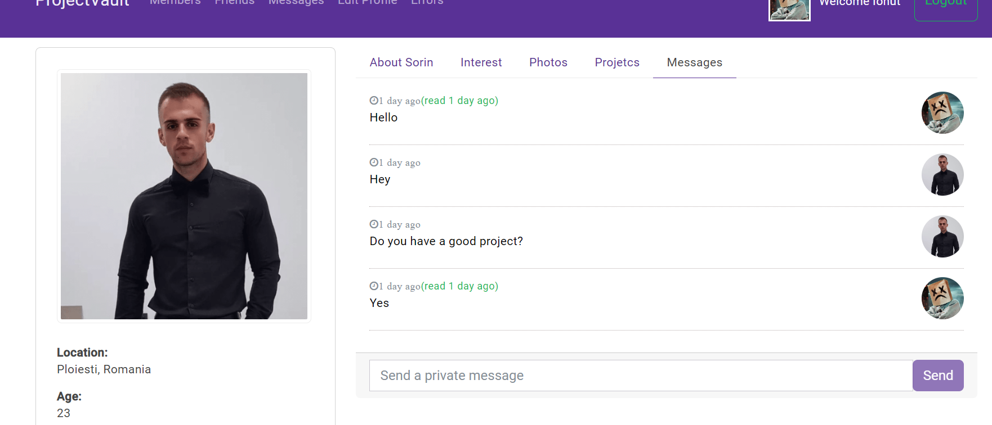

Real Time Communication with SignalR
SignalR is a powerful real-time communication library for building interactive and collaborative features in the project. It enables seamless, bidirectional communication between clients and servers, allowing real-time updates, notifications, and live interactions.

Slide 14
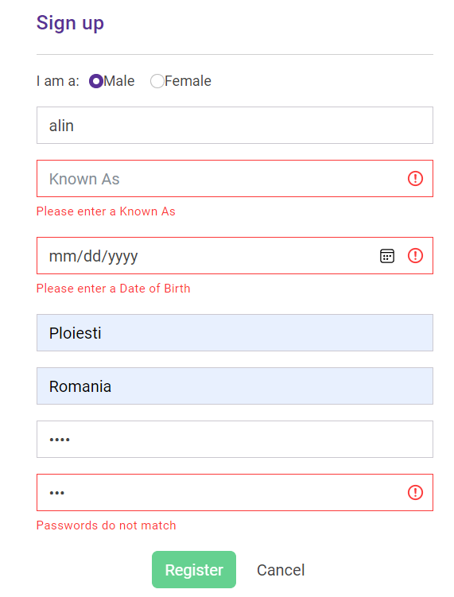

Register and Login using JWT
JSON Web Tokens (JWT) are an industry-standard method for securely transmitting information between parties as a compact and self-contained token. They are commonly used for authentication and authorization purposes in web applications, APIs, and microservices.

Slide 15

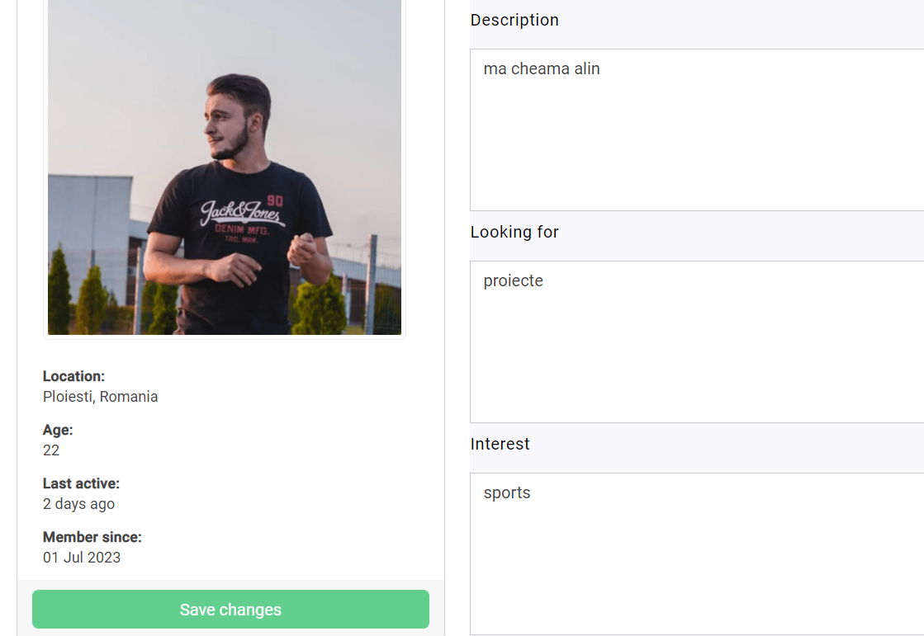


Slide 16
THANK YOU FOR YOUR ATTENTION!

