Slide 1

Web Server
Anuj Gupta, Sida Zhu, Tianyi Wu, Zhiang Wu

Slide 2

Pure Python Server
Built in Python Packages ONLY,
NO external dependencies

Slide 3
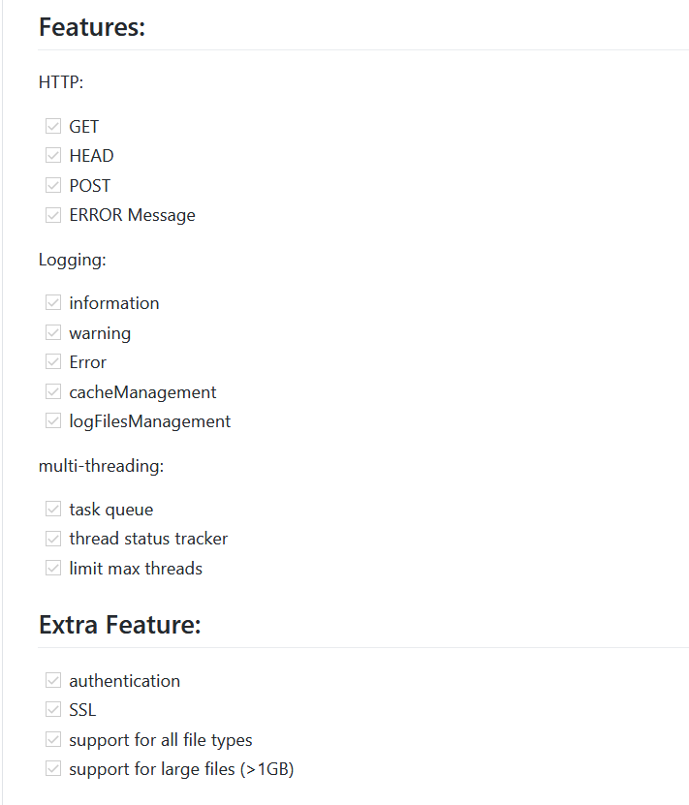

Slide 4
HTTP
Get
Head
Post
Error Message

Slide 5
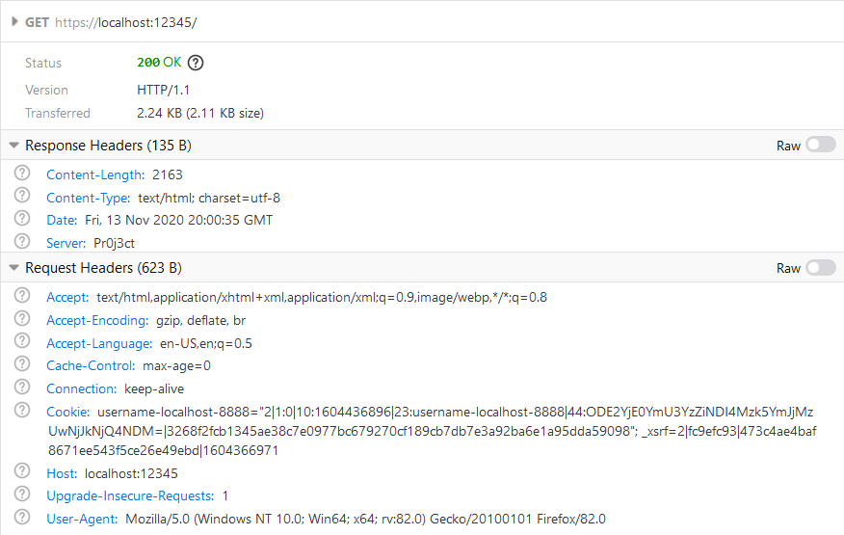
Get
Notes:
As you cna see, the sample get request and response in firefox.
The above is the get reuqest.
The bottom one is request header. It shows several information about the browser.
The mid one is the response header that we send it to the browser from the server.

Slide 6
Head
SEND the same information in Header to client.
But does not send the body.
Return the same header.

Slide 7
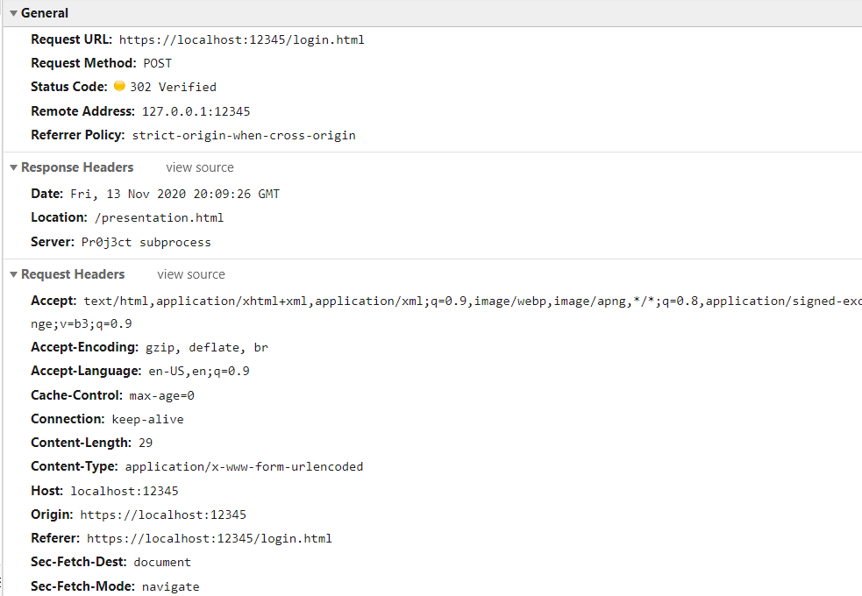
Post
Notes:
This is a sample post request in the login page.
In this case, the server will verify the userid and user password and send back 302 redirection response.
As you can see, if the user is valid, it will direct ppt page, which is Location: /presnetation.html

Slide 8
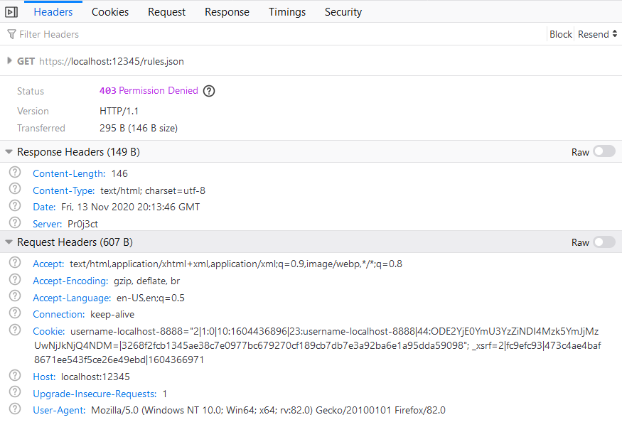
Error Message
Notes:
This is a sample error message response. Here the browser want to get access to the local file rules.json but it does not have the permission to access it.
Therefore, the server send back a 403 permission denied as on the screen.

Slide 9
Logging
Information
Warning
Error
cache&logFiles Management
Notes:
For Logging part, it is composed of 4 parts: information, warning, error and cache&logFiles Management.

Slide 10
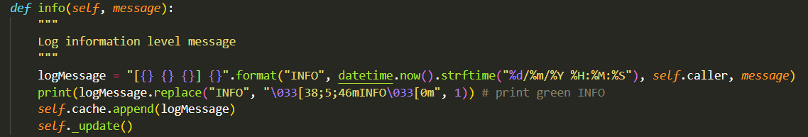
Information
Notes:
For information, it first store it and format it into the variable and print it out as we want.

Slide 11
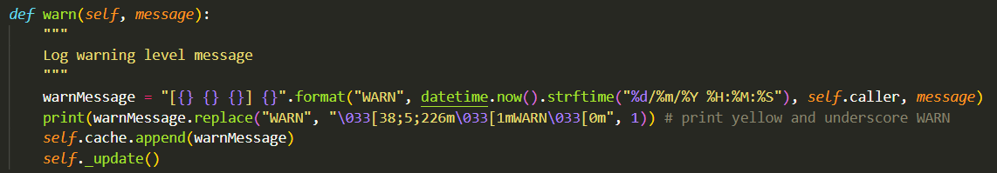
Warning
Notes:
For Warning, it first store it and format it into the variable and print the warning as we want.

Slide 12
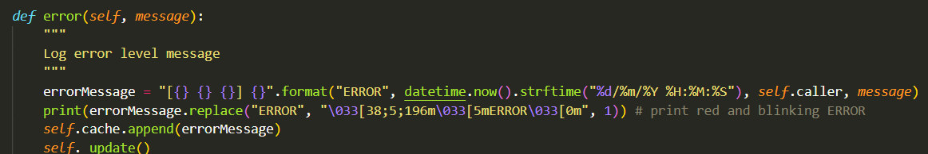
ERROR
Notes:
The same as the above function but just change the format and output content into error message style.

Slide 13
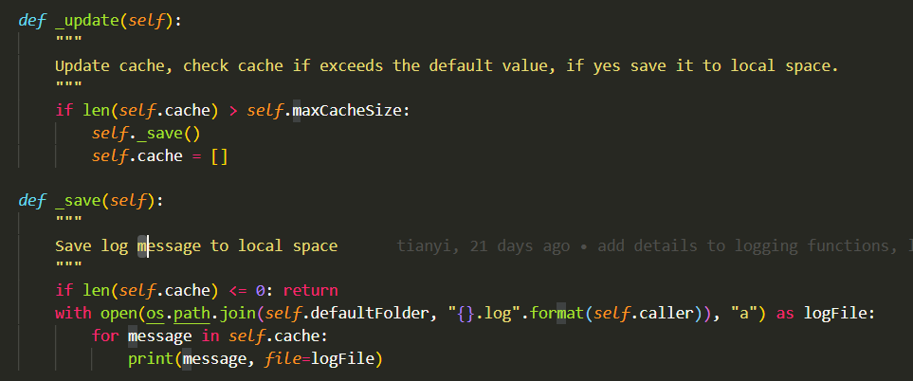
Cache & file management
Notes:
Here, we set default maxCacheSize into 100 and if there is any cache larger than 100, it will be updated and being output and stored to local files.

Slide 14
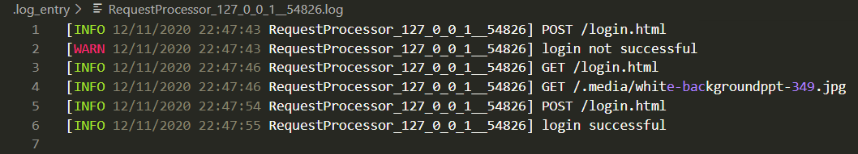
Sample Output at Local
Notes:
This is the sample output of the local file.

Slide 15
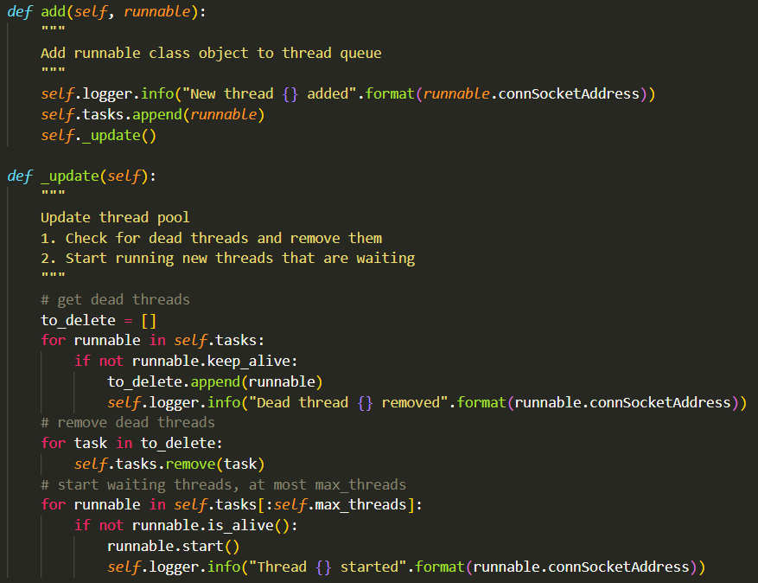
Multi-threading
Notes:
Every time the server socket connects to a client, it adds a request processor thread to the scheduler queue. The scheduler will then check for dead threads and start the first 50 threads.

Slide 16
Extra-feature
Authentication
SSL
Support for all file types
Support for large files

Slide 17
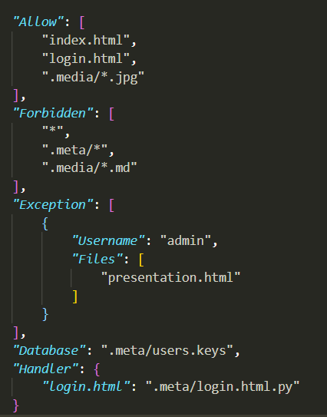
Authentication

Slide 18
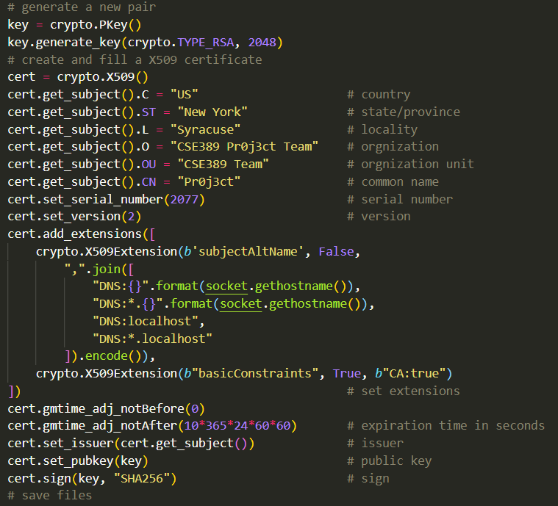
SSL

Slide 19
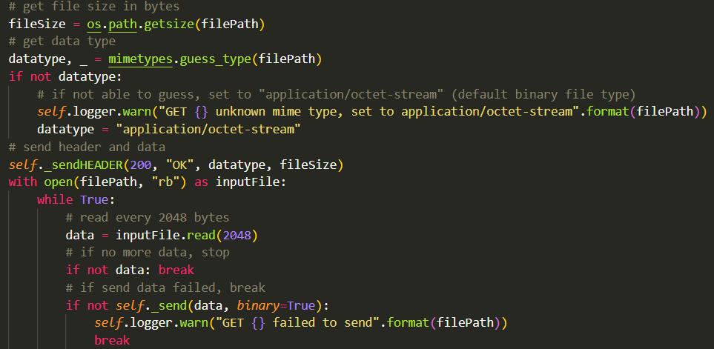
Support for all file types/large files
Notes:
Datatype= application/octet-stream is the default data type of the binary file.
The while loop read every 2048 byte of the file so it avoids saving the whole file into the memory.

