Slide 1
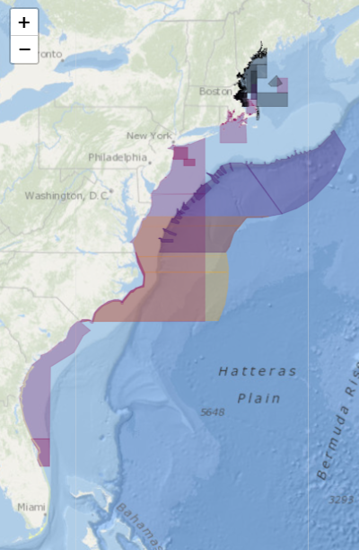
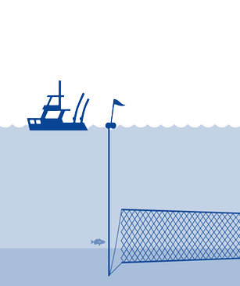

Decision Support Tool
CLOSURES & REGULATIONS APP

