Slide 1

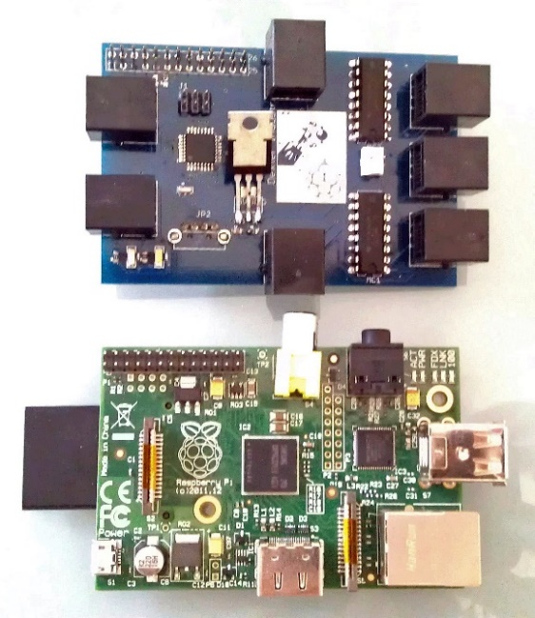
BrickBlock-Pi Robot for Introduction to Coding Student: Edmond Loi Mentors: Raghavender Goud Yadagiri PI: Dr. Vikram Kapila Mechatronics Lab, Department of Mechanical and Aerospace Engineering
Summary
Use of Blockly coding language to interface with BrickPi-enabled RaspberryPi brain to guide a robot through a maze.
RaspberryPi: Single-board single-core computer the size of a credit card
BrickPi: Slide on board for the RaspberryPi that makes it compatible with Lego NXT/EV3 robotics parts
Blockly: Google-developed graphical programming language based around using interlocking blocks to code
Software Components
C - A. libwebsocket
- B. RobotC
HTML/CSS
JavaScript
Blockly
Hardware Components
Two Lego NXT motors – Drive the robot
RaspberryPi/BrickPi combination – Controls and programs the robot
Wi-Fi dongle – Facilitates wireless communication between RaspberryPi and computer
Links
All the code in this project is open-source and can be found on my GitHub
Application
Children can be introduced to coding while experimenting with the BrickBlock-Pi robot.

