Slide 1

Retrieving Data

Slide 2
Overview
SELECT statement
Select lists
Expressions
Changing column names
Best practices
Hands-on lab

Slide 3
Objectives
At the end of this module you will be able to:
Write a query that retrieves every column of every row in a table
Write a query that retrieves only some columns from a table
Write a query that calculates some of its column values

Slide 4
SELECT statement

Slide 5
SELECT statement
SELECT <<field(s)>>
FROM <<table(s)>>
WHERE <<condition(s)>>
GROUP BY <<field(s)>>
HAVING <<condition(s)>>
ORDER BY <<field(s)>>
Notes:
The SELECT statement is the basis of all queries in SQL. There are many optional parts to a select statement, as the slide (taken from Books Online) shows. There are dozens of even more esoteric options that haven’t been listed here.
The highlighted parts are the bit we’re interested in for now; we’ll introduce the others as the course progresses.
An explanation is fairly fundamental, and hopefully straightforward. We are telling SQL that we wish to:
SELECT these pieces of information (columns / fields)
FROM these places (tables)
Although for now we’ll keep it really simple and only select columns from a single table, it is worth bearing in mind that it is possible to put things other than column names into the select list and that one of the tables in the table list could be another select statement!

Slide 6
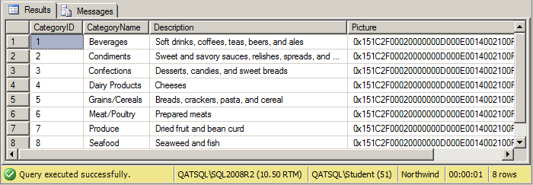
SELECT *
SELECT * FROM tablename
Example:
SELECT * FROM Categories
Notes:
The simplest form of a select statement is:
SELECT * FROM tablename.
It’s generally referred to as a “select star” and is simply telling SQL to go and retrieve everything from the specified table.
In the example on the slide, we’re asking for every row and every column from the Categories table (in the Northwind database). We chose this table because it only has four columns and eight rows.
It’s useful as a “quick check” to see what data are in a table, as long as the table is quite small. We really wouldn’t want to be running a select star query against a table with a hundred columns and a million rows!
It’s also useful for “waking up” Intellisense in SSMS; once the Query Editor can see which table we’re querying, it can populate the completion list with columns that belong to that table, making it easier to avoid spelling mistakes in column names.

Slide 7
Select lists

Slide 8
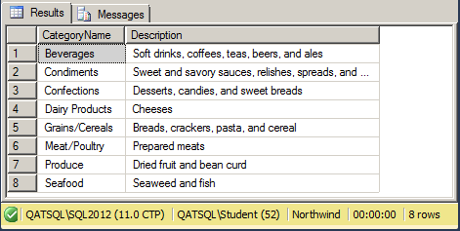
Select lists
SELECT col1, …, coln FROM tablename
Example:
SELECT CategoryName, Description
FROM Categories
Notes:
Far more useful and functional than the SELECT * … statement is the ability to provide SQL with a list of the columns we’d like to see in our results.
We provide a comma separated list of the columns we want to see in the results.
In the example on the slide, we have selected only the CategoryName and Description columns from the Categories table.

Slide 9
Expressions

Slide 10
Expressions in select lists
“Calculated” values
Expression types:
Type | Operators
Arithmetic operators | +, -, *, /, % e.g. UnitsInStock + UnitsOnOrder
String concatenation operator | + e.g. FirstName + ' ' + LastName
Notes:
As mentioned earlier, we are not restricted to just asking for column names in our select lists. It is also possible to tell SQL to calculate a value for us using an expression.
As you might expect, all of the standard mathematical operators are available – addition, subtraction, multiplication and division plus another operator that you might not be familiar with: modulus, which calculates the remainder of a division, for example 5 / 3 is 1 remainder 2, so 5 % 3 is equal to 2. On that subject, an important “gotcha” with integer maths in SQL is that 5 / 3 equals 1, i.e. the result of operations on two integers is always another integer, with the result rounded down. If you want to ensure that 5 / 3 equals 1.3 recurring, divide 5.0 by 3.0 (in other words, use decimal numbers rather than integers).
There is also the “string concatenation operator”, which is a plus sign, which appends one text value onto the end of another.
NOTE: In SQL string literals, like the space character between the FirstName and LastName above, need to be delimited with single quote characters.

Slide 11
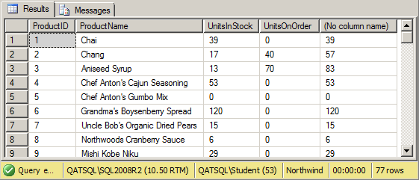
Expressions examples (1)
SELECT ProductID, ProductName, UnitsInStock, UnitsOnOrder, UnitsInStock + UnitsOnOrder FROM Products

Slide 12
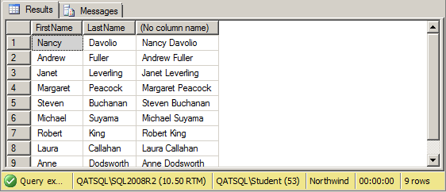
Expressions examples (2)
SELECT FirstName, LastName, FirstName + ‘ ‘ + LastName FROM Employees

Slide 13
Changing column names

Slide 14
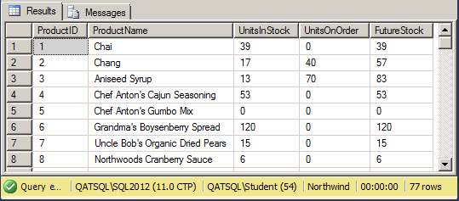
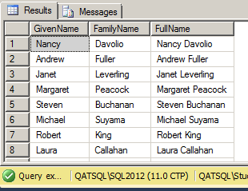
Changing column names
Notes:
You might have noticed from the two previous examples that when we use an expression in our select list, the database engine doesn’t know what to call the “new” column so it comes out as “(No column name)”. In SQL, we can change column names using the AS keyword (this is known as aliasing), so we could change the first example from before to look as follows:
SELECT
ProductID, ProductName, UnitsInStock, UnitsOnOrder,
UnitsInStock + UnitsOnOrder AS FutureStock
FROM Products
Some additional points about aliasing:
You can rename any column.
You can use it for table names as well. We’ll see why that’s useful later.
The “AS” is optional but we would highly recommend that you get into the habit of using it.
So a modification to the second earlier example might be:
SELECT
FirstName AS GivenName, LastName FamilyName,
FullName = FirstName + ' ' + LastName
FROM Employees
[note the missing “as” in the LastName column and the other alternative syntax using an equals sign on the concatenated column]

Slide 15
Best practices

Slide 16
BEST PRACTICES
Script formatting
Comments
Four-part names

Slide 17
Script formatting
SQL is not case-sensitive
SQL ignores whitespace
Best practice: BE CONSISTENT!
SELECT ProductID, ProductName, UnitsInStock, UnitsOnOrder FROM Products
select productid, productname, unitsinstock, unitsonorder from products
SELECT ProductID, ProductName, UnitsInStock, UnitsOnOrder FROM Products
SELECT ProductID, ProductName, UnitsInStock, UnitsOnOrder FROM Products
SELECT ProductID, ProductName, UnitsInStock, UnitsOnOrder FROM Products
ü
Notes:
The database engine really doesn’t care how we format our queries. It ignores most whitespace and is not case-sensitive. This is a good thing, because it means we can format our scripts in whatever way we think is easiest to read. This is also a bad thing, for exactly the same reason; it means that everyone can format their scripts in whatever way they want!
Some organisations have guidelines as to how code should be formatted, but even the best-written guidelines will be unable to take every possible scenario into account, so the key is to try to be consistent with script formatting.

Slide 18
Ignored by SQL
Add documentation to your scripts
Two styles:
SELECT UnitsInStock + UnitsOnOrder AS FutureStock -- calculate FS FROM Products
and
/* This query gets a list of employees with their full names */ SELECT FirstName + ‘ ‘ + LastName AS Name FROM Employees
Best practice: comment your scripts
Comments
Notes:
Documenting scripts can help enormously when we come back to them in six months’ time!
There are two styles of comments in SQL:
Single line comments – putting two dashes (“--”) before some text tells SQL to ignore everything up until the next new line (this is the exception to the rule that SQL doesn’t care about whitespace)
Multi line (or inline) comments – typing a slash then a star (“/*”) tells SQL to ignore everything until it comes to a star immediately followed by a slash (“*/”). It’s typically used to comment out multiple lines but can also be used to comment out only a part of a single line.
Best practice says that we should comment all but the most basic of scripts. As mentioned before, many organizations have coding standards which may include a requirement for a standard comment block in each script that specifies the author, date and purpose of the script. As a rule of thumb, if you have had to think about how to write the code you’ve written, it might be worth adding a little comment as a reminder.
/* Author: Bob Cratchit
Date: 25/12/1843
Purpose: Find out who visited Ebeneezer recently */
SELECT
‘Ghost of ‘ + GhostPeriod -- add ghost’s time to the words “Ghost of”
FROM Ghosts

Slide 19
FOUR-PART NAMES
Referring to tables in queries:
FROM Employees
FROM dbo.Employees
FROM Northwind.dbo.Employees
FROM QATSQL.Northwind.dbo.Employees
Best Practice: use at least two-part names
Notes:
In SQL Server, tables belong to things called schemas, which are (amongst other things) used for managing access to groups of tables.
A schema belongs to a database (also sometimes known as a catalog)
A database resides on a database server.
Therefore, to fully qualify a table name, we should use the format servername.databasename.schemaname.tablename, but that isn’t truly necessary:
If we don’t specify a server, SQL assumes we mean the current server
If we don’t specify a database, SQL assumes we mean the current database (remember we can change the current database with a “USE database” statement or choosing from the drop-down list in the Query Editor)
If we don’t specify a schema name, SQL assumes that we mean the current user’s default schema. This is an important point as someone who is running one of our stored scripts might have a different default schema than us. To add to the fun, in SQL 2012, a default schema can also be assigned to a group of users.
For this reason, when referring to tables, try to get into the habit of specifying two-part names.
In the Northwind sample database that this course uses, all tables belong to the default schema of dbo (“database owner”) and therefore it isn’t an issue but you are still encouraged to get into the habit now.
NOTE: Up until now, for simplicity, this manual has just been using one-part names but from now on it will switch to two-part names.

Slide 20
Hands-on lab

Slide 21
Hands-on lab
Basic SELECT statements
Expressions in select lists

Slide 22
SELECT * FROM ...
SELECT columns FROM ...
SELECT calculatedColumns FROM ...
Comments
Four-part names
Review

