Slide 1

Filtering Rows

Slide 2
Overview
WHERE clause
WHERE expression
Operators
Unknown values
Best practices
Hands-on lab

Slide 3
Objectives
At the end of this module you will be able to:
write a query that uses an equality filter
write a query that use a comparison filter
write a query that uses the IN and BETWEEN operators
write a query that looks for text within a column
write a query that correctly identifies NULL values

Slide 4
WHERE clause

Slide 5
WHERE clause
SELECT <<field(s)>>
FROM <<table(s)>>
WHERE <<condition(s)>>
GROUP BY <<field(s)>>
HAVING <<condition(s)>>
ORDER BY <<field(s)>>
Notes:
The optional WHERE clause is how we tell SQL that we want to limit the results that a query returns. Without a WHERE clause, all rows in the table are returned.
We very rarely want every row to be returned, so it’s quite an important part of a query!

Slide 6
WHERE expression

Slide 7
WHERE expression
Is a predicate
An expression that returns either true or false
SQL retrieves all rows that are true
Or possibly none at all
Example:
SELECT ProductID, ProductName, UnitsInStock, UnitsOnOrder FROM dbo.Products WHERE Discontinued = 0
Notes:
A WHERE clause consists of a predicate, which is an expression that returns either true or false.
SQL will retrieve all the rows in the table for which that predicate returns true.
In the example on the slide, we are telling SQL that we only want to see those products whose discontinued column has a value of zero (i.e. they are not discontinued)
NOTE: depending on how the database has been created, SQL may not actually need to perform the test on every single row, so if you’re concerned about a table with a million rows taking a long time to filter, don’t be.

Slide 8
Operators

Slide 9
Operators
Type | Operators
Comparison operators | =, <, >, <>, !=, >=, <= UnitsInStock > 0
Logical operators | AND, OR, NOT UnitsInStock = 0 AND UnitsOnOrder = 0
“Special” operators | BETWEEN, IN, LIKE OrderDate BETWEEN ‘2012/01/01’ AND ‘2012/01/31’
Notes:
We do not have to use an equality comparison in our WHERE clauses, nor are we limited to only one criteria in our predicates.
The next few pages will cover some of the options available when filtering.

Slide 10
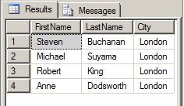
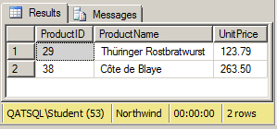
Comparison operators
SELECT FirstName, LastName, City FROM dbo.Employees WHERE Country = ‘UK’
SELECT ProductID, ProductName, UnitPrice FROM dbo.Products WHERE UnitPrice > 100
Notes:
Comparison operators perform standard value comparisons :-
= Equal to
> Greater than
< Less than
>= Greater than or equal to
<= Less than or equal to and
<> Not equal to
NOTE: The use of not equal to should be avoided.

Slide 11
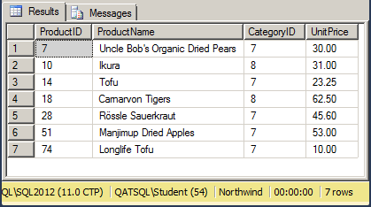
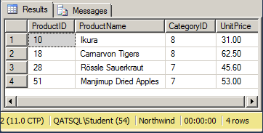
Logical operators
SELECT ProductID, ProductName, CategoryID, UnitPrice FROM dbo.Products WHERE CategoryID = 7 OR CategoryID = 8 AND UnitPrice > 30
… WHERE (CategoryID = 7 OR CategoryID = 8) AND UnitPrice > 30
Notes:
Logical operators allow us to combine multiple conditions for our filter:-
AND - retrieve rows that meet all of the criteria – generally returns fewer rows
OR - retrieve rows that meet any of the criteria – generally returns more rows
NOT - reverse the result of the following expression
We need to be careful with the order in which expressions are evaluated though – the two illustrated examples look remarkably similar but give different results.
The first query is saying “give me all the products in Category 7, plus all the products in Category 8 which have a UnitPrice more than 30”.
By using brackets around the ORed expression, the second query is saying “give me all the products in Categories 7 or 8 which have a UnitPrice of more than 30”.
The complete order in which expressions are resolved is:
NOTs are evaluated first, then ANDs are evaluated, then the ORs.
NOTE: Try to avoid using NOTs.

Slide 12
Unknown values

Slide 13
Specifying a list of values - IN
SELECT ProductID, ProductName, CategoryID, UnitPrice FROM dbo.Products WHERE (CategoryID = 7 OR CategoryID = 8) AND UnitPrice > 30
SELECT ProductID, ProductName, CategoryID, UnitPrice FROM dbo.Products WHERE CategoryID IN (7, 8) AND UnitPrice > 30
Notes:
The IN operator enables us to specify a list of values which we want the expression to match. It is a shorthand way of specifying multiple OR statements that apply to the same column.

Slide 14
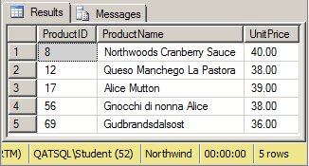
Specifying a range of values - BETWEEN
SELECT ProductID, ProductName, UnitPrice FROM dbo.Products WHERE UnitPrice >= 35 AND UnitPrice <= 40
SELECT ProductID, ProductName, UnitPrice FROM dbo.Products WHERE UnitPrice BETWEEN 35 AND 40
Notes:
Rather than using “greater than or equal to”, “AND” and “less than or equal to”, we can use a BETWEEN expression to specify a range of values.
BETWEEN and IN can look extremely similar; the difference is that IN can be used for a list of distinct values, such as:
CategoryID IN (1, 3, 5) [which excludes 2 and 4]
Whereas BETWEEN is always a range, such as:
CategoryID BETWEEN 1 AND 5 [which includes 2 and 4]
NOTE: We cannot exclude the boundary values with a BETWEEN. It is always equivalent to a “greater than or equal to”, never a “greater than”.

Slide 15
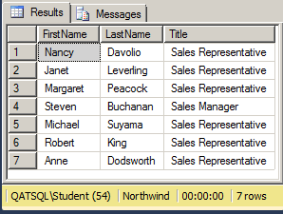
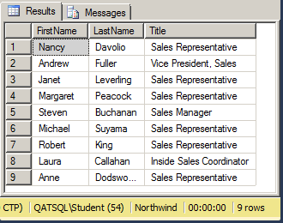
String comparisons - LIKE
SELECT FirstName, LastName, Title FROM dbo.Employees WHERE Title LIKE ‘Sales%’
SELECT FirstName, LastName, Title FROM dbo.Employees WHERE Title LIKE ‘%sales%’
Notes:
Using comparison operators (=, <, >, <=, >=, <>) against text data performs exact matches.
We can perform wildcard pattern matching on text columns using the LIKE operator:
% Matches any string of zero or more characters
_ Matches any single character
[] Matches any single character listed within the square brackets
[^] Matches any single character not listed with the square brackets
Wildcards can appear anywhere within the search text. In the left-hand query, we are asking for all the employees whose job title begins with “Sales”, whilst in the second we are asking for all employees with a job title that contains the letters “sales”.
On the installation of SQL Server used for this course, these string searches are not case sensitive. The string “sales” matches “Sales” (and would also match “SALES”, “SaLeS”, etc.). Your real world database might be case sensitive.
Using leading wildcards (as in the right-hand example) is extremely bad practice. SQL will always have to examine every single row in the table to find your rows. This should be avoided as much as possible. If you really need very flexible string matching, it is possible to use Full-text Indexing, an advanced feature of SQL Server which is beyond the scope of this course.

Slide 16
Filtering on calculated values
Reuse the expression in the WHERE clause
Has to be evaluated for every row
SELECT ProductID, ProductName, UnitsInStock + UnitsOnOrder AS FutureStock FROM dbo.Products WHERE --FutureStock < 100 --won’t work! --use: (UnitsInStock + UnitsOnOrder) < 100
Notes:
To filter based on a calculation we need to reuse the calculated expression in the WHERE clause. We cannot use the expression’s alias, because that alias column hasn’t been created at the point in time when we want to start filtering. Effectively, it’s only if the WHERE expression returns true that we pick that row and then calculate the calculated value, giving that column a name.

Slide 17
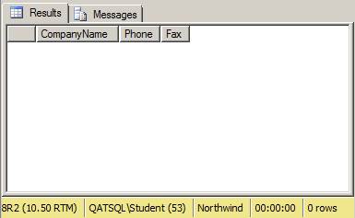
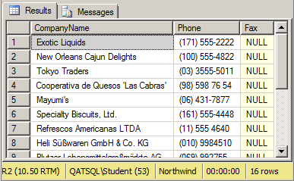
Finding unknown values (NULLs)
SELECT CompanyName, Phone, Fax FROM dbo.Suppliers WHERE Fax = NULL
SELECT CompanyName, Phone, Fax FROM dbo.Suppliers WHERE Fax IS NULL
Notes:
Some columns in a database can contain NULL values if the column has been set up to allow them and no value was given for the column when the data was entered.
NULL is not zero, nor is it a blank line of text.
NULL typically means one of three things:-
not known (i.e. a person’s middle name – we don’t know what it is)
not applicable (this person doesn’t have a middle name)
not yet been set (i.e. a “Units On Order” column – 0 means “no units on order” whilst NULL might mean “never been ordered”)
If I wanted to look for all of the Suppliers for which we don’t have a fax number, my first attempt would very likely be a comparison operator:
WHERE Fax = NULL
This might or it might not work, depending on the settings on the database I’m talking to.
If I do anything with a NULL – add, subtract, concatenate or compare, the result is UNKNOWN, which is not the same as true or false, which means it won’t be selected. SQL Server can be configured to not work this way.
The correct way to perform a NULL test is to use IS:
WHERE Fax IS NULL
As opposed to the equality expression, which might work, depending on the system and the settings, the IS NULL operator will always work.

Slide 18
Best practices

Slide 19
Avoid NOTs
Including <>
Use brackets around complex expressions
This also makes them easier to read
Use IN and BETWEEN
Rather than lots of ORs and ANDs
Avoid leading wildcards
Inefficient
Use IS NULL
Rather than = NULL
Best practices

Slide 20
Hands-on lab

Slide 21
Hands-on lab
Basic equality filters
Basic comparisons
Logical comparisons
String comparisons
NULL comparisons

Slide 22
WHERE clause
Comparisons
IN, BETWEEN, LIKE
Filtering on calculated expressions
Working with NULLs
Review

