Slide 1

Grouping and Aggregation

Slide 2
Overview
Aggregate functions
GROUP BY clause
HAVING clause
Hands-on lab

Slide 3
OBJECTIVES
At the end of this module you will be able to:
write a query that calculates single aggregates
write a query that calculates aggregates for grouped information
write a query that aggregates, groups and filters on calculated values

Slide 4
Aggregate functions

Slide 5
Aggregate functions
COUNT(*)
COUNT(<<expression>>)
SUM(<<expression>>)
AVG(<<expression>>)
MIN(<<expression>>) / MAX(<<expression>>)
Statistical aggregates
STDEV / STDEVP / VAR / VARP
Notes:
You’ve already seen that we can ask SQL to perform calculations on a row-by-row basis.
We can also ask SQL to perform mathematical operations over a set of records.
With the exception of COUNT(*), all the functions operate only on non-null values for expression.
For instance, given the following data:
Product Quantity
A 250
B 0
The COUNT(Quantity) would be 2 and the AVG(Quantity) would be 125, whilst for the following data:
Product Quantity
A 250
B null
The COUNT(Quantity) would be 1 and the AVG(Quantity) would be 250.
COUNT(*) in both cases would return 2.

Slide 6
GROUP BY clause

Slide 7
GROUP BY clause
SELECT <<field(s)>>
FROM <<table(s)>>
WHERE <<condition(s)>>
GROUP BY <<field(s)>>
HAVING <<condition(s)>>
ORDER BY <<field(s)>>
Notes:
Aggregate functions calculate a single value for all the rows in a column.
We use GROUP BY to tell SQL that we wish to calculate the aggregate for each of a number of values in another column.

Slide 8
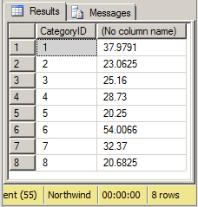
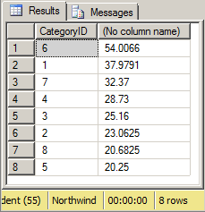
Grouping aggregates
SELECT CategoryID, AVG(UnitPrice) FROM dbo.Products GROUP BY CategoryID
SELECT CategoryID, AVG(UnitPrice) FROM dbo.Products GROUP BY CategoryID ORDER BY 2 DESC
Notes:
Aggregate functions calculate a single value for all the rows in a column.
We use GROUP BY to tell SQL that we wish to calculate the aggregate for each of the values in another column.
In fact, SQL will not let us include anything in the select list that isn’t an aggregate unless it is also in the GROUP BY clause.
Effectively GROUP BY tells SQL to generate a unique list of the values in the GROUP BY column(s) using a DISTINCT, and then to calculate the aggregate for all of the rows with that value using a WHERE.
We can use an ORDER BY to sort the results and we should probably alias the aggregate column(s)
If we use a GROUP BY on a column with null values, the null values are treated as a group

Slide 9
HAVING clause

Slide 10
HAVING clause
SELECT <<field(s)>>
FROM <<table(s)>>
WHERE <<row-level filter(s)>>
GROUP BY <<field(s)>>
HAVING <<group-level filters(s)>>
ORDER BY <<field(s)>>
Notes:
If we want to filter the grouped aggregates, we need to use a HAVING clause.
Remember, the WHERE clause applies at the row level. We now want to wait until the aggregates have been calculated before performing the filter.

Slide 11
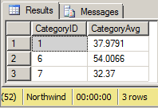
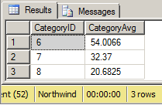
Filtering grouped aggregates
SELECT CategoryID, AVG(UnitPrice) FROM dbo.Products GROUP BY CategoryID HAVING AVG(UnitPrice) > 30
SELECT CategoryID, AVG(UnitPrice) FROM dbo.Products GROUP BY CategoryID HAVING CategoryID > 5
Notes:
You can use the HAVING clause on any of the columns in the select list.
HAVING doesn’t make any sense if you don’t have a GROUP BY clause. In fact, if you try to use a HAVING clause without a GROUP BY, you will get an error message
Much like a WHERE clause, if we are filtering on the result of an expression, we need to duplicate that expression in the HAVING clause.
NOTE: In the second example on the slide, the HAVING clause could be replaced with a WHERE clause because each row in the table has a CategoryID (in fact the query optimiser will replace it for us), whereas in the first example we must use a HAVING clause.

Slide 12
Hands-on lab

Slide 13
HANDS-ON LAB
Single aggregates
GROUP BY
HAVING

Slide 14
Aggregate functions
GROUP BY
HAVING
Review

