Slide 1
Diabetes Prediction and Analysis
Abir Biswas

Slide 2
Introduction

Slide 3
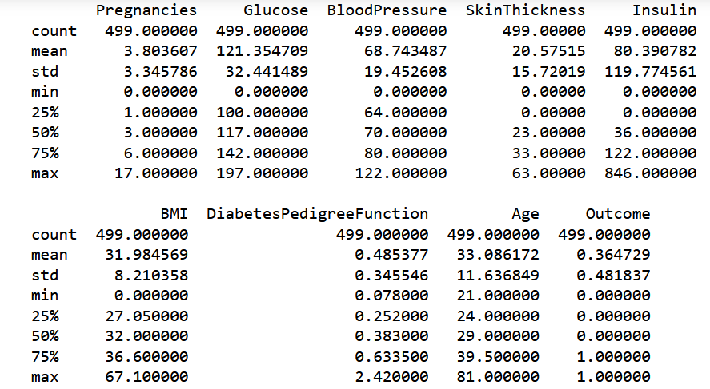
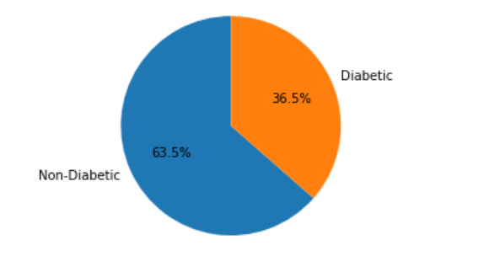
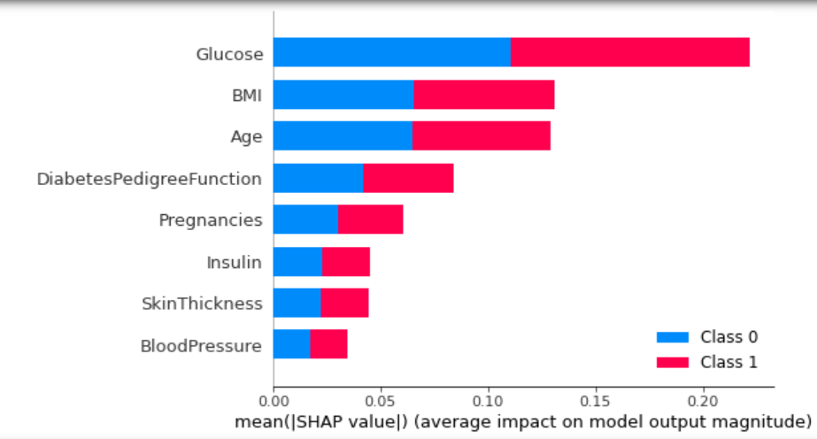
Data Overview
 | Feature | Importance
1 | Glucose | 0.240097
5 | BMI | 0.162062
7 | Age | 0.42127
6 | Diabetes Pedigree Function | 0.123649
2 | Blood Pressure | 0.092278
0 | Pregnancies | 0.080866
4 | Insulin | 0.080503
3 | Skin Thickness | 0.078417

Slide 4
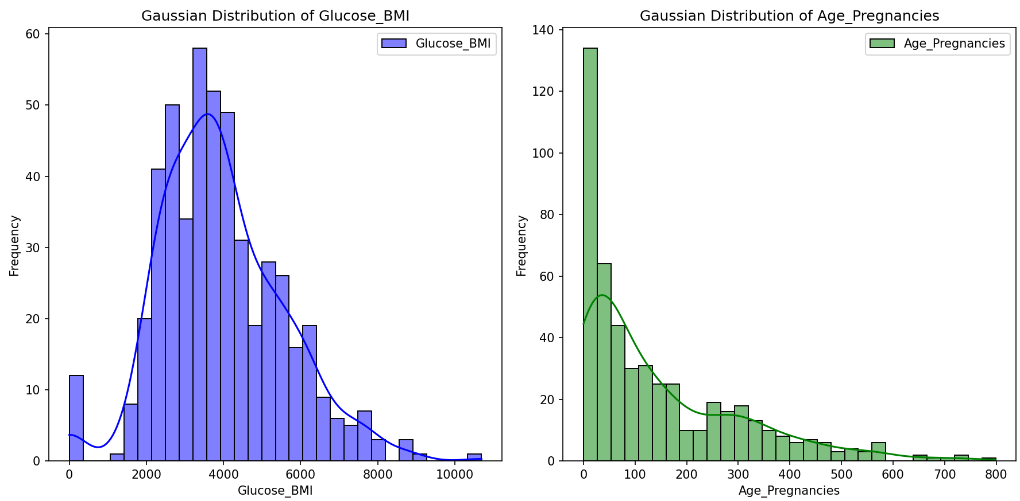
Data Preprocessing and Visualization
Addressing issues such as missing values and outliers
Standardization
Feature Engineering
Age_Pregnancies | Glucose_BMI | Class 0 | Class 1
0 | 0 | 50, 10 | 26, 2
21 | 1100 | 14, 1 | 1, 0
22 | 1448.4 | 16, 1 | 0, 0
23 | 1510.6 | 7, 1 | 0, 0
… | … | … | …

Slide 5
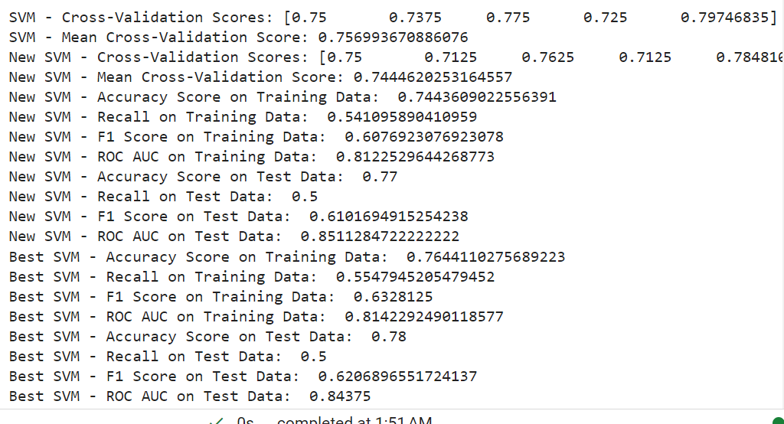
…continued
Hence, Best SVM Model > New SVM Model

Slide 6
Machine Learning Models
SVM, Decision Tree, Random Forest
Use of Evaluation Metrics to come up with solutions for better predictive power of the trained models
Step 1
Polynomial features and Interaction Terms
Capture complex relationships
Step 2
Hyperparameter tuning
Optimize model
Step 3
K-fold cross validation
Detect overfitting, improve accuracy

Slide 7
Model Evaluation Metrics
These metrics provide insights into how well the models are performing in terms of classification accuracy, sensitivity to positive cases (recall), and the balance between precision and recall (F1 score).

Slide 8
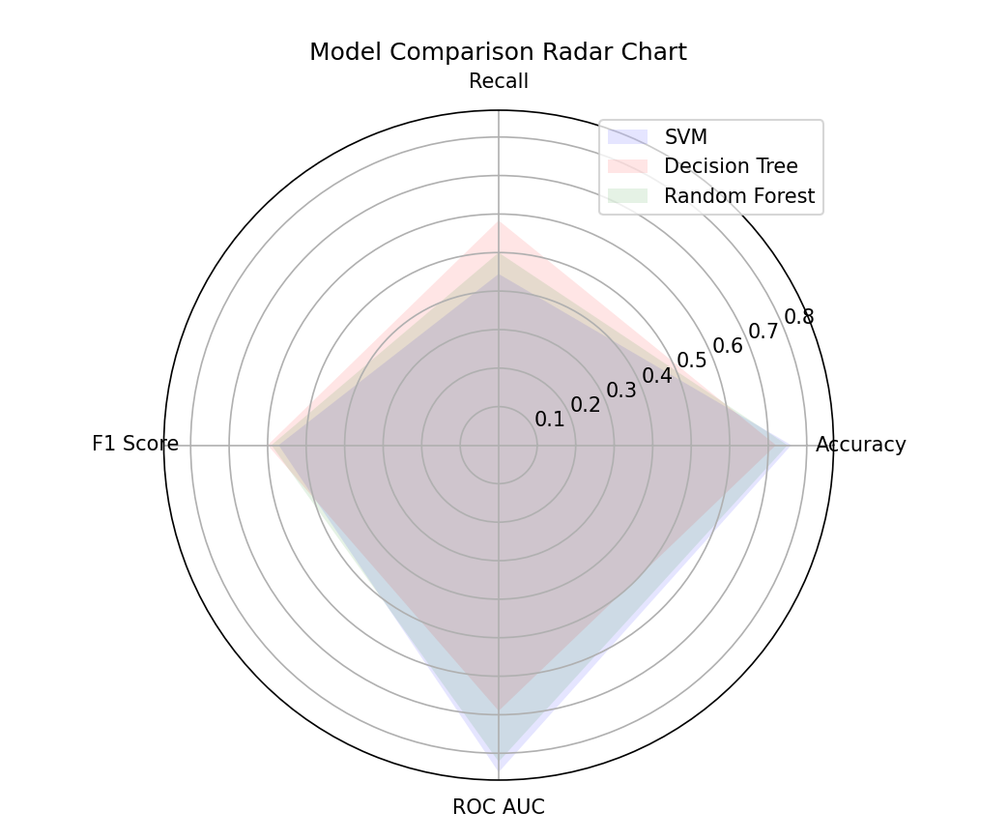
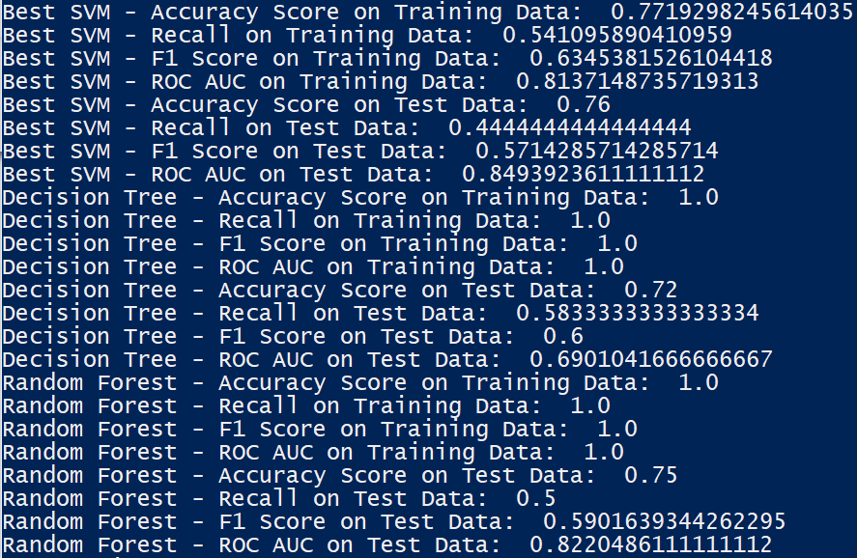
…continued
Evaluation Metrics

Slide 9
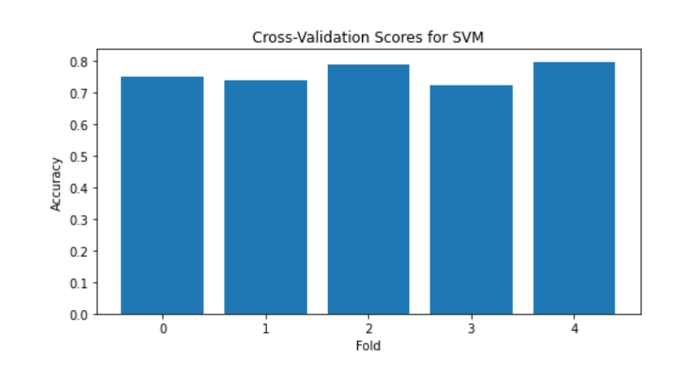
Cross Validation Results
Robust Performance
Provides confidence that the SVM model is not overfitting the training data, as it generalizes reasonably well to unseen data.

Slide 10
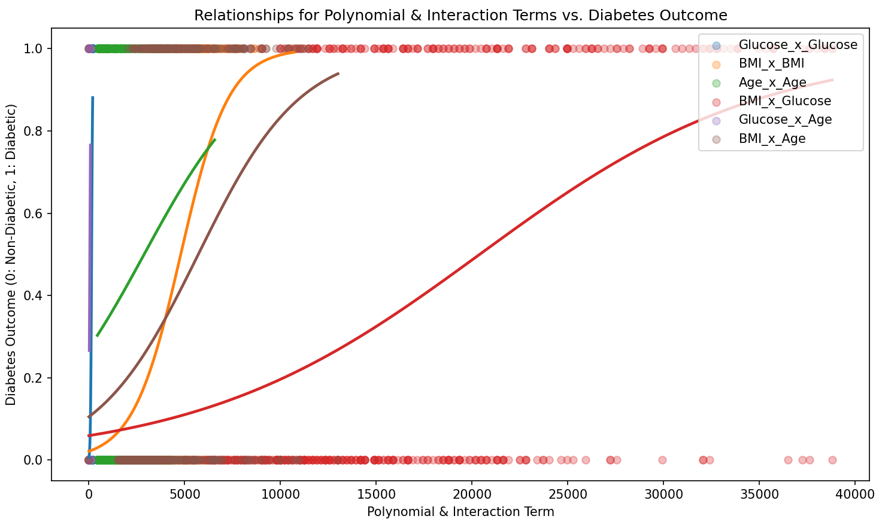

Slide 11
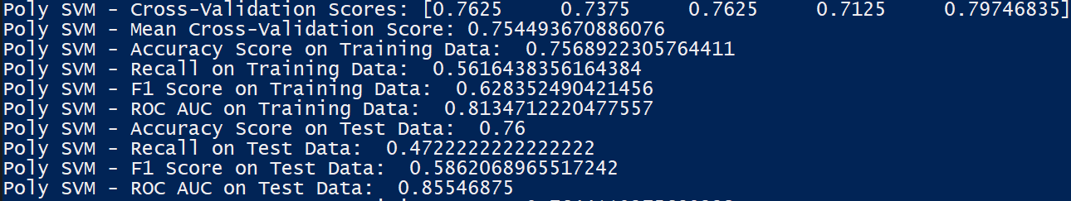
…continued
Hence, Best SVM >> Poly SVM

Slide 12
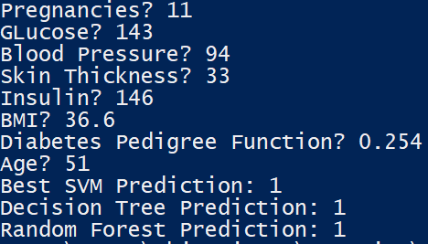
Making Predictions

Slide 13
Conclusion
Promising results with potential application in healthcare systems
Complexity Capture
Gives insights and confidence on building real-world healthcare applications with advanced algorithms, addressing class imbalance and refined feature engineering.

Slide 14
Thank You

