Slide 1
Microcontroller and Embedded Systems 18CS44
Dr. Harish Kumar B T, B.E., M.Tech., Ph.D
Assistant Professor, CSE, BIT
Email: harish.bitcse82@gmail.com, harishkumarbt@bit-bangalore.edu.in
Website: https://sites.google.com/site/harishbitcse

Slide 2
ARM Microprocessor Basics
ARM: Advance RISC Machine.
ARM was established as a joint venture between Acorn, Apple and VLSI in November 1990.
ARM is the industry's leading provider of 16/32-bit embedded RISC microprocessor solutions.
The company licenses its high-performance, low-cost, power-designs to leading international electronics companies.
ARM provides comprehensive support required in developing a complete system.

Slide 3
ARM Embedded Systems
The ARM processor is a key component of many successful 32-bit embedded systems.
You probably own one yourself and may not even realize it!
ARM cores are widely used in mobile phones, handheld devices, and a many other everyday portable consumer devices.
The first ARM prototype name ARM1 was designed in 1985 and continues to improve through constant technical innovation leading to ARM2, ARM3, ARM4, ARM5, ARM6, ARM7, ARM8, ARM9… ARM Cortex.

Slide 4

Approximately one billion ARM processors had been shipped worldwide by the end of 2001.
Now, ARM sales is 7 times more than the worlds population.
The ARM core is not a single core, but a whole family of designs sharing similar design principles and a common instruction set.
Example, ARM7TDMI is one of the most successful ARM core widely used in majority of the devices.
It provides up to 120 Dhrystone MIPS, high code density and low power consumption, making it ideal for mobile embedded devices.
ARM has adopted the RICS design philosophy.

Slide 5
ARM Holdings is a technology company headquartered in Cambridge, England, UK. The company is best known for its processors, although it also designs, licenses and sells software development tools under the RealView and KEIL brands, systems and platforms, system-on-a-chip infrastructure and software.
ARM do not make ICs !!!
ARM grant license of core to different silicon vendors like ATMEL, NXP, Cirrus logic etc.. These companies make IC’S.
Examples are: LPC2148 from NXP, AT91RM9200 from ATMEL.
ARM processors can be used in any domain
Mainly ARM processors are used in Handheld devices, Robotics, Automation, Consumer Electronics.
ARM processors are available for almost every domain.

Slide 6
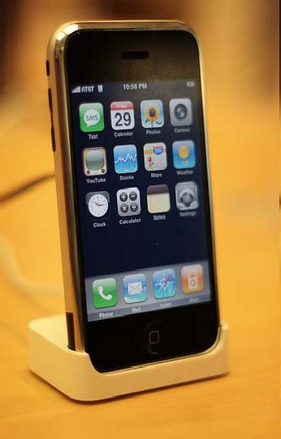
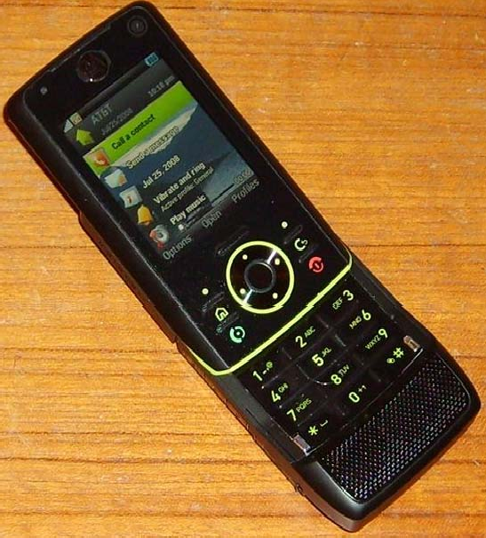
ARM Based Products
Apple iPhone ARM11
Motorola Z8 Smart phone
ARM11

Slide 7
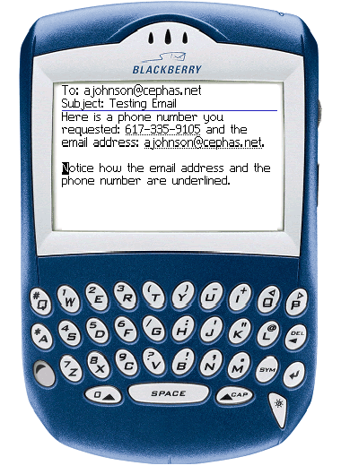
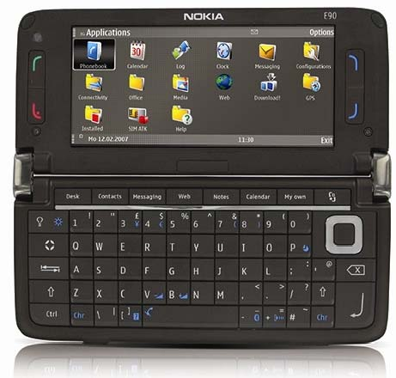
Blackberry ARM11
Nokia E90 Communicator ARM11

Slide 8
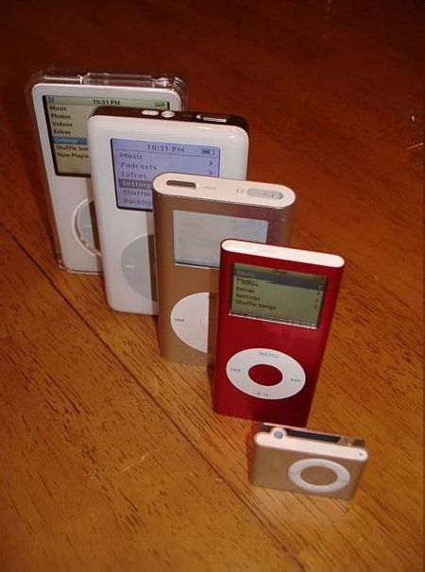
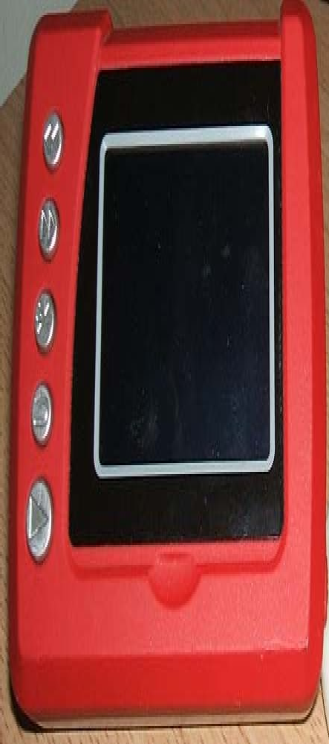
Juice Box
Low cost Multimedia player ARM7TDMI
iPOD ARM7TDMI

Slide 9
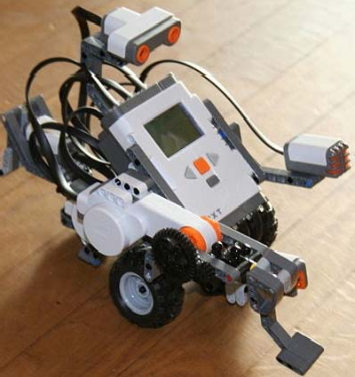
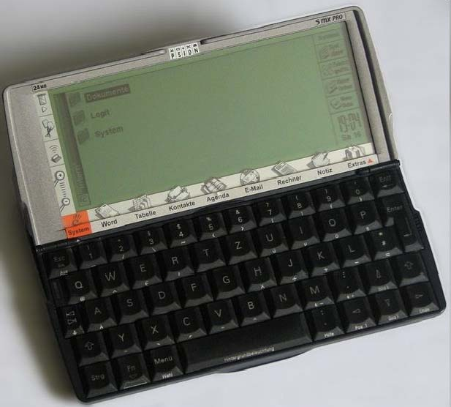
Paison Series game consoles ARM7TDMI
Lego Mindstrome Robot ARM7

Slide 10
The RISC design philosophy
The ARM processors uses a RISC architecture.
RICS-Reduced Instruction Set Computing
Instructions:
RISC is a design philosophy aims to provide few simple but powerful instructions that execute within a single clock cycle.
The RISC philosophy aims to reduce the complexity of instructions performed by the hardware because it is easier to provide greater flexibility and intelligence in software rather than hardware.
RISC design places greater burden/load on the compiler.
Traditional complex instruction set computer (CISC) relies more on the hardware (processor) for instruction functionality, as CISC instructions are more complicated.

Slide 11
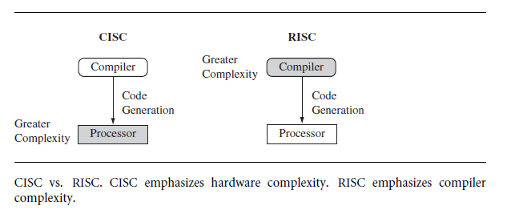

Slide 12
Pipelining:
Instruction execution is done in pipelined fashion
Ideal pipeline stage clock cycle is 1 to have maximum throughput.
Instructions are executed in pipeline stages.
ARM7 is a 3 stage pipelined processor
First stage – fetches the instruction
Second Stage - Decodes the instruction and fetches the operands
Third Stage - Executes the instruction and stores the result

Slide 13
Registers:
RISC machines have a large general-purpose register set.
Any register can contain either data or an address.
Registers act as the fast local memory store for all data processing operations.
In contrast, CISC processors have dedicated registers for specific purposes.

Slide 14
Load-store architecture:
Processor operates only on data held in registers.
Separate load and store instructions transfer data between the register bank and external memory.
Memory accesses are costly, so separating memory accesses from data processing provides an advantage because you can use data items held in the register bank multiple times without needing multiple memory accesses.
In contrast, with a CISC design the data processing operations can act on memory directly.

Slide 15
These RICS design rules allow a RISC processor to be simpler, and thus the core can operate at higher clock frequencies.
In contrast, traditional CISC processors are more complex and operate at lower clock frequencies.
Over the course of two decades, however, the distinction between RISC and CISC has blurred as CISC processors have implemented more RISC concepts.

Slide 16
RISC : Reduced Instruction Set Computing
Lesser number of fixed length instructions.
Fewer addressing modes.
Increased pipelining and increased execution speed.
Orthogonal instruction set(Allows each instruction to operate on any register and use any addressing mode).
Operations are performed on registers only. Memory operations are load and store. (Load Store Architecture).
A large number of register are available.
Programmer needs to write more code to execute a task since the instructions are simpler once.
Instruction take one clock cycle. The average clock cycle per instruction (CPI) is 1.5.

Slide 17
The ARM Design Philosophy
RICS features accepted by ARM
A large set of uniform register file
A load store architecture
Uniform and fixed length (32-bit) instruction fields
Three address instruction formats

Slide 18
The ARM Design Philosophy
RICS features rejected by ARM
Register windows – because they occupy large chip area.
Delayed Branches
Single cycle execution of all instructions.

Slide 19
Additional Features in ARM architecture
Has control over both the ALU and the barrel shifter in every data pre-processing instructions.
Auto increment and auto decrement addressing modes to optimize program loops.
Load and store multiple instructions to maximize execution throughput.
Conditional execution of all instructions to maximize data throughput.

Slide 20
Instruction Set for Embedded System
The ARM instruction set differs from pure RISC definition in several ways that make the ARM instruction set suitable for embedded applications.
Variable cycle execution for certain instruction
Barrel shifter: Inline barrel shifter for more complex instructions.
Conditional execution facility in majority of the instructions.
Enhanced instruction – Enhanced DSP instructions were added to the standard ARM instruction.
Thumb state (16 bit- instruction set) – improves the code density by 30% to 35% over 32-bit fixed length instructions

Slide 21
Embedded System Hardware
Embedded systems are designed to control many different devices,
-- from small sensors found on a production line, to
-- the real-time control systems used on a NASA space probe.
All these devices use a combination of software and hardware components.
Each component is designed to provide higher efficiency and, is designed for future extension and expansion.

Slide 22
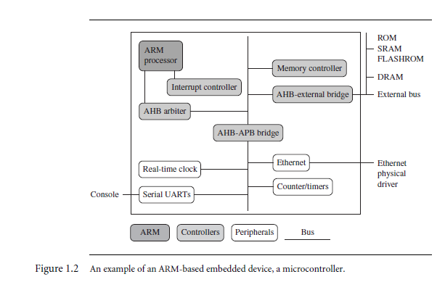
An example of an ARM-based Embedded Device, a Microcontroller
Boxes represent- feature or function
Lines represent –
Busses connecting the devices
Divided into 4 Major components
ARM processor
Controllers
Peripherals
Bus
AHB – ARM High performance Bus
APB - ARM Peripheral Bus

Slide 23
ARM Processor
Controls the embedded device.
Different versions of the ARM processor are available to suit the desired operating characteristics.
An ARM processor comprises
a core (the execution engine that processes instructions and manipulates data)
plus
the surrounding components that interface it with a bus (include memory management and caches.)

Slide 24
Controllers
Helps coordinate important functional blocks of the system.
Two commonly found controllers are
-interrupt controller and
-memory controllers.
Peripherals
Provides input-output capability external to the chip.
-includes serial I/O, Parallel I/O, Timers counters and clock circuits
Responsible for the uniqueness of the embedded device.
Bus
Supports communicate between different parts of the device.
AHB, APB

Slide 25
ARM Bus Technology
Embedded systems use different bus technologies than those designed for x86 PCs.
PCs bus technology uses Peripheral Component Interconnect (PCI) bus, to connect devices such as
- video cards and
-hard disk controllers to the x86 processor bus.
This technology is external or off-chip (i.e., the bus is designed to connect mechanically and electrically to devices external to the chip) and is built into the motherboard of a PC.
Embedded devices use an on-chip bus that is internal to the chip and that allows different peripheral devices to be interconnected with an ARM core.

Slide 26
ARM Bus Technology Cont..
There are two different classes of devices attached to the ARM on chip bus.
- A bus master: a logical device capable of initiating a data transfer with another device across the same bus. The ARM processor core is the bus master.
- Bus slaves: logical devices capable only of responding to a transfer request from a bus master device. All peripherals are bus slaves
On chip ARM bus has two architecture levels.
- Physical level covers the electrical characteristics and bus width (16, 32, or 64 bits).
- Protocol level covers the logical rules that govern the communication between the processor and a peripheral.
ARM is primarily a design company. It does not/rarely implements the electrical characteristics of the bus, but it specifies the bus protocol.

Slide 27
AMBA Bus Protocol
AMBA - Advanced Microcontroller Bus Architecture.
Was introduced in 1996 and widely adopted as the on-chip bus architecture used for ARM processors.
The first AMBA buses introduced were the
ARM System Bus (ASB) and
ARM Peripheral Bus (APB)
Later ARM introduced another bus design, called
-ARM High Performance Bus (AHB)
Using AMBA, peripheral designers can reuse the same interface design on multiple projects.
A peripheral can simply be bolted onto the on-chip bus without having to redesign an interface for each different processor architecture.

Slide 28
AMBA Bus Protocol Cont…
AHB provides higher data throughput than ASB.
- Because AHB is based on a centralized multiplexed bus scheme.
- ASB bidirectional bus design.
ARM has introduced two variations on the AHB bus:
-Multi-layer AHB and
-AHB-Lite.
The original AHB, was allowing a single bus master to be active on the bus at any time, the Multi-layer AHB bus allows multiple active bus masters.
AHB-Lite is a subset of the AHB bus and it is limited to a single bus master.
AHB-Lite was developed for designs that do not require the full features of the standard AHB bus.

Slide 29
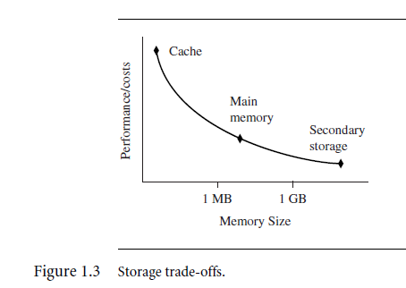
Memory
An embedded system requires some form of memory to store and execute code.
The memory should be fast, large and inexpensive.
Unfortunately it is impossible to meet all the 3 requirements.
The common solution is to have the memory hierarchy.

Slide 30
Memory Width
The memory width is the number of bits the memory returns on each access which is typically 8, 16, 32, or 64 bits.
The memory width has a direct effect on the overall performance of the system.
If you have a system using 32-bit ARM instructions and 16-bit-wide memory chips, then the processor will have to make two memory fetches per instruction.
This reduces the system performance, but the benefit is that 16-bit memory is less expensive.
If the core executes 16-bit Thumb instructions, it will achieve better performance with a 16-bit memory.

Slide 31
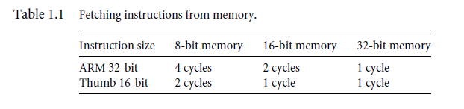
Table 1.1 summarizes theoretical cycle times on an ARM processor using different memory width devices.

Slide 32
Memory Types
There are many different types of memory
- ROM
- Flash ROM
- Dynamic RAM
- Static RAM
- SDRAM – Synchronous Dynamic RAM
ROM- Read Only Memory
Least flexible of all memory types because it contains an image that is permanently stored and cannot be reprogrammed.
Many devices use a ROM to hold boot code.

Slide 33
Flash ROM
Flash ROM can be read as well as written, but it is slow to write so it is not used for holding dynamic data.
It is mainly used for holding the device firmware or storing long-term data that needs to be preserved after power is off.
The erasing and writing of flash ROM are completely software controlled with no additional hardware circuitry required.
Dynamic Random Access Memory –DRAM
The most commonly used RAM for devices.
It has the lowest cost per megabyte compared with other types of RAM.
DRAM is dynamic—it needs to have its storage cells refreshed and given a new electronic charge every few milliseconds, so you need to set up a DRAM controller before using the memory.

Slide 34
Static Random Access Memory – SRAM
Faster than the more traditional DRAM
SRAM is static—the RAM does not require refreshing.
The access time for SRAM is considerably shorter than the equivalent DRAM because SRAM does not require a pause between data accesses.
Synchronous Dynamic Random Access Memory –SDRAM
SDRAM is synchronized with the processor clock speed.
SDRAM run at much higher clock speed than the conventional DRAMs.

Slide 35
Peripherals
Embedded systems communicate with the outside world via peripheral device.
A peripheral device performs input and output functions for the chip by connecting to other devices or sensors that are off-chip.
Peripherals range from
-a simple serial communication device to a
-more complex 802.11 wireless device.
Two important types of controllers are
- memory controllers and
- interrupt controllers.

Slide 36
Memory Controller
Memory controller provides the following functionalities.
Connects different types of memories to the processor bus.
On power up the memory controller activates certain memory devices to execute initialization code -ROM.
It configures the memory timings and the refresh rate of the DRAM before it is accessed.
Interrupt Controllers
When a peripheral or device requires processor attention, it sends an interrupt to the processor.
There are two types of interrupt controller in the ARM processor:
- the standard interrupt controller (SIC)
- and the vector interrupt controller (VIC).

Slide 37
Standard Interrupt Controller (SIC)
It sends an interrupt signal to the processor core when an external device requests servicing.
It can be programmed to ignore or mask an individual device or set of devices interrupt signals.
The interrupt handler determines which device requires servicing by reading a device bitmap register in the interrupt controller.
Vectored Interrupt Controller (VIC)
Provides more functionality than the SIC.
Along with the masking functionality it also provides the functionality to prioritize the interrupts.

Slide 38
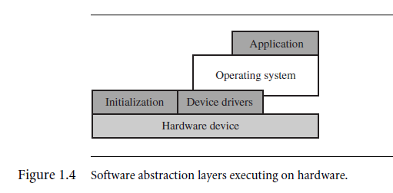
Embedded System Software
An embedded system needs software to drive it.
Figure shows four typical software components required to control an embedded device.

Slide 39
Initialization (Boot) Code
The initialization code is the first code executed on the board when the device is powered on.
It sets up the minimum parts of the board before handing control over to the operating system.
Boot code is present inside the ROM and is responsible for loading the OS to the RAM.
The initialization code handles 3 administrative tasks prior to handing control over to an operating system image.
These administrative tasks can be grouped into three phases:
- initial hardware configuration,
- diagnostics, and
- booting.

Slide 40
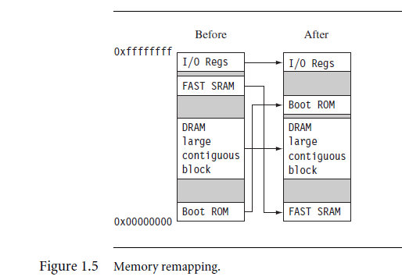
Initial Hardware Configuration:
Although the device comes up in a standard configuration, this initial hardware configuration normally requires modification to satisfy the requirements of the booted image.
For example, the memory system normally requires reorganization of the memory map, as shown in below Example

Slide 41
Diagnostics
Diagnostics is a program embedded in the initialization code.
Diagnostic code tests the system by checking if the all the hardware components is in working condition.
It also tracks down standard system-related issues.
The primary purpose of diagnostic code is fault identification and isolation.

Slide 42
Booting:
Booting involves loading an OS image to RAM and handing control over to that image.
The boot process can be complicated if the system must boot different operating systems or different versions of the same operating system.
Once booted, the system hands over control by modifying the program counter to point into the start of the OS image.
Sometimes, to reduce the image size, an image is compressed.
The image is then decompressed either when it is loaded or when control is handed over to it.

Slide 43
Operating System
The Initialization process prepares the hardware for an Operating system to take control.
ARM Processor supports over 50 operating systems.
Operating system can be divided into two main categories.
- Real Time Operating System – RTOS
- Platform Operating System –POS
RTOS used in embedded devices and they don’t use the secondary storage and POS used in the general purpose computer systems and they use secondary storage
RTOS is classified into.
Hard Real Time Operating System – Used in hard real time applications which requires the guaranteed response time.
Soft Real Time Operating System – Used in soft real time applications which does not require guaranteed response time and the performance gracefully reduces when the time overruns

Slide 44
Applications:
ARM processors are found in numerous domains, including networking, automotive, mobile and consumer devices, mass storage, and imaging devices.
Within each domain ARM processors can be found in multiple applications.
For example, the ARM processor is found in networking applications like home gateways, modems for high-speed Internet communication, and 802.11 wireless communication.
The mobile device domain is the largest application area for ARM processors because of mobile phones.
ARM processors are also found in mass storage devices domains such as hard drives, products such as inkjet printers

Slide 45
ARM7TDMI Processor
The ARM7TDMI core is a member of the ARM family of general-purpose 32-bit microprocessors.
– T: capable of executing Thumb instruction set
– D: Featuring with IEEE Std. 1149.1 JTAG boundary-scan debugging interface.
– M: Featuring with a Multiplier-And-Accumulate (MAC) unit for DSP applications.
– I: Featuring with the support of embedded In-Circuit Emulator.
The ARM family offers high performance for very low power consumption, and small size.
The ARM architecture is based on Reduced Instruction Set Computer (RISC)

Slide 46
SUMMARY:
It allows variable cycle execution on certain instructions to save power, area, and code size.
It adds a barrel shifter to expand the capability of certain instructions.
It uses the Thumb 16-bit instruction set to improve code density.
It improves code density and performance by conditionally executing instructions.
It includes enhanced instructions to perform digital signal processing type functions.

