Slide 1
Chapter-2
ARM Processor
Fundamentals

Slide 2
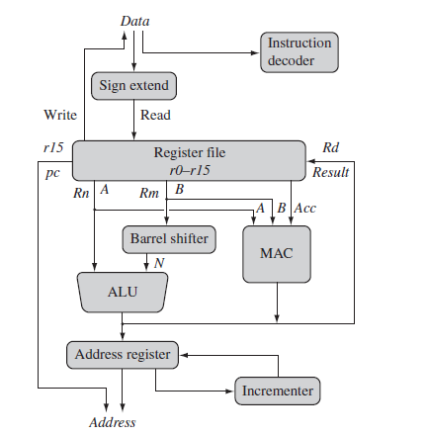
ARM core dataflow model

Slide 3
Instruction Fetch: Fetches the instruction form the memory
Instruction Decoder: Decodes the instruction and identifies the opcode of the instruction.
Sign extend hardware: The sign extend hardware converts signed 8-bit and 16-bit numbers to 32-bit values as they are read from memory and placed in a register.
ALU (arithmetic logic unit) or MAC (multiply-accumulate unit): Takes the register values Rn and Rm from the A and B buses and computes a result.
- Data processing instructions write the result in Rd directly to the register file.
- Load and store instructions use the ALU to generate an address to be held in the address register and broadcast on the Address bus.
Incrementer: For load and store instructions the incrementer updates the address register before the core reads or writes the next register value from or to the next sequential memory location.

Slide 4
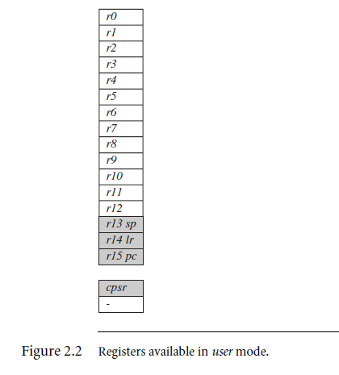
Registers
General-purpose registers hold either data or an address.
They are identified with the letter r prefixed to the register number. For example, register 4 is given the label r4.
Figure 2.2 shows the active registers available in user mode—a protected mode normally

Slide 5
The processor can operate in seven different modes
All the registers shown are 32 bits in size.
There are up to 18 active registers: 16 data registers and 2 processor status registers.
The data registers are visible to the programmer as r0 to r15.
The ARM processor has three registers assigned to a particular task or special function:
r13, r14, and r15. They are frequently given different labels to differentiate them from the other registers.
Register r13 is traditionally used as the stack pointer (sp) and stores the head of the stack in the current processor mode.
Register r14 is called the link register (lr) and is where the core puts the return address whenever it calls a subroutine.
Register r15 is the program counter (pc) and contains the address of the next instruction to be fetched by the processor.

Slide 6
Depending upon the context, registers r13 and r14 can also be used as general-purpose registers.
Dangerous to use r13 as a general register when the processor is running any form of operating system because operating systems often assume that r13 always points to a valid stack frame.
In ARM state the registers r0 to r13 are orthogonal—any instruction that you can apply to r0 you can equally well apply to any of the other registers.
However, there are instructions that treat r14 and r15 in a special way.
In addition to the 16 data registers, there are two program status registers:
cpsr and spsr (the current and saved program status registers, respectively).

Slide 7
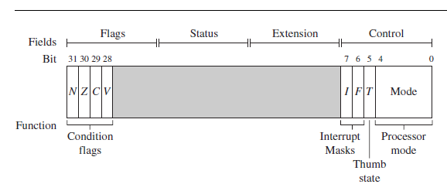
Current Program Status Register- CSPR

Slide 8
The ARM core uses the cpsr to monitor and control internal operations.
The cpsr is a dedicated 32-bit register and resides in the register file.
The shaded parts are reserved for future expansion.
The cpsr is divided into four fields, each 8 bits wide:
-flags,
- status,
- extension, and
- control.
In current designs the extension and status fields are reserved for future use.

Slide 9
The control field contains the
- processor mode,
-state, and
- interrupt mask bits.
The flags field contains the condition flags.
Some ARM processor cores have extra bits allocated.
- For example, the J bit, which can be found in the flags field, is only available on Jazelle-enabled processors, which execute 8 bit instructions

Slide 10
Processor Modes
The processor mode determines which registers are active and the access rights to the cpsr register itself.
Each processor mode is either
privileged or
non privileged
A privileged mode allows full read-write access to the cpsr.
Conversely, a non-privileged mode only allows read access to the control field in the cpsr but still allows read-write access to the condition flags.

Slide 11
There are seven processor modes in total:
- six privileged modes
(abort, fast interrupt request, interrupt request, supervisor, system, and undefined)
- one non privileged mode (User).
Abort Mode: The processor enters abort mode when there is a failed attempt to access memory.
Fast interrupt and interrupt request modes: Correspond to the two interrupt levels available on the ARM processor.

Slide 12
Supervisor mode: is the mode that an operating system kernel operates in.
System mode: is a special version of user mode that allows full read-write access to the cpsr.
Undefined mode: is used when the processor encounters an instruction that is undefined or not supported by the implementation.
User mode: is used for programs and applications.

Slide 13
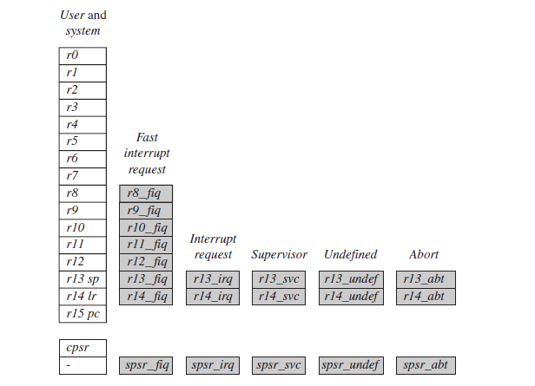
Banked Registers

Slide 14
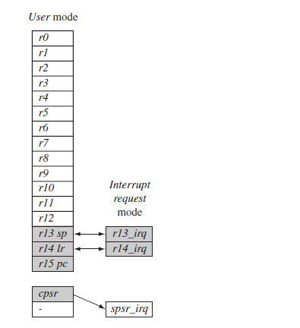
There are 37 registers in the register file. Of those, 20 registers are hidden registers and are called as banked registers indicated in shade.
They are available only when the processor is in a particular mode.
Changing mode on an interrupt

Slide 15
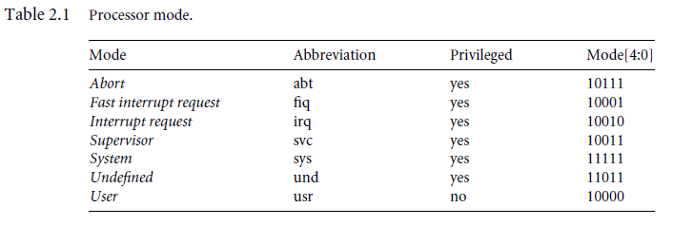

Slide 16
State and Instruction Sets
The state determines which instruction set is being executed.
There are three instruction states:
ARM state
Thumb state, and
Jazelle state.
ARM State:
The ARM instruction set (32 bit) is only active when the processor is in ARM state (T=0 and J=0).
Thumb State:
Similarly the Thumb instruction set (16 bits) is only active when the processor is in Thumb state (T=1 and J=0).
In Thumb state the processor executes only Thumb 16-bit instructions. You cannot intermingle ARM , Thumb, and Jazelle instructions

Slide 17
Jazelle State:
The Jazelle instruction set (8 bits) is only active when the processor is in Jazelle state (T=0 and J=1).
Jazelle executes 8-bit instructions and is a hybrid mix of software and hardware designed to speed up the execution of Java byte-codes.
To execute Java byte-codes, Jazelle technology plus a Java virtual machine is required.

Slide 18
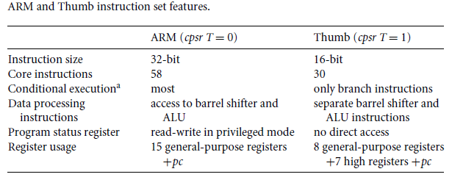
Comparison of ARM and Thumb State

Slide 19
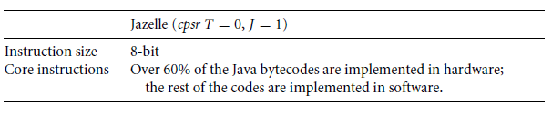
Jazelle instruction set features.

Slide 20
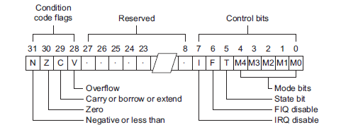
Interrupt Masks
Interrupt masks are used to stop interrupt requests from interrupting the processor.
There are two interrupt request levels available on the ARM processor core
- interrupt request (IRQ) and
- fast interrupt request (FIQ).
The cpsr has two interrupt mask bits, 7 and 6 (or I and F), which control the masking of IRQ and FIQ, respectively.
The I bit masks IRQ when set to binary 1, and similarly the F bit masks FIQ when set to binary 1.

Slide 21
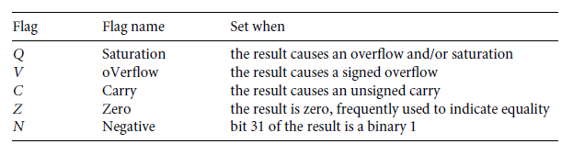
Condition Flags
Condition flags are updated by comparisons and the result of ALU operations that specify the S instruction suffix.
For example, if a SUBS subtract instruction results in a register value of zero, then the Z flag in the cpsr is set.

Slide 22
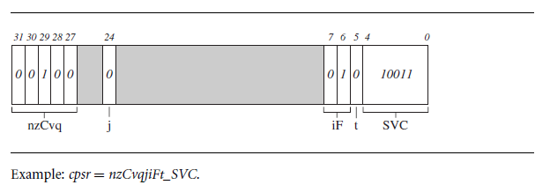
In this book we use a notation that presents the cpsr data in a more human readable form.
When a bit is a binary 1 we use a capital letter;
when a bit is a binary 0, we use a lowercase letter.
For the condition flags a capital letter shows that the flag has been set.
For interrupts a capital letter shows that an interrupt is disabled.

Slide 23
Conditional Execution
Conditional execution controls the execution of an instruction.
Most instructions have a condition attribute that determines if the Microcontroller core will execute it or not based on the setting of the condition flags.
Prior to execution, the processor compares the condition attribute with the condition flags in the cpsr.
If they match, then the instruction is executed; otherwise the instruction is ignored.

Slide 24
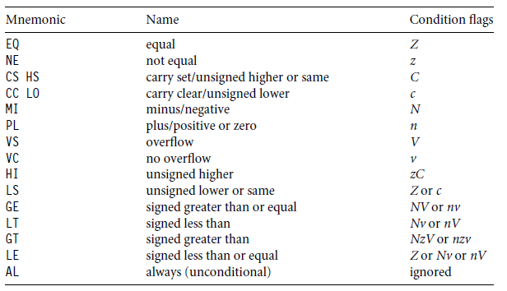
Condition mnemonics

Slide 25
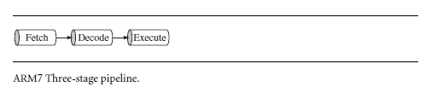
Pipeline
Fetch loads an instruction from memory.
Decode identifies the instruction to be executed.
Execute processes the instruction and writes the result back to a register.

Slide 26
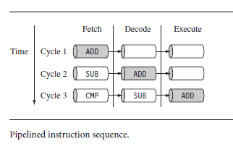
Example

Slide 27
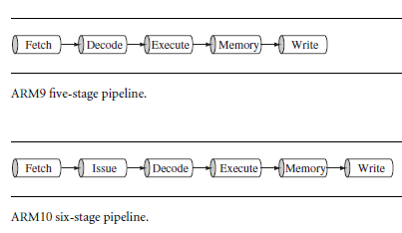
ARM9 and ARM10 Pipeline
ARM9 has instruction throughput of around 13% more compared with an ARM7.
The ARM10 has instruction throughput of around 34% more than an ARM7 processor core.

Slide 28
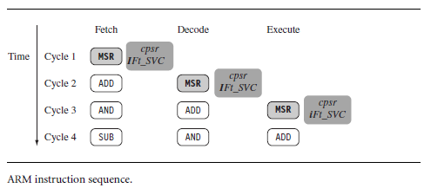
Pipeline Executing Characteristics
The MSR instruction is used to enable IRQ interrupts, which only occurs once the MSR instruction completes the execute stage of the pipeline.
It clears the I bit in the cpsr to enable the IRQ interrupts.
Once the AND instruction enters the execute stage of the pipeline, IRQ interrupts are enabled

Slide 29
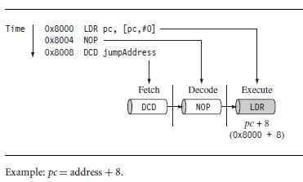
In the execute stage, the pc always points to the address of the instruction plus 8 bytes.
In other words, the pc always points to the address of the instruction being executed plus two instructions ahead.

Slide 30
Exceptions, Interrupts, and the Vector Table
When an exception or interrupt occurs, the processor sets the pc to a specific memory address.
This special address range called the vector table.
The entries in the vector table are instructions that branch to specific routines designed to handle a particular exception or interrupt.
On some processors the vector table is located at a higher address in memory (starting at the offset 0xffff0000). On some processor from the lower address 0x00000000.

Slide 31
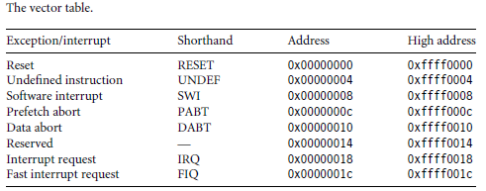
When an exception or interrupt occurs, the processor suspends normal execution and loads instructions from the vector table.
Each vector table entry contains a form of branch instruction pointing to the start of a specific routine.

Slide 32
Reset vector:
is the location of the first instruction executed by the processor when power is applied. This instruction branches to the initialization code.
Undefined instruction vector:
is called when the processor cannot decode an instruction.
Software interrupt vector:
is called when you execute a SWI instruction. The SWI instruction is frequently used as the mechanism to invoke an operating system routine.
Prefetch abort vector:
occurs when the processor attempts to fetch an instruction from an address without the correct access permissions. The actual abort occurs in the decode stage.

Slide 33
Data abort vector:
is similar to a prefetch abort but is raised when an instruction attempts to access data memory without the correct access permissions.
Interrupt request vector:
is used by external hardware to interrupt the normal execution flow of the processor. It can only be raised if IRQs are not masked in the cpsr.
Fast interrupt request vector:
is similar to the interrupt request but is reserved for hardware requiring faster response times. It can only be raised if FIQs are not masked in the cpsr.

Slide 34
Core Extensions
The hardware extensions (Assistants) are standard components placed next to the ARM core.
They improve performance, manage resources, and provide extra functionality and are designed to provide flexibility in handling particular applications.
There are three hardware extensions ARM wraps around the core:
- cache and Tightly Coupled Memory(TCM),
- memory management, and
- the coprocessor interface.

Slide 35
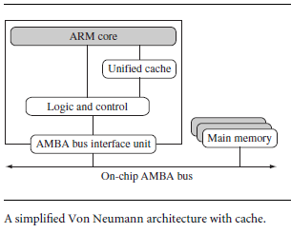
Cache and Tightly Coupled Memory

Slide 36
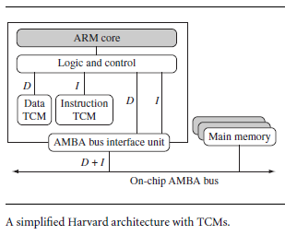

Slide 37
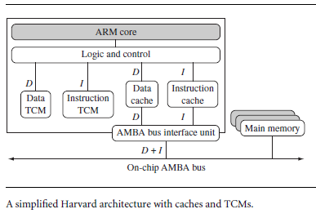

Slide 38
Memory Management
Embedded systems often use multiple memory devices.
It is usually necessary to have a method to help organize these devices and protect the system from applications trying to make inappropriate accesses to hardware.
This is achieved with the assistance of memory management hardware.
ARM cores have three different types of memory management hardware.
- Non-protected memory – no protection
- MPUs – limited protection
- MMUs – full protection

Slide 39
Coprocessors
Coprocessors can be attached to the ARM processor.
A coprocessor extends the processing features of a core and increases the throughput.
More than one coprocessor can be added to the ARM core via the coprocessor interface.

