Slide 1
Chapter-3
Introduction to the ARM
Instruction Set

Slide 2
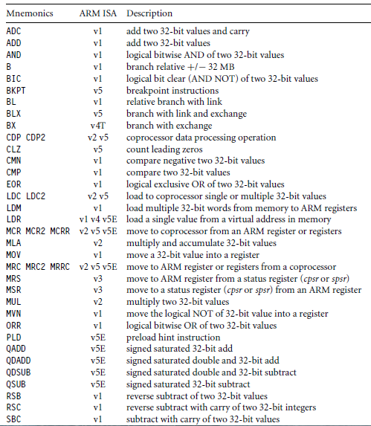
ARM Instruction Set

Slide 3
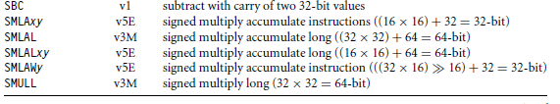
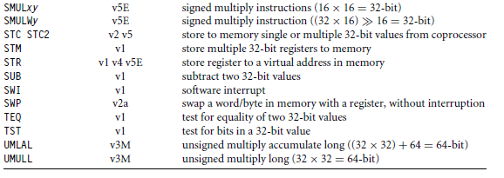

Slide 4
Data Processing Instructions
The data processing instructions manipulate data within registers. They are
- move instructions,
- arithmetic instructions,
- logical instructions,
- comparison instructions, and
- multiply instructions.
Most data processing instructions can process one of their operands using the barrel shifter.

Slide 5
If you use the S suffix on a data processing instruction, then it updates the flags in the cpsr.
Move and logical operations update the carry flag C, negative flag N, and zero flag Z.
The carry flag is set from the result of the barrel shift as the last bit shifted out.
The N flag is set to bit 31 of the result.
The Z flag is set if the result is zero.

Slide 6
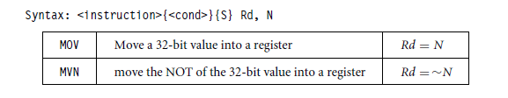
Move Instructions
Move is the simplest ARM instruction.
It copies N into a destination register Rd, where N is a register or immediate value.
This instruction is useful for setting initial values and transferring data between registers.

Slide 7
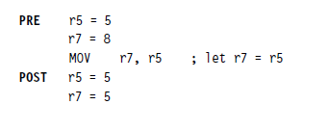
Examples
Condition Embedded in ADD Instruction
{cond} Rd, N
MOVEQ r0, r1 ; If zero flag set then…
; ... r0 = r1

Slide 8
Example
AREA MOV1, CODE, READONLY
START
MOV R0,#5
MOV R1,#6
SUBS R0,R0,#4 ; FIRST SUBTRACT 5 AND NEXT 4
MOVEQ R2,R1
MOV R3,#10
BACK B BACK
END

Slide 9
For example to move the value zero to destination register and set the condition flags:
MOVS Rd, N
MOVS r0,r1 ; r0 = r1
; ... and set flags

Slide 10
Example
AREA MOV2, CODE, READONLY
START
MOV R0,#0
MOV R1,#6
MOVS R2,R0 ; Z
MOVS R3,R1 ; z
BACK B BACK
END

Slide 11
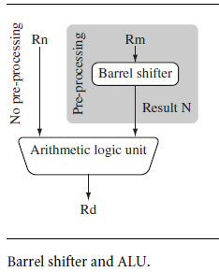
Barrel Shifter

Slide 12
In MOV instruction N is a simple register/immediate value.
It can also be a register Rm that has been preprocessed by the barrel shifter prior to being used by a data processing instruction.
Majority of the data processing instructions are processed within the arithmetic logic unit (ALU).
A unique and powerful feature of the ARM processor is the ability to shift the 32-bit binary pattern in one of the source registers left or right by a specific number of positions before it enters the ALU.
This shift increases the power and flexibility of many data processing operations.
There are data processing instructions that do not use the barrel shift, for example,
-- the MUL (multiply),
-- CLZ (count leading zeros), and
-- QADD (signed saturated 32-bit add)

Slide 13


Example

Slide 14
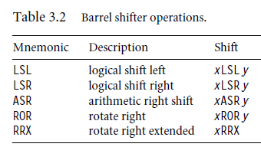
Barrel shifter operations
Note: x represents the register being shifted and y represents the shift amount.

Slide 15
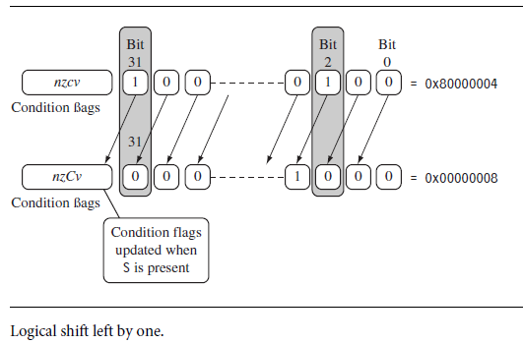

Slide 16
Barrel Shifter - Left Shift
Shifts left by the specified amount
Multiplies by powers of two
e.g.
LSL #5 = multiply by 32
Logical Shift Left (LSL)
CF
Destination
0

Slide 17
Barrel Shifter - Right Shifts
Logical Shift Right
Shifts right by the specified amount (divides by powers of two)
e.g.
LSR #5 = divide by 32
Logical Shift Right
Destination
CF
...0

Slide 18
Arithmetic Shift Right
Arithmetic Shift Right
Shifts right (divides by powers of two) and preserves the sign bit, for 2's complement operations.
e.g.
ASR #5 = divide by 32
Arithmetic Shift Right
Destination
CF
Sign bit shifted in

Slide 19
Barrel Shifter - Rotations
Rotate Right (ROR)
•Similar to an ASR but the bits wrap around as they leave the LSB and appear as the MSB.
e.g. ROR #5
Note the last bit rotated is also used as the Carry Out.
Rotate Right
Destination
CF

Slide 20
Barrel Shifter - Rotations Rotate Right Extended (RRX)
Rotate Right Extended (RRX)
• This operation uses the CPSR C flag as a 33rd bit.
Rotates right by 1 bit. Encoded as ROR #0.
Rotate Right through Carry
Destination
CF

Slide 21
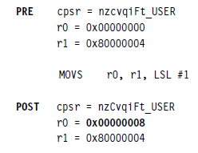
MOVS - example

Slide 22
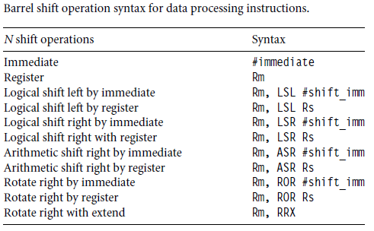

Slide 23
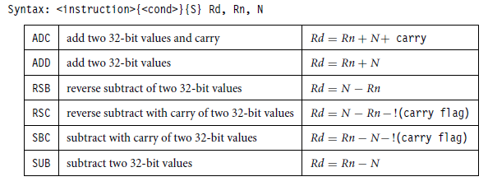
Arithmetic Instructions

Slide 24
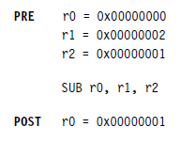
Example-1
Subtract instruction subtracts a value stored in register r2 from a value stored in register r1. The result is stored in register r0.

Slide 25
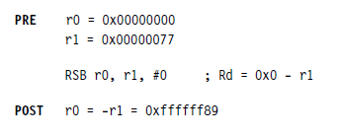
Example-2
Reverse Subtract Instruction (RSB) subtracts r1 from the constant value #0, writing the result to r0. You can use this instruction to negate numbers.

Slide 26
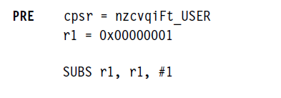

Example-3
SUBS instruction is useful for decrementing loop counters. In this example we subtract the immediate value one from the value one stored in register r1. The result value zero is written to register r1. The cpsr is updated with the ZC flags being set.

Slide 27
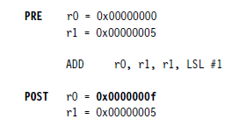
Using the Barrel Shifter with Arithmetic Instructions
The wide range of second operand shifts available on arithmetic and logical instructions is a very powerful feature of the ARM instruction set.

Slide 28
Example-1
AREA MOV2, CODE, READONLY
START
MOV R0,#5
MOV R1,#6
add R2,R0,R1, LSL #0x2
BACK B BACK
END

Slide 29
Example-2
AREA ADD1, CODE, READONLY
START
MOV R0,#5
MOV R1,#6
SUBS R0,R0,#4 ; FIRST SUBTRACT 5 AND NEXT 4
ADDEQ R2,R1,R0
MOV R3,#10
BACK B BACK
END

Slide 30
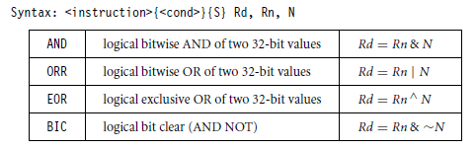
Logical Instructions
Logical instructions perform bitwise logical operations on the two source registers.

Slide 31


Example-1
Logical OR operation between registers r1 and r2. r0 holds the result.

Slide 32
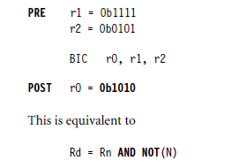
Example-2
A more complicated logical instruction called BIC, which carries out a logical bit clear.

Slide 33
Example-3
AREA ADD1, CODE, READONLY
START
MOV R0,#5
MOV R1,#6
AND R2,R1,R0
BACK B BACK
END

Slide 34
Example-4
AREA ADD1, CODE, READONLY
START
MOV R0,#5
MOV R1,#6
AND R2,R1,R0
BACK B BACK
END

Slide 35
Example-5
AREA ADD1, CODE, READONLY
START
mov R0,#15
mov R1,#5
bic R2,R0,R1 ; r2=r0 & (~R1)
BACK B BACK
END

Slide 36
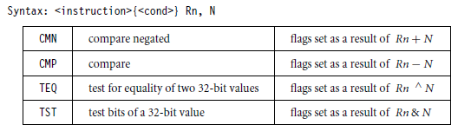
Comparison Instructions
The comparison instructions are used to compare or test a register with a 32-bit value.
They update the cpsr flag bits according to the result, but do not affect other registers.
After the bits have been set, the information can then be used to change program flow by using conditional execution.

Slide 37
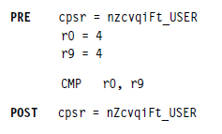
CMP Example

Slide 38
CMN Instruction
The CMN instruction adds the value of N to the value in Rn.
This is the same as an ADDS instruction, except that the result is discarded.
The conditional flags are updated accordingly.
RO=50
R1=10
CMN RO, R1

Slide 39
TEQ
Test Equivalence.
The TEQ instruction performs a bitwise Exclusive OR operation on the value in Rn and the value of N. the result is discarded.
Use the TEQ instruction to test if two values are equal, without affecting the V or C flags (as CMP does). It affects the N and Z flags.

Slide 40
TEQ- Example
AREA TEST, CODE, READONLY
ENTRY
START
MOV R0,#6
MOV R1,#5
TEQ R0,R1
BACK B BACK
END

Slide 41
TST - Instruction
This instruction tests the value in a register against N. It updates the condition flags on the result, but does not place the result in any register.
The TST instruction performs a bitwise AND operation on the value in Rn and the value of N.
This is the same as an ANDS instruction, except that the result is discarded.

Slide 42
TST – EXAMPLE-1
AREA TEST, CODE, READONLY
ENTRY
START
MOV R0,#6
MOV R1,#9
TST R0,R1 ; 6 & 9 = 0 Z
BACK B BACK
END

Slide 43
TST – EXAMPLE-2
AREA TEST, CODE, READONLY
ENTRY
START
MOV R0,#6
MOV R1,#5
TST R0,R1 ; 6 & 5 = 4 z
BACK B BACK
END

Slide 44
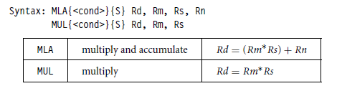
Multiply Instructions
The multiply instructions multiply the contents of a pair of registers.

Slide 45
MLA- EXAMPLE-1
AREA TEST, CODE, READONLY
ENTRY
START
MOV R0,#6
MOV R1,#5
MOV R2,#1
MLA R3,R0,R1,R2 ;R3=(R0*R1) + R2
BACK B BACK
END

Slide 46
MLA- EXAMPLE-2
AREA TEST, CODE, READONLY
ENTRY
START
MOV R0,#6
MOV R1,#5
MOV R2,#1
MLA R0,R0,R1,R2 ;R0=(R0*R1) + R2 NOT ALLOWED
BACK B BACK
END

Slide 47
MLA- EXAMPLE-3
AREA TEST, CODE, READONLY
ENTRY
START
MOV R0,#6
MOV R1,#5
MOV R2,#1
MLA R1,R0,R1,R2 ;R1=(R0*R1) + R2 ALLOWED
BACK B BACK
END

Slide 48
MLA- EXAMPLE-4
AREA TEST, CODE, READONLY
ENTRY
START
MOV R0,#6
MOV R1,#5
MOV R2,#1
MLA R2,R0,R1,R2 ;R2=(R0*R1) + R2 ALLOWED
BACK B BACK
END

Slide 49
MUL – EXAMPLE-1
AREA TEST, CODE, READONLY
ENTRY
START
MOV R0,#6
MOV R1,#5
MUL R3,R0,R1 ;R3=R0*R1
BACK B BACK
END

Slide 50
MUL- EXAMPLE-2
AREA TEST, CODE, READONLY
ENTRY
START
MOV R0,#6
MOV R1,#5
MUL R0,R0,R1 ; THIS REGISTER SEQUENCE NOT ;ALLOWED
BACK B BACK
END

Slide 51
MUL- EXAMPLE-2
AREA TEST, CODE, READONLY
ENTRY
START
MOV R0,#6
MOV R1,#5
MUL R1,R0,R1 ; THIS REGISTER SEQUENCE IS ;ALLOWED BECAUSE N IS COPIED TO TEMP REG
BACK B BACK
END

Slide 52
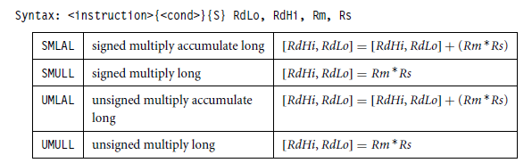

Slide 53
SMLAL - EXAMPLE
AREA TEST, CODE, READONLY
ENTRY
START
ldr R0,=0x5
ldr R1,=0x5
LDR R2,=0X2
LDR R3,=0X4
SMLAL R3,R2,R0,R1 ;[R3Lo,R2Hi]=[R3,R2]+(R0*R1)
BACK B BACK
END

Slide 54
SMULL - EXAMPLE
AREA TEST, CODE, READONLY
ENTRY
START
ldr R0,=0x5
ldr R1,=0x5
LDR R2,=0X2
LDR R3,=0X4
SMULL R3,R2,R0,R1 ;[R3Lo,R2Hi]=(R0*R1)
BACK B BACK
END

Slide 55
UMULL- Example
AREA UMULL1, CODE, READONLY
START
ldr R0,=0xf0000002
ldr R1,=0x00000002
umull r3,R2,R1,R0
MOV R3,#10
BACK B BACK
END

Slide 56
UMLAL- Example
AREA TEST, CODE, READONLY
ENTRY
START
ldr R0,=0x5
ldr R1,=0x5
LDR R2,=0X2
LDR R3,=0X4
UMLAL R3,R2,R0,R1 ;[RdHi, RdLo] = [RdHi, RdLo] + (Rm *Rs)
BACK B BACK
END

Slide 57
Branch Instructions
A branch instruction changes the flow of execution or is used to call a routine.
This type of instruction allows programs to have subroutines, if-then-else structures, and loops.
The change of execution flow forces the program counter pc to point to a new address.

Slide 58
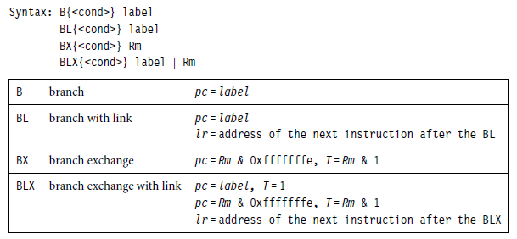
The label is the address stored in the instruction as a signed pc-relative offset and must be within approximately 32 MB of the branch instruction.
T refers to the Thumb bit in the cpsr.
When instructions set T, the ARM switches to Thumb state.

Slide 59
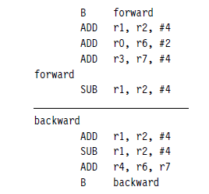
Forward and Backward branch
These loops are address specific, we do not include the pre- and post-conditions.
Following example the forward branch skips three instructions. The backward branch creates an infinite loop.

Slide 60

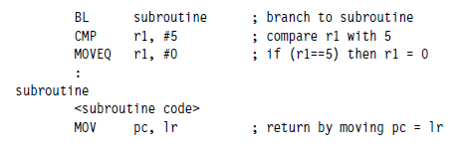
BL (Branch with Link instruction)
BL, instruction is similar to the B instruction but overwrites the link register lr with a return address.
It performs a subroutine call.
Example:

Slide 61
BX (Branch Exchange), BLX (Branch Exchange with Link)
The branch exchange (BX) and branch exchange with link (BLX) are the third type of branch instruction.
The BX instruction uses an absolute address stored in register Rm.
It is used to branch to and from Thumb code.
The T bit in the cpsr is updated by the least significant bit of the branch register.
pc = Rm & 0xfffffffe, T = Rm & 1
Similarly the BLX instruction updates the T bit of the cpsr with the least significant bit and additionally sets the link register with the return address.
pc = label, T = 1
pc = Rm & 0xfffffffe, T = Rm & 1
lr = address of the next instruction after the BLX

Slide 62
Load-Store Instructions
Load-store instructions transfer data between memory and processor registers.
There are three types of load-store instructions:
- single-register transfer,
- multiple-register transfer, and
- swap.

Slide 63
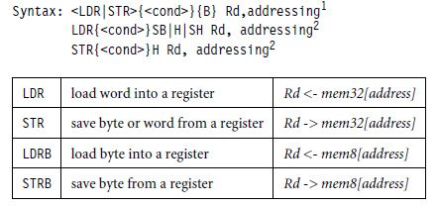
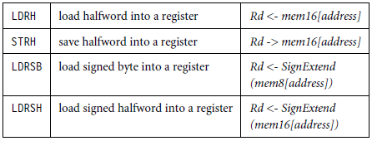
Single-Register Transfer
These instructions are used for moving a single data item in and out of a register.
The datatypes supported are signed and unsigned words (32-bit), halfwords (16-bit), and bytes.

Slide 64
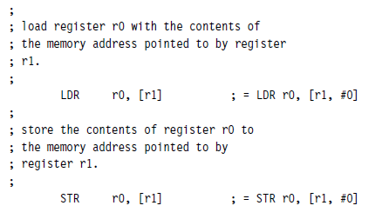
For example, LDR can only load 32-bit words on a memory address that is a multiple of four bytes—0, 4, 8, and so on.
This example shows a load from a memory address contained in register r1, followed by a store back to the same address in memory.

Slide 65
Single-Register Load-Store Addressing Modes
The ARM instruction set provides different modes for addressing memory.
These modes incorporate one of the indexing methods:
-- preindex with writeback,
-- preindex, and
-- postindex

Slide 66
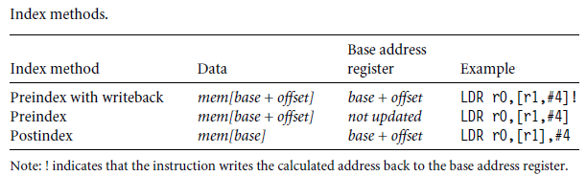

Slide 67
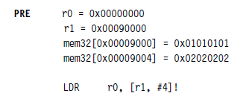

Preindexing with writeback: (Base Register Updated)

Slide 68

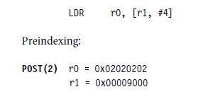
Preindexing: (Base Register not updated)

Slide 69

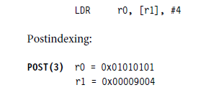
Postindexing: (Base Register Updated)

Slide 70
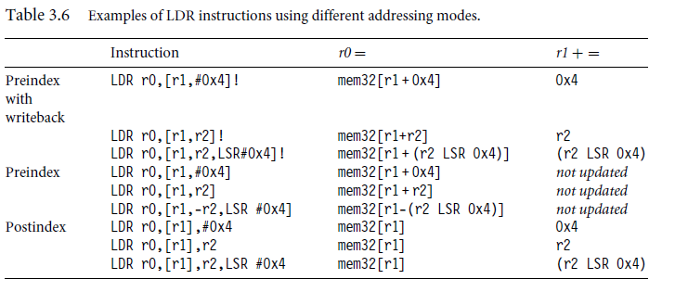

Slide 71
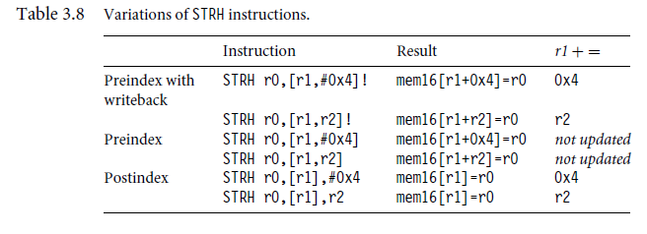

Slide 72
Multiple-Register Load-Store Instructions
Load-store multiple instructions can transfer multiple registers between memory and the processor in a single instruction.
The transfer occurs from a base address register Rn pointing into memory.
Multiple-register transfer instructions are more efficient from single-register transfers.
Load-store multiple instructions increases interrupt latency.

Slide 73
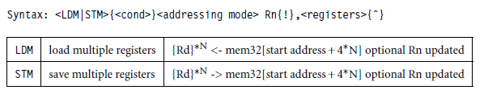
For example, on an ARM7 a load multiple instruction takes
2 + Nt cycles,
where N is the number of registers to load
-- t is the number of cycles required for each sequential access to memory.
If an interrupt has been raised, then it has no effect until the load-store multiple instruction is complete.

Slide 74
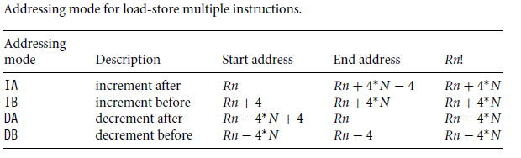
Addressing mode for load-store multiple instructions.

Slide 75

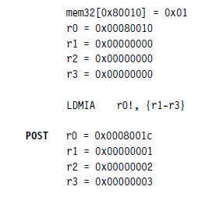
Example

Slide 76
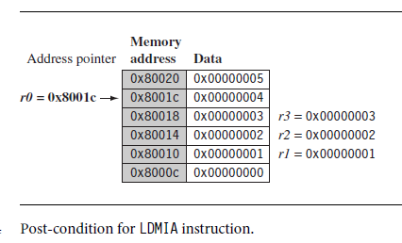
Graphical Representation (IA).

Slide 77
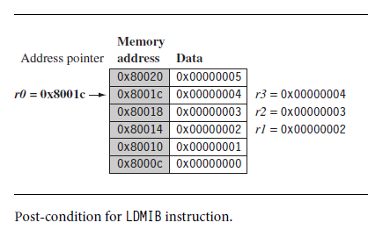
Graphical Representation (IB).

Slide 78
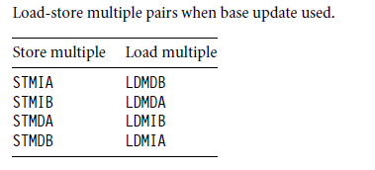
Load-store multiple pairs when base update used.

Slide 79
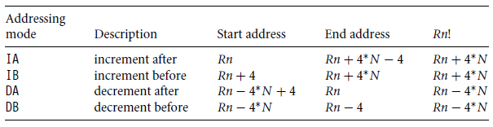
EXAMPLE-1 LDMIA
AREA ASCENDING , CODE, READONLY
ENTRY ;Mark first instruction to execute
START
LDR R2,=CVALUE ; ADDRESS OF CODE REGION
LDMIA R2!,{R3-R6}
BACK B BACK
CVALUE
DCD 0X44444444 ;
DCD 0X11111111 ;
DCD 0X33333333 ;
DCD 0X22222222 ;
END

Slide 80
EXAMPLE-2 LDMIB
AREA ASCENDING , CODE, READONLY
ENTRY ;Mark first instruction to execute
START
LDR R2,=CVALUE ; ADDRESS OF CODE REGION
LDMIB R2!,{R3-R6}
BACK B BACK
CVALUE
DCD 0X44444444 ;
DCD 0X11111111 ;
DCD 0X33333333 ;
DCD 0X22222222 ;
END

Slide 81
EXAMPLE (STMIA)
AREA ASCENDING , CODE, READONLY
ENTRY ;Mark first instruction to execute
START
LDR R2,=CVALUE ; ADDRESS OF CODE REGION
LDMIA R2!,{R3-R6}
LDR R7,=DVALUE
STMIA R7!,{R3-R6}
BACK B BACK
CVALUE
DCD 0X44444444 ;
DCD 0X11111111 ;
DCD 0X33333333 ;
DCD 0X22222222 ;
AREA DATA1, DATA, READWRITE
DVALUE DCD 0X00
END

Slide 82
EXAMPLE (STMIB and LDMDA)
AREA ASCENDING , CODE, READONLY
ENTRY ;Mark first instruction to execute
START
LDR R0,=0X40000000
LDR R1,=0x00000009
LDR R2,=0x00000008
LDR R3,=0x00000007
STMIB r0!, {r1-r3}
MOV r1, #1
MOV r2, #2
MOV r3, #3
LDMDA r0!, {r1-r3}
BACK B BACK

Slide 83
EXAMPLE (STMIB and LDMDB)
AREA ASCENDING , CODE, READONLY
ENTRY ;Mark first instruction to execute
START
LDR R0,=0X40000000
LDR R1,=0x00000009
LDR R2,=0x00000008
LDR R3,=0x00000007
STMIB r0!, {r1-r3}
MOV r1, #1
MOV r2, #2
MOV r3, #3
LDMDB r0!, {r1-r3}
BACK B BACK
end

Slide 84
Stack Operations
The ARM architecture uses the load-store multiple instructions to carry out stack operations.
The pop operation (removing data from a stack) uses a load multiple instruction;
-- The push operation (placing data onto the stack) uses a store multiple instruction
We have to decide whether the stack will grow up or down in memory. A stack is either
-- ascending (A) or
-- descending (D).
Ascending stacks grow towards higher memory addresses;
Descending stacks grow towards lower memory addresses.

Slide 85
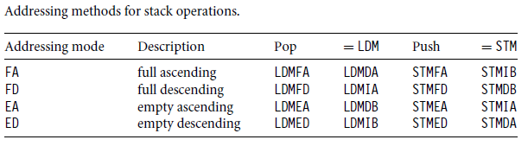
In full stack (F), the stack pointer sp points to an address that is the last used or full location (i.e., sp points to the last item on the stack).
In an empty stack (E) the sp points to an address that is the first unused or empty location (i.e., it points after the last item on the stack).

Slide 86
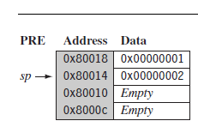
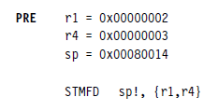
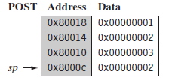

Example-STMFD
The STMFD instruction pushes registers onto the stack, updating the sp. Below example push onto a full descending stack.
When the stack grows the stack pointer (sp) points to the last full entry in the stack. Hence it is called as full and descending because address decreases.

Slide 87
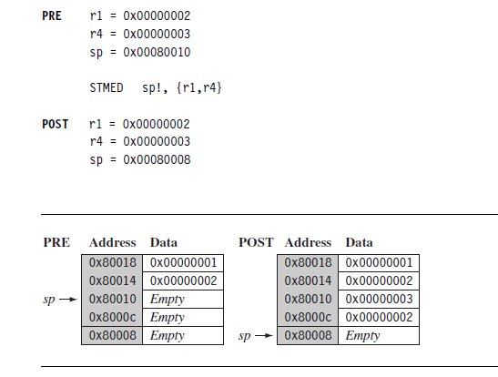
Example-STMED
The STMED instruction pushes the registers onto the stack but updates register sp to point to the next empty location downward.

Slide 88
Example-1 POPING ONE AT A TIME
AREA ASCENDING , CODE, READONLY
ENTRY ;Mark first instruction to execute
START
LDR SP,=0X40000000
LDR R1,=0x00000009
LDR R2,=0x00000008
LDR R3,=0x00000007
STMFA SP!, {r1-r3}
LDMFA SP!,{R4}
LDMFA SP!,{R5}
LDMFA SP!,{R6}
BACK B BACK
END
Note: STMFA == STMIB, LDMFA == LDMDA

Slide 89
Example-2 POPING ALL 3 ELEMENTS
AREA ASCENDING , CODE, READONLY
ENTRY ;Mark first instruction to execute
START
LDR SP,=0X40000000
LDR R1,=0x00000009
LDR R2,=0x00000008
LDR R3,=0x00000007
STMFA SP!, {r1-r3}
LDMFA SP!,{R4-R6}
BACK B BACK
END

Slide 90
Example-3 POPING FROM EMPTY STACK
AREA ASCENDING , CODE, READONLY
ENTRY ;Mark first instruction to execute
START
LDR SP,=0X40000000
LDR R1,=0x00000009
LDR R2,=0x00000008
LDR R3,=0x00000007
STMFA SP!, {r1-r3}
LDMFA SP!,{R4-R6}
LDMFA SP!,{R7} ; UNDER FLOW
BACK B BACK
END

Slide 91
Example-4 Full Descending Stack
AREA ASCENDING , CODE, READONLY
ENTRY ;Mark first instruction to execute
START
LDR SP,=0X4000001F
LDR R1,=0x00000009
LDR R2,=0x00000008
LDR R3,=0x00000007
STMFD SP!, {r1-r3}
LDMFD SP!,{R4-R6}
LDMFD SP!,{R7}
BACK B BACK
END

Slide 92
Checking Stack Under Flow
In handling the stack there are three attributes that need to be preserved:
The stack base,
the stack pointer, and
the stack limit.
The stack base is the starting address of the stack in memory.
The stack pointer initially points to the stack base; as data is pushed onto the stack, the stack pointer descends memory and continuously points to the top of stack.
If the stack pointer passes the stack limit, then a stack overflow occurs

Slide 93
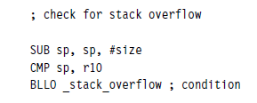
Small piece of code that checks for stack overflow errors for a descending stack

Slide 94
Checking Stack Under Flow
; check for stack overflow
Mov r10,rn
CMP sp, r10
BLT _stack_underflow ; condition

Slide 95
Swap Instruction
The swap instruction is a special case of a load-store instruction.
It swaps the contents of memory with the contents of a register.
This instruction is an atomic operation
—it reads and writes a location in the same bus operation, preventing any other instruction from reading or writing to that location until it completes.

Slide 96
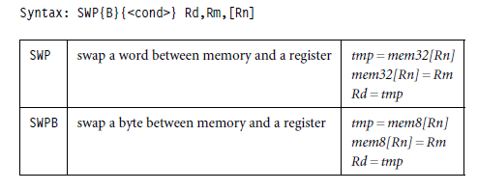
Swap Syntax
Note: Swap cannot be interrupted by any other instruction or any other bus access. The system “holds the bus” until the transaction is complete

Slide 97
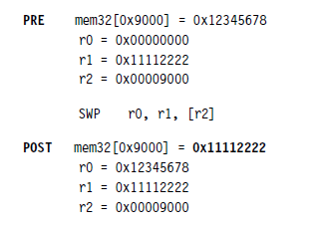
Example-1

Slide 98
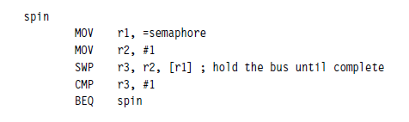
Example-2
This example shows a simple data guard that can be used to protect data from being written by another task.
The SWP instruction “holds the bus” until the transaction is complete.
The address pointed to by the semaphore either contains the value 0 or 1.
If current value of the semaphore is 1, the resource is currently used by other process.
If current value of the semaphore is 0, the resource is currently available/ not used by any of the process.
The process that intends to use the resource (register/ memory ) will make the change the semaphore from 0 to 1
The process that intends to release the resource (register/memory) will change the semaphore from 1 to 0

Slide 99
EXAMPLE-3
AREA ASCENDING , CODE, READONLY
ENTRY ;Mark first instruction to execute
START
LDR R0,=0X11111111
LDR R1,=CVALUE
LDR R2,[R1]
LDR R1,=DVALUE
STR R2,[R1]
SWP R3,R0,[R1]
BACK B BACK
CVALUE DCD 0X22222222
AREA DATA1, DATA, READWRITE
DVALUE DCD 0X22222222
END

Slide 100
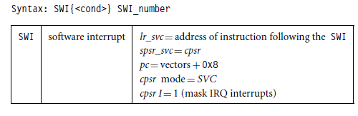
Software Interrupt Instruction
A software interrupt instruction - (SWI)
This causes a software interrupt exception,
Provides a mechanism for applications to call operating system routines.

Slide 101
When the processor executes an SWI instruction, it sets the program counter pc to the offset 0x8 in the vector table.
The processor mode changes to SVC, This allows an operating system routine to be called in a privileged mode.
Each SWI instruction has an associated SWI number, which is used to represent a particular function call or feature.

Slide 102
Example
AREA HelloW,CODE,READONLY; declare area
SWIWrite EQU 0x00 ; Angel SWI number
ENTRY ; code entry point
START ADR r1, TEXT-1 ; r1 -> “Hello World” -1
LOOP MOV r0, #0x1 ; Angel write char in [r1]
LDRB r2, [r1,#1]! ; get the next byte
CMP r2, #0 ; check for text end
SWINE SWIWrite ; if not end print ..
BNE LOOP ; .. and loop back
MOV r0, #0x18 ; Angel exception call
LDR r1, =0x20026 ; Exit reason
SWI &11 ; end of execution
TEXT = "Hello World",0xA,0xD,0
END ; end of program source

Slide 103
Program Status Register Instructions
The ARM instruction set provides two instructions to directly control a program status register (psr).
The MRS instruction transfers the contents of either the cpsr or spsr into a register; in the reverse direction
The MSR instruction transfers the contents of a register into the cpsr or spsr.
Together these instructions are used to read and write the cpsr and spsr.

Slide 104

MRS, MSR Syntax
In syntax the label called fields can be any combination of control (c), extension (x), status (s), and flags (f ).

Slide 105


Slide 106

Example
The MSR first copies the cpsr into register r1.
The BIC instruction clears bit 7 of r1.
Register r1 is then copied back into the cpsr, which enables IRQ interrupts.
This code preserves all the other settings in the cpsr and only modifies the I bit in the control field.
This example is in SVC mode. In user mode you can read all cpsr bits, but you can only update the condition flag field f.

Slide 107
Coprocessor Instructions
Coprocessor instructions are used to extend the instruction set.
A coprocessor provides additional computation capability.
The coprocessor instructions include
- data processing,
- register transfer, and
- memory transfer instructions.
We discuss only a short overview since these instructions are coprocessor specific.
Note that these instructions are only used by cores with a coprocessor.

Slide 108


Co-processor Instruction Syntax
The cp field represents the coprocessor number between p0 and p15.
The opcode fields describe the operation to take place on the coprocessor.
The Cn, Cm, and Cd fields describe registers within the coprocessor.
Coprocessor 15 (CP15) is reserved for system control purposes, such as memory management, write buffer control, cache control, and identification registers.

Slide 109
Example
Transferring the contents of CP15 coprocessor register c0 to register r10.
Here CP15 register-0 contains the processor identification number. This register is copied into the general-purpose register r10.

Slide 110

Loading Constants
In ARM there is no ARM instruction to move a 32-bit constant into a register.
To aid programming there are two pseudo instructions to move a 32-bit value into a register.

