Slide 1
Chapter-6
Writing and Optimizing ARM
Assembly Code

Slide 2
Code Optimization
Optimizing code reduces the
system power consumption and
reduce the clock speed needed for real-time operation.
Optimization can turn an infeasible system into a feasible one, or an uncompetitive system into a competitive one.
Maximum performance, can be achieved using hand-written assembly code.
Writing assembly code gives you direct control of three optimization tools that you cannot explicitly use by writing C source:

Slide 3
Three optimization tools
■ Instruction scheduling:
Reordering the instructions in a code sequence to avoid processor Stalls because of dependency.
■ Register allocation:
Deciding how variables should be allocated to ARM registers or stack locations for maximum performance.
■ Conditional execution:
Accessing the full range of ARM condition codes and conditional instructions..

Slide 4
Register Allocation
Amoung 16 visible ARM registers, 14 registers can be used to hold general-purpose data.
The other twonregisters are the
stack pointer r13
program counter r15.
For a function to be ATPCS (ARM-Thumb Procedure Call Standard) compliant it must preserve the callee values of registers r4 to r11.
ATPCS also specifies that the stack should be eight-byte aligned;
Use the following template for optimized assembly routines requiring many registers:

Slide 5
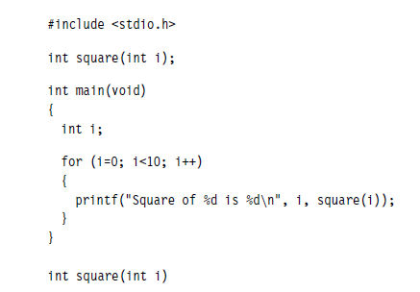

Writing Assembly Code
This section gives examples showing how to convert the C function to basic assembly code. Main.c

Slide 6
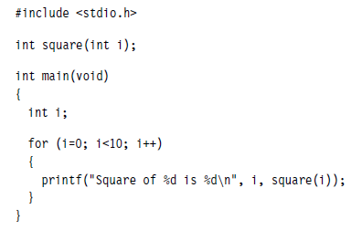
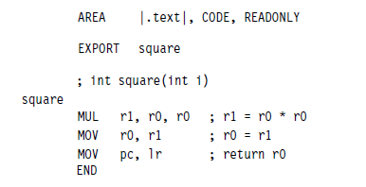
Assembly Equivalent Code for square function Main1.c square.s
The AREA directive names the area or code section that the code lives in.
If you use non-alphanumeric characters in a symbol or area name, then enclose the name in vertical bars.
Read-only code area called .text.

Slide 7
The EXPORT directive makes the symbol square available for external linking.
At line six we define the symbol square as a code label.

Slide 8
armasm treats non-indented text as a label definition.
When square is called the input argument is passed in register r0, and the return value is returned in register r0.
Return control back
The multiply instruction has a restriction that the destination register must not be the same as the first argument register.
Therefore we place the multiply result into r1 and move this to r0.
The END directive marks the end of the assembly file. Comments follow a semicolon.
MOV pc, lr ; return r0

Slide 9

Building this example using command line tools.
This only works if you are compiling your C as ARM code. i.e., armcc

Slide 10
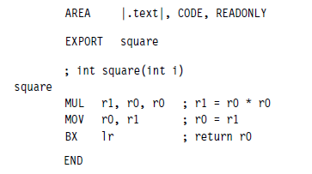
Compile your C code as Thumb code
When calling ARM code from C program compiled as Thumb, the only change required to the assembly code of previous example is to change the return instruction to a BX.
Use BX lr instead of MOV pc, lr
square2.s

Slide 11

Building C Program as Thumb Code
-apcs/Interwork option to tell armasm that the square2.s arm state program interworks with C thumb code.
APCS –Automated Project Control System

Slide 12
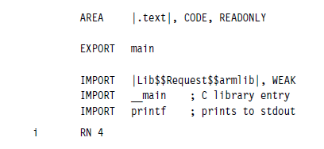
Calling C subroutine from assembly Code
Create a new assembly file main3.s
IMPORT directive is used to declare symbols that are defined in other files.
The imported symbol Lib$$Request$$armlib makes a request that the linker links with the standard ARM C library.
The WEAK specifier prevents the linker from giving an error if the symbol is not found at link time. If the symbol is not found, it will take the value zero.
The second imported symbol ___main is the start of the C library initialization code.
You only need to import these symbols if you are defining your own main; a main defined in C code will import these automatically for you.
Importing printf allows us to call that C library function.
The RN directive allows us to define i as an alternate name for register r4.

Slide 13
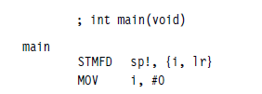
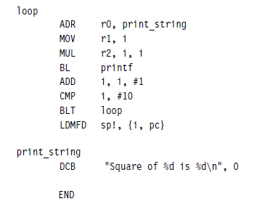
Complete Program

Slide 14
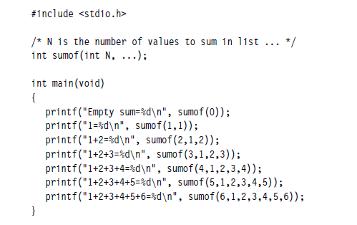
Example
The sumof function is written in assembly and can accept any number of arguments.
C program file main4.c:

Slide 15
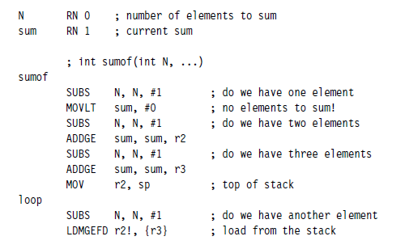
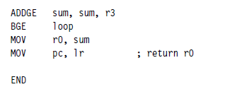
sumof function in an assembly file sumof.s:

Slide 16

Building this example using the commands
Note: Execution requires a special simulator or external display device like LCD display.

Slide 17
Profiling and Cycle Counting
The optimization process requires the identification of the
- critical routines and measure their current performance.
A profiler:
- is a tool that measures the time or cycles taken for each subroutine.
- Profiler is used to identify the most critical routines.
A cycle counter:
- measures the number of cycles taken by a specific routine.
- cycle counter can be used as a benchmark to measure the subroutine performance before and after an optimization.
Note: The ARM simulator called the ARMulator and provides profiling and cycle counting features.

Slide 18
Instruction Scheduling
The time taken to execute instructions depends on the implementation of pipeline.
Here we consider the ARM9TDMI pipeline timings.
All conditional instructions on the value of the ARM condition codes in the cpsr take one cycle if the condition is not met.
If the condition is met, then the following rules apply:
ALU operations such as addition, subtraction, and logical operations take one cycle. This includes a shift by an immediate value. If you use a register-specified shift, then add one cycle. If the instruction writes to the pc, then add two cycles.

Slide 19
2. Load instructions that load 32-bit words of memory such as LDR and LDM take N cycles to issue. If the instruction loads pc, then add two cycles.
3. Load instructions that load 16-bit or 8-bit data such as LDRB, LDRSB, LDRH, and LDRSH take one cycle to issue.
4. Branch instructions take three cycles.
5. Store instructions that store N values take N cycles.
6. Multiply instructions take a varying number of cycles depending on the value of the second operand

Slide 20
ARM pipeline and dependencies
To understand how to schedule code efficiently on the ARM, we need to understand the ARM pipeline and dependencies.
The ARM9TDMI processor performs five operations in parallel:
1. Fetch
2. Decode
3. Execute (ALU)
4. LS1
5. LS2

Slide 21
ARM9TDMI- Pipeline
Fetch:
Fetches instruction from memory using pc.
The instruction is then loaded into the core and then processed down the core pipeline.
Decode:
Decode the instruction that was fetched in the previous cycle.
The processor also reads the input operands from the register bank or if they are not available via one of the forwarding paths.

Slide 22
Execute (ALU):
Executes the instruction that was decoded in the previous cycle.
This instruction was originally fetched from address pc − 8 (ARM state) or pc − 4 (Thumb state).
This stage calculates
- the answer for a data processing operation,
- the address for a load, store, or branch operation.
Some instructions takes several cycles in this stage.
- For example, multiply and register-controlled shift operations take several ALU cycles.

Slide 23
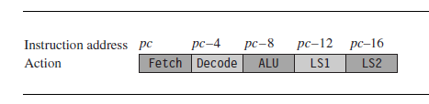
LS1:
- This stage Load or store the data specified by a load or store instruction.
- If the instruction is not a load or store, then this stage has no effect or bypassed.
LS2:
Sign-extend the data loaded by a byte or halfword load instruction. - If the instruction is not a load of an 8-bit byte or 16-bit halfword item, then this stage has no effect.

Slide 24

How does the pipeline affect the timing of instructions?
If an instruction requires the result of a previous instruction that is not available, then the processor stalls.
This is called a pipeline hazard or pipeline interlock.
Example with no pipeline interlock
The ALU calculates r0 + r1 in one cycle.
Therefore this result is available for the ALU to calculate r0 + r2 in the second cycle.

Slide 25

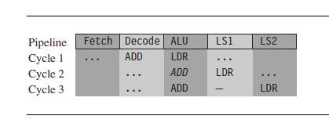
Example shows a one-cycle pipeline interlock caused by load use.
The ALU calculates the address r2 + 4 in the first cycle while decoding the ADD instruction in parallel.
However, the ADD cannot proceed on the second cycle because the load instruction has not yet loaded the value of r1.
Therefore the pipeline stalls for one cycle while the load instruction completes the LS1 stage. Now that r1 is ready, the processor executes the ADD in the ALU on the third cycle.

Slide 26

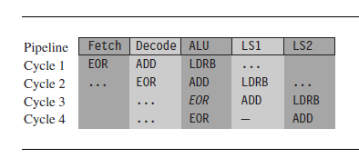
Example shows a one-cycle interlock caused by delayed load use.

Slide 27
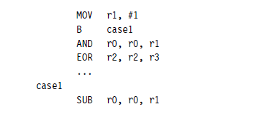
Example shows why a branch instruction takes three cycles
On the second cycle, the branch instruction calculates the destination address.
This causes the core to flush the pipeline and refill it using this new pc value.
The refill takes two cycles. Finally, the SUB instruction executes normally.

Slide 28
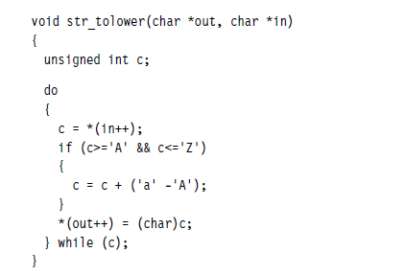
Scheduling of load instructions
Let’s consider an example of a memory-intensive task.
The following function, str_tolower, copies a zero-terminated string of characters from in to out. It converts the string to lowercase in the process.

Slide 29
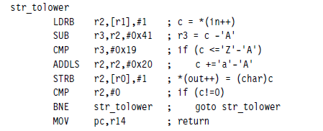
Compiler generates the following compiled output.
Notice that the compiler optimizes the condition (c>=‘A’ && c<=‘Z’) to the check that 0<=c-‘A’<=‘Z’-‘A’.
The ARM9TDMI pipeline will stall for two cycles in each iteration

Slide 30
Cycle Count
str_tolower
LDRB r2,[r1],#1 ; c = *(in++) cycle-1
cycle-2 stall
cycle-3 stall
SUB r3,r2,#0x41 ; r3 = c -‘A’ cycle-4
CMP r3,#0x19 ; if (c <=‘Z’-‘A’) cycle-5
ADDLS r2,r2,#0x20 ; c +=‘a’-‘A’ cycle-6
STRB r2,[r0],#1 ; *(out++) = (char)c cycle-7
CMP r2,#0 ; if (c!=0) cycle -8
BNE str_tolower ; goto str_tolower cycle-9
cycle-10 flush
cycle-11 flush
MOV pc,r14 ; return

Slide 31

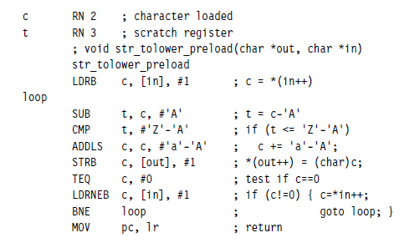
Load scheduling by preloading and unrolling.
Apply the preload method to the str_tolower function.

Slide 32
Pre load Cycle count
LDRB c, [in], #1 ; c = *(in++)
loop
SUB t, c, #’A’ ; t = c-’A’ cycle-1
CMP t, #’Z’-’A’ ; if (t <= ’Z’-’A’) cycle-2
ADDLS c, c, #’a’-’A’ ; c += ’a’-’A’; cycle-3
STRB c, [out], #1 ; *(out++) = (char)c; cycle-4
TEQ c, #0 ; test if c==0 cycle-5
LDRNEB c, [in], #1 ; if (c!=0) { c=*in++; cycle-6
BNE loop ; goto loop; } cycle-7
cycle-8 flush
cycle-9 flush
MOV pc, lr ; return

Slide 33
Preload speed improvement
Scheduling with Preload speed improvement over the original code is
= 11/9
= 1.22 time more faster than the original code.

Slide 34

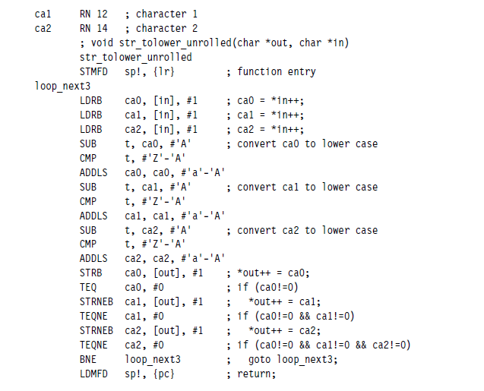
Load Scheduling by Unrolling

Slide 35
loop_next3 Clock Cycles
LDRB ca0, [in], #1 ; ca0 = *in++; c1
LDRB ca1, [in], #1 ; ca1 = *in++; c2
LDRB ca2, [in], #1 ; ca2 = *in++; c3
SUB t, ca0, #’A’ ; convert ca0 to lower case c4
CMP t, #’Z’-’A’ c5
ADDLS ca0, ca0, #’a’-’A’ c6
SUB t, ca1, #’A’ ; convert ca1 to lower case c7
CMP t, #’Z’-’A’ c8
ADDLS ca1, ca1, #’a’-’A’ c9
SUB t, ca2, #’A’ ; convert ca2 to lower case c10
CMP t, #’Z’-’A’ c11
ADDLS ca2, ca2, #’a’-’A’ c12
STRB ca0, [out], #1 ; *out++ = ca0; c13
TEQ ca0, #0 ; if (ca0!=0) c14
STRNEB ca1, [out], #1 ; *out++ = ca1; c15
TEQNE ca1, #0 ; if (ca0!=0 && ca1!=0) c16
STRNEB ca2, [out], #1 ; *out++ = ca2; c17
TEQNE ca2, #0 ; if (ca0!=0 && ca1!=0 && ca2!=0) c18
BNE loop_next3 ; goto loop_next3; c19
flush c20
flush c21
3 iterations – 21 cycles
1 Iteration – 7 cycles
Hence the performance enhancement of unrolled code=11/7
= 1.57 time more faster than the original code

Slide 36
Register Allocation
Among 16 visible ARM registers, 14 registers are used to hold general-purpose data.
The remaining two registers are the
- stack pointer r13 and
- the program counter r15.
For a function to be ATPCS – ARM-Thumb Procedure Call Standards compliant it must preserve the callee values of registers r4 to r11.
ATPCS also specifies that the stack should be eight-byte aligned;
-stored at an address which is multiple of 8 bytes.

Slide 37
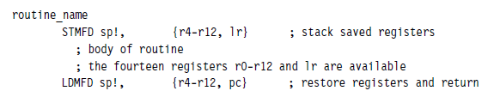
Template for optimized assembly routines requiring many registers
r12 is also stacked just to keep the stack eight-byte aligned.
Address starts from 0 and ends at 28 for r4-r11. 28 is not multiple of 8.
Address starts from 0 and ends at 32 for r4-r12. 32 is multiple of 8.
r12 need not be stacked if your routine doesn’t call other ATPCS routines.

Slide 38
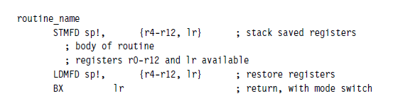
For ARMv5 and above you can use the preceding template even when being called from Thumb code.
For ARM4 and below you have to use the following template.

Slide 39
Allocating Variables to Register Numbers
It is best to use alternate names to the registers, rather than explicit register numbers.
Benefits of using alternate names:
Allows you to change the allocation of variables to register numbers easily.
Allows to use different register names for the same physical register number when their use doesn’t overlap.
Register names increase the clarity and readability of optimized code.

Slide 40
There are several cases where the physical number of the register is important:
■ Argument registers.
- The ATPCS convention defines that the first four arguments to a function are placed in registers r0 to r3.
- Further arguments are placed on the stack.
- The return value must be placed in r0.
■ Registers used in a load or store multiple.
- Load and store multiple instructions LDM and STM operate on a list of registers in order of ascending register number.
- For example if r0 and r1 appear in the register list, then the processor will always load or store r0 using a lower address than r1 and so on.
■ Load and store double word.
The LDRD and STRD instructions introduced in ARMv5E operate on a pair of registers with sequential register numbers, Rd and Rd + 1.

Slide 41
How to allocate registers when writing assembly?
suppose if we want
- to shift an array of N bits upwards in memory by k bits.
- For simplicity assume that N is large and a multiple of 256.
- Also assume that 0 ≤ k < 32 and that the input and output pointers are word aligned I,e. 2 to the power k .
- Block a copy from one bit or byte alignment to a different bit or byte alignment

Slide 42
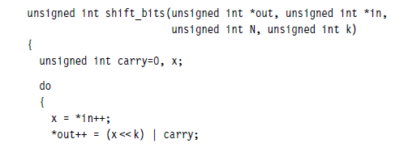
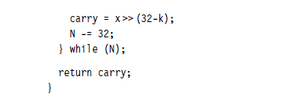
C Function

Slide 43
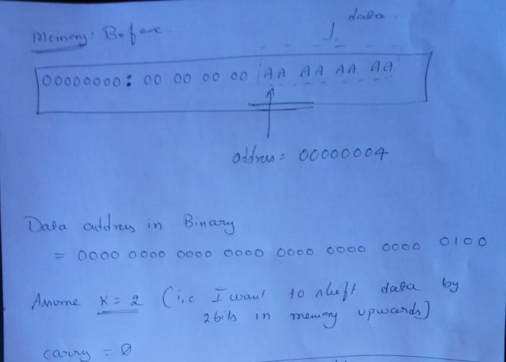
Explanation

Slide 44
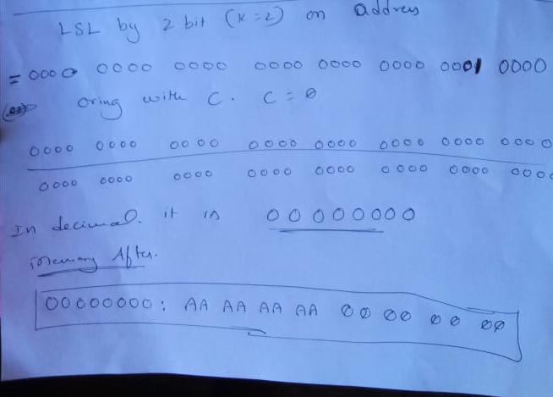

Slide 45
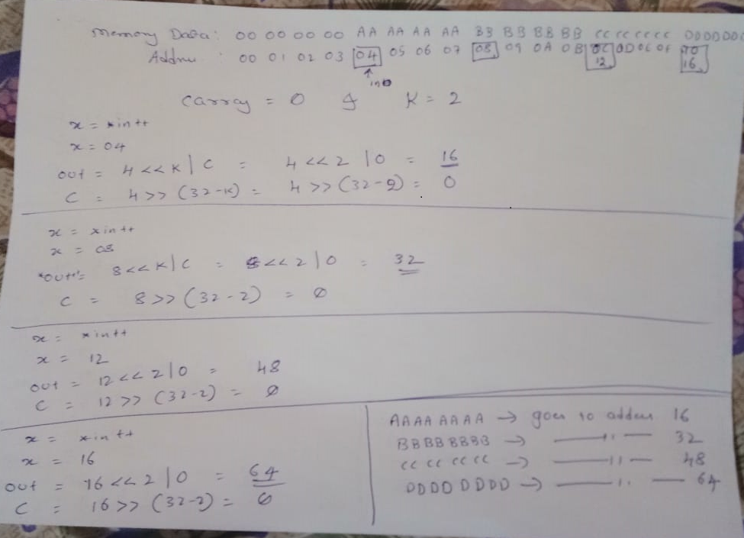

Slide 46
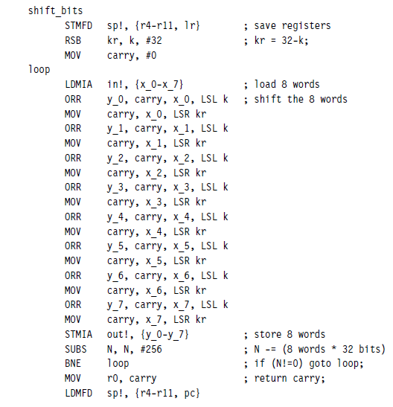
Improving the efficiency of the by loop unrolling

Slide 47

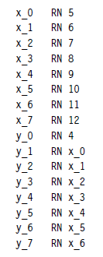

Register Allocation
All registers are finished. There are two remaining variables carry and kr, but only one remaining free register lr.

Slide 48
Possible ways deal when we run out of registers:
■ Reduce the number of registers required by performing fewer operations in each loop.
In previous example we could load four words in each load multiple rather than eight.
■ Use the stack to store the least-used values to free up more registers.
In previous example we could store the loop counter N on the stack.
■ Alter the code implementation to free up more registers.
This is the solution we consider in the next example.

Slide 49
Modified Implementation
We notice that the carry value need not stay in the same register.
We can start off with the carry value in y0 and then move it to y1 when x0 is no longer required, and so on.
We complete the routine by allocating kr to lr and recoding so that carry is not required.

Slide 50
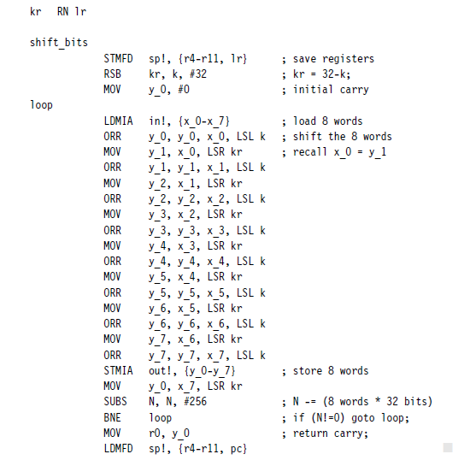

Slide 51
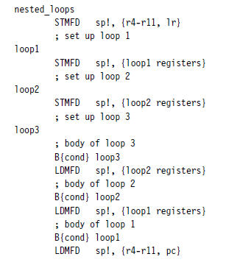
Using More than 14 Local Variables
If you need more than 14 local 32-bit variables in a routine, then you must store some variables on the stack.
While poping pop them
in the reverse order.

Slide 52
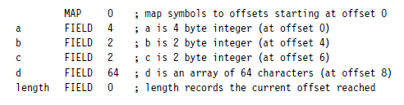
ARM assembler directives MAP (alias ∧) and FIELD (alias #)
ARM assembler directives MAP (alias ∧) and FIELD (alias #) to define and allocate space for variables and arrays on the processor stack.

Slide 53
Making the Most of Available Registers
It is more efficient to access values held in registers than values held in memory.
There are several tricks you can use to fit several sub-32-bit length variables into a single 32-bit register and thus can reduce code size and increase performance.

Slide 54

Example
sample = table[index];
index += increment;
Commonly index and increment are small enough to be held as 16-bit values.
We can pack these two variables into a single 32-bit variable indinc:
31 15 0
Index Increment
indinc = (index>>16) + Mask MSB( increment)

Slide 55


SIMD- Single Issue Multiple Data Example
Example of how to process multiple 8-bit pixels in an image using normal ADD and MUL instructions to achieve some SIMD operations.
Suppose we want to merge two images X and Y to produce a new image Z.
Let xn, yn, and zn denote the nth 8-bit pixel in these images, respectively.
Let 0 ≤ a ≤ 256 be a scaling factor.
To merge the images, we set

Slide 56
Summary Register Allocation
■ ARM has 14 available registers for general-purpose use: r0 to r12 and r14.
The stack pointer r13 and program counter r15 cannot be used for general-purpose data.
■ If you need more than 14 local variables, push the variables to the stack.
■ Use register names instead of physical register numbers when writing assembly routines. This makes it easier to reallocate registers and to maintain the code.
■ Store multiple values in the same register.
For example, you can store a loop counter and a shift in one register.
You can also store multiple pixels in one register.

Slide 57
Conditional Execution
The processor core can conditionally execute most ARM instructions.
By combining conditional execution and conditional setting of the flags, it is possible to implement simple if statements without any need for branches.
This improves efficiency since branches can take many cycles and also reduces code size.

Slide 58
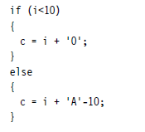

Example-1
The following C code converts an unsigned integer 0 ≤ i ≤ 15 to a hexadecimal character c:

Slide 59
Working Example
AREA TEST, CODE, READONLY
START
MOV R0,#11
CMP R0, #10
ADDLO R1,R0, #'0'
ADDHS R1,R0, #'A'-10
END

Slide 60

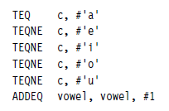
Example-2
Counting vowels

Slide 61

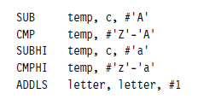
Example-3
Detect if c is a letter:

Slide 62
Working Example
AREA TEST, CODE, READONLY
c rn 0
temp rn 1
letter rn 2
START
MOV c,#66
sub temp,c,#'A'
cmp temp,#'Z'-'A'
subhi temp, c, #'a'
cmphi temp,#'z'-'a'
addls letter,letter,#1
END

Slide 63
Looping Constructs
ARM loops are fastest when they count down towards zero.
Here we understand to implement
- count down loops efficiently in assembly and
- unroll loops for maximum performance.

Slide 64
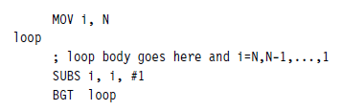
Decremented Counted Loops N to 1 (inclusive)
In decrementing loop of N iterations, the loop counter i counts down from N to 1 inclusive.
The loop terminates with i = 0. An efficient implementation is

Slide 65
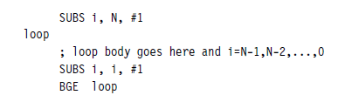
Decremented Counted Loops N to 0 (inclusive)

Slide 66
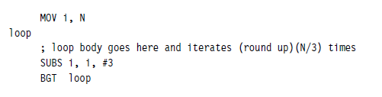
Decremented Counted Loops N to N/3 (inclusive)

Slide 67
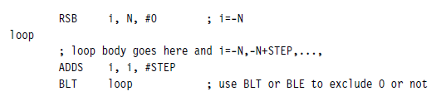
Other Counted Loops
Negative Indexing
This loop structure counts from −N to 0 (inclusive or exclusive) in steps of size STEP.

Slide 68
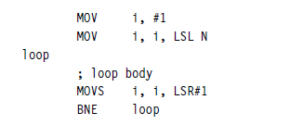
Logarithmic Indexing
-- This loop structure counts down from 2N to 1 in powers of two. For example, if N = 4, then it counts 16, 8, 4, 2, 1.

Slide 69


The following loop structure counts down from an N-bit mask to a one-bit mask.
For example, if N = 4, then it counts 15, 7, 3, 1.

Slide 70

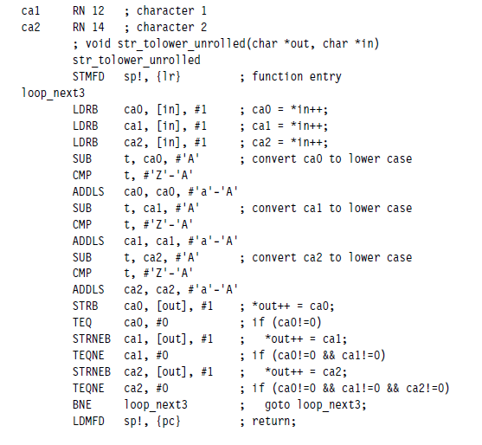
Unrolled Loop

Slide 71
Summary Looping Constructs
■ ARM requires two instructions to implement a counted loop: a subtract that sets flags and a conditional branch.
■ Unroll loops to improve loop performance. Do not over unroll because this will hurt cache performance. Number of unroll is limited by the number of registers available.
■ ARM can implement negative and logarithmic indexed loops efficiently.

