Slide 1
OPENAI SINGAPORE HAPPY HOUR
Celebrating 100 Staff
100
Tuesday, 23 June 2026
Marina Bay
A Singapore team milestone worth pausing for.
Food, trivia, prizes, jerseys, and a proper toast to the team.
OpenAI Singapore Happy Hour | 23 Jun 2026 | Marina Bay
01

Slide 2
PROPOSED AGENDA
The evening at a glance
4:30
4:45
5:00
5:05
5:15+
Food arrival
Guests arrive
Opening remarks
Trivia challenge
Feast & social
Catering arrives on-site; allow 15 minutes for setup.
Food, trivia, and jersey area ready for the team.
Host welcome and 100-staff milestone celebration.
Scan, join, and complete 15 questions in 5 minutes.
Food service, photos, and time together.
Keep the formal moments crisp; let the room move quickly into the celebration.
OpenAI Singapore Happy Hour | 23 Jun 2026 | Marina Bay
02

Slide 3
READINESS
Before guests arrive
4:30 PM
Food setup
Trivia platform
Completed and guest-ready by 4:45 PM.
Test the link and keep QR visible in rooms.
Food arrival
Catering arrives on-site. Allow approximately 15 minutes for setup and arrangement.
Jersey swag distribution
Prep the distribution area early so giveaway flow stays relaxed after winners are announced.
OpenAI Singapore Happy Hour | 23 Jun 2026 | Marina Bay
03

Slide 4
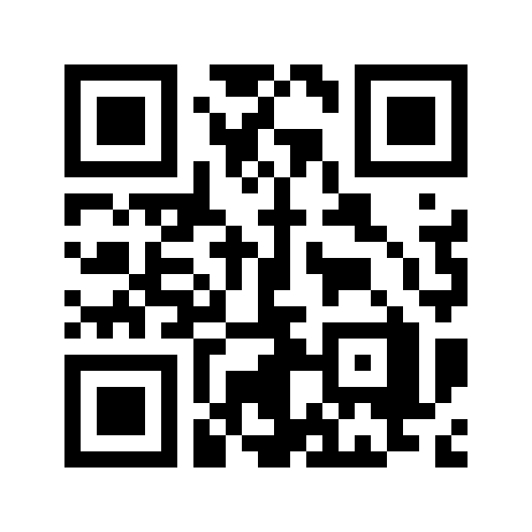
OPENAI TRIVIA CHALLENGE
Scan to play
15 Singapore office questions
5 minutes to complete
Leaderboard unlocks at completion
https://oai-trivia.vercel.app/
Host: Madani starts the game once everyone is ready.
Enter your name, wait for host start, then answer quickly.
OpenAI Singapore Happy Hour | 23 Jun 2026 | Marina Bay
04

Slide 5
WINNERS AND GIVEAWAYS
Top 3 take the prizes
1st
2nd
3rd
Trivia prize
Trivia prize
Trivia prize
$30 Grab voucher
$20 Grab voucher
$10 Grab voucher
100 commemorative jersey swags
Distributed to attendees to mark the 100-staff milestone.
OpenAI Singapore Happy Hour | 23 Jun 2026 | Marina Bay
05

Slide 6
5:15 PM ONWARDS
Feast, social hour, and photos
Food service begins.
Team celebration and networking.
Photo opportunities around the room.
Enjoy the evening and celebrate the growth of the Singapore team.
100
Singapore staff milestone
Thank you for helping make the Singapore office feel like a team.
OpenAI Singapore Happy Hour | 23 Jun 2026 | Marina Bay
06

