Slide 1
The Battle of the Neighbourhoods
By Aayush Mishra

Slide 2
Introduction
Mumbai is a big fast moving city in India.It gives homes to millions and also acts as a tourist spot.Mumbai is known as the economical capital of india.There are many places to go around in the city. There are many restaurants and cafes in Mumbai that are famous for their different food items.There are many places for tourists to go shopping at.

Slide 3
Problems and goal of the project
The issues that i target:
1)List and visualize all the restaurants and cafes in Mumbai.
2)List and visualize all the Hotels in Mumbai.
3)List and visualize all the shopping areas in Mumbai
Goal -
The goal of this project is to create a representation for the tourists visiting mumbai in order to make their stay comfortable in this beautiful city.This representation aims to show them the restaurants,hotels and shopping areas to go visit and stay at.

Slide 4
DATA SECTION
To get all of this data, i am using the Foursquare API which is sufficient to provide me with all the data i need.It can provide me with the categories,names of the places and most importantly, its latitude and longitudes

Slide 5
METHODOLOGY
Step1) We begin by importing all the libraries that we might need while doing this problem.Once we are done with that,we can put in our client id and the key to access the Foursquare API.
Step2) We put in the location in my case,Mumbai, and first we look for all the restaurants using the API. We fetch all the data and store it in a form of dataframe.
Step3)We check for all the null values that might be present in our data before cleaning our data.
Step4)We drop all the null values and drop all those columns which do not provide any value to our data.And the we then get the data that we can visualize.
Step5)We look for all the Hotels using the API. We fetch all the data and store it in a form of dataframe.
Step6)We again check for any null values in our data and get rid of them.We also drop the columns which are of no use to us and hence clean our data.
Step7)We then look for all the shopping centres and fetch them using the API.We take the data and put it in a dataframe.
Step8)We check for possible null values in our data and drop the columns that are not required in order to clean our data.
Step9)We now have our three different cleaned data frames of all the restaurants,,shopping centres and hotels.We take these data frames and concatenate them to form one single data frame.
Step10) We make use of folium library to make the map of the region and use various methods to mark our locations on the map to distinguish them from other places.Then we plot the final map to locate all the places.

Slide 6
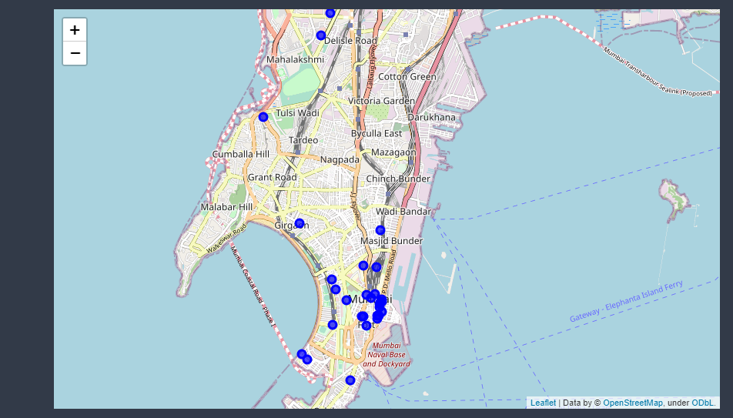
RESULT
We were able to successfully create a map visualization to show all the nearby shopping centres,Restaurants and Hotels which might help the tourists who are visiting the city for the first time, to get good food, tourism and overall a great experience..This Project was build to help the tourists find the best and most comfortable stay possible in the city.

