Slide 1
AM2PM SUPPORT
Call Center CRM
Architecture, database relationships and build plan
Vercel
MongoDB Atlas
Upstash QStash
Upstash Redis
Blob / R2
Version 1.0 · 1 October 2026

Slide 2
Serverless CRM for ~$105/month at 200 agents
Vercel + MongoDB Atlas + Upstash; no servers, Kubernetes or ops staff
$28
$105
$550
per month in pilot
per month at growth
per month at scale
1 client, ≤20 agents
~200 agents
~2,000 agents
Auto-import
Auto-assignment
Outbound webhooks
Every source pushes a webhook or is pulled every 15 minutes. Nobody clicks "Sync".
Deduped and handed to an eligible agent within seconds, atomically.
lead.converted and 7 more events, HMAC-signed, retried for 24 hours.
AM2PM Call Center CRM

Slide 3
What we keep from each existing design
crmv7 logic + MongoDB doc structure + low-cost PDF runtime
Area | crmv7.gs (Sheets) | MongoDB doc v1 | Low-cost PDF | This design
Runtime | Apps Script, 6-min runs | NestJS + BullMQ on K8s | Vercel + QStash | Vercel + QStash
Database | Sheet tabs | Replica set → sharded | Neon Postgres | MongoDB Atlas
Lead import | Manual sync | source + dedupeKey | Auto, 7 sources | Auto, 7 sources
Assignment | Equal/%/Ratio/Number | RR / skill / load | All of both | All, interleaved, atomic
Outbound webhooks | None | Workflow action | Signed, retried | Signed, retried, outbox
Tenant isolation | Sheet per client | tenantId layer | Row-Level Security | tenantId layer + tests
Cost at 200 agents | ~$0, breaks at scale | ~$400+ + ops | ~$70 | ~$105
AM2PM Call Center CRM

Slide 4
One serverless stack, billed per use
Each layer replaces something that was expensive or fragile
APP + API
DATABASE
QUEUE
Next.js on Vercel
Agent screen, admin, client portal, public API
MongoDB Atlas (Mumbai)
Via Vercel Marketplace; one bill
Upstash QStash
Retries, DLQ, cron fan-out
LIVE STATE
JOBS
FILES
Upstash Redis
Presence, cursors, rate limits
Vercel Cron
Reminders, sweeper, rollups
Vercel Blob / R2
Recordings, CSVs, signed URLs
AUTH
TELEPHONY
MESSAGING
Auth.js
Google + OTP, optional TOTP
CallerDesk
Click-to-call, recordings
Interakt · Brevo · Resend
WhatsApp, campaigns, email
AM2PM Call Center CRM

Slide 5
MongoDB costs ~1.5× Neon at every stage
Monthly USD by stage, provider charges (minutes, WhatsApp, email) excluded
Atlas tier by stage
Pilot: Flex $8 (5 GB)
Growth: M10 ~$57
Scale: M30 ~$388
Cost rules
Recordings in Blob/R2, never in MongoDB. TTL on raw webhooks (60 d). Dashboards read daily_stats only. M10 before first paying client.
AM2PM Call Center CRM

Slide 6
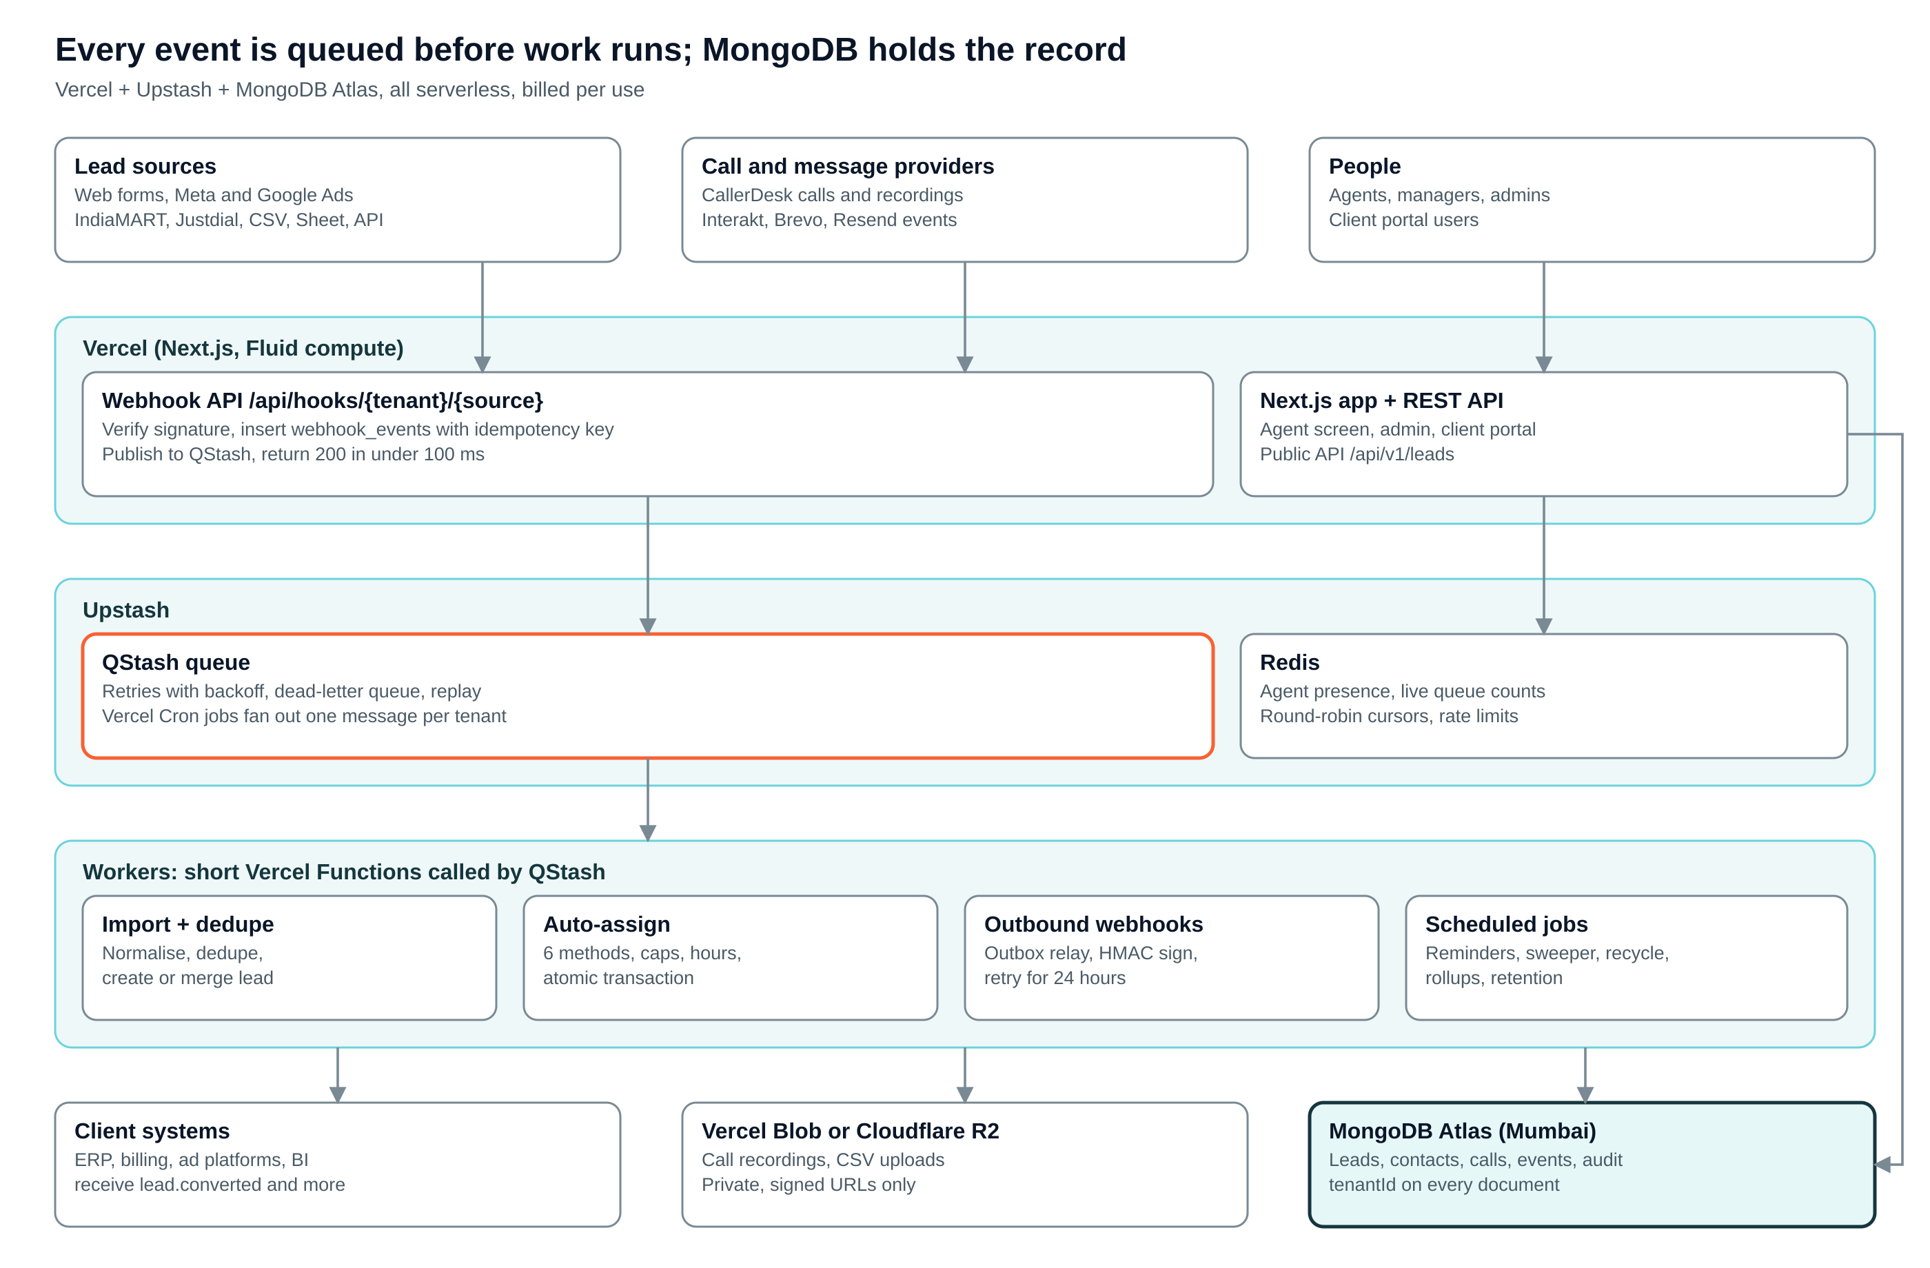
Architecture: every event is queued before work runs
AM2PM Call Center CRM

Slide 7
One database, many clients: isolation by design
MongoDB has no row-level security, so the app layer enforces it and tests prove it
Tenancy model
Rules that enforce safety
Default: shared collections, tenantId on every document
Large or regulated client: own database, same code (isolation: "dedicated")
Cluster per tenant: avoid, too expensive
Atlas region Mumbai for DPDP
$jsonSchema rejects documents without tenantId
Every index starts with tenantId
Repository db(ctx) injects tenantId into every query and $match
Lint rule blocks raw collection access
Cross-tenant test on every API route
Super Admin queries audit-logged
AM2PM Call Center CRM

Slide 8
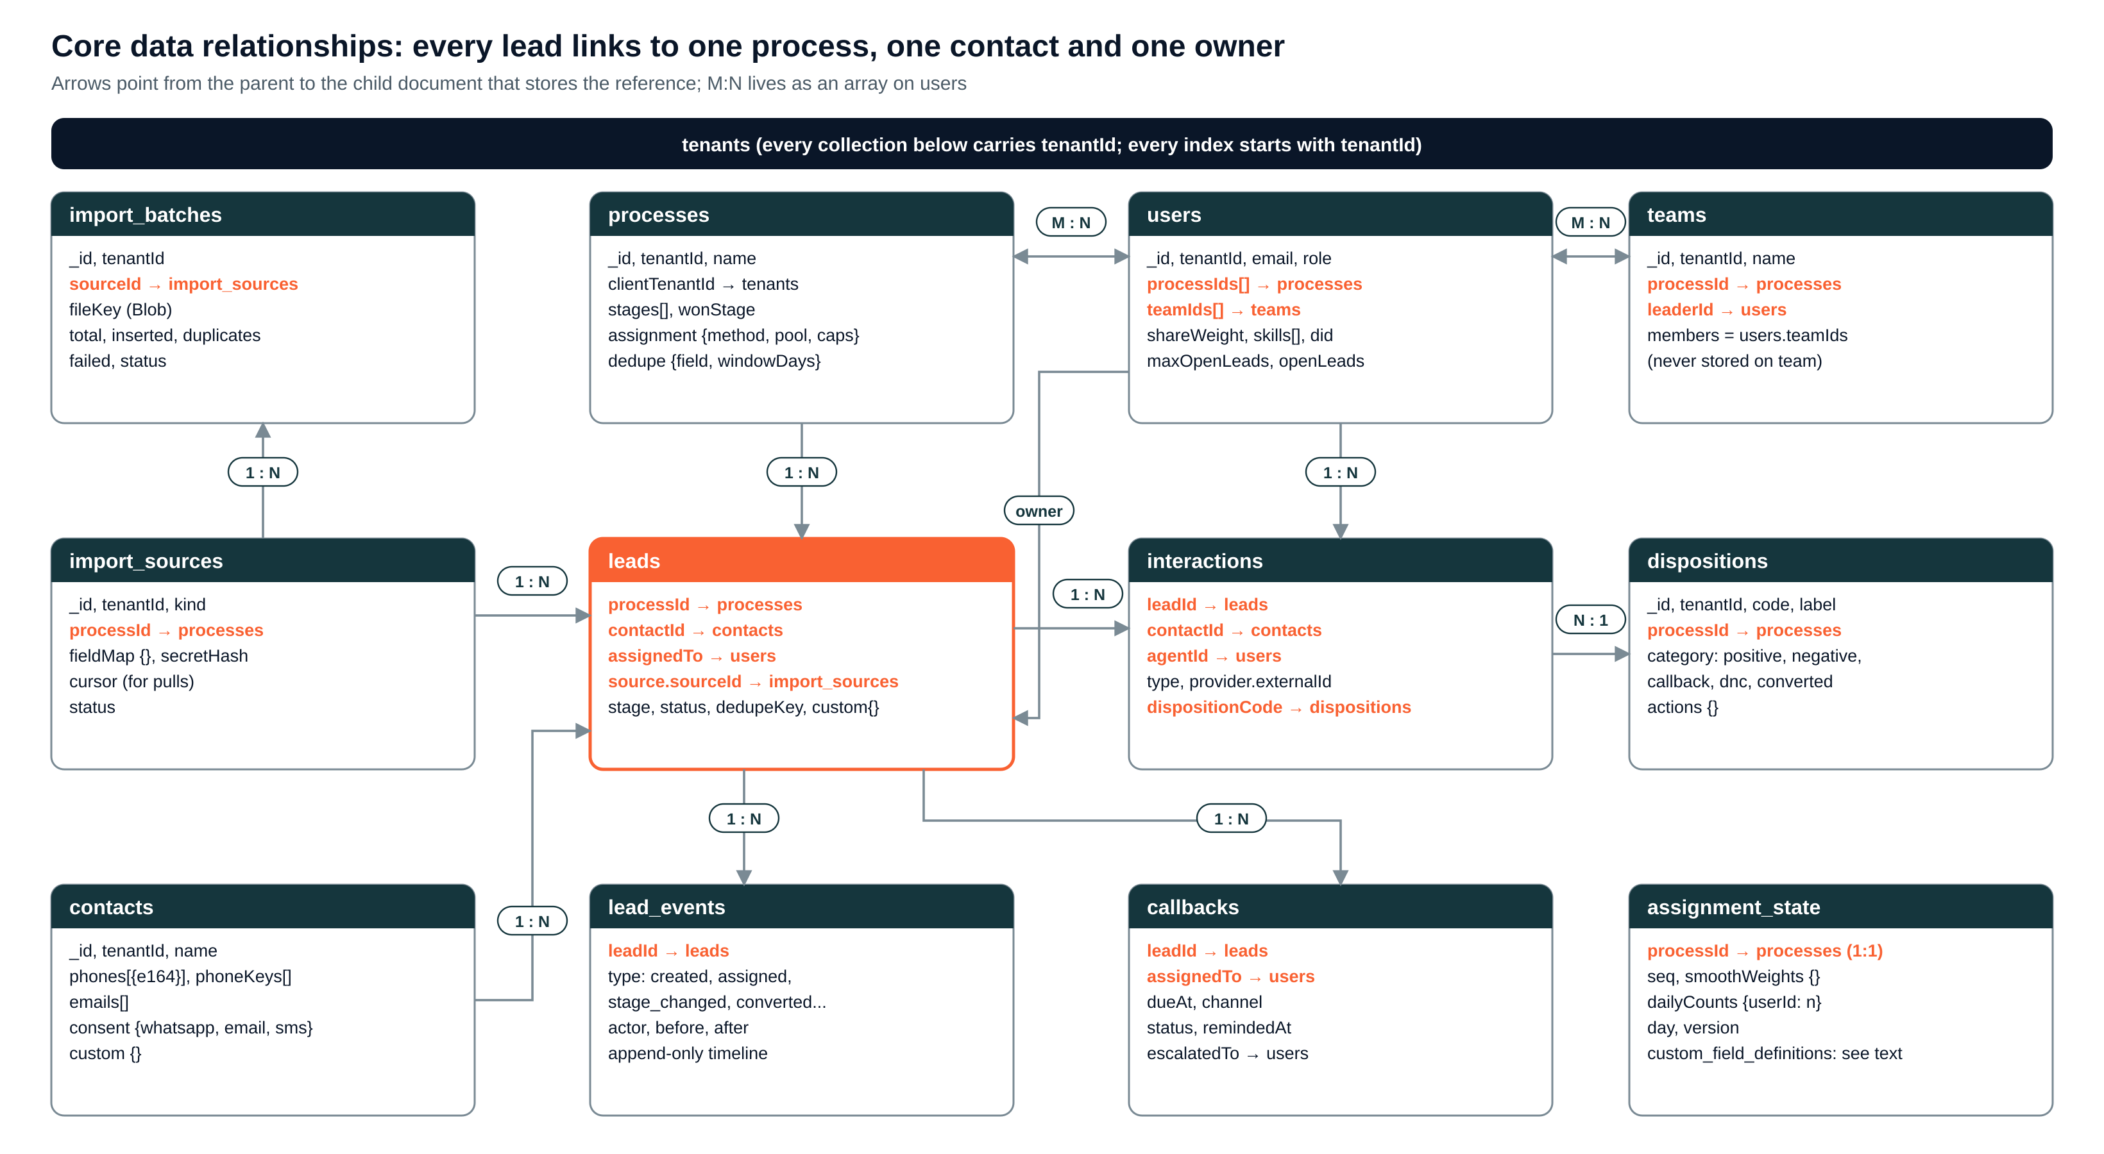
Core relationships: lead → process, contact, owner
AM2PM Call Center CRM

Slide 9
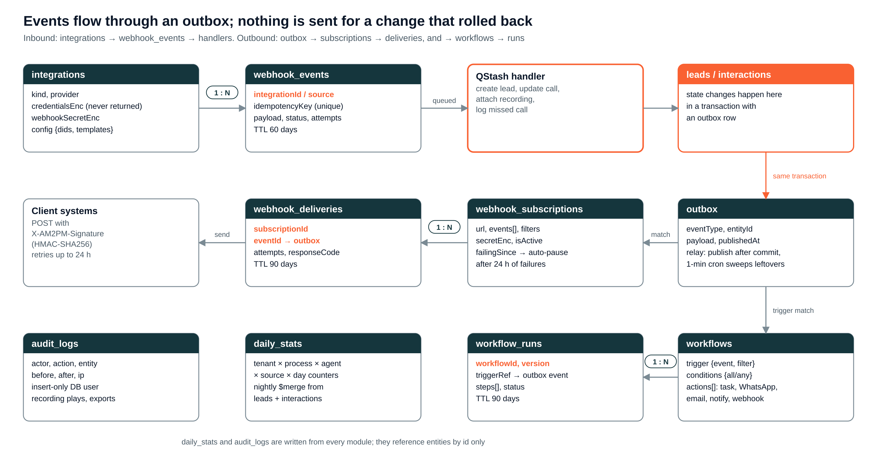
Event relationships: outbox → webhooks and workflows
AM2PM Call Center CRM

Slide 10
26 collections in four groups
References live on the child; unbounded lists are never embedded
Platform
Leads
tenants · users · teams · processes · integrations · custom_field_definitions
contacts · leads · lead_events · import_sources · import_batches · assignment_state
Activity
Events & reports
interactions (calls, WhatsApp, email, notes) · dispositions · callbacks
webhook_events · outbox · webhook_subscriptions · webhook_deliveries · workflows · workflow_runs · daily_stats · audit_logs · backup_policies · backup_snapshots · restore_jobs
Rule | Example
Embed bounded children | contacts.phones[], processes.stages[]
Reference unbounded ones | interactions.leadId, lead_events.leadId
Snapshot small values | interactions.agent {id, name}
M:N as array | users.processIds[], users.teamIds[]
AM2PM Call Center CRM

Slide 11
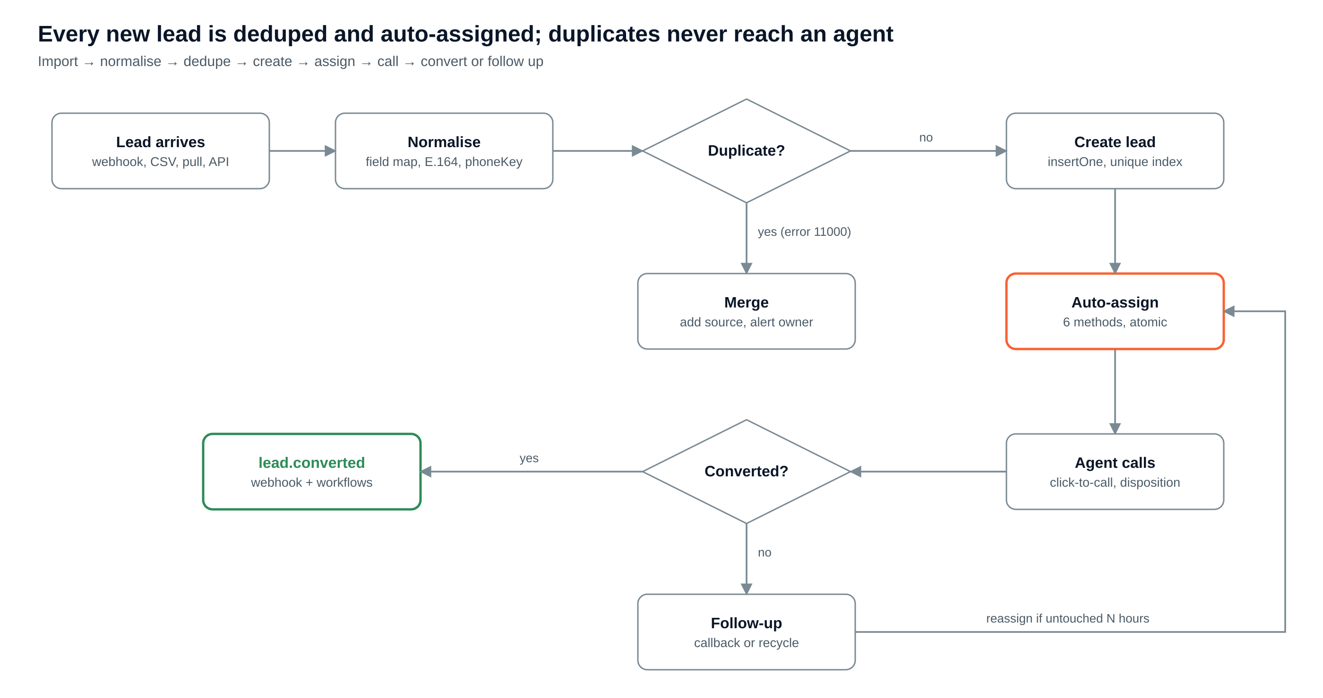
Lead pipeline: deduped and auto-assigned, no clicks
AM2PM Call Center CRM

Slide 12
Seven lead sources, one dedupe rule
Push where the source supports it, pull every 15 minutes where it does not
Source | How it arrives
Website / landing forms | POST /api/hooks/{tenant}/{sourceId}
Meta Lead Ads | leadgen webhook + Graph API fetch
Google Ads lead forms | Lead-form webhook, shared key
IndiaMART, Justdial | Push, else 15-min pull with cursor
CSV / Excel | Blob upload, 500-row QStash batches
Google Sheet | 15-min pull (migration bridge)
Public API | POST /api/v1/leads with API key
Dedupe
dedupeKey = process + last 10 digits of phone (crmv7 rule), or email / any field per process.
Unique partial index where isActive = true: racing imports still create one lead; the loser (error 11000) becomes a merge.
Merge adds the source to lead_events and alerts the owner.
AM2PM Call Center CRM

Slide 13
Auto-assignment: six methods, one atomic transaction
Equal
Percentage / Ratio
Number
The atomic pick
Next eligible agent in turn
Smooth weighted RR, interleaved
Daily quota per agent
findOneAndUpdate the agent where openLeads < max, $inc openLeads
Update assignment_state with a version check
Set leads.assignedTo only if still unassigned
Write lead_events + outbox (lead.assigned)
All in one transaction; retry next agent up to 3 times
Load-based
Skill / city
Sticky owner
Fewest open leads
Tags must match
Returning contact, same agent
Eligible = active → mapped to process → available → in working hours → under capacity → under quota
No one eligible → 5-min sweeper retries, SLA alert. Untouched N hours → recycled.
AM2PM Call Center CRM

Slide 14
Outbound webhooks: signed, retried, never lost
Events are written to an outbox in the same transaction as the change
Event | Fires when
lead.created | Any import or manual create
lead.assigned | Auto or manual assignment
disposition.set | Agent saves a call outcome
lead.stage_changed | Stage moves (Warm → Hot)
lead.converted | Converted disposition or won stage
lead.lost | Negative / DNC closes the lead
callback.missed | Due + 15 min, no call
call.completed | CallerDesk call report
Delivery rules
Header X-AM2PM-Signature: t=…, v1=HMAC-SHA256(secret, t.body); reject if older than 5 min.
Retries ~1m, 5m, 30m, 2h, 12h; every attempt in webhook_deliveries.
24 h of failures → auto-pause + email admin.
Stable event id so receivers dedupe.
AM2PM Call Center CRM

Slide 15
What happens when a lead converts
One transaction, then fan-out through the queue
1
2
3
4
5
Agent saves
Transaction
Relay
Webhooks
Workflows + stats
disposition = converted or stage = won
status won, convertedAt, openLeads − 1, lead_events, outbox
outbox → QStash right after commit
signed POST to ERP, billing, ad platforms
thank-you WhatsApp, tasks; nightly daily_stats
AM2PM Call Center CRM

Slide 16
Every Apps Script trigger becomes a Vercel Cron job
Job | Schedule | Replaces in crmv7 | What it does
Callback reminders | Every 5 min | processCallbackReminders | Notify 15 min before; escalate after 30
Assignment sweeper | Every 5 min | runControlAutoAssign | Assign leads left unassigned
Outbox relay | Every 1 min | — | Publish unpublished events
Stale-lead recycle | Hourly | rptStaleLeads | Reassign untouched leads
Scheduled imports | Every 15 min | syncMarketingToCalling | Pull Sheet / IndiaMART / Justdial
Daily rollup | 00:30 | Report builders | $merge into daily_stats
Manager digest | 09:00 | runNotifications | Hot leads, follow-ups due
Agent weekly report | Mon 08:00 | sendAllUserReports | Per-agent summary
AM2PM Call Center CRM

Slide 17
Security, access and DPDP compliance
Module | Admin | Manager | Client | Agent
Leads | VCEDX | VCEAX | V (process) | VE (own)
Interactions | VX | VX | V (masked) | VC (own)
Callbacks | VCEDX | VCEA | — | VCE (own)
Webhooks / workflows | VCED | V | — | —
Reports | VX | VX | V (assigned) | own
Integrations | VCE | — | — | —
Backups | VCX + restore req. | V | V + download* | —
Controls
Provider keys AES-256-GCM encrypted, never returned
Google + OTP login, optional TOTP and IP allowlist
Phone masking by role
Recordings via short-lived signed URLs; plays audit-logged
Consent per channel; DNC blocks outreach
Erasure job + per-tenant retention (DPDP)
Rate limits on /api/hooks/*
V view · C create · E edit · D delete · A approve · X export. * download only if the client contract allows. 8 roles; scopes own, team, process, tenant, global.
AM2PM Call Center CRM

Slide 18
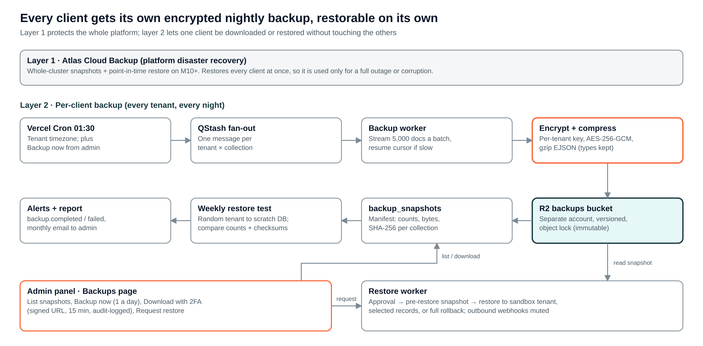
Per-client backup: every client restorable on its own
AM2PM Call Center CRM

Slide 19
Backups page for each client admin
Two-person rule on restores; every download and restore is audit-logged
Action | Who | Guard rail
View snapshots | Admin, Manager | Own tenant only
Backup now | Client Admin | Max once a day
Download backup | Client Admin (if contract allows) | Fresh 2FA, 15-min signed URL
Export CSV | Admin, Manager | Phone masking by role
Request restore | Client Admin | Snapshot, mode, reason
Approve restore | AM2PM Super Admin | Must differ from requester
Sandbox restore
Load snapshot into a read-only copy tenant to inspect; deleted after 7 days
Selective restore
Upsert chosen collections or ids; newer live data kept unless overwrite
Full rollback restore
Pre-restore snapshot first, tenant read-only, replace, recount, reopen
Retention: Standard 7 daily · 4 weekly · 3 monthly. Premium 14 · 8 · 12 + 6-hourly. RPO 24 h, RTO < 1 h per client. Webhooks muted during restore.
AM2PM Call Center CRM

Slide 20
14-week build with a gate at every phase
Assumes 2 full-stack developers; each client moves after 14 days of matching counts
Weeks 1–6
Weeks 7–10
Weeks 11–14
Week 15+
Phase 1 · Core
Phase 2 · Automation
Phase 3 · Reporting
Phase 4 · Later
Leads, dispositions, callbacks, agent screen, imports, dedupe, 4 crmv7 methods, CallerDesk, nightly client backup
Ads + portal connectors, load/skill/sticky, recycle, outbound webhooks, workflows, Interakt/Brevo/Resend
Rollups, dashboards, client portal, audit viewer, admin Backups page, Atlas M10 + PITR
LMS, attendance, shifts, reimbursements, invoicing, AI call QA
Gate: Pilot process matches sheet for 14 days
Gate: Signed lead.converted verified by a client
Gate: All clients off Sheets
Gate: —
AM2PM Call Center CRM

Slide 21
Decisions needed before build
MongoDB Atlas or Neon Postgres (~$35/month more at 200 agents for Mongo)
Agents and leads per day at launch and in 12 months
Which lead sources are live today
Which systems receive lead.converted, and what "converted" means per client
CallerDesk only, or MyOperator / Exotel fallback in v1
Recording and backup retention per client contract
Build in-house or with a contractor
Top risk
A missed tenantId filter could leak one client’s data.
Mitigation: one repository layer, lint rule, and a cross-tenant test on every API route.

