Slide 1

Ansible Automation
“Building the Future with DevOps"
By – Amit Bhatt

Slide 2
Introduction to Ansible & Configuration Management

Slide 3
The Old Way: Manual Configuration
The Challenge: "Snowflake Servers"
  Servers configured manually often become unique and difficult to replicate accurately.
  Logging into each server to make changes is error-prone and time-consuming.
  Inconsistencies arise as changes might be missed or applied differently across servers.
  Rebuilding or scaling requires significant manual effort and guesswork
Shell Scripting: A Step Forward, But Limited
  Shell scripts attempt automation but quickly become complex.
  They often lack robustness, failing to handle all edge cases or errors gracefully.
  Ensuring a script produces the exact same state every time (idempotency) is difficult and requires extra work
  Managing configuration synchronization across multiple servers remains a challenge.
The Need: A better way to manage configurations consistently, reliably, and efficiently across many servers.

Slide 4
Enter Configuration Management
What is it?
  Tools and processes to automate the setup and maintenance of server configurations.
  Treating infrastructure setup like code – defining the desired state centrally.
Key Benefits:
  Consistency: Ensures servers are configured identically, avoiding "snowflake" servers.
  Repeatability: Allows servers to be built or rebuilt to the exact same state reliably, every time.
  Scalability: Enables managing tens, hundreds, or thousands of servers efficiently, which is difficult manually.
  Efficiency: Saves significant time compared to manual configuration or complex shell scripting.
Popular Tools:
  Besides Ansible, other established tools include Puppet and Chef.
  (Focus of this course is Ansible due to its simplicity and agentless approach

Slide 5
Why Ansible?
Simple & Clear:
  Uses YAML for Playbooks – easy for anyone (admins, developers, managers) to read and write.
  Focuses on describing the desired state, not complex scripting logic.
Agentless Architecture:
  No extra software (agents/daemons) needed on managed servers.
  Communicates securely using standard SSH.
  Lower overhead: more resources for your applications, fewer things to manage/update.
Idempotent:
  Running a playbook once or multiple times produces the same result.
  Ansible checks the current state; it only makes changes if needed. Ensures predictable and reliable configuration.
Key Features:
  Fast: Quick to learn and set up; parallel execution by default.
  Complete: Handles configuration management, application deployment, and ad-hoc tasks in one tool.
  Efficient: Minimal footprint on managed nodes; easily extendable.
  Secure: Uses existing SSH infrastructure; no extra open ports required.

Slide 6
Ansible Architecture Overview
Control Node:
  The machine where you install and run Ansible commands (ansible, ansible-playbook).
  Manages the execution of tasks on Managed Nodes.
Managed Nodes:
  The servers or devices being configured by Ansible.
  Ansible connects to them (usually via SSH) and requires Python.
  No Ansible agent software needs to be installed on them.
Inventory:
  A list of Managed Nodes (servers) that Ansible knows about.
  Can be a simple file organizing hosts into groups.
  Can also contain variables specific to hosts or groups.
Playbooks:
  The files where you define Ansible's configuration, deployment, and orchestration logic.
  Written in YAML format.
  Contain 'plays' which map groups of hosts to tasks.
Modules:
  The units of code Ansible executes to perform specific tasks (e.g., install a package, copy a file, start a service).
  Ansible ships with many modules ("batteries included").
  Modules are executed on the Managed Nodes.
Plugins:
  Pieces of code that augment Ansible's core functionality (e.g., connection types, inventory sources). Less commonly used directly by beginners.

Slide 7
Prerequisites
Linux Fundamentals:
  Comfortable using the Linux command line.
  Basic server administration via SSH.
  Skills needed: File system navigation (cd, ls), basic commands (cp, mv, rm), text editing (e.g., nano, vim), understanding SSH basics.
Python:
  Ansible is built on Python, so Python needs to be installed on the Control Node.
  Usually installed via your system's package manager or pip.
SSH Key-based Authentication (Recommended):
  Ansible primarily uses SSH to connect to managed nodes.
  Using SSH keys (passwordless login) is strongly recommended and assumed by Ansible for seamless operation.
  Why? It's much more secure than passwords (avoids brute-force attacks) and simplifies automation (no need to constantly enter passwords ).

Slide 8
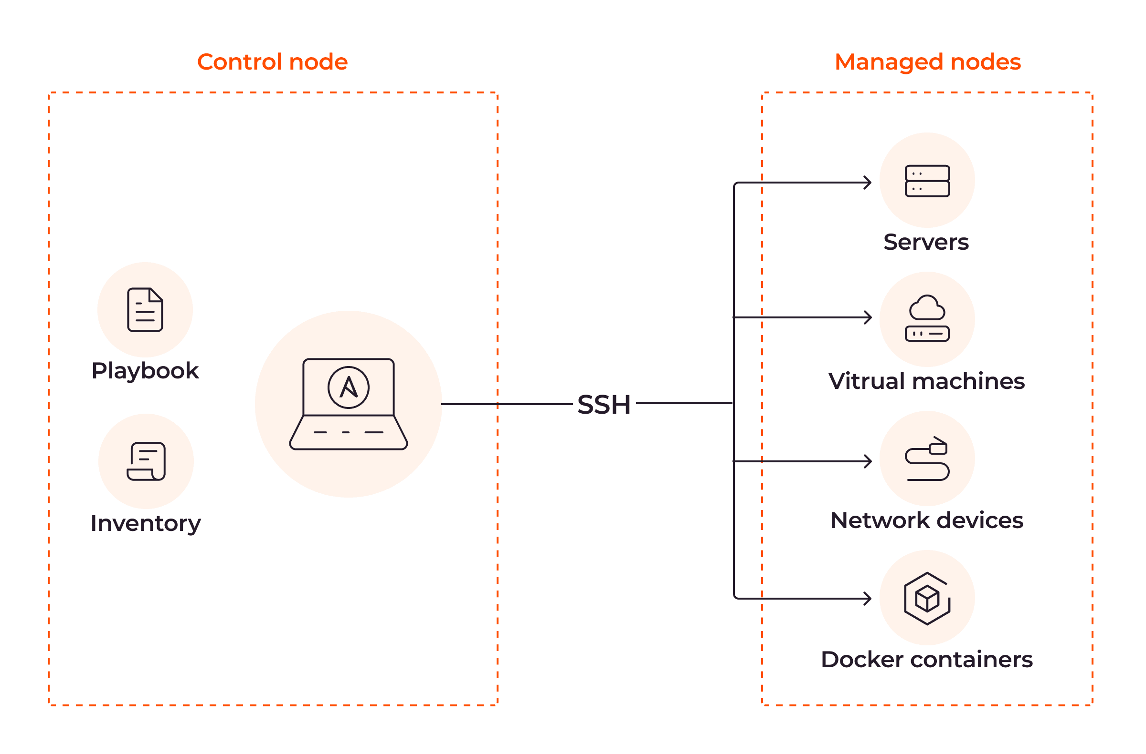
How Ansible Works
1. Control Node Initiates: run ansible or ansible-playbook on the Control Node. Ansible reads your Inventory and Playbook/command.
2. Connection via SSH: The Control Node connects to the target Managed Nodes using standard SSH (no agents needed!).
3. Pushing Instructions: Ansible transfers the necessary Module code (small Python scripts) for the task(s) to the Managed Node(s) temporarily.
4. Execution on Managed Node: The module code is executed on the Managed Node(s). The module performs the actions defined in your task (e.g., install a package, copy file, check service state).
5. Results Return: The results (success/failure, changes made) are sent back to the Control Node. Temporary files/modules are removed from the Managed Node.
6. Control Node Reports: Ansible aggregates the results from all Managed Nodes and reports back to you on the Control Node.

Slide 9
Setup On Control node
1. Create Ansible User (Recommended):
  # useradd –G wheel automate ; passwd automate
2. Setup SSH Key-based Authentication:
  $ ssh-keygen ; ssh-copy-id nodes
3. Install Ansible:
  Method A (Package Manager - Recommended for Linux):
    # dnf install ansible-core
  Method B (Python `pip`):
    # dnf install python3-pip
    $ pip install ansible --user
4. Inventory File:
  $ vi inventory
  Node1
  Node2
5. Ansible Configuration File (`ansible.cfg`):
  $ vi ansible.cfg
  [defaults]
  inventory = inventory
  remote_user = automate
  ssh_ask_pass = false
  [privilege_escalation]
  become = true
  become_method = sudo
  become_user = root
  become_ask_pass = false

Slide 10
Setup On Managed node
1. Create Ansible User:
  # useradd automate ; passwd automate
2. Setup passwordless sudo:
  # echo “automate ALL=(ALL) NOPASSWD: ALL” > /etc/sudoers.d/automate
  # chmod 0440 /etc/sudoers.d/automate
  # visudo –c
3. Check python version
  # python -V

Slide 11
The Inventory File: Telling Ansible About Your Servers
Purpose:
  A list of servers (Managed Nodes) that Ansible will manage.
  Matches servers (IP addresses or domain names) to groups for easy targeting.
Basic Format (INI-like):
  Simple text file.
  Uses [group_name] headings to define groups.
  Hosts (IPs or FQDNs) are listed under group names.
  Lines beginning with # are comments.
Location:
  Default: /etc/ansible/hosts on the Control Node.
  Can use a custom path with the -i <path/to/inventory> flag with ansible or ansible-playbook.
  $ /etc/ansible/hosts or ./my-inventory
  [webservers]
  web1.example.com
  192.168.1.101
  [dbservers]
  db1.example.com
  192.168.1.102
  [servers:children]
  webservers
  dbservers

Slide 12
Your First Ansible Commands (Ad-Hoc)
What are Ad-Hoc Commands?
  Simple, one-liner commands executed directly from the command line.
  Used for quick tasks like checking server status, rebooting, managing users, or copying a single file.
  Not typically used for complex, multi-step configurations (that's what Playbooks are for).
The ansible Command Structure:
  ansible <host-pattern> [options]
  <host-pattern>: Which host(s) or group(s) from your inventory to target (e.g., all, webservers, host1.example.com).
  [options]:
    -m <module>: Specify the module to use (e.g., ping, command, apt).
    -a "<arguments>": Arguments to pass to the module.
    -i <inventory_file>: Specify inventory file path (if not default).
    -u <remote_user>: Connect as this user.
    --become (or -b): Run tasks with privilege escalation (e.g., sudo).
Common Ad-Hoc Examples:
Pinging hosts (ping module): Check connectivity.
    $ ansible all -m ping
Running Shell Commands (command or shell module):
  command is the default module if -m is omitted. Doesn't support shell features like pipes (|) or redirects (>).
  $ ansible webservers -a "uptime“
  ansible dbservers -a "df -h“
shell module allows using shell features.
  $ ansible webservers -m shell -a "cat /var/log/nginx/access.log | grep ERROR“
Checking Host Facts (setup module): Gather detailed information about hosts.
  $ ansible host1.example.com -m setup
  $ ansible all -m setup -a "filter=ansible_distribution"

Slide 13
Understanding Modules: Ansible's Workhorses
Building Blocks for Tasks:
  Modules are the fundamental units of work in Ansible.
  Think of them as specialized tools or scripts that perform specific actions on your managed nodes.
  Ansible pushes module code to managed nodes, executes it, and removes it.
Commonly Used Modules:
  ping: Test connectivity to hosts.
  command/shell: Execute arbitrary commands (use shell for pipes, redirects, etc.).
  copy: Copy files from the control node to managed nodes.
  file: Manage files and directories (create, delete, set permissions/ownership).
  apt/yum/dnf/package: Manage packages on Debian/Ubuntu or RHEL/CentOS/Fedora systems.
  service: Manage services (start, stop, restart, enable/disable).
Finding Modules:
  Ansible comes with hundreds of built-in modules
  The Official Ansible Documentation is the best resource for finding modules and their usage
  You can list available modules using ansible-doc -l.
  Get details on a specific module using ansible-doc <module_name>.

Slide 14
Lab 1: Basic Ad-Hoc Commands
Setup: Managed nodes and control node
Config: configure ansible.cfg and inventory file on control node
Tasks:
  Ping managed nodes
  check uptime (command -a "uptime")
  check free memory (command -a "free -m").

Slide 15
Introduction to Playbooks

Slide 16
Why Playbooks? Beyond Ad-Hoc Commands
Repeatable & Complex Configurations:
  Ad-hoc commands are great for simple, one-off tasks.
  Playbooks allow you to define and execute multi-step, complex configurations consistently across many servers.
  They ensure tasks are performed in the right order, every time.
Infrastructure as Code (IaC):
  Playbooks allow you to treat your infrastructure configuration just like application code
Benefits:
  Version Control: Store playbooks in Git, track changes, collaborate.
  Testing: Test your infrastructure configurations before applying them.
  Reusability: Easily reuse configuration logic across different environments.
  Documentation: Playbooks serve as living documentation of your infrastructure setup.
Configure vim editor
  $ vi $HOME/.vimrc
  autocmd FileType yaml setlocal ai ts=2 sw=2 et
  set nu

Slide 17
YAML Basics for Ansible
What is YAML?
  A human-readable data format, often used for configuration files.
  Stands for "YAML Ain't Markup Language".
  Ansible uses it for writing Playbooks because it's clear and structured.
Key Concepts:
  Key-Value Pairs: The most basic structure, uses a colon (:) followed by a space.
  name: Install Nginx
  state: present
Lists/Sequences: Items in a list start with a hyphen (-) followed by a space. List items have the same indentation level.
  packages:
  - nginx
  - tree
  - htop
Indentation Matters! YAML uses indentation (spaces) to define structure. Consistency is crucial.
  Use Spaces, NOT Tabs: Configure your editor accordingly.
  Items at the same level must have the same indentation.
  Nested items are indented further (typically 2 spaces).

Slide 18
Anatomy of a Playbook
--- (Triple Hyphen):
  Indicates the start of a YAML document. Most playbooks begin with this.
Plays (- hosts:):
  A playbook is a list of one or more 'plays'. Each play starts with a hyphen (-).
  hosts: defines which managed nodes (from your inventory) this play targets.
Tasks (tasks:):
  Each play contains a list of tasks to be executed on the target hosts.
  Tasks are executed sequentially.
Modules within Tasks:
  Each task typically executes an Ansible Module (e.g., apt, yum, service, copy).
  Module arguments define what the module should do (e.g., package name, service state).
Naming Tasks (name:):
  Provides a human-readable description for each task.
  This name is shown in the output when the playbook runs, making it easier to follow.
Variables (vars:):
  (Brief Intro) You can define variables directly within a play using the vars: section for use within that play's tasks.

Slide 19
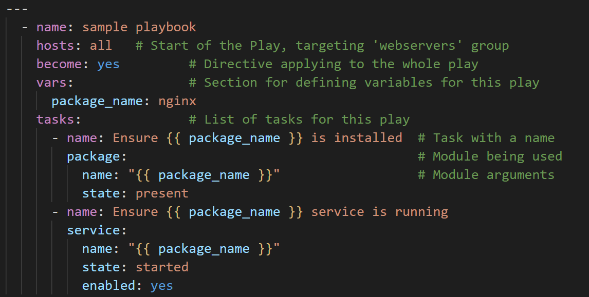
Anatomy of a Playbook

Slide 20
Running Playbooks
The Command:
  Use the ansible-playbook command to execute your playbooks.
  Basic usage: ansible-playbook <playbook_file.yml>.
Key Options:
  Specifying Inventory (-i):
    Tells Ansible which inventory file to use if not the default (/etc/ansible/hosts).
    Example: ansible-playbook -i ./my_inventory playbook.yml.
Checking Syntax (--syntax-check):
  Validates the YAML syntax of your playbook and any included files/roles without running tasks.
  Catches errors like incorrect indentation or missing quotes early.
  Example: ansible-playbook --syntax-check playbook.yml.
Dry Run (--check):
  Runs the playbook in 'Check Mode'.
  Ansible reports what would change if the playbook were run, but doesn't actually make any modifications to the managed nodes.
  Useful for verifying playbook logic before applying changes.
  Example: ansible-playbook --check playbook.yml

Slide 21
Idempotency in Playbooks
What is Idempotency?
  A core principle in Ansible (and configuration management).
  An operation is idempotent if running it once has the same effect as running it multiple times.
  Result: Running the same playbook multiple times on a server will result in the exact same configured state without unintended side effects.
Running Playbooks Multiple Times Safely:
  After the first successful run, running the same playbook again should not make any changes if the desired state is already achieved.
  Ansible will report "ok" for tasks where the state is already correct, instead of "changed".
  This makes playbook execution predictable and safe to run repeatedly (e.g., for configuration enforcement).
How Modules Achieve Idempotency:
  Well-designed Ansible modules first check the current state of the system resource they manage (e.g., is the package installed? Is the service running? Does the file content match?).
  They only take action if the current state differs from the desired state defined in your playbook task.
  Example (service module): Checks if the service is already started/enabled before attempting to start/enable it again

Slide 22
Lab2 - Your First Playbook
Task: Create a playbook to install NTP, ensure the service is running and enabled.
Run the playbook, verify idempotence by running again.

Slide 23
Working with Variables and Facts

Slide 24
Introduction to Variables
Why Use Variables?
  Flexibility: Allows you to change values (like package names, user names, file paths) easily without modifying the core task logic.
  Reusability: Makes playbooks and roles adaptable to different environments (dev, staging, prod) or different server types by simply changing variable values.
  Avoids hardcoding values directly into tasks.
Variable Naming Conventions:
  Must start with a letter ([A-Za-z]).
  Can contain letters, numbers ([0-9]), and underscores (_).
  Valid examples: package_name, web_server_port, user_name, db_server_1.
  Invalid examples: _bad_start, package-name (uses hyphen), 2_users (starts with number), user.name (uses period), user name (uses space).
  Standard Practice: Use all lowercase letters with underscores separating words (e.g., http_port).

Slide 25
Variable Structures
Simple Variables:
  Assigning a single value to a variable name using YAML syntax.
  vars:
  username: bob
List Variables:
  Storing multiple values using YAML list syntax.
  vars:
  versions:
  - v1
  - v2
  - v3
  Access items by index (0-based): {{ versions[2] }}
  (accesses 'v3').
Dictionary Variables:
  Storing key-value pairs within a variable.
  vars:
  users:
  user_1: maria
  user_2: peter
  Access values using bracket or dot notation: {{ users['user_1'] }} or {{ users.user_1 }} (bracket notation preferred).

Slide 26
Variable Structures
Nested Variables:
  Complex structures combining lists and dictionaries (like Ansible facts).
  Access using chained bracket or dot notation: {{ cidr_blocks['production']['vpc_cidr'] }}.
- hosts: dbservers
vars:
cidr_blocks:
production:
vpc_cidr: "172.31.0.0/16"
staging:
vpc_cidr: "10.0.0.0/24"
tasks:
- name: Print production vpc_cidr
ansible.builtin.debug:
var: cidr_blocks['production']['vpc_cidr']

Slide 27
Variable Structures
Nested Variables:
  Complex structures combining lists and dictionaries (like Ansible facts).
  Access using chained bracket or dot notation: {{ cidr_blocks['production']['vpc_cidr'] }}.
- hosts: dbservers
vars:
cidr_blocks:
production:
vpc_cidr: "172.31.0.0/16"
staging:
vpc_cidr: "10.0.0.0/24"
tasks:
- name: Print production vpc_cidr
ansible.builtin.debug:
var: cidr_blocks['production']['vpc_cidr']

Slide 28
Main Types/Sources of Variables
Variables can originate from various places, affecting their scope and precedence:
Playbook Variables: Defined within a play (vars:, vars_files:). Apply to tasks within that play.
Host Variables: Specific to a single host (defined in inventory or host_vars/).
Group Variables: Apply to all hosts within a specific group (defined in inventory or group_vars/).
Inventory Variables: Defined directly within the inventory file structure.
Fact Variables (ansible_facts): Discovered by Ansible from managed nodes (OS, IP, etc.). Read-only system state.
Role Variables: Defined within a role (defaults/main.yml or vars/main.yml) for reusability.
Extra Variables (-e or --extra-vars): Passed via the command line; have the highest precedence.
Registered Variables: Created from the output of a task using the register keyword. Available only during the current playbook run.

Slide 29
Special Variables
Magic Variables:
  Predefined by Ansible, reflect the execution context, cannot be changed by users.
    Examples:
    hostvars: Access variables defined for other hosts.
    inventory_hostname: The name of the current host as defined in the inventory.
    group_names: List of groups the current host belongs to.
    groups: Dictionary of all groups and their hosts.
Connection Variables:
  Define how Ansible connects to managed nodes (e.g., ansible_connection, ansible_user, ansible_ssh_private_key_file). Often set in inventory or host_vars/group_vars.

Slide 30
Where to Define Variables
In Playbooks (vars: section):
  Define variables directly within a play for tasks within that specific play.
  Good for variables tightly coupled to a single play's logic.
- hosts: appservers
vars:
app_port: 8080
tasks:
# ... tasks using {{ app_port }} ...
In Inventory Files:
Define directly alongside a host or using a [group:vars] section.
Suitable for a small number of host-specific or group-specific variables, but can become hard to manage for many variables.
[webservers]
web1.example.com http_port=80 php_version=7.4
web2.example.com http_port=8080 php_version=8.0
[webservers:vars]
ntp_server=ntp.example.com

Slide 31
Where to Define Variables
In Separate Files (vars_files:):
  Include external YAML files containing variables into a playbook using the vars_files: directive.
  Helps keep playbooks clean and organize variables logically.
- hosts: dbservers
vars_files:
- vars/database_vars.yml
- vars/common_vars.yml
tasks:
# ... tasks ...
Group Variables (group_vars/):
  Place YAML files in a directory named group_vars/ (either next to your playbook/inventory or in /etc/ansible/).
  Files should be named after your inventory groups (e.g., group_vars/webservers.yml, group_vars/all.yml).
  Variables in these files are automatically available to hosts in the corresponding group(s).
Host Variables (host_vars/):
  Similar to group_vars/, but the directory is named host_vars/.
  Files should be named after specific hostnames in your inventory (e.g., host_vars/db1.example.com.yml).
  Variables in these files are automatically available only to that specific host.

Slide 32
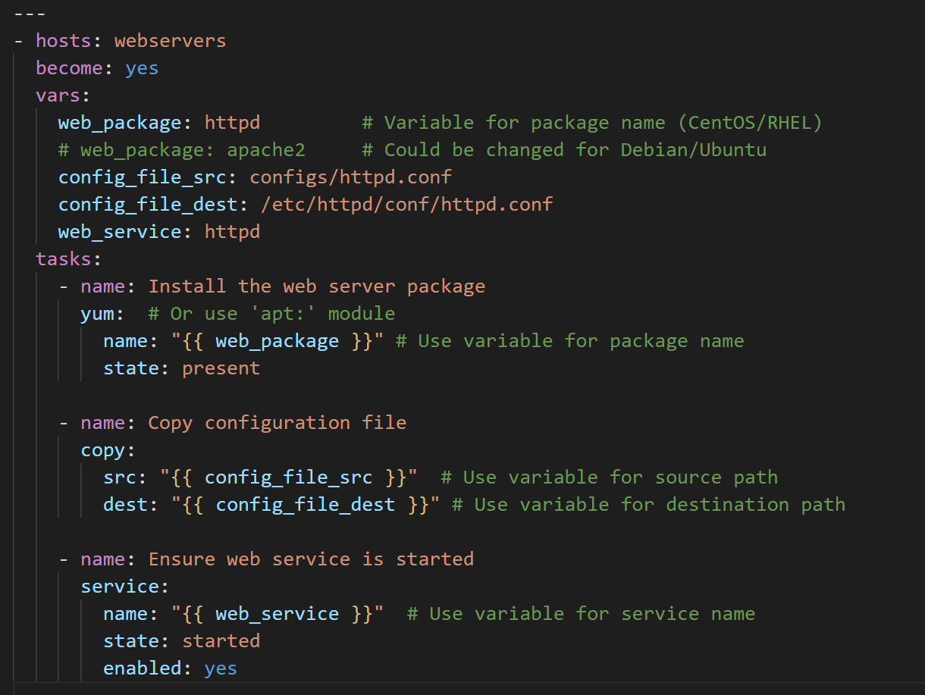
Using Variables in Playbooks
Syntax: Jinja2 Templating:
  Ansible uses the Jinja2 templating engine to substitute variable values.
  To use a variable's value within a task, enclose the variable name in double curly braces: {{ variable_name }}.
  Ansible replaces {{ variable_name }} with the actual value of the variable when the task runs.
Example: Parameterizing Tasks:
  Define variables (e.g., in the vars: section, inventory, or included files).
  Use the {{ }} syntax in your tasks to make them flexible.

Slide 33
Ansible Facts: Discovering Your Systems
What are Facts?
  System-specific information gathered by Ansible from your managed nodes (servers) at the beginning of a play execution.
  Examples: OS type, IP addresses, hostname, CPU/memory info, disk space, etc..
  Think of them as automatically discovered variables about the current state of the node.
Automatic Gathering (gather_facts: yes):
  By default, Ansible automatically connects to hosts and gathers facts before running tasks in a play. You'll see GATHERING FACTS ***** in the output.
  This behavior is controlled by the gather_facts: yes directive (which is the default if omitted).
Accessing Facts:
  Facts are available as variables within your playbooks, typically prefixed with ansible_.
  Use Jinja2 syntax {{ }} to access them:
    Operating System Family: {{ ansible_os_family }} (e.g., 'Debian', 'RedHat')
    Default IPv4 Address: {{ ansible_default_ipv4.address }}
    Hostname: {{ ansible_hostname }}
    Total Memory: {{ ansible_memtotal_mb }}

Slide 34
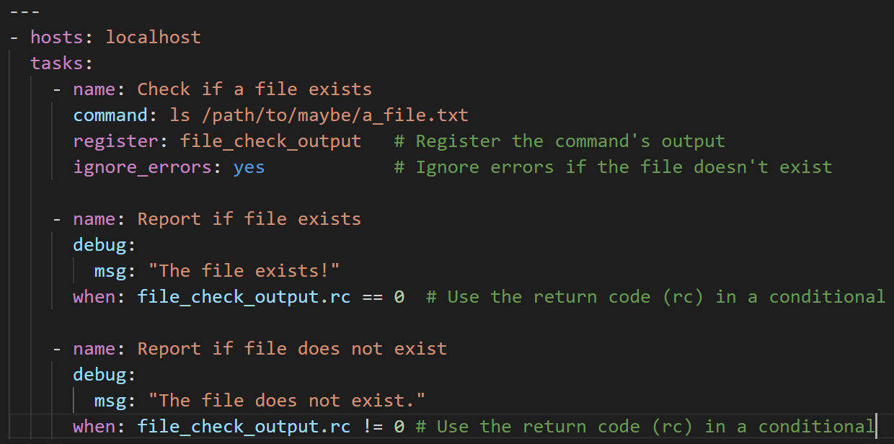
Registered Variables: Capturing Task Output
What are Registered Variables?
  Sometimes you need the output (like standard output, standard error, or return code) of one task to influence a later task.
  Ansible allows you to "register" the result of a task into a new variable you create.
Capturing Output (register: keyword):
  Add the register: keyword to a task, followed by the name you want to give the new variable.
  Ansible will store the task's execution results (including stdout, stderr, rc (return code), changed status, etc.) in this variable.
Using Registered Variables:
  Access the stored information using dot notation (e.g., variable_name.stdout, variable_name.rc).
  Commonly used in when conditionals to control whether subsequent tasks run.

Slide 35
Lab 3: Using Variables and Facts
Task: Modify the NTP playbook to use a variable for the package name.
Task: Create a playbook that installs different packages based on the ansible_os_family fact.

Slide 36
Task Control

Slide 37
Task Control: Conditionals (when)
Running Tasks Based on Conditions:
  The when: clause allows you to control whether a task is executed based on the result of a condition.
  The task only runs if the condition specified in the when: clause evaluates to true
Using Variables, Facts, and Registered Variables:
  Conditions are Jinja2 expressions, meaning you can use:
    Variables: when: setup_firewall == true
    Ansible Facts: when: ansible_os_family == "Debian"
    Registered Variables: when: "'SUCCESS' in command_result.stdout" or when: command_result.rc == 0
Basic Operators and Tests:
  Comparison: == (equal to), != (not equal to), >, >=, <, <=
  Logical: and, or, not
  Membership: in, not in
  Defined Check: is defined, is undefined (Useful for checking if a variable exists)
  Parentheses () can be used for grouping expressions.

Slide 38
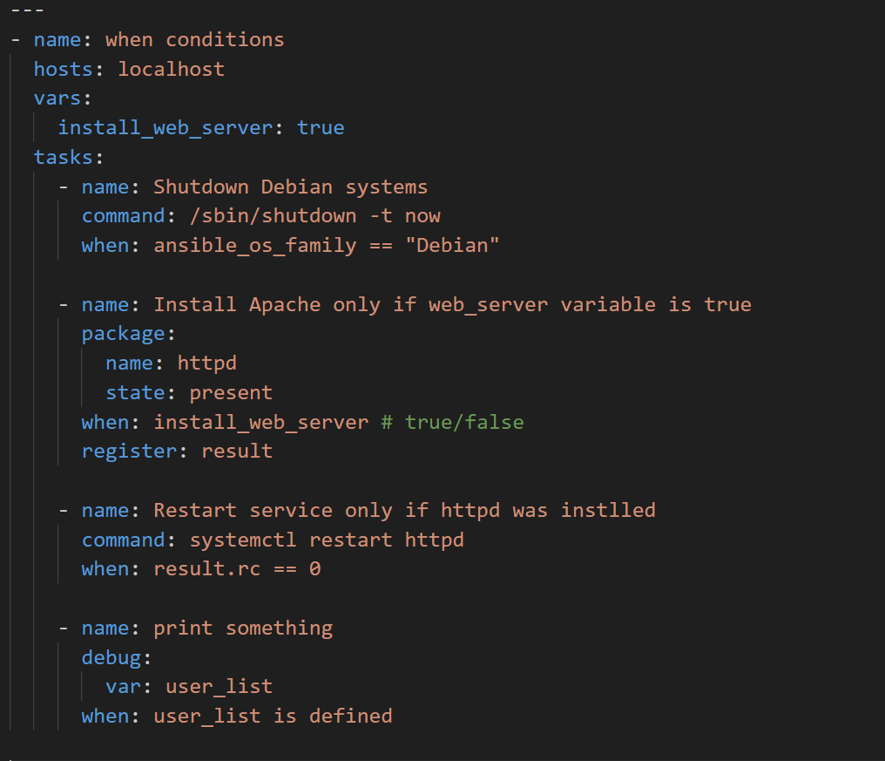
Task Control: Conditionals (when)

Slide 39
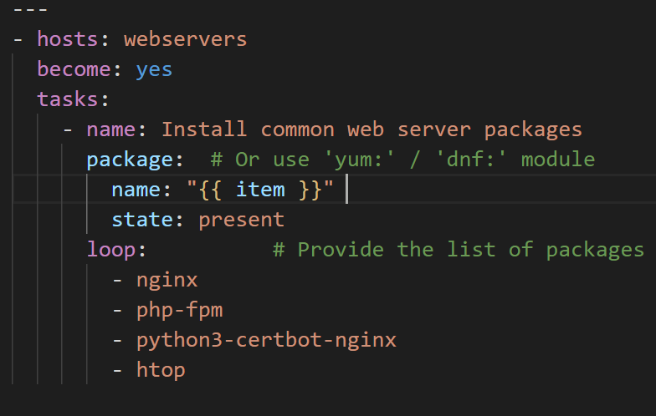
Task Control: Loops
Repeating Tasks Efficiently:
  Loops allow you to run the same task multiple times with different values without duplicating the task definition.
  Very useful when you need to perform the same action on a list of items (e.g., packages, users, files).
Iterating Over a List:
  Use the loop: keyword followed by a YAML list to specify the items you want to iterate over.
  Inside the task, use the special variable {{ item }} to refer to the current item from the list during each iteration.
Example: Installing Multiple Packages:
  Instead of writing separate tasks for each package, use a loop:

Slide 40
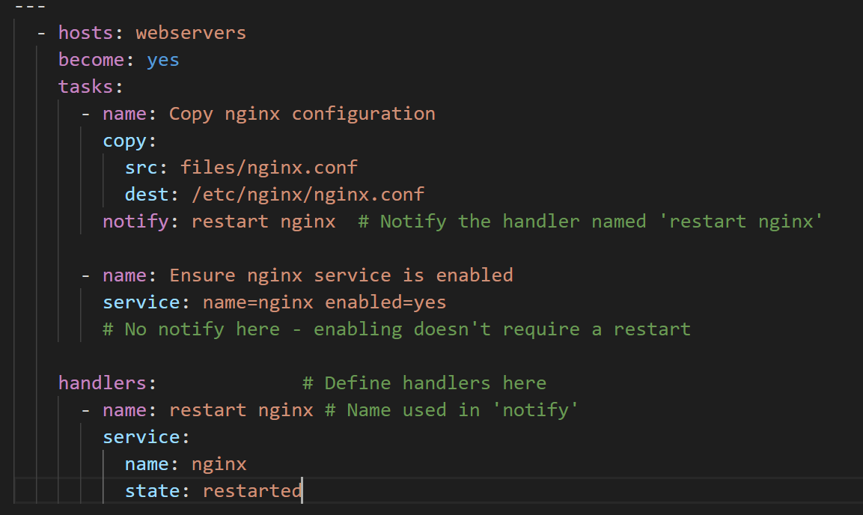
Task Control: Handlers - Triggering Actions on Change
What are Handlers?
  Handlers are special tasks that only run when "notified" by another task.
  They are triggered only if the notifying task makes a change to the system (i.e., reports state "changed").
  Handlers run after all regular tasks in a particular play have finished.
Common Use Case:
  Restarting or reloading services after their configuration files have been modified. Ensures services pick up new settings without restarting unnecessarily on every playbook run.
Defining Handlers (handlers: section):
  Handlers are defined in a dedicated handlers: block within your playbook (usually at the same level as hosts and tasks).
  Each handler looks like a regular task and must have a globally unique name.
Notifying Handlers (notify: keyword):
  Add the notify: keyword to a regular task.
  The value for notify: is the name of the handler you want to trigger.
  You can notify multiple handlers from one task.

Slide 41
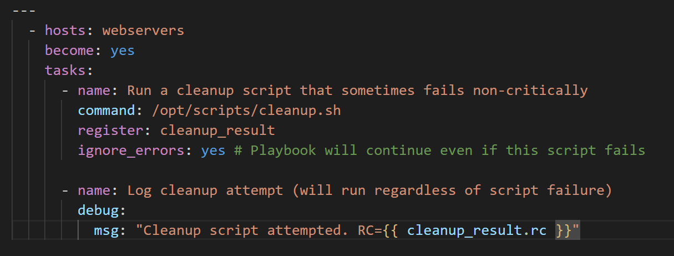
Task Control: Ignoring Failures (ignore_errors)
Continuing Playbook Execution:
  Sometimes, a task might fail for reasons you expect or consider non-critical, but you want the playbook to continue running subsequent tasks.
  You can add ignore_errors: yes to a task to tell Ansible to continue the playbook run even if that specific task fails.
Use With Caution!
  While useful in certain situations (e.g., running scripts that often output non-fatal errors), use ignore_errors sparingly.
  Ignoring errors can mask real problems in your infrastructure or deployment.
  It's generally better to fix the underlying cause of the error or use failed_when to more accurately define failure conditions if possible.

Slide 42
Lab 4: Conditionals, Loops, and Handlers
Task: Create a playbook to install multiple packages using loop
Task: Create a playbook that copies a config file and restarts a service using a handler.
Task: Add a when condition to a task based on a fact.

Slide 43
Introduction to Roles

Slide 44
Why Roles? Organizing Playbooks
Problem: As playbooks grow larger (configuring multiple services, handling different OSs), they can become hard to manage, read, and maintain. Nested include files can also become complex.
Solution: Roles!
  Reusable Components: Roles break down complex automation logic into self-contained, reusable units typically focused on configuring a specific service or function (e.g., setting up a web server, configuring NTP, deploying an application).
Encapsulation: Roles bundle related content together using a predefined directory structure. This includes:
  Tasks (tasks/)
  Variables (vars/, defaults/)
  Files (files/)
  Templates (templates/)
  Handlers (handlers/)
Improved Maintainability: Instead of one large file, you manage smaller, focused files within a role's structure, making updates and debugging easier.
Shareability: Roles are designed to be easily shared within teams or with the wider community (e.g., via Ansible Galaxy), promoting reuse and saving effort.

Slide 45
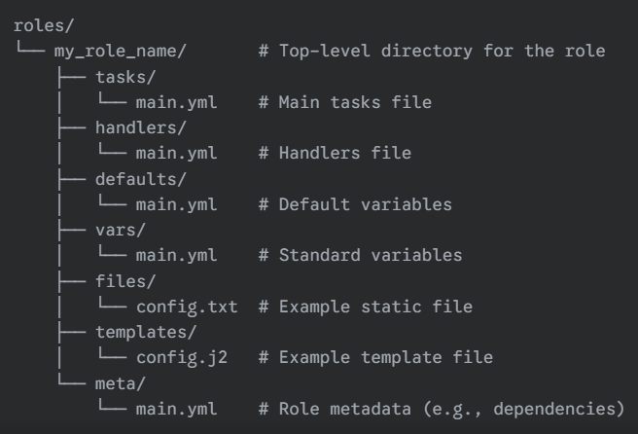
Role Directory Structure
Standard Layout: Ansible Roles use a predefined directory structure to organize content. Ansible automatically looks for specific directories and files within a role.
Common Directories & Purpose:
  tasks/: Contains the main list of tasks to be executed by the role.
  handlers/: Contains handlers, which can be triggered by tasks.
  defaults/: Contains default variables for the role. These have the lowest precedence and are easily overridden.
  vars/: Contains standard variables for the role. These have higher precedence than defaults.
  files/: Contains static files that the role can copy to managed nodes.
  templates/: Contains file templates (usually Jinja2 .j2 files) that the role can process and copy to managed nodes.
  meta/: Contains metadata for the role, including dependencies on other roles.
main.yml Files:
  Within most of these directories (tasks, handlers, vars, defaults, meta), Ansible automatically looks for a file named main.yml to load the relevant content.

Slide 46
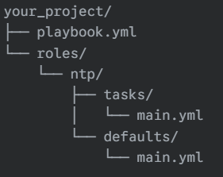
Creating a Simple Role (Example: NTP)
1. Create the Directory Structure:In your project, create a roles/ directory if it doesn't exist.Inside roles/, create a directory for your role: ntp.Inside roles/ntp/, create the necessary subdirectories: tasks, defaults.
2. Move Tasks:Cut the NTP-related tasks from your original playbook.Paste them into roles/ntp/tasks/main.yml:
3. Move/Create Variables (Defaults):Define default values for variables used in your tasks.Place them in roles/ntp/defaults/main.yml:
4. (If Applicable) Move Handlers:If your original playbook had handlers related to NTP (e.g., restart ntpd), move them to roles/ntp/handlers/main.yml.Result: Your original playbook becomes much simpler, just calling the role:
https://github.com/abhatt014/ansible/tree/main/devops

Slide 47
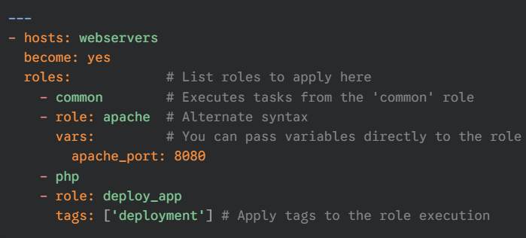
Using Roles in Playbooks
Applying Roles (roles: section):
  To use a role within a play, list it under the roles: section.
  Ansible will execute the tasks, handlers, etc., defined within the listed role(s) for the hosts targeted by the play.
  Roles listed are executed before the tasks defined directly in the tasks: section of the play.\
How Ansible Finds Roles (roles_path):
  Ansible searches for roles in a defined sequence of paths:
    A directory named roles/ located in the same directory as the playbook file (common practice).
    Configured roles paths (defined in ansible.cfg via roles_path).
    The default system roles path (often /etc/ansible/roles).
Roles downloaded via ansible-galaxy are typically placed in one of these configured paths.

Slide 48
Role Variables: vars vs. defaults
Roles have two primary directories for defining variables, affecting their precedence:
defaults/main.yml:
  Purpose: Defines the default values for variables used within the role.
  Precedence: Variables here have the lowest priority.
  Use Case: Intended for values that users of the role might frequently want to override in their own playbooks, inventory, or vars_files. Provides sensible defaults if the user doesn't specify their own value.
vars/main.yml:
  Purpose: Defines standard variables for the role.
  Precedence: Variables here have a higher priority than t hose in defaults/main.yml. They can still be overridden by inventory variables, extra vars, etc., but override defaults.
  Use Case: Intended for variables that are fundamental to the role's internal logic or values that should typically not be changed by the user unless necessary.
In Summary:
  Use defaults/main.yml for variables you expect users to customize.Use vars/main.yml for variables the role needs internally or that have fixed values essential to the role's function.

Slide 49
Introduction to Ansible Galaxy
What is Ansible Galaxy?
  A public repository (website and command-line tool) for finding, sharing, and managing community-developed Ansible Roles.
  Allows you to leverage roles created by others for common tasks (installing databases, web servers, applications) instead of writing everything from scratch.
The ansible-galaxy Command:
  The command-line tool for interacting with Galaxy and managing roles locally.
  Key subcommands:
    # Install role 'geerlingguy.apache' from Galaxy
    $ ansible-galaxy install geerlingguy.apache
    # Install specific version
    $ ansible-galaxy install geerlingguy.mysql,1.9.0
list: Shows roles currently installed locally in your configured roles_path
  $ ansible-galaxy list
init: Creates a basic directory structure template for a new role, suitable for development and sharing on Galaxy.
  $ ansible-galaxy init my_new_role_name

Slide 50
Templates (Jinja2)
Dynamic Configuration Files:
  Ansible's template module uses the Jinja2 templating engine to create dynamic files based on variables and logic.
  Allows generating customized configuration files for different hosts or environments from a single template file (usually ending in .j2).
1. Using Variables:
  Access Ansible variables (facts, host/group vars, playbook vars) directly within the template using {{ variable_name }}.
    # Example: /etc/myapp/config.j2
    listen_port = {{ app_listen_port | default(80) }}
    server_name {{ inventory_hostname }}
    database_host = {{ db_server_ip | default('127.0.0.1') }}
2. Conditions (if/else/endif):
  Include or exclude blocks of text based on conditions (using variables, facts, etc.).
    # Example: httpd.conf.j2
    {% if enable_ssl %}
    SSLEngine on
    SSLCertificateFile /etc/pki/tls/certs/server.crt
    SSLCertificateKeyFile /etc/pki/tls/private/server.key
    {% else %}
    # SSL is disabled
    {% endif %}

Slide 51
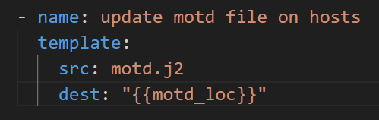
Templates (Jinja2)
3. Loops (for/endfor):
  Iterate over lists or dictionaries to generate repetitive configuration blocks.
    # Example: firewall_rules.j2
    {% for port in allowed_tcp_ports %}
    -A INPUT -p tcp --dport {{ port }} -j ACCEPT
    {% endfor %}
    {% for user, uid in user_accounts.items() %}
    User {{ user }} has UID {{ uid }}
    {% endfor %}
Deployment:
  Use the template module in your playbook to process the .j2 file and deploy the resulting configuration file to managed nodes.

Slide 52
Lab 5: Creating and Using a Role
Task: Convert the NTP playbook into a reusable role.
Task: Create a new playbook that uses the NTP role.
Task: (Optional) Install a role from Ansible Galaxy.

Slide 53
Lab 6: Deploy custom motd file on managed nodes
Task: Create dynamic motd file on manage node (/etc/motd) with below content
This is the system <server_fqdn>.
This is a <Distro> version <version> system.
Only use this system with permission.
Please report issues to: <admin email>.

Slide 54
Ansible Navigator

Slide 55
Understanding & Getting Execution Environments for Ansible Navigator
ansible-navigator is a modern command-line tool for running Ansible Playbooks. Unlike older tools, it runs playbooks inside Automation Execution Environments.
What are Execution Environments (EEs)?
  Self-contained: EEs are container images (like Docker or Podman images) that bundle everything needed to run your Ansible automation.
  Included Components: An EE contains:
    Ansible Core (the engine itself).
    Specific Ansible Content Collections (extra modules, roles, plugins).
    Python libraries and other dependencies required by your automation.
  Consistency & Portability: Using EEs ensures your automation runs the same way everywhere (your laptop, CI/CD, production controller) because the environment is packaged together. It separates the Ansible control node (where you type commands) from the execution plane (the container where Ansible actually runs).
Why use EEs with ansible-navigator?
  Standardizes the environment for running playbooks.
  Makes it easier to manage dependencies for your automation.
  Ensures consistency between development and production (using tools like Automation Controller).
Downloading an Execution Environment Image
  Before ansible-navigator can run a playbook, it needs an EE image available locally. You typically use podman (or docker) for this.

Slide 56
Ansible Navigator Installation
  Install Ansible Navigator:
    $ python –m pip install ansible-navigator --user
  Log in to the Registry: If pulling from a private or authenticated registry (like Red Hat's Quay.io or Automation Hub), log in first. For Red Hat's registry:
    podman login registry.redhat.io
  Pull the Image: Use the podman pull command followed by the full image name and tag. For the standard Red Hat supported EE for RHEL 8/9 based controllers:
    podman pull registry.redhat.io/ansible-automation-platform-22/ee-supported-rhel8:latest
  Verify Download (Optional): You can list your local container images. ansible-navigator can also show the EEs it finds:
    podman images
    ansible-navigator images
  ansible-navigator images will attempt to pull the default image specified in its settings if it's not found locally
Now ansible-navigator can use this downloaded Execution Environment to run your playbooks consistently. You can configure which EE ansible-navigator uses in its settings file (ansible-navigator.yml).

Slide 57
Ansible Navigator Configuration
Configuration File:
  Name: ansible-navigator.yml
  Format: YAML
  Location Priority: ansible-navigator looks for this file in the following order and uses the first one it finds:
    The path specified by the ANSIBLE_NAVIGATOR_CONFIG environment variable.
    ansible-navigator.yml in the current Ansible project directory.
    ansible-navigator.yml (note the leading dot) in your user's home directory.
  Best Practice: Typically, you place an ansible-navigator.yml file within each Ansible project directory for project-specific settings
Common Configuration Settings:
  The settings file uses YAML format. Here's an example with common options from the course:
---
ansible-navigator:
# --- Execution Environment Settings ---
execution-environment:
# Specify the container image to use
image: utility.lab.example.com/ee-supported-rhel8:latest
# Control when the image is pulled
pull:
policy: missing # Options: always, missing, never, tag
# --- Playbook Artifact Settings ---
playbook-artifact:
# Enable/disable saving detailed JSON logs of playbook runs
enable: false # Set to false if using interactive prompts
# ... other settings can go here ...

Slide 58
Ansible Navigator Configuration
Key Sections Explained:
  execution-environment:: Controls the containerized environment where Ansible runs.
    image:: Defines the specific EE container image (name:tag) to use.
    pull: -> policy:: Determines when ansible-navigator should pull the image (e.g., missing only pulls if it's not already local).
  playbook-artifact:: Manages the saving of detailed playbook run results.
    enable:: Set to false to disable artifact saving. This is required if your playbooks need to prompt for input, like Ansible Vault passwords. Artifacts are enabled by default.
Note: Many other configuration options exist. Refer to the official ansible-navigator documentation for a full list.
By using ansible-navigator.yml, you can standardize how ansible-navigator operates within your projects, especially regarding the execution environment and handling of playbook results.

Slide 59
Ansible Navigator Commands
ansible-navigator provides a Text-based User Interface (TUI) and command-line access for interacting with Ansible. Here are some key subcommands:
  ansible-navigator run <playbook.yml>
  Purpose: Executes an Ansible Playbook. This is the primary command for running your automation.
    -m stdout: Displays output directly to the terminal instead of the interactive TUI. Useful for scripting or simpler viewing. -
    -syntax-check: Validates the playbook syntax without running it.
    --check: Performs a "dry run" (if modules support it), showing what changes would be made without actually changing hosts.
    -i <inventory_file>: Specifies a specific inventory file to use.
    -v, -vv, -vvv, -vvvv: Increases output verbosity for debugging.
    --vault-id @prompt or --vault-password-file <file>: Provides the password for Ansible Vault encrypted files.
    --playbook-artifact-enable false: Disables saving playbook run results, necessary for interactive password prompts.
ansible-navigator inventory
Purpose: View and query your Ansible inventory.
  -i <inventory_file>: Specifies which inventory to view.
  -m stdout --list: Lists all hosts and groups in JSON format.
  -m stdout --graph <group_name>: Shows hosts within a specific group in a tree format.
  Interactive Mode (Default): Allows browsing groups and hosts within the TUI.
ansible-navigator doc <module_or_collection_name>
  Purpose: Displays documentation for Ansible modules, plugins, or collections.
    -m stdout: Displays documentation formatted for the terminal.
    -l: Lists available modules/plugins.
    -s: Shows a snippet/template for using a module

Slide 60
Ansible Navigator Commands
ansible-navigator config
  Purpose: View the current Ansible configuration settings and their sources (default, environment variable, config file).
ansible-navigator collections
  Purpose: Lists installed Ansible Content Collections and allows browsing their contents (modules, roles) in the TUI.
ansible-navigator images
  Purpose: Shows the Automation Execution Environment images available locally that ansible-navigator can use.
ansible-navigator –version
  Purpose: Displays the installed version of ansible-navigator.
These commands form the core toolkit for developing and running Ansible automation using ansible-navigator

Slide 61
Ansible Vault

Slide 62
Ansible Vault
Sensitive data is stored as values in variables in a separate variable file.
The variable file is encrypted, using the ansible-vault command.
While accessing the variable file from a playbook, you enter a password to decrypt.
ansible-vault options to manage vault files
  create: Creates a new encrypted file
  encrypt: encrypts an existing file
  decrypt: Decrypts an existing file
  rekey: changes the password on an encrypted file
  view: show contents
  edit: modify encrypted file
$ansible-vault create secrets.yaml
password: redhat
username: bob
pwhash: secure123
$vi user.yml - https://github.com/abhatt014/rhce/blob/main/lesson5/user.yml
$ ansible-playbook user.yml --ask-vault-pass user.yml
password: redhat
or
$ vi vaultpasssfile
redhat
$ ansible-playbook --vault-password-file=vaultpassfile user.yml

Slide 63
Ansible Content Collections

Slide 64
Next Steps & Best Practices

Slide 65
Ansible Best Practices
Use Version Control (e.g., Git):
  Treat your playbooks, roles, and inventory like code. Store them in a version control system to track changes, collaborate, and revert if necessary.
Keep Playbooks Simple and Focused:
  Avoid overly long, monolithic playbooks.
  Group related tasks logically. Use include statements or, preferably, roles to break down complexity.
Leverage Roles for Reusability:
  Encapsulate configuration for specific services or components into roles.
  Roles promote organization, reusability across different projects/environments, and shareability.
Test Your Playbooks:
  Syntax Check: Use ansible-playbook --syntax-check to catch YAML errors early.
  Dry Run: Use ansible-playbook --check to see what changes would be made without actually applying them.
  Test Environments: Use tools like Vagrant or cloud instances to test playbooks in isolated environments before running on production. Consider automated testing.
Write Comments and Use Descriptive Names:
  Use comments (#) in your YAML files to explain complex logic or intent.
  Give every task a clear, descriptive name: so playbook output is easy to understand

