Slide 1
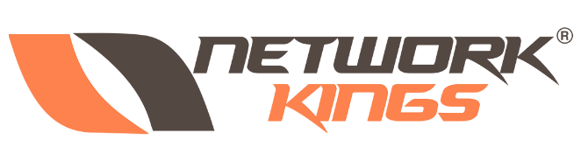
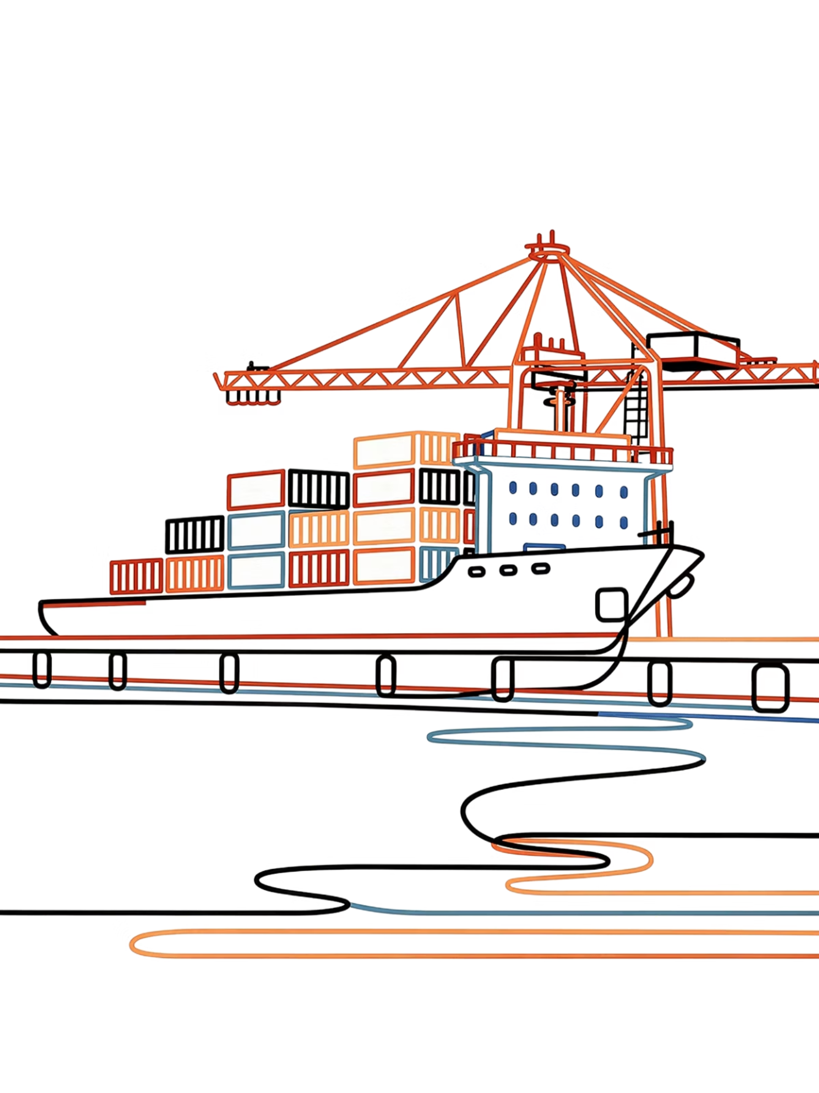
Module 1: Introduction to Podman
A hands-on guide to daemonless containerization for DevOps engineers and system administrators ready to move beyond legacy container runtimes.
CONTAINER FUNDAMENTALS
MODULE 1 OF 5
https://github.com/abhatt014/python_oct.git

Slide 2
CORE CONCEPTS
The Basics: Daemonless and OCI Compliant
What Is Podman?
Two Defining Properties
Podman is a powerful, open-source container engine designed for developing, managing, and running containers on Linux systems. It was created as a modern alternative to daemon-based runtimes, addressing both architectural and security shortcomings that had accumulated in older tooling.
Maintained by Red Hat and the open-source community, Podman has become the default container engine on Red Hat Enterprise Linux and Fedora — and it's rapidly gaining adoption across the broader DevOps ecosystem.
Daemonless Architecture
OCI Compliant
Podman fully adheres to the Open Container Initiative (OCI) standards for both container runtimes and image formats. This means images built with Podman run on any OCI-compliant runtime, and you can use images from any standard registry without conversion or compatibility shims.
Podman does not require a long-running background service (daemon) with root privileges to manage containers. Each podman command you run is a self-contained process. There is no central bottleneck, no single point of failure, and no persistent privileged process exposed on your system.

Slide 3
ANALOGY
The Restaurant Manager vs. The Food Truck
🍽️ Traditional Daemon-Based Engines: The Restaurant
🚚 Podman: The Food Truck Fleet
Podman is like a fleet of independent food trucks. You are the chef, and you cook the food directly — there is no middleman manager standing between you and your container. Each truck (each Podman process) operates independently.
If one food truck breaks down, every other truck keeps operating perfectly. There is no central failure point. And because you are cooking as yourself (not as a privileged root manager), the blast radius of any incident is dramatically reduced. This is the architectural philosophy that makes Podman safer and more resilient by design.
Think of a traditional, daemon-based container engine like a large sit-down restaurant. To get any food — that is, to run any container — you must place your order through the manager (the daemon). The manager coordinates everything and holds the keys to the entire building, meaning they operate with full root privileges at all times.
The critical vulnerability: if the manager crashes, goes on a break, or gets compromised, the entire restaurant stops serving food. All containers go down. Worse, because the manager has keys to the whole building, a security breach at the manager level is catastrophic — an attacker gains root access to the host system.

Slide 4

HANDS-ON
Lab Exercise 1: First Steps with Podman
Objective: Verify your Podman environment is correctly installed and run your first simple container to confirm everything is working end-to-end.
1
2
3
Open Your Terminal
Verify Installation
Run Your First Container
Open a standard Linux terminal as your regular, non-root user. All commands in this lab should be run without sudo unless explicitly stated — this is part of the rootless Podman experience.
Check that Podman is installed and confirm the installed version:
Run a simple, temporary Alpine Linux container that prints a message and immediately removes itself:
podman --version
podman run --rm alpine echo "Hello from Podman!"
You should see output like podman version 4.x.x. If the command is not found, consult your distribution's package manager.
The --rm flag tells Podman to automatically delete the container after it exits. This is best practice for short-lived, one-shot tasks.
If you see "Hello from Podman!" printed to your terminal, your environment is correctly set up. Podman pulled the Alpine image, started a container, ran the command, and cleaned up — all without a daemon.

Slide 5
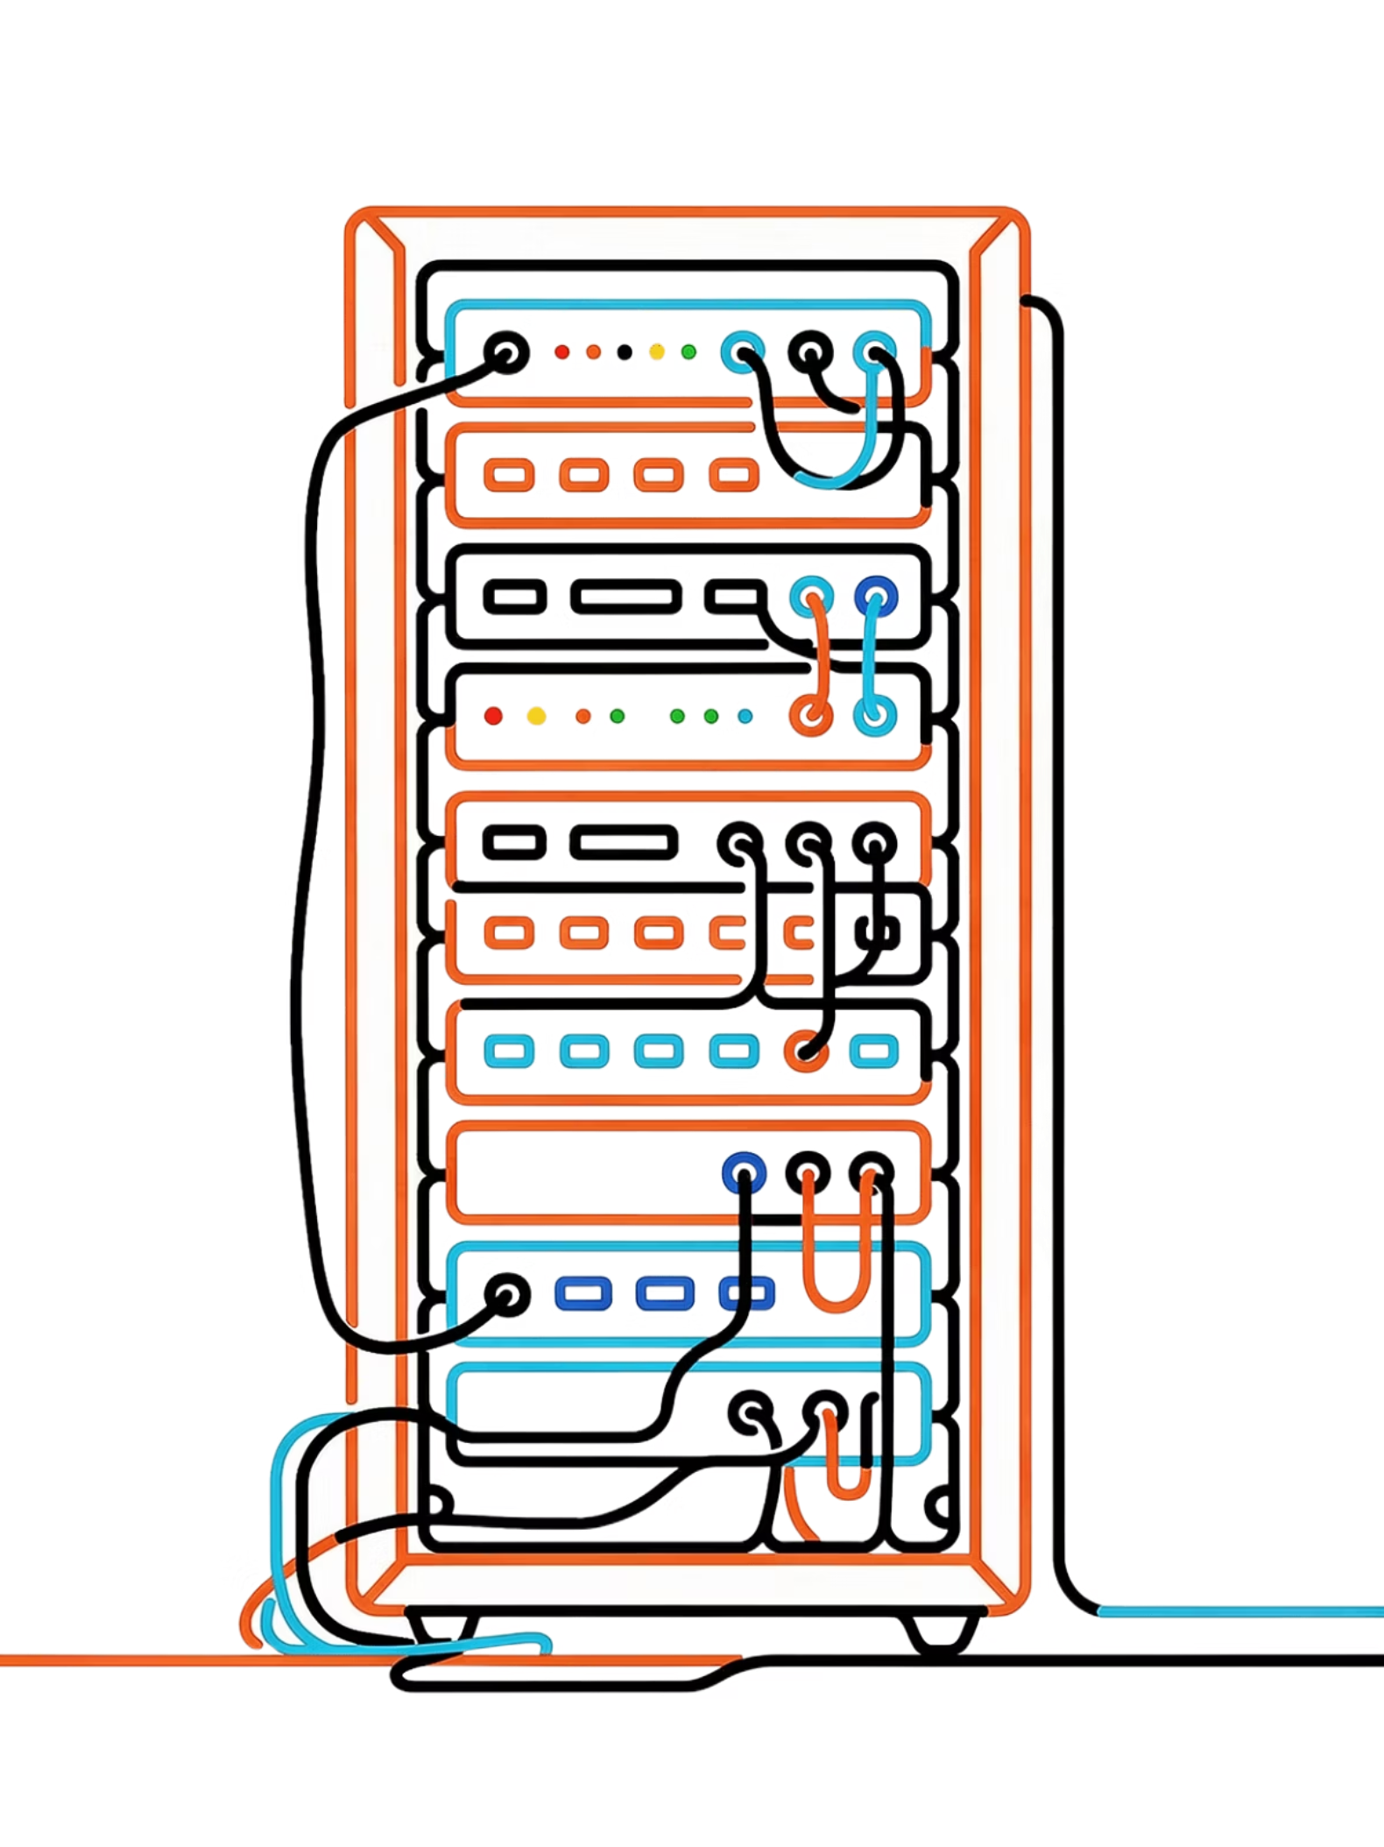
MODULE 2 OF 5
Module 2: The Core Architecture and Security Concepts
Before you can troubleshoot, optimize, or secure your containers, you need a clear mental model of how Podman actually works under the hood — from the CLI command you type to the kernel process that ultimately runs your workload.

Slide 6
ARCHITECTURE DEEP DIVE
How Podman Works Under the Hood
To master Podman, it is essential to understand the Linux components and tools that form the full container execution stack. Every time you run podman run, a chain of components activates in sequence.
Component
Description
Userspace
The memory area where user applications — including the Podman CLI itself — run. This is kept strictly separate from the operating system kernel, which is a foundational security boundary.
Podman CLI
The command-line interface you interact with directly. It maps familiar, human-readable commands like run, build, and ps to concrete container management actions, delegating the heavy lifting to libpod.
libpod
The core library embedded within Podman that handles the lifecycle of containers, pods, and volumes. Think of it as the engine beneath the dashboard — all the logic lives here.
OCI Runtime
The low-level tool — typically crun or runc — that libpod calls to actually spawn and run the container process inside the kernel using Linux primitives like namespaces and cgroups.
CNI / Netavark / Aardvark-dns
The networking stack. Netavark manages bridge and network setup for containers, while Aardvark-dns provides DNS-based container-to-container name resolution within pods and networks.
Volumes
Persistent storage mechanisms that decouple container data from the container lifecycle. Data in a volume survives container deletion and can be shared between multiple containers.
Registries
Remote servers that store and distribute container images. Common examples include quay.io (Red Hat's enterprise registry) and docker.io (Docker Hub).

Slide 7
LINUX SECURITY PRIMITIVES
Security and Resource Management
Containers are not true virtual machines. They are isolated processes sharing the host's Linux kernel. Podman relies on four key Linux kernel features to enforce strong isolation and prevent containers from interfering with each other or the host system.
Namespaces
Cgroups
Provide process isolation. Linux namespaces ensure that a container only sees its own network interfaces, process tree, hostname, and file system mount points. From the container's perspective, it is the only thing running on the machine — like blinders on a horse that prevent it from seeing what's beside it.
Provide resource limits. Control Groups (cgroups) define hard boundaries on how much CPU, memory, and disk I/O a container process is allowed to consume. This prevents a single runaway container from starving the host system or other containers of resources.
Seccomp
Capabilities
Filters kernel system calls. A Seccomp (secure computing mode) profile defines an allowlist of system calls a container is permitted to make to the Linux kernel. Any call outside the profile is blocked, dramatically reducing the attack surface available to a compromised container.
Granular privilege control. Instead of granting a binary "root or not root" permission, Linux capabilities break root privileges into dozens of distinct permissions. Podman grants containers only the specific capabilities they need (e.g., NET_BIND_SERVICE to bind ports below 1024) without full root access.

Slide 8

HANDS-ON
Lab Exercise 2: Inspecting Container Isolation
Objective: See namespace isolation and process separation in action. This lab demonstrates concretely that a container process has its own isolated view of the system — it cannot see host processes, and host tools can inspect it from the outside.
01
02
03
Start a Background Container
Inspect the Container's Process Table
Clean Up
Launch a long-running Alpine container in detached mode (-d) and name it for easy reference:
Force-stop and remove the container in one step:
Use podman top to see only the processes running inside the container's namespace:
podman rm -f test-isolation
podman run -d --name test-isolation alpine sleep 1000
podman top test-isolation
The -f flag stops a running container before removing it. Verify it's gone with podman ps -a.
You'll see only the sleep 1000 process — not the hundreds of processes running on the host. This is namespace isolation in action. The container genuinely cannot see anything outside its own namespace boundary.
The sleep 1000 command keeps the container alive for ~16 minutes, giving you time to inspect it.
Try running ps aux | grep sleep on the host while the container is running. Notice how the sleep process is visible from the host (since they share a kernel), but inside the container it appears as PID 1. This illustrates the asymmetric nature of namespace isolation.

Slide 9
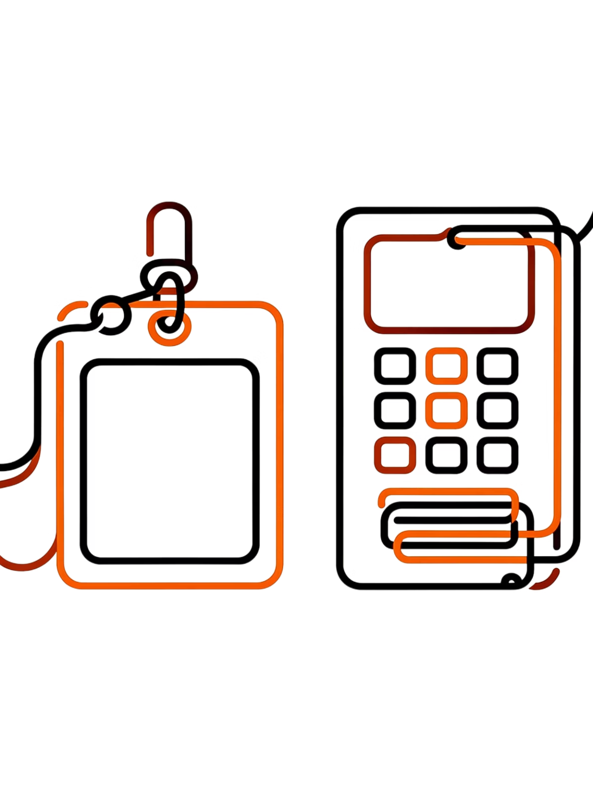
MODULE 3 OF 5
Module 3: Execution Modes — Rootless vs. Rootfull
One of Podman's most important and widely praised features is its ability to run containers securely without ever requiring root privileges. This module explains the two execution modes, when to use each, and why rootless containers represent a significant advancement in container security posture.

Slide 10
EXECUTION MODES
Understanding the Modes
Rootfull Mode
Rootless Mode
The container process is run by the root user of the host system. This grants the container runtime broad privileges over host resources.
When to use it: Rootfull is necessary for containers that need to perform system-level tasks such as binding to privileged ports below 1024 (like port 80 or 443), mounting specific host hardware, or manipulating host-level network interfaces.
The trade-off: If the container process escapes isolation — or if Podman itself has a vulnerability — the attacker gains root on the host. This is a significant risk in multi-tenant environments.
The container is run by a standard, unprivileged user. Even if the process running inside the container appears to be "root" (UID 0 inside the container), it is remapped to a standard unprivileged user ID on the host via Linux user namespace mapping.
Why it matters: A container escape in rootless mode gives an attacker the same privileges as your normal user account — not system-wide root. This vastly reduces the blast radius of any security incident.
Rootless Data Storage: All container images and runtime data for rootless containers are stored in the user's home directory at:
$HOME/.local/share/containers/storage
This means no shared state between users, and no root-owned files scattered across the system.

Slide 11
ANALOGY + LAB
The Corporate Credit Card vs. A Gift Card
💳 Understanding the Risk Difference
🔬 Lab Exercise 3: Exploring Rootless Storage
Rootfull mode is like giving an application a corporate credit card with a $50,000 limit. It can do almost anything, purchase from anywhere, and approve its own transactions. If that card number gets stolen, the attacker has access to the full company account — the damage is potentially unlimited and affects the entire organization.
Rootless mode is like issuing the application a prepaid gift card loaded with exactly the funds it needs for one specific job. Even if the application is completely compromised and goes rogue, the damage is strictly limited to the balance on that one specific card. The company's main account is completely untouched.
This analogy captures why security-conscious organizations are standardizing on rootless containers for the vast majority of their workloads. The principle of least privilege — granting only the access absolutely required — is baked directly into Podman's default execution model.
Objective: Verify exactly where Podman stores images and data when running as a non-root user, and explore the directory structure.
1
Check the Graph Root
Run the following as a standard (non-root) user to find the configured storage location:
podman info | grep -i "GraphRoot"
2
Confirm the Path
Verify the output points to your home directory — not a system-wide location like /var/lib/containers:
$HOME/.local/share/containers/storage
3
Explore the Directory
List the contents to see the physical layout of your local image layers on disk:
ls -l $HOME/.local/share/containers/storage

Slide 12
MODULE 4 OF 5
Module 4: Container Images and Registries
Images and Registries Defined
A Container Image is a lightweight, standalone, executable package that includes everything needed to run a piece of software: application code, runtime environment, system tools, system libraries, environment variables, and configuration files. Once built, an image is immutable — it cannot change, which makes it perfectly reproducible across any environment.
Image Registries are the distribution centers — the warehouses — for these images. They allow teams to push, pull, version, and share container images across machines and environments. Two of the most commonly used public registries are:
quay.io
hub.docker.com
A highly secure, enterprise-grade registry maintained by Red Hat. It offers built-in vulnerability scanning, robot accounts for CI/CD automation, and fine-grained access controls. Heavily used in enterprise and regulated environments. It is the default registry for Red Hat and Fedora official images.
The default public registry for the Docker and broader container community. Contains millions of official, verified, and community-built images. It is often the easiest starting point for finding base images for popular languages, databases, and tools. Always review community images carefully before using them in production.

Slide 13

IMAGE BUILDING
The Building Blocks: Containerfile / Dockerfile Keywords
To create a custom container image, you write a plain text file — called a Containerfile (the OCI standard name) or Dockerfile (the Docker convention; Podman accepts both) — containing a series of declarative instructions. Each instruction becomes a layer in the final image.
Keyword
Function and Usage
FROM
Defines the base image to start building upon. Every Containerfile must begin with a FROM instruction. Example: FROM docker.io/library/ubuntu:22.04
MAINTAINER
Identifies the original author of the image. This directive is deprecated in favor of LABEL but is still common in older Containerfiles you will encounter in the wild.
LABEL
Adds arbitrary key-value metadata to an image, such as version, description, or author. Example: LABEL version="1.0" description="My web app". Labels are queryable and useful for automation.
RUN
Executes a shell command inside the image during the build process, creating a new layer with the result. Commonly used to install packages: RUN apt-get update && apt-get install -y python3. Chain commands with && to minimize layers.
EXPOSE
Documents which network ports the container intends to listen on at runtime. This is metadata only — it does not actually publish the port. You still need -p at runtime to map ports to the host.
ENTRYPOINT
Configures the primary executable that will always run when the container starts. It cannot be easily overridden. Example: ENTRYPOINT ["python3"] means the container always runs Python.
CMD
Provides default arguments passed to ENTRYPOINT, or a default command if no ENTRYPOINT is defined. Unlike ENTRYPOINT, CMD can be overridden by passing arguments to podman run.
Best Practice: Use ENTRYPOINT to define what runs (the executable), and CMD to define how it runs by default (the arguments). This gives you a predictable container with a flexible, overridable default behavior.

Slide 14



HANDS-ON
Lab Exercise 4: Pulling from Different Registries
Objective: Learn to explicitly specify the full registry path when fetching images. Understanding the fully-qualified image name — registry/namespace/image:tag — is essential for avoiding ambiguity and ensuring you pull exactly the image you intend.
Step 1: Pull from Quay.io
Step 2: Pull from Docker Hub
Step 3: List Your Images
Pull the official Fedora image directly from Red Hat's enterprise registry:
Pull the official Nginx web server image from Docker Hub:
Confirm both images were downloaded and inspect their metadata:
podman pull quay.io/fedora/fedora:latest
podman pull docker.io/library/nginx:latest
podman images
Notice the fully-qualified path: registry / namespace / image : tag. Being explicit avoids Podman guessing which registry to use.
The library namespace on Docker Hub refers to Docker's official, curated images. Always prefer official images as your base when possible.
The output shows the repository, tag, image ID, creation date, and compressed size. Note how images from different registries coexist locally without conflict.
You can configure default search registries in /etc/containers/registries.conf. However, always using fully-qualified image names in scripts and CI pipelines is considered a best practice to prevent supply-chain confusion attacks.

Slide 15
MODULE 5 OF 5
Module 5: The Anatomy of a Container — Layers
How Container Storage Works
Container images are not single, massive monolithic files. They are built using a series of overlapping, read-only layers, where each layer represents a discrete set of filesystem changes produced by a single instruction in your Containerfile. When you run a container from an image, Podman adds one thin, read-write layer on the very top — the container layer — where all runtime changes happen.
This layered architecture is what makes container images both storage-efficient and fast to distribute. If two images share a common base layer (like Ubuntu 22.04), that layer is stored once on disk and shared between both images. Pulling a new image that shares layers with an existing one only downloads the delta — the layers you don't already have.

Slide 16
LAYER ARCHITECTURE
The Architect's Tracing Paper — and the Layer Hierarchy
🏗️ The Analogy
🧱 Typical Python App Image — Layer by Layer
Imagine an architect designing a house using stacked sheets of tracing paper:
They draw the foundation on the first sheet (Layer 1 — Base OS)
A transparent sheet goes on top: they draw the walls (Layer 2 — OS dependencies)
Another sheet: they draw the plumbing (Layer 3 — Language libraries)
Another sheet: they draw the furniture layout (Layer 4 — Application code)
Final sheet: they mark the front door (Layer 5 — Entrypoint command)
Layer 1: Base Ubuntu
The OS foundation. Read-only. Shared with any other image that uses the same Ubuntu base.
Layer 2: apt Packages
All these sheets are finalized and permanently bonded together — they are the read-only image. When a new buyer wants to test paint colors, the architect places one fresh blank sheet on top. The buyer can paint anything on that sheet without ever touching or damaging the original architectural drawings underneath. That blank sheet is the read-write container layer — temporary and discarded when the container stops.
OS-level dependencies installed via apt-get. Read-only once built.
Layer 3: pip Packages
Python-specific libraries installed via pip3. Read-only once built.
Layer 4: Source Code
The actual application files copied into the image. Read-only once built.
Layer 5 + 6: Entrypoint + Container Layer
Startup command (read-only) and the live read-write container layer created only at runtime. All file changes during execution happen here and are discarded on container exit.

Slide 17

HANDS-ON
Lab Exercise 5: Building a Layered Image
Objective: Write a Containerfile from scratch, build a multi-layer image, and use podman history to inspect the resulting layer structure. This exercise ties together everything learned in Module 4 and Module 5.
Step 1: Create Your Containerfile
Step 2: Build the Image
Create a new file named Containerfile in an empty working directory and add the following content exactly:
Build the image and tag it with a name. Watch the output carefully — you'll see Podman process each layer step-by-step:
FROM docker.io/library/ubuntu:latest
LABEL description="My Layered App"
RUN apt-get update && apt-get install -y \
python3 python3-pip
RUN pip3 install flask
COPY . /app
EXPOSE 8080
ENTRYPOINT ["python3"]
CMD ["/app/main.py"]
podman build -t my-layered-app .
The -t flag assigns a human-readable tag to the final image. The . tells Podman to use the current directory as the build context (where it looks for your Containerfile and any files referenced by COPY).
Step 3: Inspect the Layer History
After the build completes, inspect the full layer history to see each layer's command and disk size contribution:
Notice that each RUN, COPY, ENTRYPOINT, and CMD instruction will produce a separate, identifiable layer in the final image.
podman history my-layered-app
Each row in the output corresponds to a layer. Notice that the apt-get and pip3 install layers tend to be the largest. This is why experienced engineers chain related RUN commands together with && — to reduce the total number of layers and minimize image size.
Key Takeaway: Layers that change frequently (like COPY . /app with your source code) should be placed near the bottom of your Containerfile. Layers that rarely change (like installing system packages) should be near the top. This maximizes build cache reuse and dramatically speeds up iterative development builds.

Slide 18
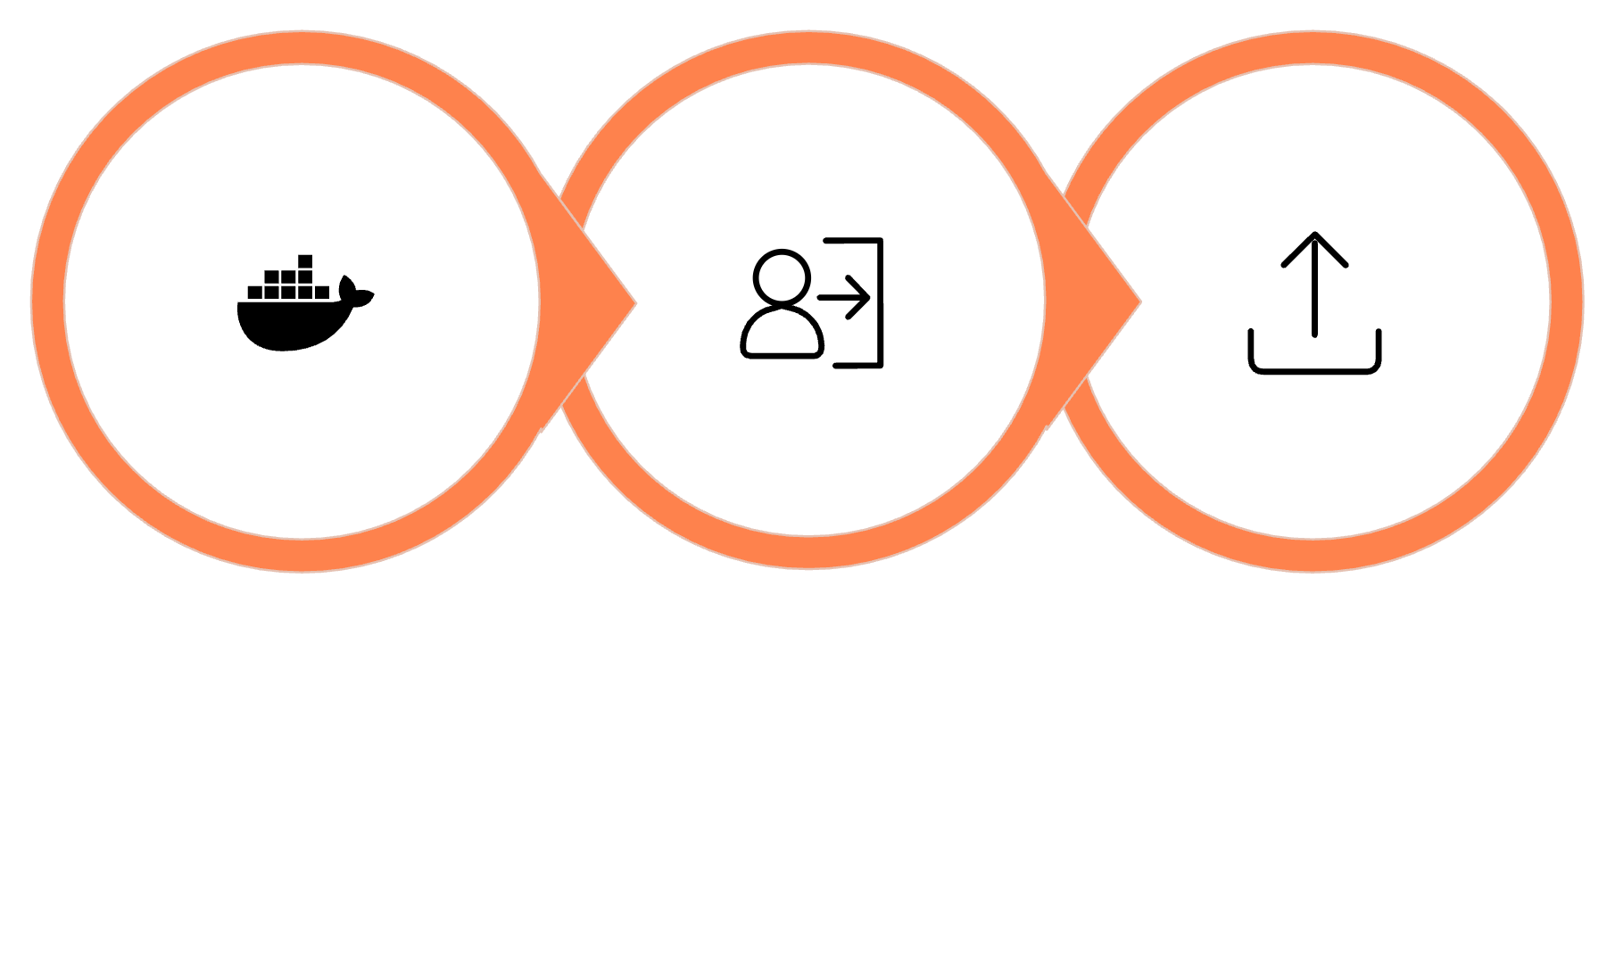

Docker Hub Essentials & Authentication
Now that we have a local image, we need to store it in a Registry so servers (or other developers) can download and run it. Docker Hub is the most popular public registry.
Authenticate
Push to Registry
Build Image
Since you've already created a repository (amitfreeze/test), authenticate your local Podman installation with Docker Hub. Run this command and provide your Docker Hub username and password:
$podman login docker.io
Specifying docker.io is a good practice with Podman to ensure it authenticates against the correct registry, as Podman can connect to multiple registries (Quay.io, Red Hat Registry) by default.

Slide 19
Pushing to Docker Hub
You cannot push an image named monolith-app:latest directly — the registry won't know whose account it belongs to. You must tag the image with your Docker Hub username and repository name.
01
02
Tag the Image
Push the Image
Tag your local image so it points to your amitfreeze/test repository with the tag v1-monolith.
Upload the tagged image to Docker Hub:
$podman push \
docker.io/amitfreeze/test:v1-monolith
$podman tag monolith-app:latest \
docker.io/amitfreeze/test:v1-monolith

Slide 20
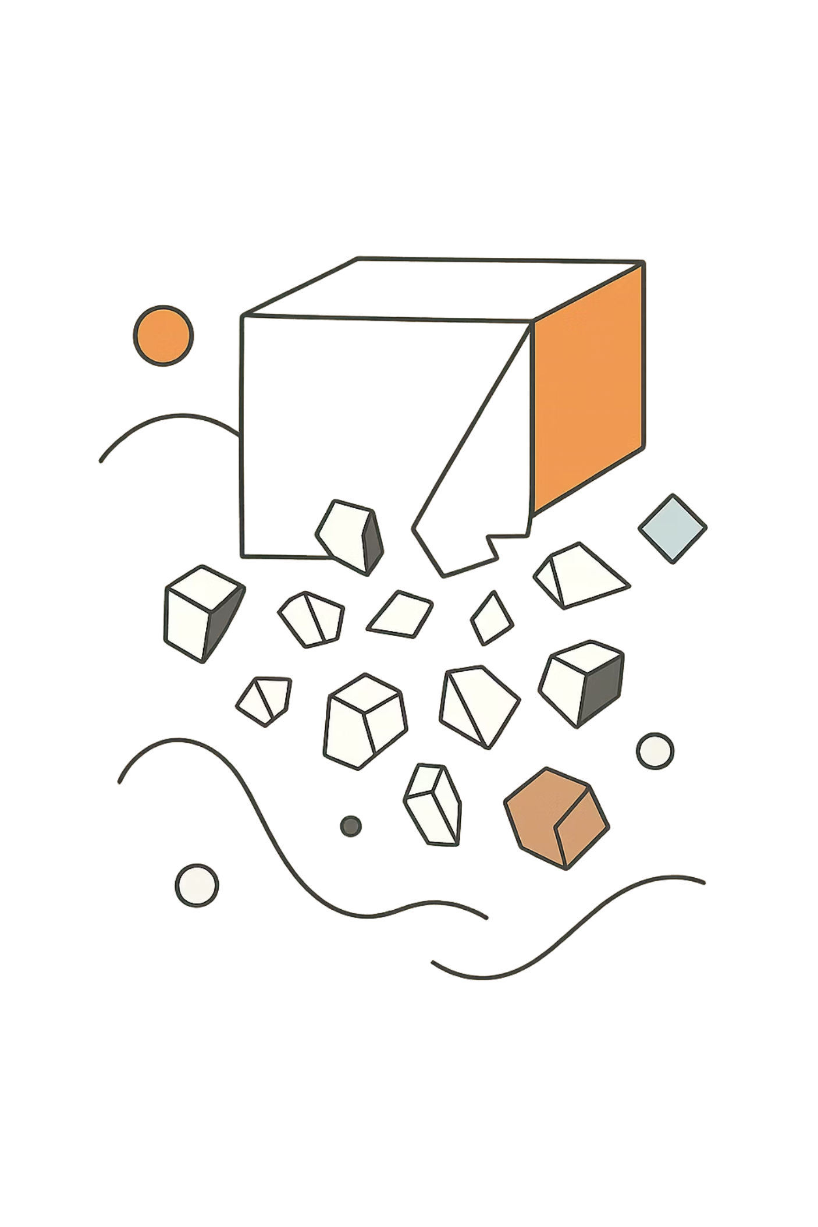
Breaking the Monolith
Sample Application #2 — The Microservices Refactor
Welcome to the core of microservices! In Module 2, we built a monolith where Users, Products, and Orders lived in the exact same memory space. If the application crashed, everything went down. Now, we will refactor that application into three independent services.

Slide 21

4.1 The Refactoring Strategy
We will split our monolith into three bounded contexts, each running on its own port:
👤 User Service
📦 Product Service
🛒 Order Service
Port 5001
Port 5002
Port 5003
Manages user data exclusively. No knowledge of products or orders.
Manages the product catalog and stock levels independently.
Handles order creation by orchestrating calls to the other services.
The Communication Challenge: In the monolith, create_order() simply looked up users[user_id]. In microservices, the Order Service has absolutely no access to the User Service's memory or database. It must communicate over the network using HTTP REST calls via Python's requests library.

Slide 22
Coding the Microservices
Three Lightweight Services
The Order Service as Orchestrator
Take a look at the three new Python files: user_service.py, product_service.py, and order_service.py. Notice how lightweight they are compared to the monolith.
Pay close attention to order_service.py. It acts as an orchestrator:
Makes an HTTP GET request to the User Service to verify the user exists
Makes an HTTP PUT request to the Product Service to reduce stock
Only then creates the order record

Slide 23
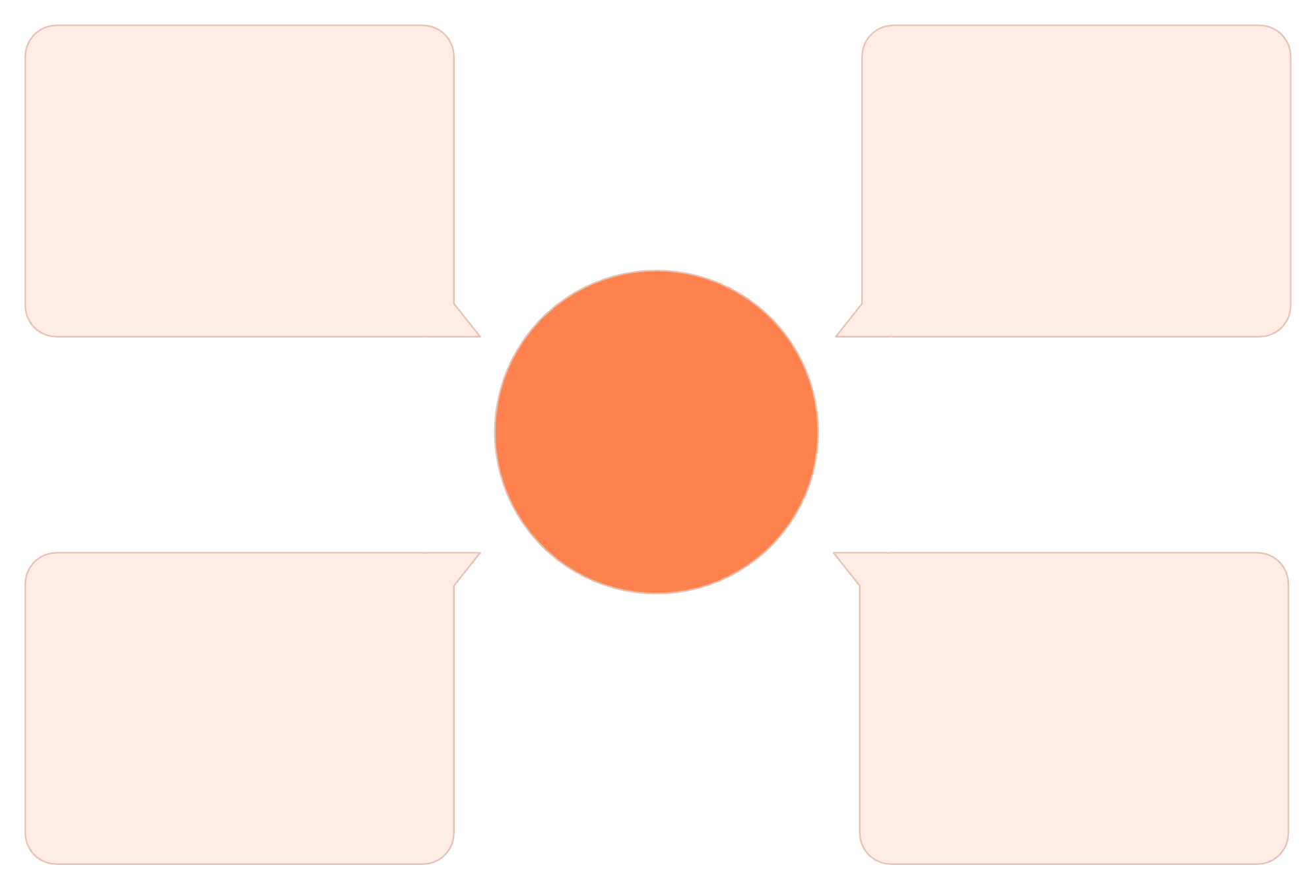
Container Networking
If we containerize these three services and run them blindly, they won't be able to talk to each other. By default, containers are isolated. We need to create a Virtual Network so they can discover each other by their container names.
podman network create ecommerce-net
HTTP Communication
User Service
Handles customer requests
REST calls over ecommerce-net
ecommerce-net Virtual Network
Order Service
Product Service
Manages orders and state
Serves product catalog
Once on the same network, containers can reach each other using their names as hostnames — e.g., http://user-service:5001 — without knowing each other's IP addresses.

Slide 24

Containerizing and Running
We use the same Containerfile from Module 3. We build one base image, but override the startup command when running to launch different Python files.
01
02
Build the Unified Image
Run the User Service
podman build -t microservices-base:latest .
podman run -d --name user-service \
--network ecommerce-net -p 5001:5001 \
microservices-base:latest python user_service.py
03
04
Run the Product Service
Run the Order Service
podman run -d --name product-service \
--network ecommerce-net -p 5002:5002 \
microservices-base:latest python product_service.py
podman run -d --name order-service \
--network ecommerce-net -p 5003:5003 \
microservices-base:latest python order_service.py
The container name is crucial! The Order Service uses http://user-service:5001 to find the User Service — the name must match exactly.

Slide 25
Testing the Microservices
You now have a distributed system running on your machine!
Check Products Directly
What's Happening Behind the Scenes
Ask the Product Service directly:
When you POST to the Order Service, it automatically:
Calls user-service:5001 to verify the user
Calls product-service:5002 to reduce stock
Returns the completed order
curl http://localhost:5002/products
Place an Order
Three containers. One seamless operation. This is microservices in action.
Send a request to the Order Service and watch it orchestrate behind the scenes:
curl -X POST \
-H "Content-Type: application/json" \
-d '{"user_id": 1, "product_id": 101}' \
http://localhost:5003/orders

Slide 26

Production-Ready Microservices
Adding a UI — The Final Layer
In the previous module, we successfully split our monolithic application into three distinct backend microservices using static, in-memory lists for data storage. While our backend is fully decoupled, we currently interact with it using command-line tools like curl. In a production environment, users need a graphical interface.

Slide 27
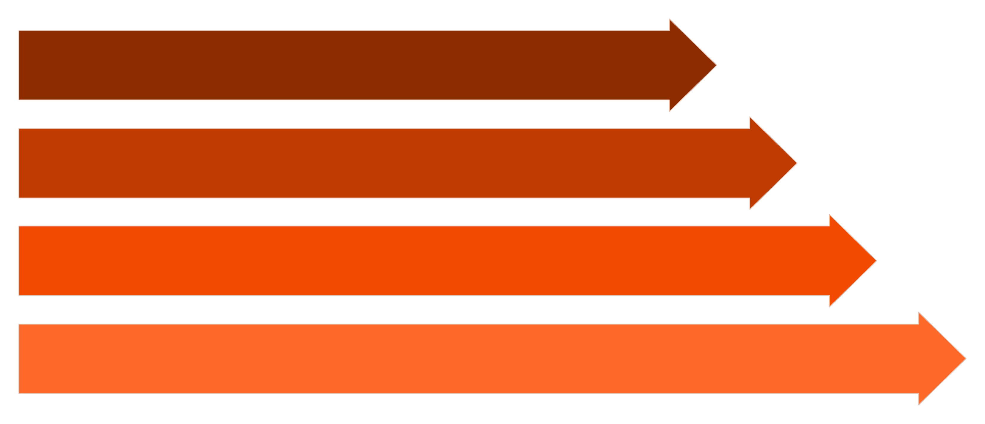
The API Gateway / Frontend Pattern
In a microservices architecture, you rarely expose your internal microservices directly to the web browser. Doing so creates Cross-Origin Resource Sharing (CORS) issues and tight coupling between the frontend and dozens of backend services.
Browser
Frontend Service
Proxy APIs
Microservices
The Frontend Service acts as a single entry point — the browser only ever talks to it, while it handles all internal routing to the appropriate microservices.

Slide 28
The Frontend Service Architecture
Serves the UI
Acts as a Proxy
Uses Container DNS
The Flask application serves a modern, responsive HTML page using Tailwind CSS — no separate frontend build step required.
Exposes three API endpoints (/api/users, /api/products, /api/orders) that translate and forward requests to internal services.
Communicates with backend services using their container DNS names: http://user-service:5001, http://product-service:5002, etc.

Slide 29
The Frontend Containerfile
Create a file named Containerfile_frontend to package the new UI service:
# 1. Base Image
FROM python:3.9-slim
# 2. Working Directory
WORKDIR /app
# 3. Dependencies
COPY requirements_frontend.txt .
RUN pip install --no-cache-dir -r requirements_frontend.txt
# 4. Copy Application Code
COPY frontend_service.py .
# 5. Expose Port
EXPOSE 5000
# 6. Startup Command
CMD ["python", "frontend_service.py"]

Slide 30
Running the Complete Stack
Step 2: Start Backend Services
Step 1: Ensure Network Exists
If already running from Module 4, skip this step. Otherwise, start all three backend containers on the ecommerce-net network.
podman network create ecommerce-net
Step 4: Run the Frontend
Step 3: Build the Frontend
podman run -d \
--name frontend-service \
--network ecommerce-net \
-p 5000:5000 \
frontend-ui:latest
podman build -f Containerfile_frontend \
-t frontend-ui:latest .

Slide 31


Access the Application!
http://localhost:5000
Open your web browser and navigate to the address above. You will see your complete, functioning e-commerce dashboard powering interactions across three isolated backend microservices — all through a single, clean user interface.
Congratulations! You've built a production-ready microservices ecosystem with a visual frontend, container networking, and independent deployability for each service.

Slide 32
The Final Push to Docker Hub
Our application is now a complete microservices ecosystem with a visual frontend. The final step is to push our new UI image to your repository.
01
02
03
Log In (if session expired)
Tag the Image
Push the Image
We'll tag this as v3-ui to mark our UI addition milestone.
podman login docker.io
podman push \
docker.io/amitfreeze/test:v3-ui
podman tag frontend-ui:latest \
docker.io/amitfreeze/test:v3-ui

Slide 33
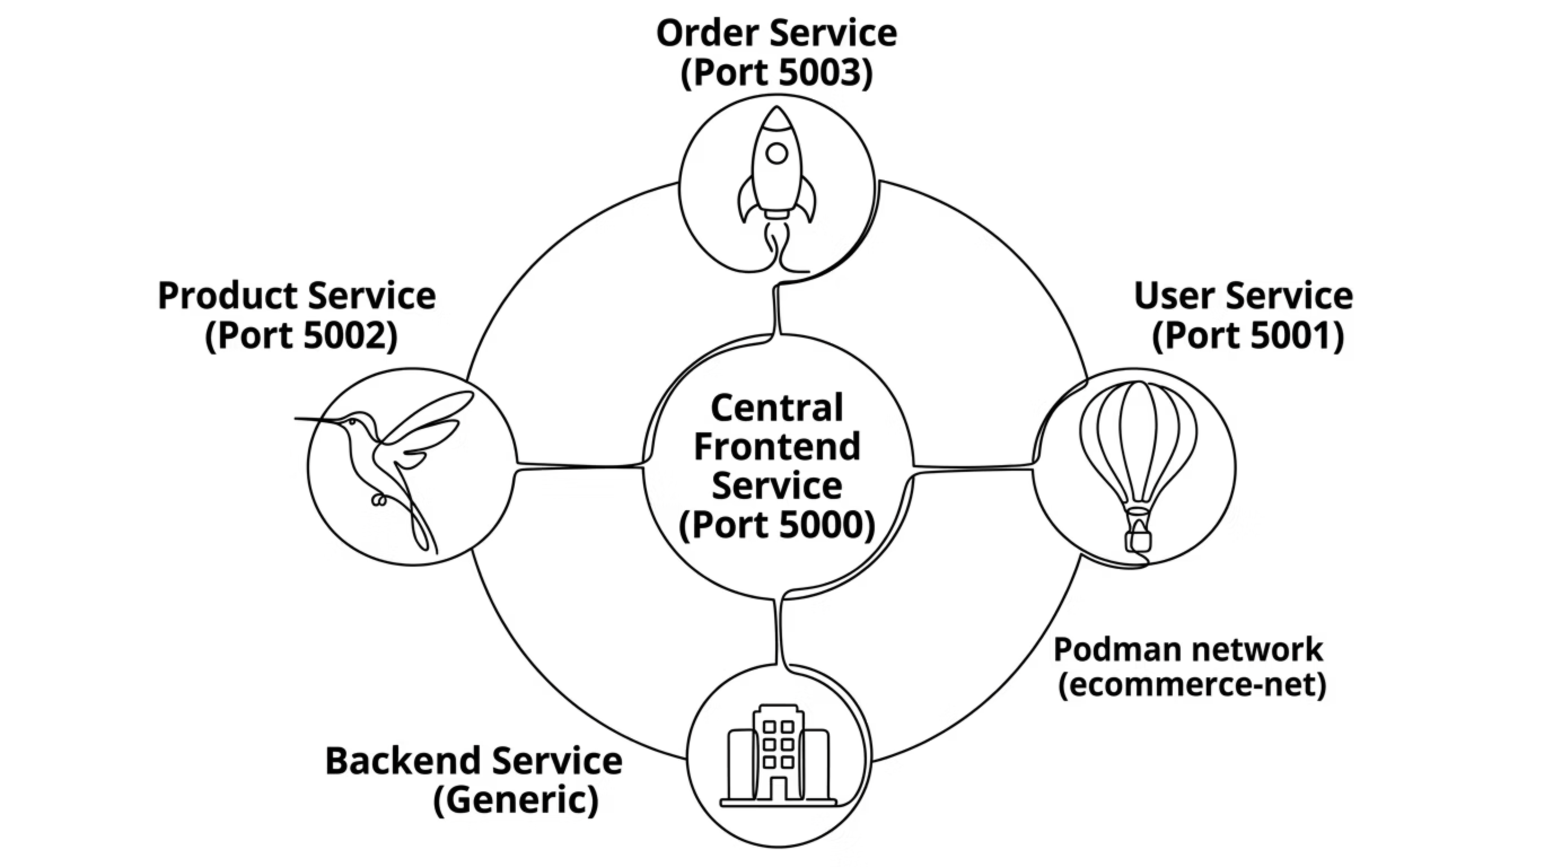

The Complete Architecture at a Glance
The browser communicates exclusively with the Frontend Service, which proxies all requests to the appropriate internal microservice over the shared ecommerce-net container network.

Slide 34
The Evolution: From Monolith to Microservices
Module 1
1
Architectural theory — understanding monoliths vs. microservices and when to use each.
2
Module 2
Built the monolith — a single Flask app handling Users, Products, and Orders with in-memory data.
Module 3
3
Containerized with Podman — packaged the monolith and pushed it to Docker Hub as v1-monolith.
4
Module 4
Broke the monolith — three independent services communicating over a virtual container network.
Module 5
5
Added the UI — a Frontend Service acting as API Gateway, completing the production-ready ecosystem.

Slide 35

Key Takeaways: Architecture
Start Simple
Know When to Split
Monoliths are not bad. They are the right choice for MVPs, startups, and small teams. Don't over-engineer from day one.
When scaling bottlenecks, deployment fear, and spaghetti code become real pain points — that's when microservices earn their complexity cost.
Bounded Contexts Win
Each service should do one thing well. Clear boundaries between services prevent the same coupling problems that plagued the monolith.

Slide 36
Key Takeaways: Containerization
Containers Are Essential
Podman Over Docker
Registries Enable Teams
Without containers, managing 10 microservices with different dependencies across multiple servers would be a nightmare. Containers make it tractable.
Daemonless and rootless operation makes Podman more secure and production-appropriate than Docker for most enterprise environments.
Pushing images to Docker Hub means any team member or server can pull and run your exact environment — no setup required.

Slide 37
Key Takeaways: Networking & Patterns
Container Networking
The API Gateway Pattern
Creating a dedicated Podman network (ecommerce-net) allows containers to discover each other by name. This is the foundation of service-to-service communication in microservices.
Never expose internal microservices directly to browsers. A Frontend Service acting as an API Gateway:
Solves CORS issues
Decouples the UI from backend topology
Provides a single entry point for security and monitoring

Slide 38
What's Next?
You've completed the foundational modules of Microservices with Python. Here's where the journey continues:
Module 5 Foundation
1
In-memory data → Real databases (PostgreSQL, Redis)
Service Discovery
2
Dynamic service registration and discovery at scale
Orchestration
3
Kubernetes / Podman Compose for managing the full ecosystem
Observability
4
Logging, tracing, and monitoring across distributed services

Slide 39

You've Built a Microservices System
From Blueprint to Production
Starting from architectural theory, you've built a real, containerized, networked microservices ecosystem — complete with a visual frontend, independent deployability, and images published to Docker Hub. This is the foundation every modern cloud-native application is built on.
🏗️ Architecture
Monolith vs. Microservices — theory and practice
🐍 Python / Flask
Lightweight services with clean HTTP APIs
📦 Podman
Rootless, daemonless containerization
🌐 Networking
Container DNS and the API Gateway pattern

Slide 40
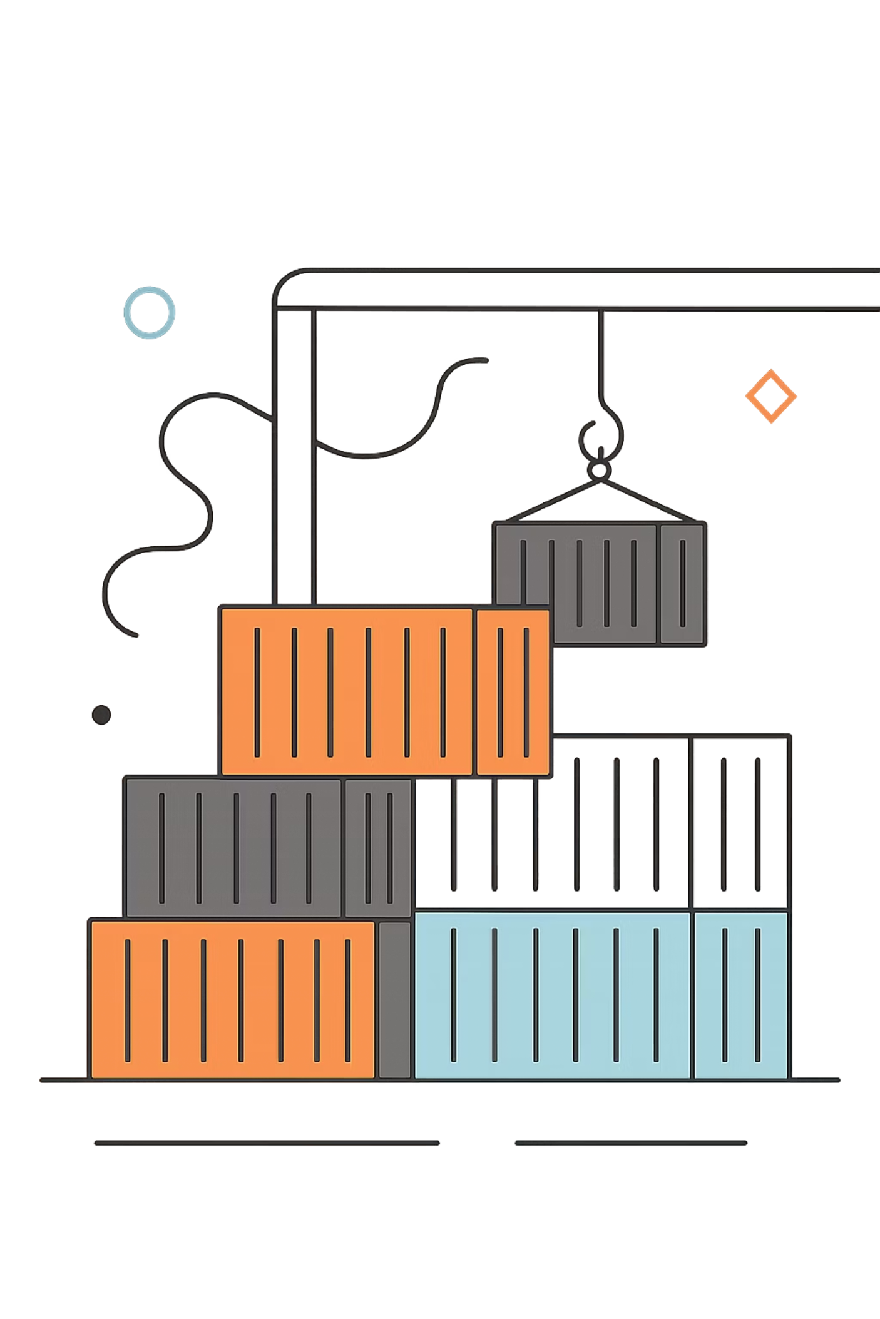
Orchestrating with Podman Compose
From four sprawling CLI commands to a single, declarative configuration file — this module walks you through how podman-compose brings Infrastructure as Code discipline to your local container workflows. Whether you're managing microservices for development or staging, Podman Compose eliminates manual orchestration and makes your entire environment reproducible, version-controlled, and one command away from running.
MODULE 6
DEVOPS WORKFLOW

Slide 41
The Problem: Manual Orchestration Doesn't Scale
As applications evolve from a single monolith to multiple cooperating services, the operational overhead of managing each container by hand grows rapidly — and unsustainably.
Before: Four Services, Four Commands
After: Infrastructure as Code
Our application now consists of four separate containers that must all be running simultaneously:
Infrastructure as Code (IaC) is the practice of defining your environment in a declarative configuration file that can be checked into version control, shared across teams, and executed deterministically.
User Service — handles authentication and user data
Product Service — manages the product catalog
Order Service — processes and tracks orders
Frontend — serves the web UI to the browser
With a single docker-compose.yml file and one terminal command, podman-compose handles:
Building all images in the correct order
Creating and connecting virtual networks
Mapping ports to localhost
Enforcing startup dependencies between services
Each requires its own podman run invocation with specific flags for ports, networks, and environment variables — in exactly the right order. Restart your machine and you're starting over from scratch.

Slide 42
What is Podman Compose?
podman-compose is a Python utility that reads standard docker-compose.yml specification files and executes them using Podman as the container backend. If you already know Docker Compose, the mental model transfers directly — podman-compose maps every familiar Compose directive to the equivalent Podman CLI command under the hood.
Drop-in Compatibility
Podman Backend
Standard Directives
Uses the same docker-compose.yml format you already know. No file conversion or syntax changes required to migrate from Docker Compose workflows.
All containers are managed by Podman, giving you rootless execution, no daemon dependency, and OCI compliance — advantages you don't get with Docker Compose.
Supports services, networks, ports, volumes, depends_on, build, and command — the full set of directives needed for realistic multi-service apps.

Slide 43
Anatomy of the Compose File
The docker-compose.yml file is a YAML document that declaratively describes every aspect of your multi-container environment. Each top-level key maps directly to a Podman concept you've already used in previous modules — the Compose file simply consolidates them in one place.
build
command
ports
Points to a directory containing a Containerfile (or Dockerfile). Podman Compose runs the equivalent of podman build automatically. You no longer need to pre-build images manually before starting services.
Overrides the default CMD defined in the Containerfile. This is powerful because it allows you to build a single base image and reuse it for multiple services — just pointing each service at a different Python script entry point.
Declares host-to-container port mappings in HOST:CONTAINER format. This is equivalent to the -p flag in podman run. For example, 5000:5000 makes the frontend reachable at http://localhost:5000.
networks
depends_on
Automatically creates a named virtual network and attaches all listed services to it. Containers on the same network resolve each other by service name via internal DNS — e.g., http://user-service:5001 works without any manual configuration.
Dictates startup order between services. For example, the Order service can declare that it depends on both User and Product services, ensuring Podman Compose starts backend services before the services that consume them.

Slide 44

Installing Podman Compose
Before you can use podman-compose, you need to install it. There are two primary methods depending on your environment. For most developers, the pip method is the fastest path to get started, especially in virtual environments or CI pipelines. OS-level package managers are preferred for system-wide installations on Linux workstations.
Method 1 — Python pip (Universal)
Method 2 — OS Package Manager (Linux)
Works on any system with Python 3 installed, including macOS, Windows (WSL2), and Linux. Ideal if you're working inside a Python virtual environment or want the latest release.
Preferred for system-wide installation on Fedora/RHEL-based or Debian/Ubuntu-based distros. Managed by your distribution's update cycle.
pip install podman-compose
# Fedora / RHEL / CentOS
dnf install podman-compose
# Debian / Ubuntu
apt install podman-compose
To verify the installation was successful:
podman-compose --version
If you have both Docker Compose and Podman Compose installed, they operate independently. Your docker-compose.yml files are shared between them — the tool you invoke determines the backend used to run the containers.

Slide 45
Launching the Entire Ecosystem
With your docker-compose.yml in place and podman-compose installed, starting the full four-service application is a single command. Navigate to the directory containing the Compose file and run:
podman-compose up -d --build
The --build Flag
The -d Flag (Detached Mode)
Verifying It Works
Forces Podman Compose to rebuild all images from their Containerfiles before starting containers. Essential after any code change — without it, Compose may reuse a cached image that doesn't reflect your latest Python edits. Always use --build during active development.
Once the command completes, open your browser to http://localhost:5000. The Frontend container is now serving the UI, which in turn calls the User, Product, and Order services over the internal virtual network — fully wired up automatically.
Runs all containers in the background so your terminal remains free. Without -d, the terminal attaches to the combined log stream of all services. Both modes are useful — omit -d during debugging to watch logs in real time.

Slide 46

What Happens Under the Hood
When you run podman-compose up -d --build, podman-compose executes a precise sequence of operations on your behalf. Understanding this sequence helps you diagnose failures and reason about the state of your environment at any point in time.
Create Network
Start Containers
Provisions the virtual network defined under networks.
Launches services in depends_on order with mappings.
Build Images
Attach & Detach
Runs podman build for each service with build directives.
Streams logs then detaches to background if -d flag set.
Each step is idempotent where possible — if a network already exists, Compose reuses it. If an image hasn't changed and you omit --build, Compose skips the build step. This makes repeated invocations safe and fast during iterative development cycles.

Slide 47

Tearing It All Down
When you're finished testing, podman-compose down provides a clean, single-command teardown of everything that was started — no manual cleanup required.
podman-compose down
What down Removes
What down Does NOT Remove
Gracefully stops all running service containers (sends SIGTERM, waits, then SIGKILL)
Removes the stopped containers from Podman's container list
Destroys the virtual network created by up
Leaves your built images intact — no need to rebuild next time unless code changed
Named volumes — persistent data volumes are preserved by default to protect your data between sessions
Built images — cached layers remain, making the next up --build faster
Your source code — bind mounts are untouched
To also remove volumes, add the -v flag: podman-compose down -v. Use this for a truly clean slate reset.
Think of up and down as environment power switches. They are safe to use repeatedly throughout your development day — start your stack in the morning, tear it down at night, and bring it back exactly as you left it the next time.

Slide 48

Key Takeaways
Module 6 introduced podman-compose as the orchestration layer that transforms a fragile sequence of manual podman run commands into a reproducible, version-controlled environment. Here's what to carry forward into the next module.
One File to Rule Them All
Drop-in Podman Backend
A single docker-compose.yml replaces all manual CLI commands. Commit it to your repo and every teammate gets an identical environment.
podman-compose reads standard Compose files — no syntax changes needed. You gain Podman's rootless, daemonless advantages without rewriting any configuration.
Automatic Networking
Simple Lifecycle Commands
Internal DNS resolution between services is configured automatically. Services communicate by name — http://user-service:5001 — without any manual network setup.
Two commands manage the full lifecycle: podman-compose up -d --build to start everything, and podman-compose down to cleanly stop and remove it all.
You now have a fully orchestrated, multi-container application running under Podman Compose. In the next module, we'll explore adding persistent volumes and environment variable management to make the setup production-ready.

