Slide 1
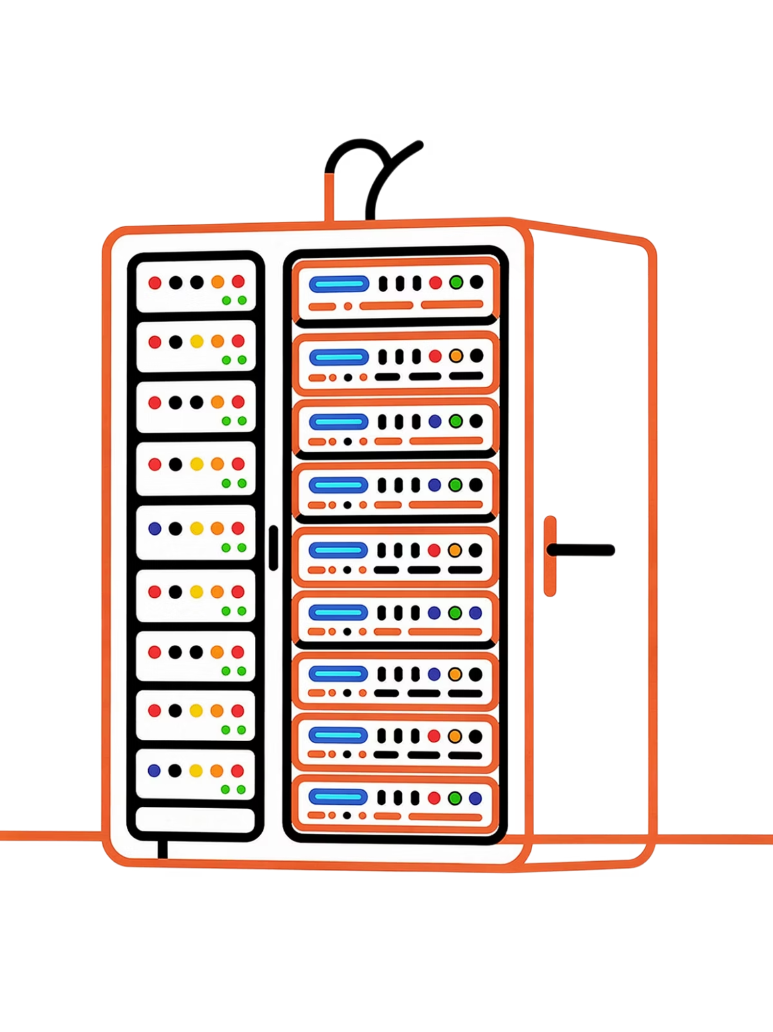
Kubernetes: From Novice to Cloud-Native Architect
Instructor Teaching Notes & Lab Guide — A comprehensive journey through container orchestration, cluster architecture, security, and real-world microservices deployment.
CLOUD-NATIVE SERIES
HANDS-ON LAB GUIDE

Slide 2


MODULE 1
The Evolution of Computing & Deployment
Before diving into Kubernetes, it's essential to understand why it exists. The history of software deployment is a story of steadily removing friction — from months-long hardware procurement cycles to spinning up containers in milliseconds. Each technological leap solved real pain points, and understanding those pain points makes every subsequent innovation feel inevitable.
The Core Objective
The Helper Tools
Why This History Matters
Every era of computing — from mainframes to the cloud — shares one fundamental goal: deploying applications efficiently to end-users. The tools and abstractions change; the mission does not.
Servers, operating systems, Docker, and Kubernetes are all means to an end. They exist to help teams ship faster, debug quicker, and scale seamlessly — not as goals in themselves.
Understanding the constraints of each era explains why the next tool was invented. No matter the decade, enterprises need to ship software reliably — the journey is about reducing the cost and complexity of doing so.
Instructor note: Ground your audience here. Before introducing any technology, remind them that every tool covered in this course — however complex — exists only to serve that single, simple goal of delivering software to users.

Slide 3
The Bare Metal Era: Traditional Data Centers
For decades, deploying an application meant a painful, multi-month process of physical hardware procurement, manual configuration, and brittle monolithic codebases. Understanding this era makes modern cloud-native architecture feel like a revolution — because it was.
The Deployment Process
The Monolithic Architecture
The lifecycle was linear and slow: Order hardware → Wait weeks/months → Rack & Stack in data center → Install OS → Install app-specific dependencies (e.g., JDK for Java apps, specific runtime versions). Every new environment — staging, dev, QA — required repeating this entire expensive cycle from scratch.
Servers routinely ran at 15–20% CPU utilization, meaning 80% of your hardware investment sat idle. There was no elasticity, no self-service, and no quick path to recovery when hardware failed.
Applications of this era were typically monoliths: a single deployable unit containing all features — UI, business logic, authentication, and database access — compiled and shipped together.
✅ Pros
❌ Cons
Faster to develop in early stages
Easier for small, co-located teams
Single deployment pipeline
Rigid — adding a new tech stack is extremely difficult
One broken feature (e.g., login) takes down the entire app
Cannot scale individual components independently

Slide 4

Virtualization & Cloud Computing
The first major leap beyond bare metal was virtualization — the ability to carve a single physical server into multiple isolated virtual machines. Cloud computing then took this further, abstracting away the data center entirely and making infrastructure available on-demand via a few CLI commands.
Virtualization: Slicing the Hardware
Cloud Computing: Infrastructure as a Service
The Remaining Problem
VMs solved the hardware problem but introduced their own overhead: each VM runs a full OS — kernel, system libraries, daemons — even when the application inside it is tiny. Booting a VM takes minutes. Running 50 microservices inside 50 separate VMs wastes enormous memory and compute on OS redundancy, paving the way for the next evolution: containers.
Originating in the 1960s on mainframes and popularized by VMware in the 2000s, virtualization introduces a hypervisor layer between hardware and software. Type 1 hypervisors (bare-metal, e.g., VMware ESXi) run directly on hardware. Type 2 hypervisors run on top of an existing OS (e.g., VirtualBox). Each VM gets a slice of physical CPU and RAM and runs its own full OS, dramatically improving hardware utilization compared to bare metal.
Providers like AWS, GCP, Azure, and Exoscale abstracted away the data center entirely. Instead of ordering physical servers, teams could provision VMs via a web UI or CLI in minutes — paying only for what they use. This was transformative for startups (no upfront CapEx) and for handling variable load events like Black Friday spikes, where capacity could be doubled in minutes and released just as quickly.
Instructor note: The cloud solved upfront cost and provisioning speed. But the per-VM OS overhead remained. This gap is exactly what containers were designed to fill — and why Docker's 2013 release was such a turning point.

Slide 5
The Container Era & Microservices
Docker's 2013 public release democratized container technology that had existed in Linux for years. By packaging an application and all its dependencies into a single portable artifact — without bundling a full OS — containers delivered unprecedented speed, density, and consistency across environments.
Containers: How They Work
Microservices Architecture
A container packages your code, libraries, and runtime dependencies together and runs as an isolated process on the host OS kernel — sharing it rather than duplicating it.
Two Linux kernel primitives power this:
Containers catalyzed a shift in how applications are structured. Rather than one large monolith, teams now decompose applications into independently deployable services, each owning a specific domain:
Frontend — React/Nginx serving the UI
Auth Service — login, tokens, identity
Game Service — business logic
Database — persistent data layer
Namespaces — provide isolation (PID, network, filesystem, user)
cgroups — enforce resource limits (CPU, memory, I/O)
The result: containers start in milliseconds, consume megabytes instead of gigabytes, and behave identically from a developer's laptop to production.
This enables polyglot programming — JS for the frontend, Go for auth, Python for AI — and allows teams to update or scale any single service independently without redeploying the whole application.

Slide 6

🧪 LAB EXERCISE 1
Introduction to Containers
Objective: Experience firsthand the speed and isolation that containers provide — the foundation for everything Kubernetes builds upon.
1
2
Install Docker Desktop
Run an Nginx Web Server
Download and install Docker Desktop on your local machine from docker.com. Ensure it is running before proceeding. Docker Desktop includes the Docker CLI and a local container runtime.
Execute the following command to pull the Nginx image and start a container in detached mode, mapping port 8080 on your host to port 80 in the container:
docker run -d -p 8080:80 nginx
3
4
Verify in Browser
Stop & Remove
Open your browser and navigate to http://localhost:8080. You should see the default Nginx welcome page — served by a fully isolated container process, not a VM or installed application.
Clean up the running container using the container ID returned by docker ps:
docker rm -f <container_id>
Notice how the server disappears instantly — no uninstall wizard, no leftover files.
Key Takeaway: The web server started in milliseconds — no OS boot, no hardware provisioning, no dependency conflicts. This speed and portability is exactly why containers became the universal unit of deployment.

Slide 7

MODULE 2
What Is Kubernetes?
Kubernetes (K8s) is an open-source system for automating deployment, scaling, and management of containerized applications. It has become the de facto standard for running applications at scale in cloud-native environments — and for good reason. It is battle-tested, extensible, and backed by one of the largest open-source communities in the world.
Origins: Google Borg & Omega
CNCF's First Graduate
The "K8s" Abbreviation
Kubernetes was born from Google's internal cluster management systems — Borg and later Omega — which ran Google's production workloads for over a decade. Google open-sourced the lessons learned in those systems when it launched Kubernetes in June 2014.
Kubernetes was donated to the Cloud Native Computing Foundation (CNCF) and became its first graduated project — signaling production readiness, governance, and long-term support from the broader industry. Today it has contributions from thousands of engineers worldwide.
"K8s" replaces the 8 letters between K and s in "Kubernetes" — a common convention in the cloud-native world. The name itself comes from the Greek word for helmsman or navigator, a fitting metaphor for something that steers containers across a fleet of servers.
Instructor note: Point students to the "Borg & Omega" research papers and the CNCF documentary on Kubernetes' origin for those who want to go deeper on the historical context.

Slide 8
Why Do We Need Kubernetes?
Docker solves the problem of packaging and running a single container. But production systems don't run one container — they run hundreds or thousands, distributed across many servers. At that scale, manual container management becomes operationally impossible. Kubernetes was built specifically to solve this problem.
The Scale Problem
The Kubernetes Solution
Consider a realistic production scenario: 20 microservices × 10 container replicas each = 200 containers, potentially spread across 10–20 servers. Now ask yourself:
Self-Healing
Autoscaling
Detects failed containers and automatically restarts them. Reschedules workloads away from failed nodes.
Scales replicas horizontally based on CPU, memory, or custom metrics — automatically, without manual intervention.
How do containers find and talk to each other across servers?
What happens when a container crashes at 3am?
How do you roll out an update to 50 replicas without downtime?
How do you scale a service from 10 to 100 replicas under sudden load?
How do you ensure containers are distributed for high availability?
Service Discovery
Desired State Reconciliation
Built-in DNS and load balancing so services can find each other by name, regardless of which node they're on.
Managing this manually with scripts is fragile, error-prone, and impossible to maintain.
You declare what you want; K8s continuously works to match reality to that declaration — forever.

Slide 9

Kubernetes Extensibility
One of Kubernetes' most underappreciated strengths is that it is not merely a container orchestrator — it is a highly extensible platform API. While it ships with native primitives for containers, its architecture allows you to extend it to manage virtually any kind of resource, inside or outside the cluster.
Custom Resource Definitions (CRDs)
Custom Controllers & Operators
Cluster API
One of the most powerful examples of extensibility: using Kubernetes to provision and manage other Kubernetes clusters. Cluster API (CAPI) treats cluster infrastructure as Kubernetes objects — nodes, control planes, and machine pools managed declaratively.
CRDs allow you to extend the Kubernetes API with your own resource types. You define the schema, and K8s stores and exposes those objects through its standard API machinery — with versioning, validation, and RBAC built in.
A controller is a control loop that watches the state of resources and takes action to drive current state toward desired state. You can write controllers in any language to manage cloud databases, AWS S3 buckets, DNS records, TLS certificates — anything with an API.
Calling K8s a "container orchestrator" is accurate — but incomplete. It is better described as a universal infrastructure control plane that happens to have excellent native support for containers.

Slide 10

🧪 LAB EXERCISE 2
Exploring the K8s Ecosystem with kind
Objective: Set up a local, fully functional Kubernetes cluster using kind (Kubernetes in Docker) — where each "node" is actually a Docker container running on your laptop. This gives you a realistic multi-node cluster experience without any cloud costs.
01
02
Verify Docker is Running
Install kind
Ensure Docker Desktop is active. kind uses Docker containers as Kubernetes nodes, so Docker must be running before any cluster operations.
Install the kind binary via your preferred package manager. On macOS with Homebrew: brew install kind. On Linux, download the binary from kind.sigs.k8s.io and place it in your PATH.
docker ps
03
04
Create a Local Cluster
Verify Cluster Health
Provision a named cluster. kind will pull the node image, create Docker containers for the control plane, and bootstrap the cluster automatically:
Confirm the cluster is running and your local kubectl context has been updated automatically by kind:
kind create cluster --name k8s-course
kubectl get nodes
You should see a node in Ready status — your cluster is live.
Key Takeaway: You now have a production-grade Kubernetes cluster running on your laptop. Each "node" is a Docker container — demonstrating K8s' own use of containers to manage its infrastructure.

Slide 11
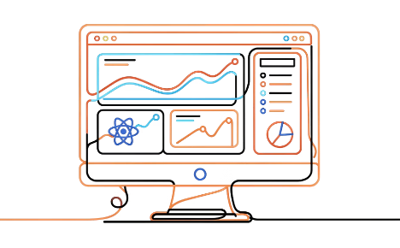
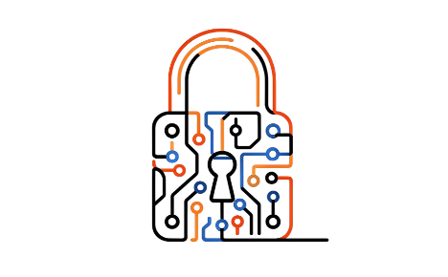
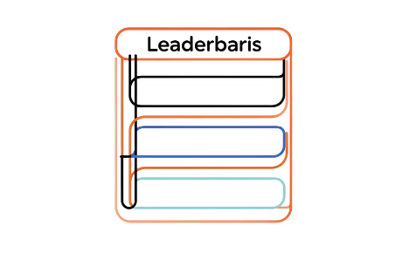
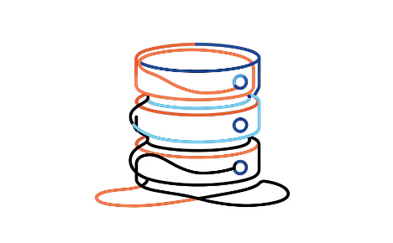
MODULE 3
The "Game Hub" Application
Throughout this course, we'll deploy a real, multi-tier microservices application called Game Hub. Rather than working with toy examples, this gives us a production-representative system with authentication, APIs, a frontend, and a database — all the components you'll encounter in the real world, wired together through Kubernetes.
Frontend — React / Nginx
Auth Service — Python
Game Service — Python
Database — PostgreSQL
Manages user signup and login. Hashes passwords using bcrypt, stores credentials in PostgreSQL, and issues signed JWT tokens upon successful authentication.
Contains core game logic and score tracking. Validates incoming JWT tokens before processing requests, then persists high scores to the shared PostgreSQL database.
The persistent data layer. Stores user account records (hashed passwords, usernames) and game high scores. Accessed exclusively by the Auth and Game services — never directly from the frontend.
Serves the user interface. Handles client-side routing, displays game state, and attaches JWT tokens to every authenticated API request via Authorization: Bearer headers.

Slide 12

Dockerizing the Game Hub App
Before deploying to Kubernetes, every service must be packaged as a container image. The quality of your Dockerfiles directly impacts image size, build speed, security surface area, and runtime stability. Here's how we approached each service.
Frontend: Multi-Stage Build
Backend Services: Python Slim Images
Cross-Platform Builds (Apple Silicon)
The React frontend uses a multi-stage Dockerfile — one of Docker's most important optimization patterns. Stage 1 uses a full Node.js image to compile the React app (npm run build). Stage 2 copies only the compiled static files into a lightweight Nginx image, discarding all Node.js build tooling. The result: an image that might be 20MB instead of 800MB, with a dramatically smaller attack surface.
The Auth and Game services use python:3.11-slim base images — stripped-down variants that omit unnecessary OS packages. Dependencies are installed via pip install -r requirements.txt and the app is served in production using Gunicorn, a production-grade Python WSGI server that handles concurrency far better than Flask's built-in development server.
Apple M1/M2 Macs use ARM64 architecture, but most cloud Kubernetes nodes run AMD64. Building and pushing AMD64-compatible images from an Apple Silicon Mac requires Docker Buildx with QEMU emulation:
docker buildx build --platform linux/amd64 -t myapp:latest --push .
Always verify your target cluster's node architecture and build accordingly to avoid mysterious exec format error crashes.
Instructor note: While this isn't a Docker course, well-optimized images are a prerequisite for smooth K8s operations. Bloated images slow down pod startup, waste node storage, and increase security exposure.

Slide 13
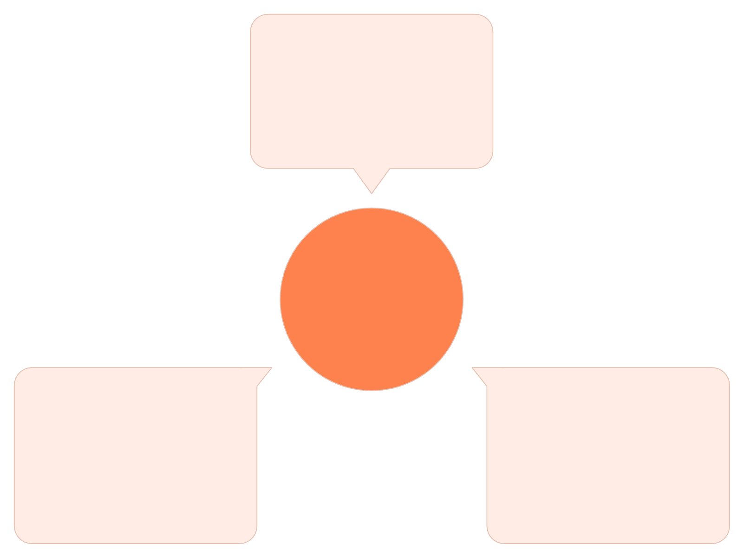
🧪 LAB EXERCISE 3
Application Code Review: Microservice Communication
Objective: Understand how the Game Hub services communicate with each other — specifically how the JWT token flows from the Auth service through the Frontend to the Game service. This inter-service communication pattern is fundamental to understanding why Kubernetes networking matters.
Auth Service issues JWT
Generates signed token after login
JWT Token Flow
Game Service validates JWT
Frontend stores & attaches
Verifies signature before processing
Saves token and sends with requests
The JWT flow is the backbone of the application's security model. Follow these steps to trace it through the codebase:
1
Review docker-compose.yml
2
Find JWT Generation in Auth Service
3
Trace the Authorization Header in the Frontend
Examine the provided docker-compose.yml (available in your course files). Identify how services are networked together, which ports are exposed, and how environment variables (database URLs, JWT secret keys) are passed between services. This mirrors how Kubernetes Services and ConfigMaps will be configured later.
Open the Auth service Python code. Locate the login endpoint and find where jwt.encode() is called. Note the payload (user ID, expiry) and the secret key used for signing. This token is what every protected endpoint will later validate.
Open the React frontend code. Find where the JWT received from login is stored (typically localStorage or React state) and where it is attached to outgoing requests as Authorization: Bearer <token> in the API call headers. This is the contract between frontend and backend services.

Slide 14
MODULE 4
Building a Kubernetes Cluster: Self-Managed vs. Managed
There are two fundamental approaches to running a Kubernetes cluster in production: build and manage it yourself on raw VMs, or let a cloud provider handle the control plane for you. Both have their place, but understanding the self-managed path is essential for grasping what managed services abstract away.
🔧 Self-Managed — "The Hard Way"
☁️ Managed — "The Easy Way" (e.g., Exoscale SKS)
You own every layer of the stack. On Ubuntu VMs (e.g., Exoscale), you must:
The cloud provider runs and maintains the control plane. You interact with it as a black box via API. Your responsibilities shrink to:
Prepare the OS: Disable swap, load kernel modules (overlay, br_netfilter), configure sysctl networking params
Install components: containerd (runtime), kubelet, kubeadm, kubectl
Bootstrap: kubeadm init on the control plane, then kubeadm join on worker nodes
Install CNI: A Container Network Interface plugin like Flannel or Calico for pod-to-pod networking
Ongoing maintenance: Certificate rotation, etcd backups, K8s version upgrades
Provision the cluster: Via UI, Terraform, or CLI (exo compute sks create)
Configure security groups: Open TCP 10250 (Kubelet API) and UDP 4789 (VXLAN/CNI traffic)
Download kubeconfig: And deploy your workloads
No etcd management. No certificate rotation. No control plane upgrades. This is how 95% of companies run Kubernetes in production — and the model you should default to unless you have a specific reason not to.
Excellent for learning K8s internals. Operationally heavy for production.

Slide 15
🧪 LAB EXERCISE 4
Provisioning a Cluster: Infrastructure Prerequisites
Objective: Understand the network and security prerequisites required before a Kubernetes cluster can function correctly — whether on a cloud provider or locally. Misconfigured firewalls are one of the most common causes of mysterious cluster failures.
1
2
Create a Security Group
Add Required Firewall Rules
If using a cloud provider (Exoscale, AWS, GCP), create a new Security Group via the CLI or UI. This will act as the cluster firewall, controlling which traffic is allowed between nodes and from external sources.
At minimum, Kubernetes requires two critical ports to be open between nodes:
TCP 10250 — Kubelet API (used by the control plane to talk to worker nodes)
UDP 4789 — VXLAN traffic for Calico or Flannel CNI pod networking
exo compute security-group create k8s-cluster-sg
3
4
Export kubeconfig (Local kind Alternative)
Test Connectivity
If not using a cloud provider, extract your kind cluster's kubeconfig to a file:
Set the KUBECONFIG environment variable and verify you can query all system pods — a reliable indicator that networking, authentication, and the API server are all healthy:
kind get kubeconfig --name k8s-course > my-kubeconfig.yaml
This file contains your cluster endpoint, CA certificate, and client credentials — treat it like a password.
export KUBECONFIG=my-kubeconfig.yaml
kubectl get pods -A

Slide 16
MODULE 5
Speaking Kubernetes: YAML Basics
Every interaction with Kubernetes — creating pods, deploying applications, configuring networking — is expressed through YAML manifests. YAML (YAML Ain't Markup Language) is a human-readable data serialization format that Kubernetes adopted as its primary configuration language. Mastering it is non-negotiable for anyone working with K8s.
Core YAML Syntax
Practical Validation Tips
Key-Value Pairs
Lists / Arrays
Even experienced engineers make YAML indentation mistakes. Build validation into your workflow from day one:
The atomic unit of YAML: name: sam. Simple, flat data — strings, numbers, booleans.
Denoted by hyphens. Each - item is one element. Used extensively in K8s for container lists, port lists, environment variables.
Use yamllint to catch syntax errors before applying manifests
Use kubectl apply --dry-run=client -f manifest.yaml to validate against the API schema without creating resources
Configure your editor (VS Code + YAML extension) for real-time validation and auto-formatting
Use kubectl explain <resource> to browse the K8s API schema inline
Objects / Dictionaries
Multi-Line Strings
Nested key-value pairs using consistent indentation with spaces — never tabs. Misaligned indentation is the #1 cause of YAML parse errors.
The pipe symbol | preserves newlines — perfect for embedding shell scripts in ConfigMaps or init containers.
The Golden Rule
If a deployment fails and the container image is correct, check your YAML indentation first. A single extra space or a tab character where a space is expected will cause a cryptic parse error that can take minutes to find without tooling.

Slide 17
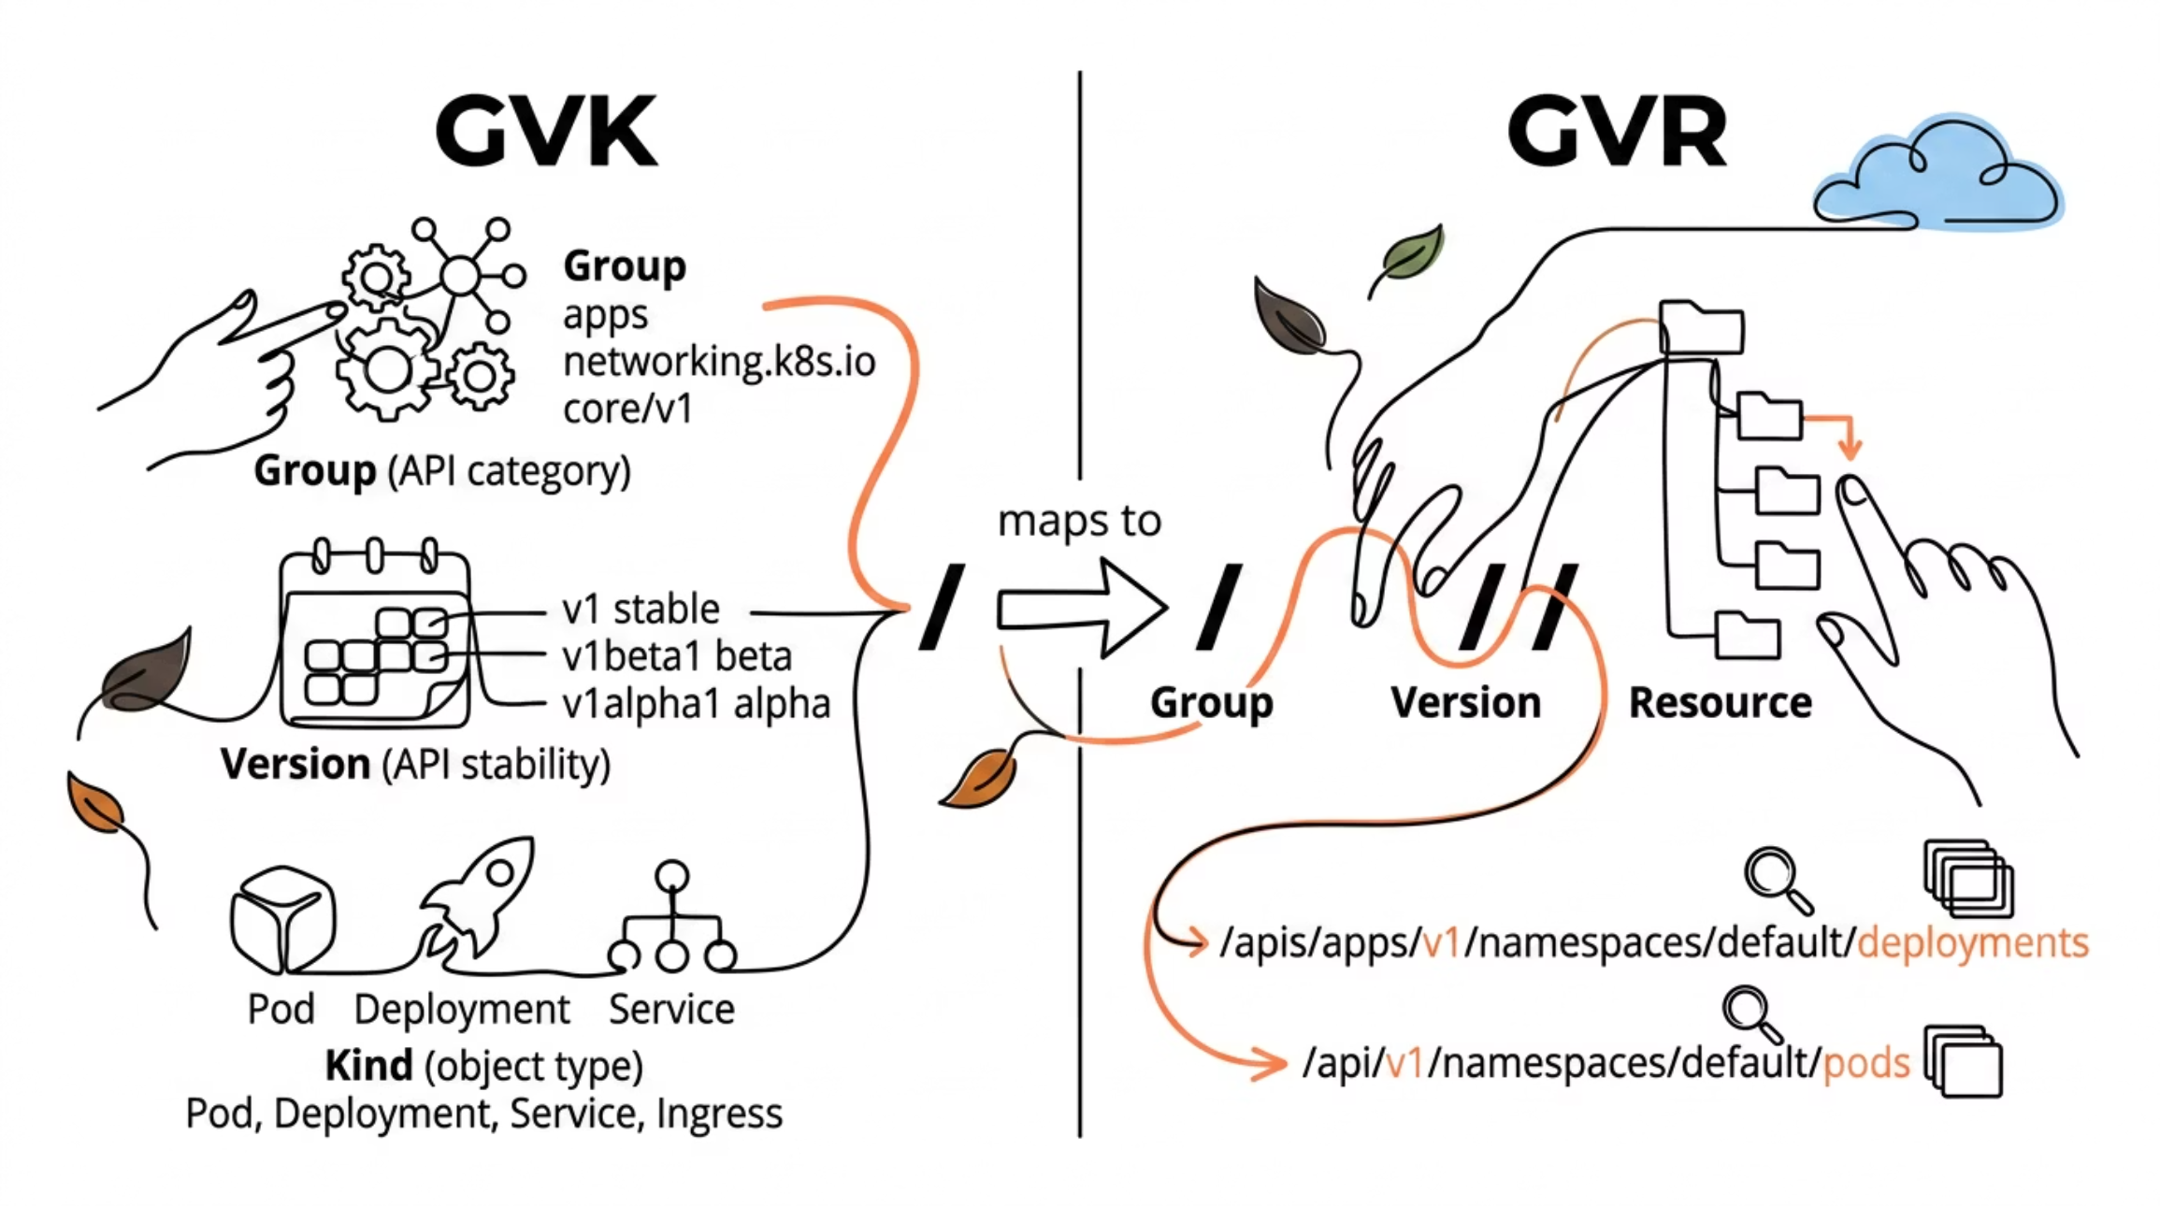

Understanding GVK and GVR
When you write a Kubernetes manifest or interact with the K8s REST API, you're working with a structured type system. Two acronyms — GVK and GVR — describe how Kubernetes organizes and exposes its API objects. Understanding them demystifies every manifest you'll ever write and every API call you'll ever make.
GVK — Group, Version, Kind
GVR — Group, Version, Resource
GVK defines the schema of an object as it appears in a YAML manifest. In apiVersion: apps/v1 and kind: Deployment: the Group is apps, the Version is v1, and the Kind is Deployment. Core resources like Pods and Services use an empty group, expressed simply as apiVersion: v1.
GVR is the plural form used in REST API endpoints. The Deployment Kind maps to the deployments Resource. The full API path becomes: /apis/apps/v1/namespaces/default/deployments. This is the endpoint kubectl hits when you run kubectl get deployments. Understanding GVR is essential when writing controllers or making direct API calls with curl.
Use the "Department Store" analogy: Group = store department (Networking, Apps, Storage). Kind = specific product type (Pod, Deployment). Resource = the plural shelf label where all instances of that product are stored.

Slide 18

🧪 LAB EXERCISE 5
Writing Your First Kubernetes Manifest
Objective: Write a YAML manifest from scratch, apply it to your cluster, and observe a running Pod — your first hands-on experience with the Kubernetes declarative model.
The Manifest
Apply, Verify & Inspect
Create a file named nginx-pod.yaml with the following content. Pay close attention to indentation — every level is 2 spaces, never tabs:
Step 1 — Apply the manifest to your cluster. Kubernetes will receive the desired state and schedule the Pod onto an available node:
apiVersion: v1
kind: Pod
metadata:
name: my-nginx
labels:
app: nginx
spec:
containers:
- name: nginx-container
image: nginx:latest
ports:
- containerPort: 80
kubectl apply -f nginx-pod.yaml
Step 2 — Verify it's running:
kubectl get pods
Step 3 — Inspect the Pod details including events, node assignment, and IP address:
kubectl describe pod my-nginx
Step 4 — View live logs from the running container:
kubectl logs my-nginx
Step 5 — Clean up:
kubectl delete pod my-nginx
Key Takeaway: You just experienced the Kubernetes declarative model — you described what you want, and K8s figured out how to make it happen. This pattern scales from a single pod to thousands of services without changing your workflow.

Slide 19

MODULE 6
How kubectl Works: The Kubeconfig
Every command you type in kubectl ultimately becomes an authenticated HTTPS request to the Kubernetes API server. Understanding how that authentication works — through the kubeconfig file — is foundational for both day-to-day operations and production security practices.
Clusters
Users
Contexts
Defines where the API server lives. Contains the server URL (e.g., https://10.0.0.1:6443) and the Certificate Authority (CA) certificate used to verify the server's identity — preventing man-in-the-middle attacks.
Defines who is connecting. Most commonly stores a client certificate and private key pair that identifies the caller to the API server. Can also store bearer tokens, OIDC credentials, or exec-based credential plugins.
A named mapping of a User to a Cluster (and optionally a default Namespace). When you run kubectl config use-context my-cluster, you're telling kubectl which User/Cluster pair to use for subsequent commands. Multiple contexts let you switch between dev, staging, and production clusters safely.
The kubeconfig file lives at ~/.kube/config by default, or at the path specified by the KUBECONFIG environment variable. You can merge multiple kubeconfig files by setting KUBECONFIG=file1:file2 — useful when managing clusters across multiple cloud providers.
Treat your kubeconfig file like a password. A kubeconfig with cluster-admin privileges gives complete, unrestricted access to every resource in the cluster. Never commit it to version control or share it insecurely.

Slide 20

Creating a K8s User & Role-Based Access Control
Kubernetes has no built-in user management system — there is no kubectl create user command. Instead, identity is established through X.509 certificates or external identity providers, and what that identity is allowed to do is controlled by RBAC (Role-Based Access Control). Understanding this separation is critical for building secure clusters.
Submit & Approve CSR
Create Role
Send CSR to Kubernetes and approve it.
Define Role with required API permissions.
Generate Key & CSR
Create RoleBinding
Create private key and CSR using OpenSSL.
Bind the Role to the user certificate identity.
Establishing Identity (Steps 1–2)
Defining & Assigning Permissions (Steps 3–4)
Step 1 — Generate credentials: Use OpenSSL to create a private key and a Certificate Signing Request (CSR). The CSR's Common Name becomes the K8s username; the Organization field maps to K8s groups.
Step 3 — Create a Role: A Role defines a set of allowed actions (verbs) on specific resources (resources) within a namespace. For example, allowing read-only Pod access:
openssl genrsa -out sam.key 2048
openssl req -new -key sam.key \
-subj "/CN=sam/O=developers" \
-out sam.csr
rules:
- apiGroups: [""]
resources: ["pods"]
verbs: ["get","list","watch"]
Step 2 — Submit to Kubernetes: Encode the CSR in base64, embed in a CertificateSigningRequest YAML, and approve with:
Step 4 — Create a RoleBinding: Attaches the Role to the user identity. Without a RoleBinding, the certificate is valid but has zero permissions.
kubectl certificate approve sam-csr
Service Accounts
For applications running inside the cluster that need to call the K8s API (e.g., operators, CI/CD pipelines), use Service Accounts — machine identities managed natively by Kubernetes with automatically rotated tokens.

Slide 21
🧪 LAB EXERCISE 6
Direct API Interaction via Service Account
Objective: Bypass kubectl entirely and query the Kubernetes REST API directly using curl with a bearer token from a Service Account. This is exactly how internal controllers, operators, and CI/CD pipelines authenticate — understanding it demystifies the "magic" behind kubectl.
Create a Service Account
1
kubectl create serviceaccount demo-api-user
This creates a K8s identity for a machine/application within the default namespace.
Grant Cluster Permissions
2
kubectl create clusterrolebinding demo-api-binding \
--clusterrole=cluster-admin \
--serviceaccount=default:demo-api-user
Binds the cluster-admin ClusterRole for full API access. In production, always use least-privilege roles.
Generate a Bearer Token
3
kubectl create token demo-api-user
Save the output string — this is a short-lived JWT token that proves identity to the API server.
Get the API Server Address
4
kubectl cluster-info
Note the Kubernetes control plane URL — this is the HTTPS endpoint you'll call directly.
Query the API with curl
5
curl -k \
-H "Authorization: Bearer <YOUR_TOKEN>" \
https://<API_SERVER_IP>/api/v1/namespaces/default/pods
You'll receive a raw JSON response listing all pods — the same data kubectl formats for you.
Key Takeaway: You have successfully authenticated to the Kubernetes REST API the same way every controller, operator, and cloud-native tool does internally. kubectl is just a friendly wrapper around these same HTTP calls — now you know what's underneath.

