Slide 1


Hyper Parameter Optimization

Slide 2
Techniques
Manual Searching
RandomizedSearchCV
GridSearchCV
Bayesian Optimization

Slide 3
Manual Searching
Based on intuition and personal experience
Repeated until satisfactory results met

Slide 4
Random Search
Create grid of parameters
Randomly picks subset of possible parameters from grid and returns set with best score
Score can be any metric
Parameter 2
Parameter 1

Slide 5
Grid Search
Create grid of parameters
Checks every possible set of parameters in grid and returns set with best score
Score can be any metric
Parameter 2
Parameter 1

Slide 6
Random Search VS Grid Search
Random Search
Can search wide range of parameters
Might miss important points
Fast results
Grid Search
Will find optimal set of parameters within grid
More parameter possibilities greatly increases duration
High computation cost

Slide 7
Bayesian Optimization
Used if computation cost is high
limit expensive evaluations of the objective function by choosing the next input values based on those that have done well in the past.

Slide 8
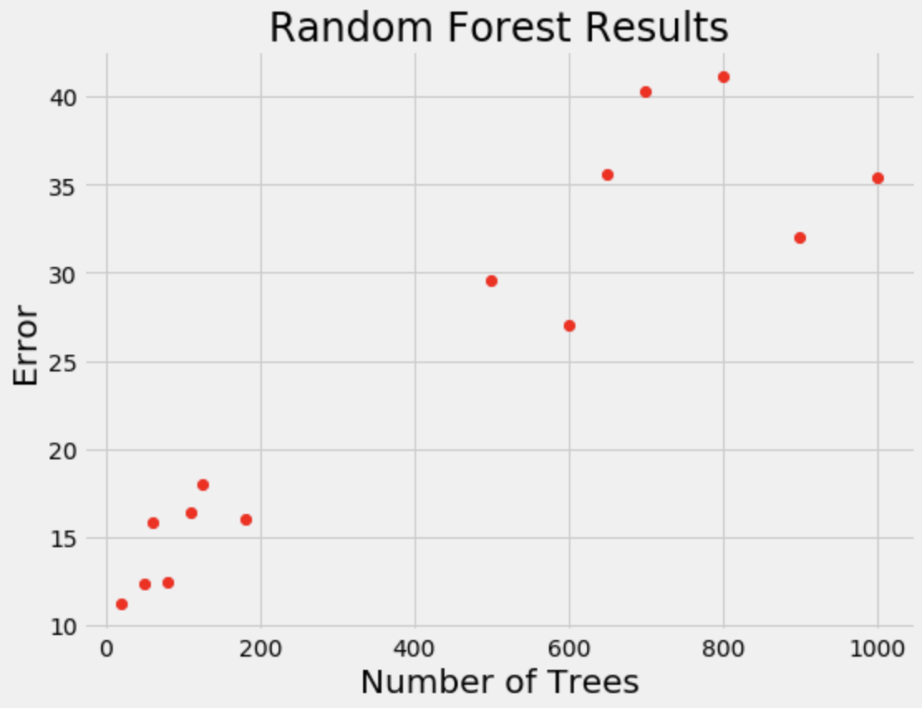
Bayesian Optimization
Concentrates search where error is lower
Creates surrogate function
Surrogate model is much cheaper to compute
Notes:
So the algorthm doesn’t waste computation time checking values near high error points.

Slide 9
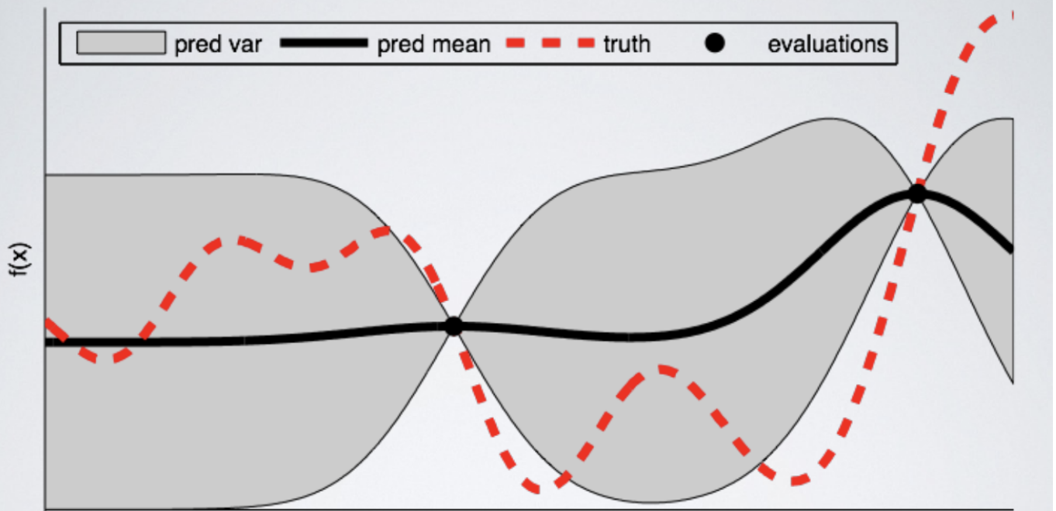
Bayes Optimization
Notes:
This shows an initial estimate of the surrogate model — in black with associated uncertainty in gray — after two evaluation
s. Clearly, the surrogate model is a poor approximation of the actual objective function in red

Slide 10
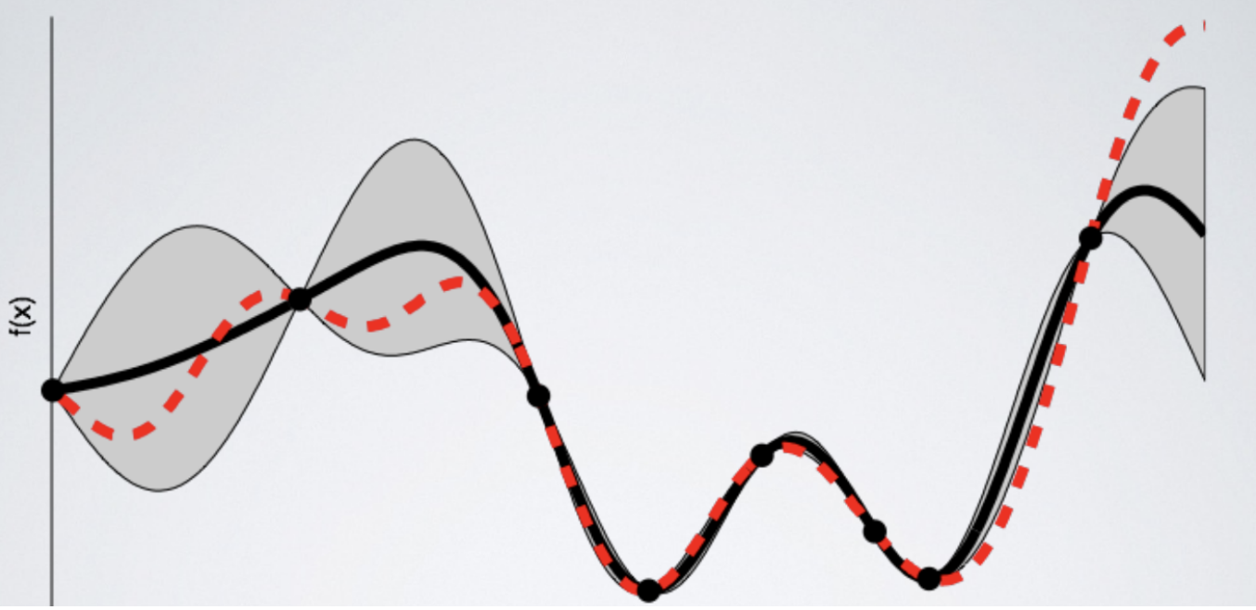
Bayes Optimization
Notes:
This image shows the surrogate function after 8 evaluations. Now the surrogate almost exactly matches the true function. Therefore, if the algorithm selects the hyperparameters that maximize the surrogate, they will likely yield very good results on the true evaluation function

Slide 11
Additional Resources
https://towardsdatascience.com/a-conceptual-explanation-of-bayesian-model-based-hyperparameter-optimization-for-machine-learning-b8172278050f
https://towardsdatascience.com/automated-machine-learning-hyperparameter-tuning-in-python-dfda59b72f8a
https://towardsdatascience.com/an-introductory-example-of-bayesian-optimization-in-python-with-hyperopt-aae40fff4ff0
Notes:
Thisimage shows the surrogate function after 8 evaluations. Now the surrogate almost exactly matches the true function. Therefore, if the algorithm selects the hyperparameters that maximize the surrogate, they will likely yield very good results on the true evaluation function

