Slide 1


Hyper Parameter Tuning

Slide 2
Techniques
Manual Searching
RandomizedSearchCV
GridSearchCV

Slide 3
Manual Searching
Based on intuition and personal experience
Repeated until satisfactory results met

Slide 4
Random Search
Create grid of parameters
Randomly picks subset of possible parameters from grid and returns set with best score
Score can be any metric
Parameter 2
Parameter 1

Slide 5
Grid Search
Create grid of parameters
Checks every possible set of parameters in grid and returns set with best score
Score can be any metric
Parameter 2
Parameter 1

Slide 6
Random Search VS Grid Search
Random Search
Can search wide range of parameters
Might miss important points
Fast results
Grid Search
Will find optimal set of parameters within grid
More parameter possibilities greatly increases duration

Slide 7
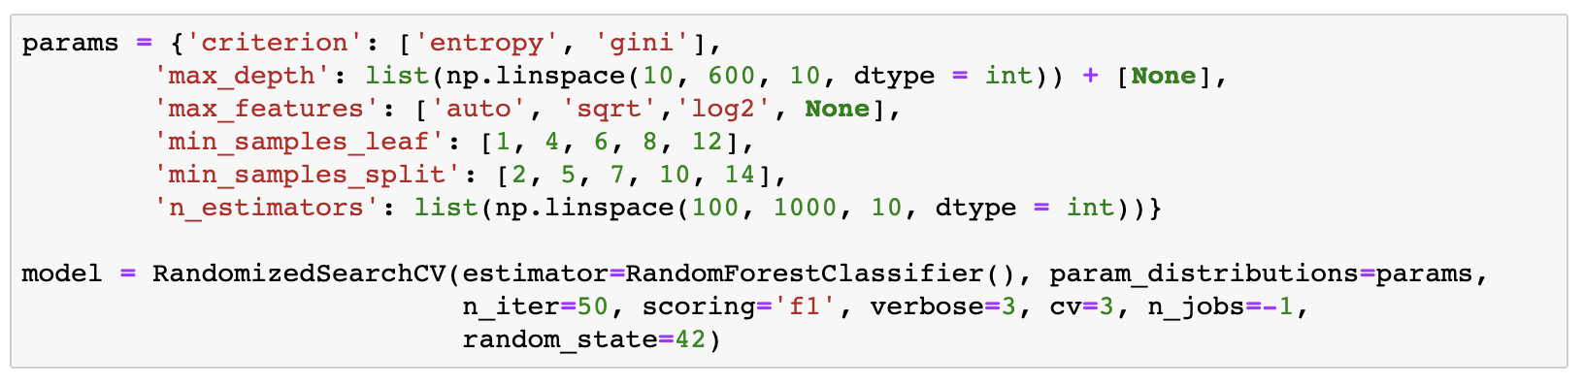
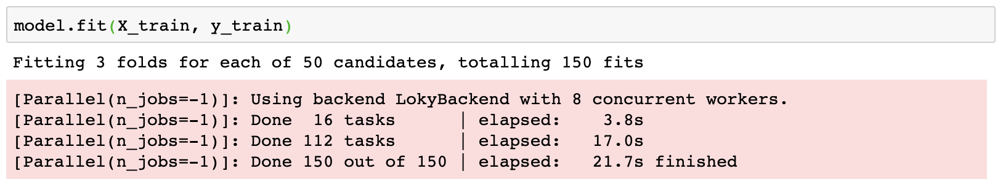
Example 1

Slide 8
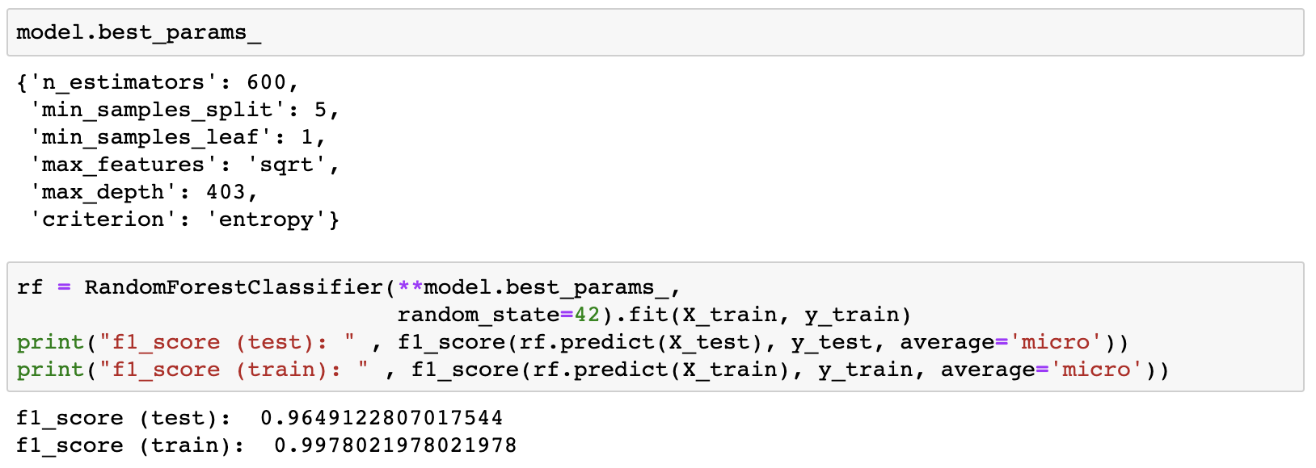
Example 1

Slide 9
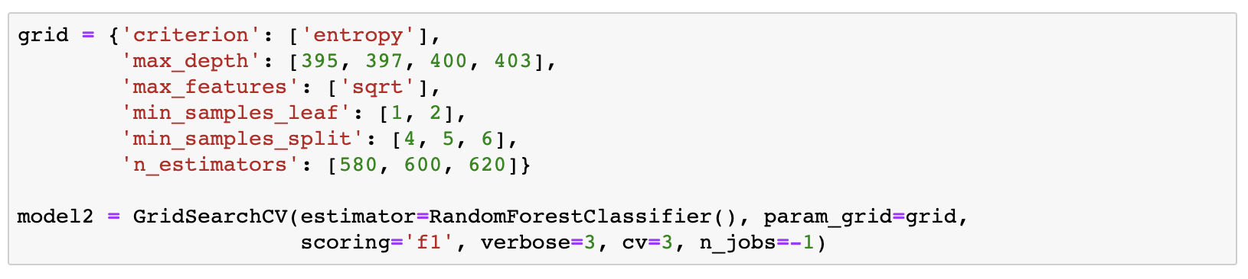
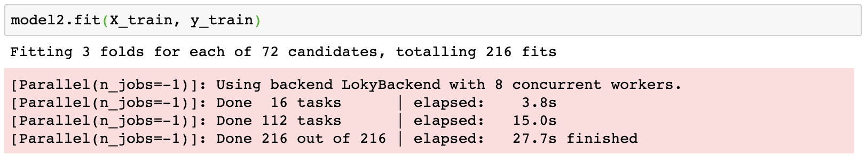
Example 1

Slide 10
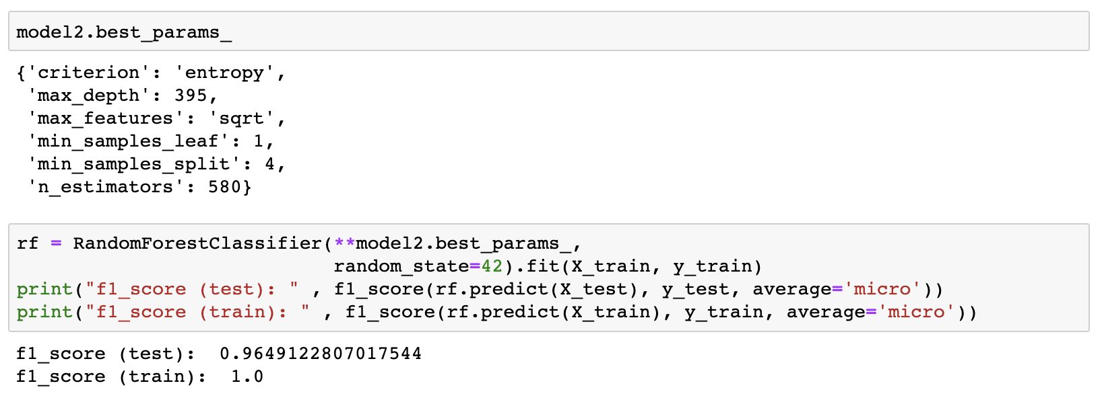
Example 1

