Slide 1
KLE Technological University · Deep Learning Course Project · Academic Year 2026
NC-MedAI
Neural Collapse-Aware
Medical Image Classification
Team Members
Faculty Guide
Rishi P Kulkarni, 01FE23BCI088
Amaanali Doddamani, 01FE23BCI091
Chirag S H, 01FE23BCI005
B V Om, 01FE23BCI055
Prof. Uma Devi F M
Dept. of CSE (AI), KLE Technological University
10,015
7
ResNet-18
ETF Head
Images
Lesion Classes
Backbone
Novel Method

Slide 2
Problem & Motivation
The Problem
Why Neural Collapse?
HAM10000 is severely imbalanced:
Melanocytic Nevi = 67% of all samples
Impact on deep learning models:
Majority-class gradients dominate training
Minority class features compressed into narrow cones
High false-negative rate for Melanoma
ETF geometry never emerges naturally
Neural Collapse (Papyan et al., 2020) predicts that optimal training produces class means as a Simplex ETF — maximally separated and symmetric.
NC metrics NC1–NC4 can diagnose:
Feature geometry degradation
Training pathology before accuracy drops
Imbalance-induced collapse failure
Our hypothesis:
Enforcing ETF geometry directly via a fixed classifier head will improve minority-class recall without sacrificing overall accuracy.

Slide 3
Dataset: HAM10000
Dataset at a Glance
Images
10,015
Classes
7
Format
JPG
Size
224×224×3
Split
70/15/15%
Domain
Dermatoscopy
⚠ Class imbalance ratio ≈ 67:1 (Nevi vs Dermatofibroma). Standard training fails minority classes — this is the core challenge.

Slide 4
Methodology Overview
1
2
3
4
5
6
HAM10000
Input
Preprocess
ResNet-18
Backbone
Fixed ETF
Head
NC Loss
Regularization
Evaluation
NC1–NC4 + F1
10,015 images
7 classes
Resize · Normalize
Augment · Sampler
ImageNet pretrained
512-d features
Non-learnable
Max separation
L_collapse + L_align
Clinical metrics
Fixed ETF Classifier Head — Core Innovation
NC Regularization Losses
Replaces learnable linear layer with a fixed Equiangular Tight Frame (ETF) matrix. ETF vectors are maximally equidistant regardless of class frequency, preventing majority-class dominance in feature space.
L_collapse: MSE between each feature and its ETF centroid — forces within-class collapse.
L_align: Cosine distance between class means and ETF targets — enforces inter-class geometry.
W_ETF = √(C/C−1) · (I − 1/C · 11ᵀ) · Uᵀ
L_total = L_CE + λ·L_collapse + λ·L_align

Slide 5
System Flow and Key Modules
HAM10000 Input
Key Modules
Data Loader + Imbalance Sampler
config/config.yaml
Master hyperparameter config with CLI override
data/medical_datasets.py
HAM10000 loader with imbalance ratio control
Preprocessing
(Normalize · Augment · Split)
data/imbalance_sampler.py
Weighted & balanced sampling strategies
ResNet-18 Backbone
(Conv → Layer1–4 → AvgPool → 512-d)
models/resnet.py
ResNet-18 with penultimate feature hooks
models/etf_classifier.py
Fixed ETF head — core contribution
Classifier Head
(Fixed ETF / Linear)
training/trainer.py
Training loop + checkpointing
NC Regularization
(L_collapse + L_align)
training/nc_regularization.py
L_collapse and L_align loss terms
NC Metrics
(NC1 · NC2 · NC3 · NC4)
evaluation/nc_metrics.py
NC1–NC4 mathematical formulations
evaluation/medical_metrics.py
Sensitivity · Specificity · AUC · Kappa
Output: Prediction + Metrics + Viz
visualization/
t-SNE · PCA · cosine heatmap · confusion

Slide 6
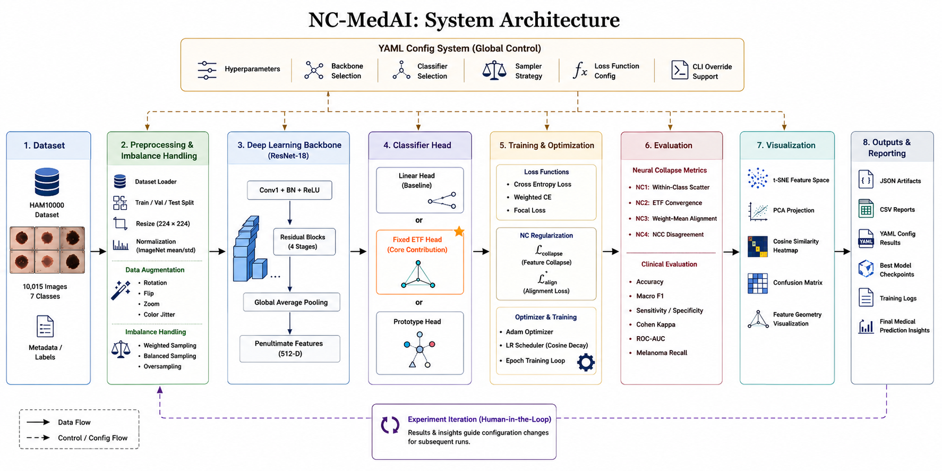
System Architecture

Slide 7
Neural Collapse: Theoretical Foundation
NC1 — Within-Class Variability
NC2 — ETF Convergence
Intra-class feature variance collapses to zero. All samples of the same class converge to a single point in feature space.
Class mean vectors form a Simplex ETF — equidistant and maximally separated. Cosine similarity between any two class means = −1/(C−1).
NC3 — Weight–Mean Alignment
NC4 — NCC Disagreement
Classifier weight vectors align with their corresponding class mean vectors (self-duality). Network weights ∝ class means.
Network argmax prediction agrees with Nearest Class Center classifier. Measures geometric coherence of the decision boundary.
Key Insight: Class imbalance prevents natural NC emergence. NC metrics serve as early-warning diagnostic tools — NC1=15.65 for Focal Loss reveals training failure before accuracy degrades.

Slide 8
Experimental Setup
Hyperparameters
6 Methods Benchmarked
Evaluation Metrics
Backbone
ResNet-18
Baseline (CE)
Clinical / Classification
Standard cross-entropy
Accuracy
Batch Size
32
Oversampling
Macro F1 (primary)
Epochs
50
CE + balanced sampler
Precision · Recall
Learning Rate
0.001
Weighted CE
Sensitivity · Specificity
Optimizer
Adam
Class-frequency weights
ROC-AUC
LR Schedule
Cosine decay
Focal Loss (γ=2)
Hard-sample focus
Cohen's Kappa
NC λ
0.01
Neural Collapse
ETF + NC-reg
Framework
PyTorch 2.0+
Fixed ETF + Lreg ★
NC1 — within-class scatter
NC2 — ETF deviation
Train/Val/Test
70 / 15 / 15%
ETF + NC-reg + Bal
ETF + balanced ★
NC3 — weight-mean align
Seed
42
NC4 — NCC disagreement

Slide 9
Results: Performance Comparison
Method | Sampler | Val Acc | Macro F1 | NC1 ↓ | NC4 ↓ | Mel. Recall
Baseline (CE) | Weighted | 64.4% | 0.436 | 4.81 | 0.194 | 56.0%
Oversampling | Weighted | 64.4% | 0.436 | 4.81 | 0.194 | 56.0%
Weighted CE | None | 62.2% | 0.332 | 7.94 | 0.396 | 36.3%
Focal Loss (γ=2) | None | 56.9% | 0.110 | 15.65 | 0.690 | 0.0%
ETF+NC-reg+Balanced | Balanced | 61.8% | 0.429 | 5.63 | 0.180 | 58.8%
ETF+NC-reg (BEST) | Weighted | 65.0% | 0.472 | 5.53 | 0.186 | 58.8%
+8.3%
0.186
0.0%→58.8%
15.65→5.53
Macro F1 vs
Focal Loss
NC4 Best
(ETF+NC-reg)
Melanoma Recall
vs Focal Loss
NC1 reduction
Focal→ETF

Slide 10
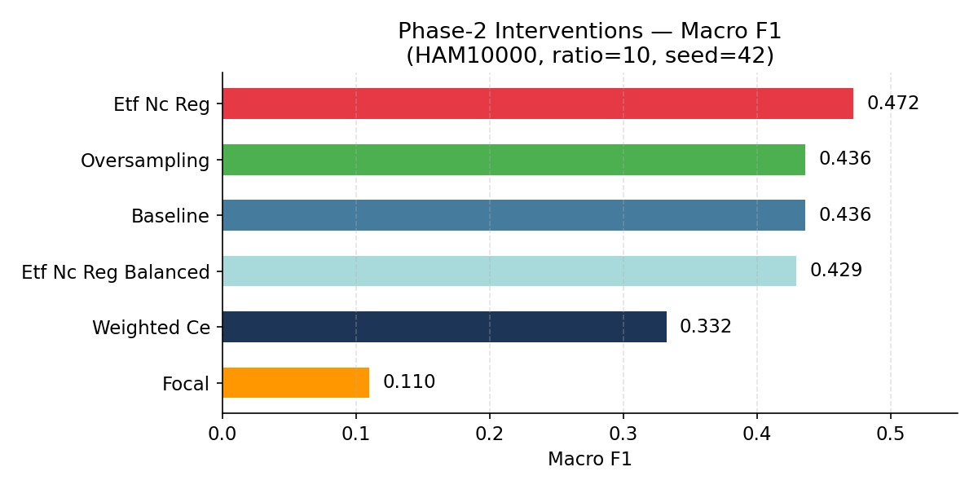
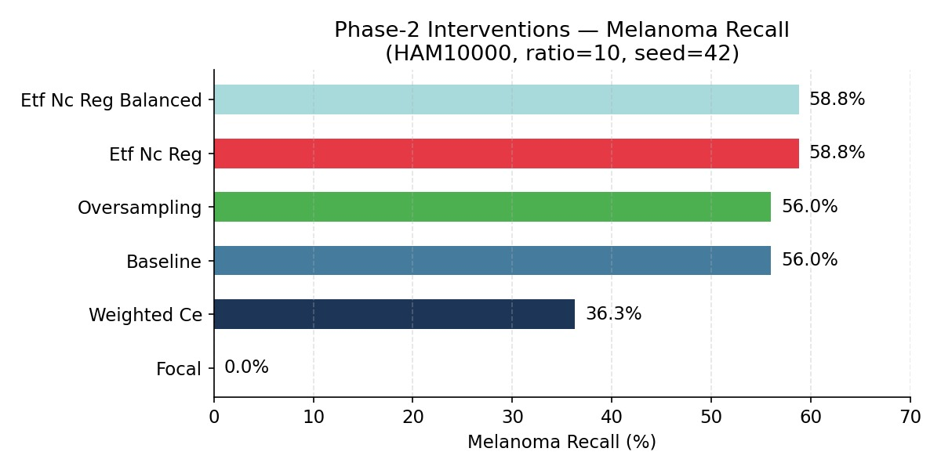
Results: Macro F1 & Melanoma Recall
ETF+NC-reg achieves highest Macro F1 (0.472) and ties the best Melanoma Recall (58.8%) while Focal Loss catastrophically fails — 0.0% Melanoma Recall and lowest Macro F1 (0.110).

Slide 11
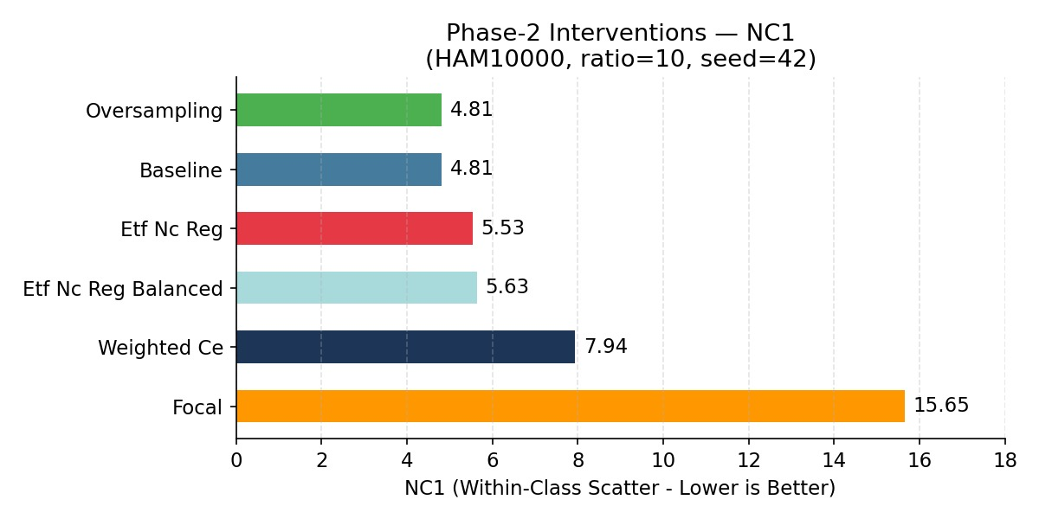
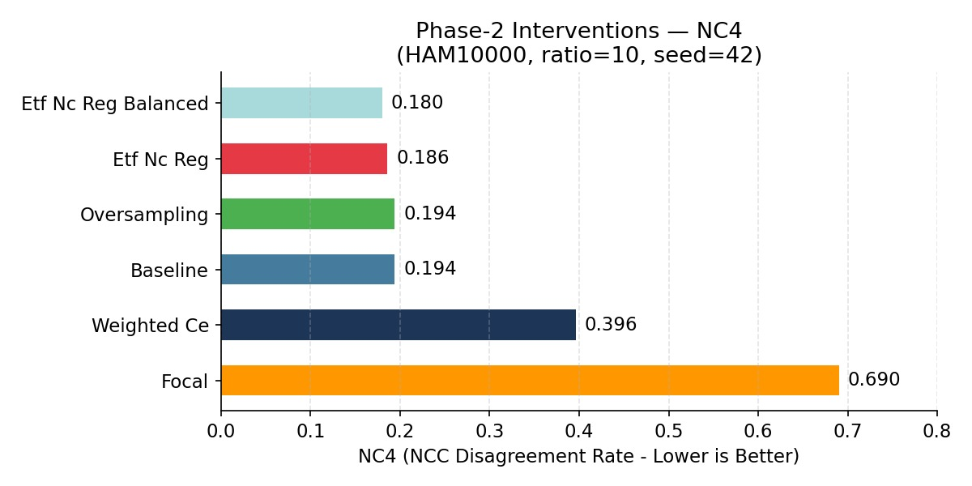
Results: Neural Collapse Metrics (NC1 & NC4)
NC1: Focal Loss = 15.65 (3× worse than ETF). Imbalance destroys within-class geometry.
NC4: ETF+NC-reg Balanced achieves best score (0.180) — most geometrically coherent predictions.

Slide 12
Key Findings & Critical Insights
ETF Enforces Optimal Geometry
Focal Loss Catastrophically Fails
NC Metrics = Clinical Safety Signal
The fixed ETF head mathematically prevents majority-class dominance in feature space, improving Macro F1 by +8.3% and Melanoma Recall by +2.8% over the baseline.
Despite being popular for imbalanced data, Focal Loss achieves 0% Melanoma Recall, NC1=15.65 and NC4=0.690 — the worst scores across all metrics. NC metrics diagnosed this failure early.
NC1 and NC4 degradation directly correlates with minority-class recall. Teams can use NC metrics as a monitoring tool to prevent dangerous under-detection of malignancies.
Main Takeaway
Geometry-aware training (Fixed ETF + NC Regularization) is not just theoretically elegant — it is practically superior in safety-critical medical imaging where minority-class recall directly impacts patient outcomes. Class imbalance degrades Neural Collapse geometry in measurable, predictable ways, and enforcing the ideal ETF structure is an effective countermeasure.

Slide 13
Conclusion & Future Work
Contributions Achieved
Future Directions
1
NC Analysis on Medical Data
Larger Datasets
First demonstration that class imbalance degrades NC1–NC4 in clinical settings.
ISIC 2020 (33K images), TCGA pathology, multi-center studies
Vision Transformers
Investigate NC in ViT, Swin Transformer, CNN-Transformer hybrids
2
Fixed ETF Classifier Head
Mathematically enforces optimal ETF geometry, outperforming all baselines on Macro F1.
Dynamic ETF Scheduling
Curriculum learning to phase in ETF constraint gradually
Clinical Deployment
3
NC Regularization Losses
DICOM-compatible decision-support system for dermatologists
L_collapse + L_align provide principled training signal toward ideal feature geometry.
Mobile/Edge AI
MobileNetV3 + lightweight ETF for smartphone screening
4
Focal Loss Warning
Explainability (XAI)
Critical finding: Focal Loss catastrophically fails on HAM10000 — NC metrics caught it.
Grad-CAM + SHAP + LIME combined with NC geometry analysis

Slide 14
Thank You
Questions & Discussion
Key References
Papyan et al. (2020) — Neural Collapse. PNAS.
Team
Han et al. (2022) — NC under MSE Loss. ICLR.
Rishi P Kulkarni · Amaanali Doddamani
Chirag S H · B V Om
Tschandl et al. (2018) — HAM10000. Sci. Data.
Guided by: Prof. Uma Devi F M
He et al. (2016) — ResNet. CVPR.
KLE Technological University · 2026
Kingma & Ba (2015) — Adam. ICLR.
Lu & Steinerberger (2024) — NC in Transfer Learning. NeurIPS.

