Slide 1
Bounded Thin-Film Evolution under VanderWaal Forces
Aman Choudhary [B23ME1005]
Mentor: Prof. Anjishnu Choudhury
Mechanical Engineering, IIT Bombay
Project Duration: May–August 2025

Slide 2
Introduction
A.) Finite Difference Simulation Code – A Python implementation of the thin-film evolution equation (including van der Waals forces ) using finite difference methods with periodic boundary conditions.
B.) Visualization Output – Plots of film profile evolution at different times and “minimum height evolution until breakup”

Slide 3
Objectives
Understand thin film flows and interfacial mechanics
Develop numerical schemes for rupture simulation
Implement finite difference methods in Python
Explore CFD, stability analysis, and reduced-order models

Slide 4
Theoretical Background
Finite difference methods used for spatial derivatives
Simulation based on the thin film equation with van der Waals forces and surface tension
Tools: Python, NumPy, Matplotlib

Slide 5
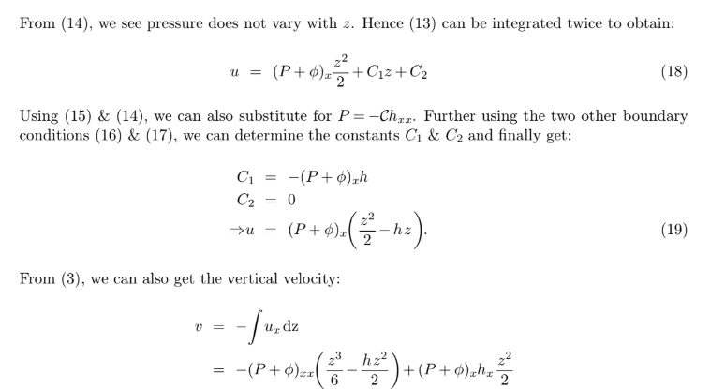
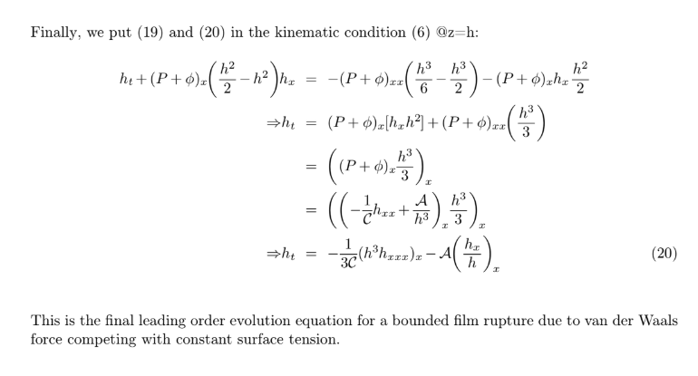

Slide 6
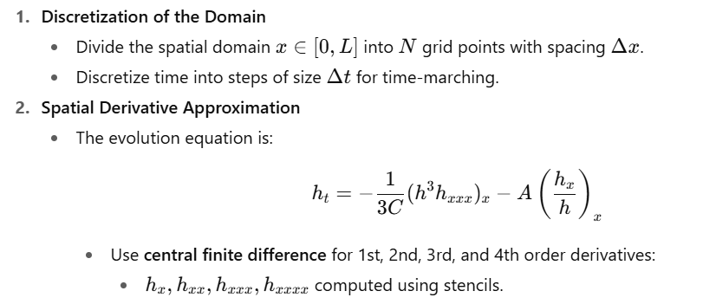
Finite Difference Algorithm

Slide 7
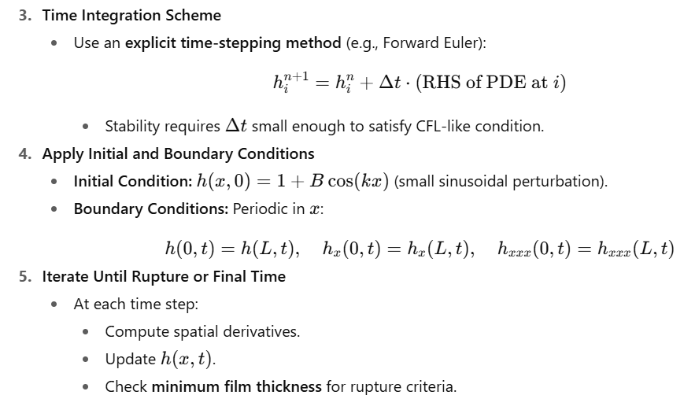


Slide 8
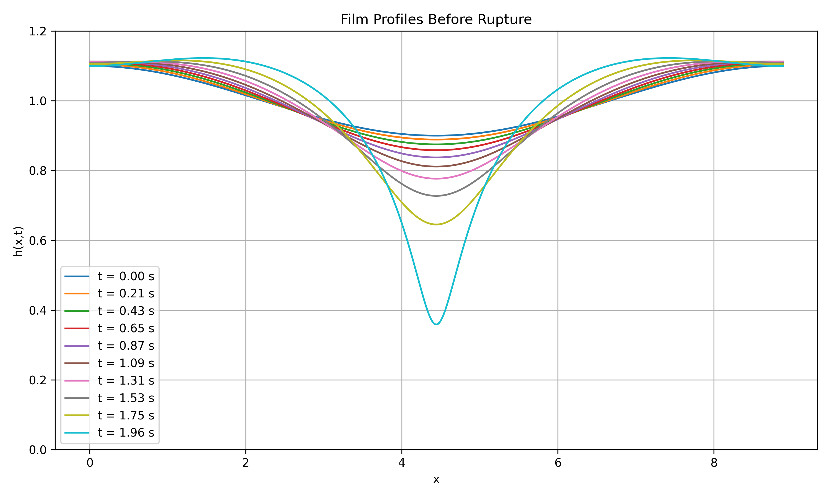

Slide 9
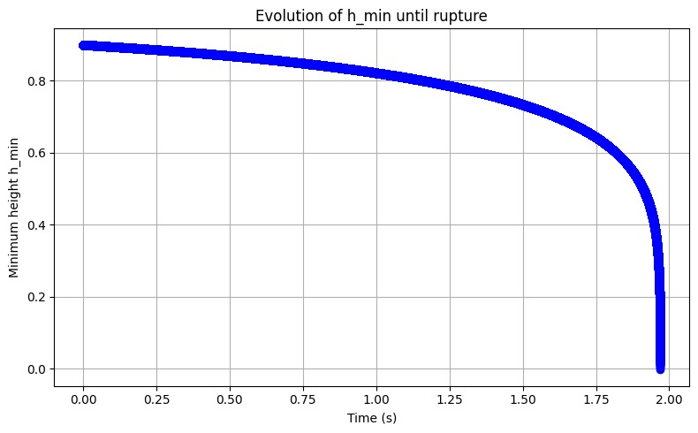
Rupture Behavior: Minimum Thickness vs Time

Slide 10
Key Learnings
Learned implementation of boundary conditions for a 4th-order PDE
Understood physical meaning of interfacial forces
Translated physical equations into working code
Gained insights into numerical stability and scaling

Slide 11
Conclusion & Acknowledgement
Successfully modeled the evolution and rupture of thin films.
Special thanks to Prof. Anjishnu Choudhury for guidance and mentorship.

