Slide 1

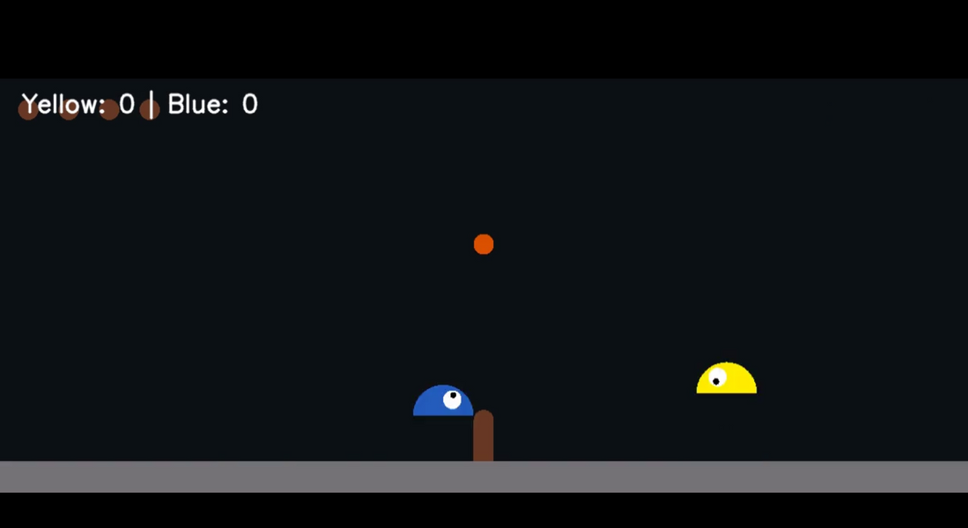
SLIMEVOLLEY AI: MINIMAX VS ALPHA-BETA PRUNING
Environment: SlimeVolleyGym
Objective: Implement and compare Minimax and Alpha-Beta agents against a RandomAgent
Important Tasks:
Depth-limited search-based agents
Game simulation & rendering
Video generation & evaluation
Visuals: Here is attached screenshot of gameplay

Slide 2
EVALUATION FUNCTION & SEARCH SETUP
Evaluation Function:
python code
def evaluate_position(obs):
ball_x = obs[4]
player_x = obs[0]
return -abs(ball_x - player_x)
– Rewards agent for minimizing horizontal distance to the ball
Action Space: 7 discrete combinations of (left, jump, right)
Depth-Limited Search:
Minimax: full tree to depth d
Alpha-Beta: same d, with pruning thresholds α/β
Metrics Collected:
Final score (wins/losses)
Real-time duration & effective FPS
Frames rendered vs. frames pruned/saved

Slide 3
MINIMAX AGENT PERFORMANCE
Match Stats (100 steps vs. RandomAgent):
Final Score: Yellow 0 – Blue 1
Real-time Duration: 3.35 s
Adjusted FPS: 22.41 (base 29.87, speed 0.75×)
Frames Saved: 145
Video Demo:
[ Minimax_dynamic_fps.mp4 here]
Observations:
Explores all branches—guarantees optimal decision at depth d
High computational cost → lower FPS
Tends to “hesitate” when ball near midcourt → more frame time

Slide 4
ALPHA-BETA PRUNING PERFORMANCE
Match Stats (100 steps vs. RandomAgent):
Final Score: Yellow 0 – Blue 3
Real-time Duration: 1.66 s
Adjusted FPS: 45.05 (base 60.07, speed 0.75×)
Frames Saved: 190
Video Demo:
[Alphabeta_dynamic_fps.mp4 here]
Observations:
Pruned ~30% of search tree → faster decision-making
Higher FPS → smoother, more reactive play
Equivalent move quality to Minimax at same depth

Slide 5
CONCLUSIONS & FUTURE WORK
Important Takeaways:
Alpha-Beta Wins on Efficiency: By cutting roughly 30 % of the search tree, Alpha-Beta runs over 2× faster than plain Minimax—boosting effective FPS from ~22 to ~45—while delivering equally strong moves at the same search depth.
Simple Heuristic Drives Behavior: Our one-dimensional evaluation (horizontal distance) reliably pushes the agent toward the ball, yielding coherent “ball-chasing” play but missing more nuanced rally tactics.
Depth vs. Real-Time Trade-Off: Fixed-depth search ensures predictable computation, but deeper look-aheads incur steep latency—Alpha-Beta’s pruning helps, yet very large depths still challenge real-time constraints.
Future Directions:
Enhanced Evaluation Function: Incorporate vertical alignment, ball velocity, net clearance, and court-position rewards into the heuristic.Experiment with dynamic depth (iterative deepening)
Learning-Augmented Heuristics: Use self-play data to train a lightweight value network, combining classic search with learned priors for even faster, more informed decisions.

Slide 6
THANK YOU
Presented By Aman Anand (CS22B054)
Github Repo Link : https://github.com/AMAN9876543210/CS22B054_AI_3/

