Slide 1

project made by:- aman giri goswami(54)-11908192 aniket bajpai(53)-11908183 yogesh (52)-11904992 submitted to:- manu bali (CSE236)

Slide 2
Design for Bank website
Introduction:
We have made a bank website. In this website we have useHTML code and applying CSS style maintaining containers. In our website system we don’t ask for any kind of CVV or number OTP (ONE TYPE PASSWORD) for costumer security purpose.
In our website we have many services like:
1) Personal Banking Service
In this service Costumer refers to all the services banks design and offer to individual consumers rather than businesses. These services include checking and savings accounts, credit and debit cards, certificates of deposit (CDs), loans, and more.

Slide 3
2) Corporate Internet Banking :
Corporate Internet Banking (CINB) of our Bank is the channel which facilitates Corporate Customers (any non- individual customer such as firms, companies, trusts, partnerships, proprietorship concerns etc.) to carry out banking activities online anywhere and anytime.
3) Merchant Bussiness :
merchant account is a type of business bank account that allows a business to accept and process electronic payment card transactions. Merchant accounts require a business to partner with a merchant acquiring bank who facilitates all communications in an electronic payment transaction.

Slide 4
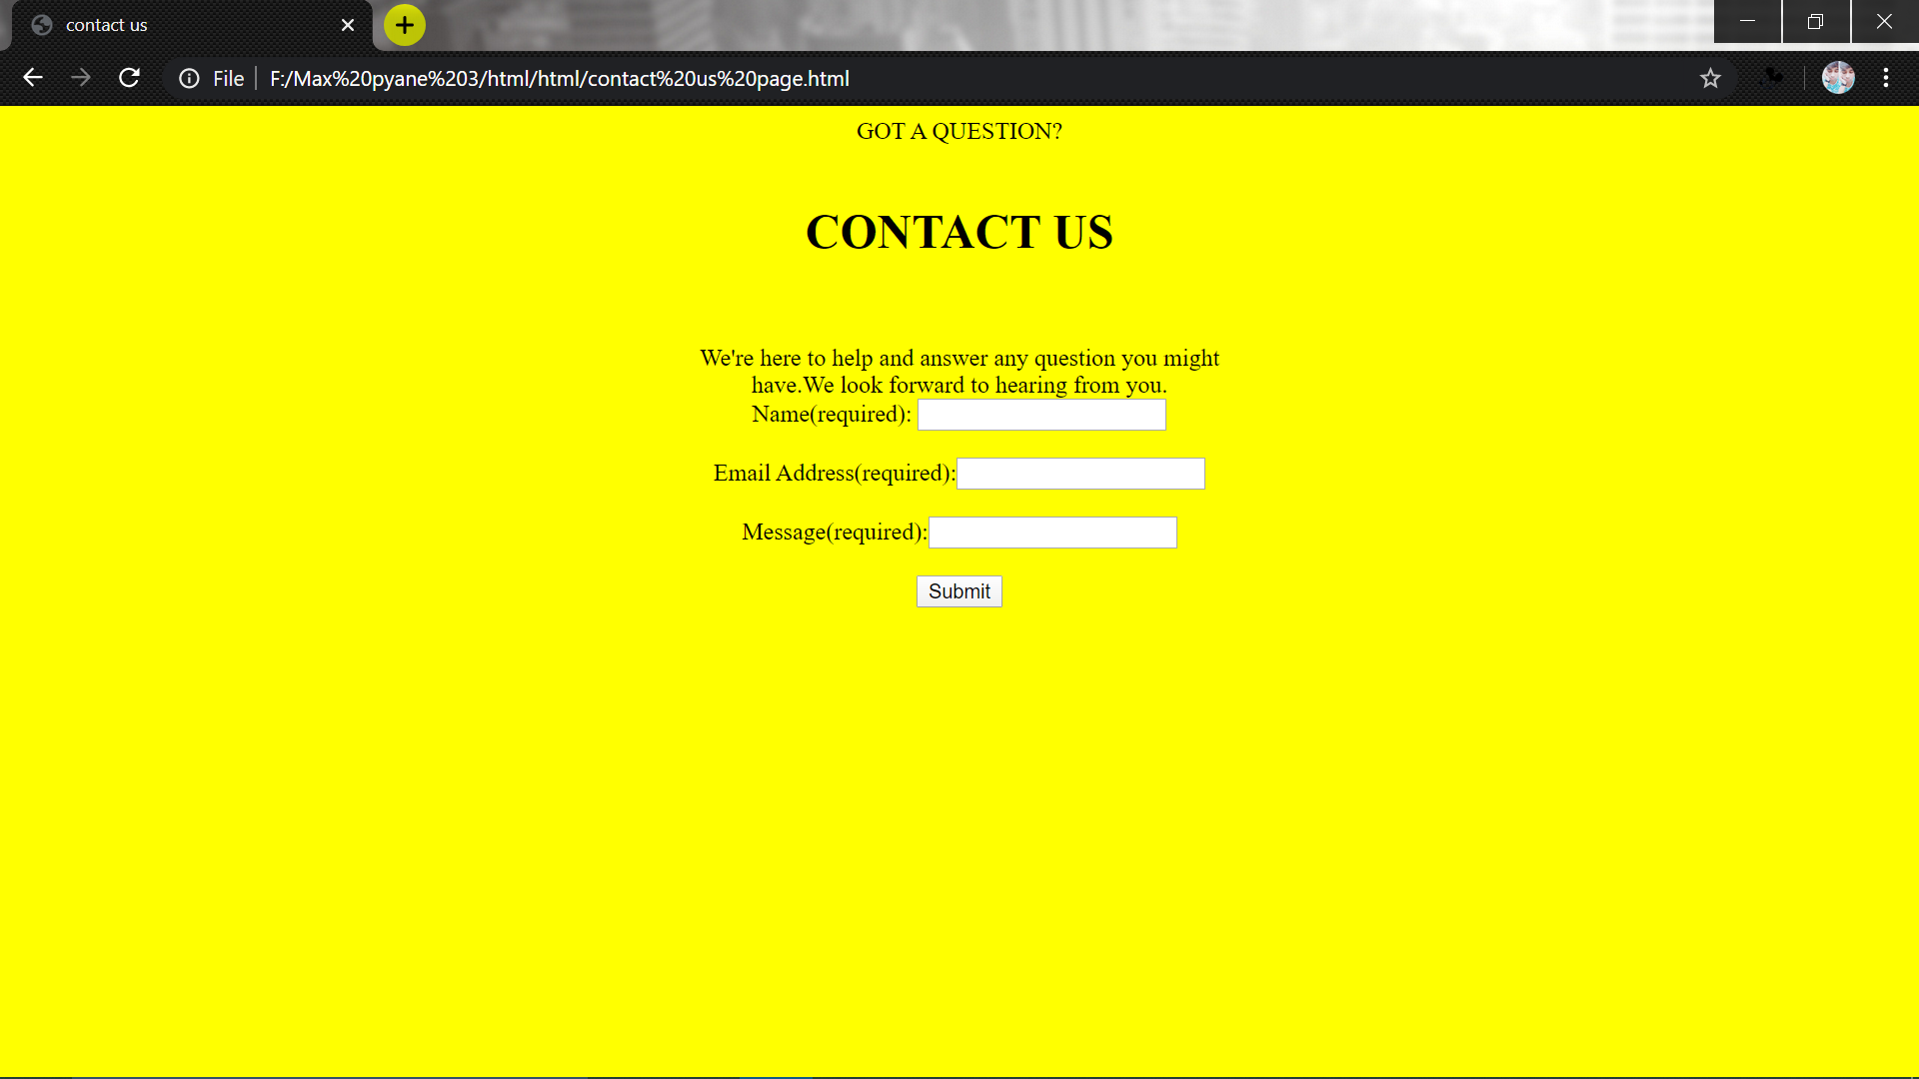
Our website page is contain of Contact Us Page
A contact page is a website page that allows visitors to reach out to the website owner, customer support, or a person at the company. Often times, there is a contact form where the visitor can fill out and will be contacted by someone from the company shortly after.

Slide 5
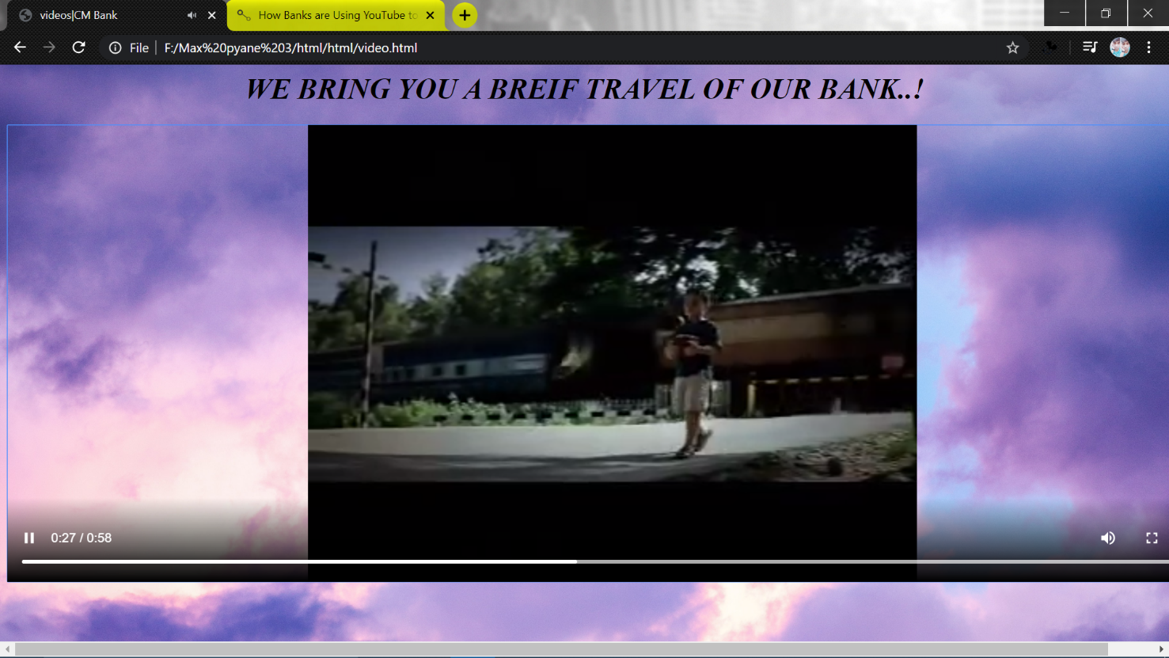
We also have a advertising video of our bank website which we also uploaded on Youtube .

Slide 6
Advertising
What could be a better way of promoting your products and services than an online video social network? YouTube is the best media- centric platform in comparison to other social networks that are only word-centric. Google ensures that companies can find tools necessary to market their products on YouTube.
One of the best ways to do so is to create an advertisement which will strike a chord with the online population and compel them to share it.

Slide 7
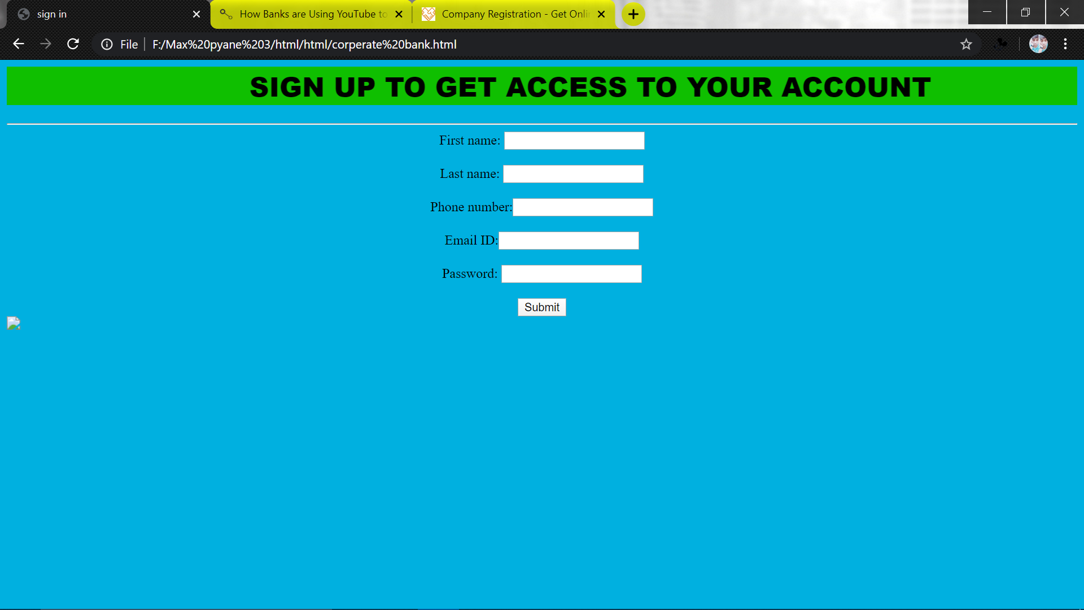
We also have corperate online registration

Slide 8
ABOUT:
Incorporation is the formation of a new corporation/ company (a corporation being a legal entity that is effectively recognized as a person under the law). The corporation may be a business, a non-profit organization, a startup, a micro small or medium scale business.MCA regulates corporate affairs in India through the Companies Act, 1956, 2013 and other allied Acts, Bills and Rules. MCA also protects investors and offers many important services to stakeholders. The Ministry is primarily concerned with administration of the Companies Act 2013, the Companies Act 1956, the Limited Liability Partnership Act, 2008 & other allied Acts and rules & regulations framed there-under mainly for regulating the functioning of the corporate sector in accordance with law.

Slide 9
We have multiples of billing oppostions-
BBPS BILL PAY:
Billers are the service providers who shall receive payments from customers for any services rendered. By participating in the BBPS scheme, the biller will be able to receive payments from third party channels for the services provided to the customer.
MOBILE/BILL PAY:
A mobile payment is a money payment made for a product or service through a portable electronic device such as a tablet or cell phone. Mobile payment technology can also be used to send money to friends or family members, such as with the applications PayPal and Venmo.

Slide 10
CONTRIBUTION:- main+login content+javascript= aman giri css+cib/pib(pages)= aniket bajpai connecting pages+video files= yogesh THANKING YOU………………….

