Slide 1
Chapter 1
An Overview of Enterprise System
Business Process
Business Function
Business Process integration

Slide 2
What is an Enterprise system(ES)?
Enterprise systems is a category of information systems which have been adopted in practice since the 1990s.
ES is use a variety of information technologies to help people work together.
Collects data from various key business processes in manufacturing and production, finance and accounting, sales and marketing, and stores the data in a single data repository(stored centrally) where they can be used. Or available to all departments, (information shared by many users ) to support business processes.
The degree of success of the enterprise is often measured by the ratio between the output and inputs. This ratios is called productivity.

Slide 3
Traditional Organization
The organization is divided into different units based on the functions they perform -finance, manufacturing, production, planning, purchasing, sales & distribution, etc.
The various department have their own goals.
The different department function in isolation and have their own data collection and analysis system.
The result is that, instead of taking the organization towards the common goal the various departments does not know what the other does and for what purpose.
The solution is to have a centralized information storage and management facility.

Slide 4
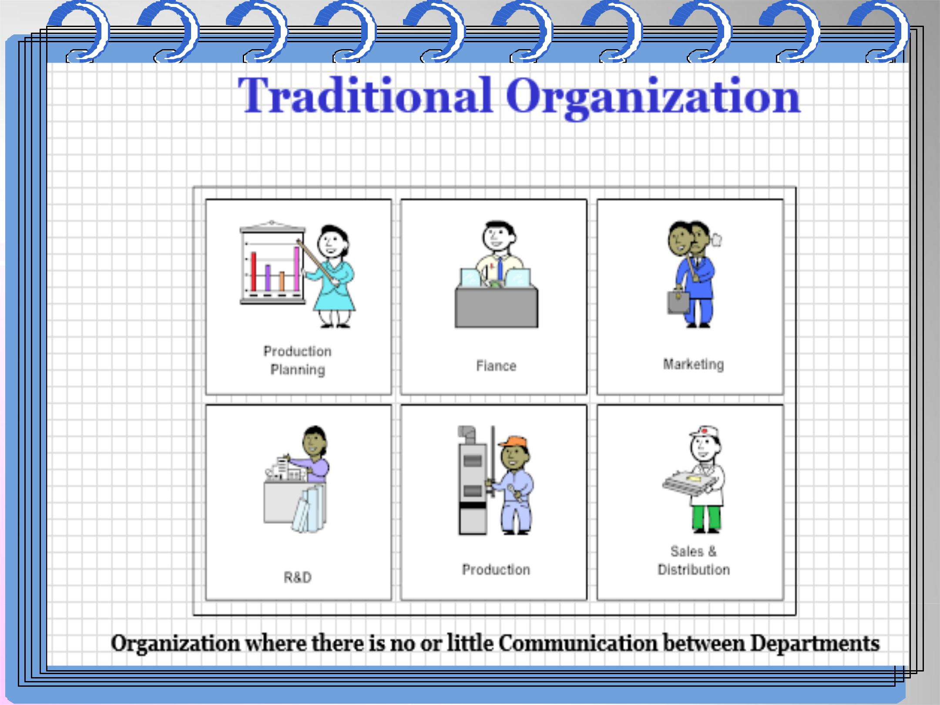
Traditional Organization…
Figure 1.1 Traditional view of systems
Organization where there is no or little communication between inter department
Enterprise systems help to make this task easier by integrating the information system, smooth flow of information across departmental barriers, and automating business process and functions.
Enterprise systems help the organization to work and move forward as a single entity.

Slide 5
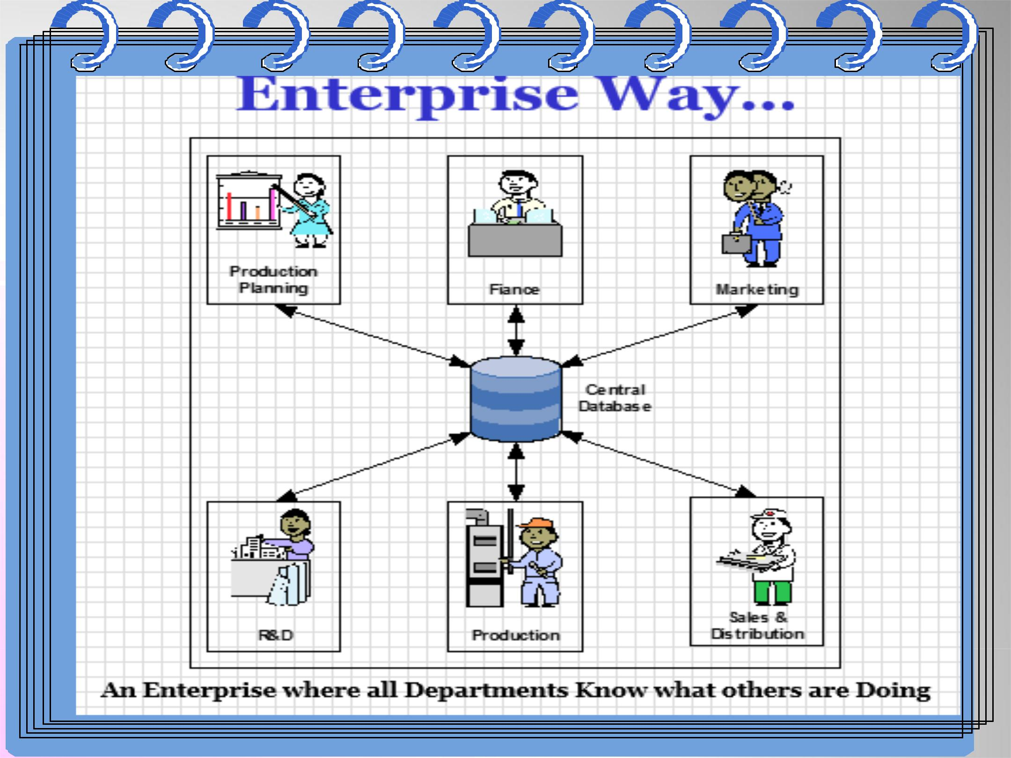
Enterprise Way…
Figure 1.2 Enterprise systems
An Enterprise where all departments know what other are doing

Slide 6
Some Characteristics of ES
Multiple Functional Modules
Includes:
Enterprise Resource Planning (ERP),
Customer Relationship Management(CRM),
Sales Force Automation (SFA),
Knowledge Management (KM) and
Supply chain Management(SCM)
Real-time operations
A common database

Slide 7
Cont’d
Integrated:
Business processes are integrated end to end department and business unit.
Integration of all the information flowing through a company— financial and accounting information, human resource information, supply chain information, and customer information. Or
are industry specific, customizable software packages (the software packages is a commercial product that can be modified to suit the particular and unique needs of the business) that integrate information and business process in organizations.

Slide 8
Cont’d
Complex:
Complex systems that involve organization-wide resources and require many changes.
Evolving:
As the IT industry changes, software changes are also required. Technology changes force the company to change as well in order to stay in business. So we must reexamine the software from time to time to see if it still supports the business needs.

Slide 9
Advantages of Enterprise Systems
Allow for integration of data and applications of a business or organization process through a system that supports different operating systems.
Allow for resource sharing through the network, which can be configured in various ways.
Centralized Databases: Databases allow the user to access data through query and data extraction programs. Interface with the databases are simple and menu- driven, which ask the individual questions to help in the selection of data.
provide the end user with various software applications or tools to perform tasks.

Slide 10
Disadvantages of Enterprise Systems
Costs: Implementing and managing enterprise systems can be expensive, especially for small and medium-sized businesses (SMBs). SMBs usually do not have the resources and money. For example, companies need the right people to make sure that their data is protected. Large companies can afford to hire the consultants who specialize in this area.
The costs to install enterprise systems, for multi- corporations, can range from approximately $30,000 to $500 million.
Costs: Another cost that companies face is licenses.
Companies purchase licenses in order to receive services, such as getting software patches(a small piece of code inserted to correct or enhance a program) or upgrades.

Slide 11
Disadvantages of Enterprise Systems…
Finally, another cost can be where enterprise systems cannot integrate with the company's legacy systems. These systems contains important data that the company still needs and uses. In order to get the enterprise system to work with legacy applications, the company might have to purchase new computers, servers, or applications. It might also have to hire some additional consultants to complete this project.
Training and Turnover: If the enterprise system is to be successful in an organization, it must have employees who know how to use it. The company must provide comprehensive training. However, many companies have ignored this area because it is costly. Even if the employees have been trained, they could leave the company, taking the knowledge with them. The company may also hire new managers that do not know very much about the system.

Slide 12
Group Discussion's question
Why enterprise system are required for the companies?

Slide 13
Business Process
Business processes: are a collection of interrelated tasks (activities) which solve a particular issue or for accomplishing a specific business result. It takes one or more kinds of input and creates an output that has a value to the customer.
Business processes are a series of steps performed by a group of stakeholders to achieve a concrete goal.
Successful business managers view business operations from the perspective of customer.
Customer (either internal or external) is not required to interact with each business function involved in the process.

Slide 14
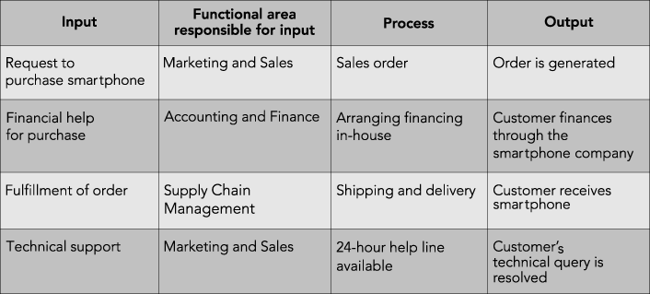
Business Process…

Slide 15
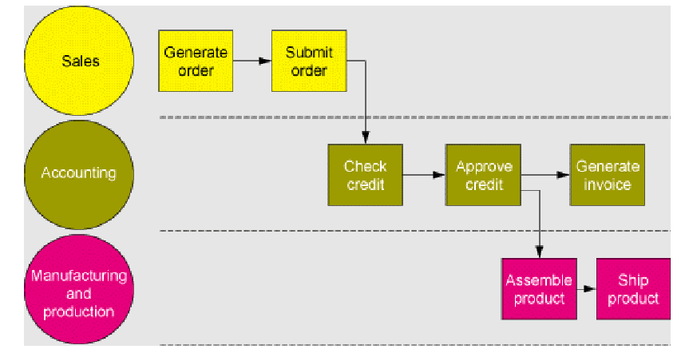
business processes…..
The Order Fulfillment Process

Slide 16
Examples of Business Processes
Human Resources: Hiring employees, evaluating performance, enrolling employees in benefits plans.
Manufacturing and production: Assembling product, checking quality, ship of materials.
Finance and accounting: Paying creditors, creating financial statements, managing cash accounts.
Sales and marketing: Identifying customers, creating customer awareness, and selling.

Slide 17
Example of a business process
What is the step for Hiring process of an HR department?

Slide 18
Types of business processes
There are three types of business processes- Management, Operational, and Supporting.
Management processes govern the operation of a system. Typical management processes include “corporate governance” and “ strategic management”.
Operational processes create the primary value stream and are part of core business. Typical operational processes are purchasing , manufacturing, marketing and sales.
Supporting processes support the core processes. Examples includes, recruitment, IT –support.

Slide 19
The steps of Business Process Lifecycle
Step 1: Define your goals: What is the purpose of the process? Why was it created? How will you know if it is successful?
Step 2: Plan and map your process: What are the strategies needed to achieve the goals? This is the broad roadmap for the process.
Step 3: Set actions and assign stakeholders: Identify the individual tasks of the teams and machines need to do in order to execute the plan.
Step 4: Test the process: Run the process on a small scale to see how it performs. Observe any gaps and make adjustments.
Step 5: Implement the process: Start running the process in a live environment. Properly communicate and train all stakeholders.
Step 6: Monitor the results: Review the process and analyze its patterns. Document the process history.
Step 7: Repeat: If the process is able to achieve the goals set for it, replicate it for future processes.

Slide 20
Business function
Activities specific to a functional areas of operation
What are the functional areas?
Marketing and Sales (M/S) . Human Resources (HR)
Supply Chain Management (SCM) . Accounting and Finance (A/F)
Organizations that make products to sell have the following functional areas of operation- purchasing, production and material management, marketing and sales, accounting and finance, human resources, etc.
Earlier business systems functioned in isolation. What happens in one functional area was not communicated with other functions.

Slide 21
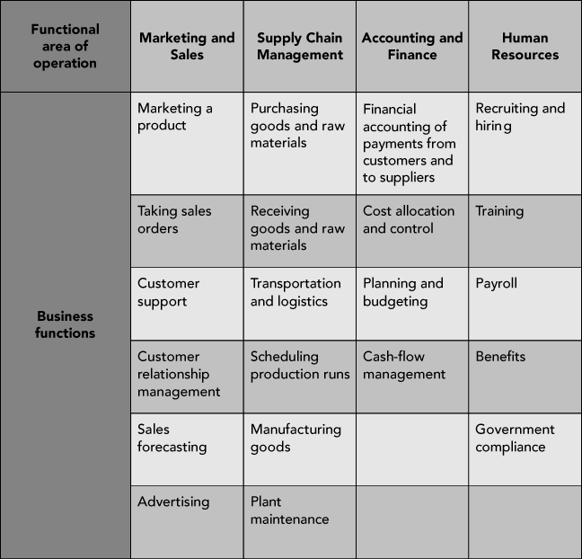
Functional Areas of Operation

Slide 22
Examples of Functional Areas & Business processes(Coffee Shop)
Marketing and Sales
1. Identify customer
2. Determining pricing
3. Promoting products to customers
4. Taking customers’ orders
5. Helping create a sales forecast
Supply Chain Management
Scheduling coffee production run
Buying raw materials
Packaging
Accounting and Finance
Recording raw data about transactions (including sales), raw material purchases, payroll, and receipt of cash from customers
Human Resources
Recruit, train, evaluate, and compensate employees
Sales Forecast
Sales Records
Sales Forecast
Sales records are important component of sales forecast
Sales forecast is used in making staffing decisions and in production planning
Sales forecast is used to plan personel needs
Functional areas are Interdependent
Each requires data from the others

Slide 23
Business Process Integration
Business Process Integration (BPI) is a combination of a company's internal operations - divisions and partners which connects them all in real-time.
It is essential for businesses looking to connect systems and information efficiently.
It is the act of bringing together smaller components into a single system that function as one.
It helps your teams collaborate closely, and bridge the gaps between the system to yield good out come.
BPI allows for automation of business processes, integration of systems and services, and secure sharing of data across numerous applications.

Slide 24
Cont’d
Previously, business process integration software was only available to large enterprise companies that could afford it.
Today, businesses of all sizes need a efficient integration solution to streamline processes between marketing, sales, customer service, and supply chain management, etc.
Sharing data effectively and efficiently between and within functional areas leads to more efficient business processes.
For instance, the BPI could build a relationship between the sales and invoice systems within an enterprise.

Slide 25
Benefits of Business Process Integration
Implementing them brings a host of business benefits such as:
Reduction of risks: helps prevent and fix errors thereby minimizing risks.
Elimination of redundancies: Monitoring processes allows for identification and elimination of duplicated tasks.
Minimized costs: Improved visibility into processes helps zero in on wasteful expenditure.
Higher efficiency: It helps managers ensure that turnaround times are short and accuracy levels are high.

Slide 26
Cont’d
Improved collaboration: BP software boosts collaboration between internal teams as well as external vendors and buyers.
Make better decision with richer insight into an integrated business.
Improved productivity: When processes are organized, approvals are faster and information retrieval is easier. Tasks are routed sequentially without human intervention. These benefits significantly boost productivity of teams.

Slide 27
Steps for implementing business process integration
What are the steps for implementing business process integration?
Four Steps are there:
Process Identification. In order to implement BPI, processes must first be identified.
Documenting and Mapping. Document an organization’s existing business processes.
Planning. Process simulation allow proposed change to be implemented in theory & observe their effect and assesses before actual changes are made.
Design, Implementation, and Management. The design and implementation of BPI help eliminate the need to duplicate data in different system & increase the efficiency of the business’s operation. Properly design of BPI can save companies time and money

Slide 28
Question
1.How do enterprise systems provide value for businesses?
2. Define and describe business processes and their relationship to Business function?
3. What is the goals of Business Process Integration?

