Slide 1


SUMMER SCHOOL OF ASTRONOMY & ASTROPHYSICS 2026
Indian Space School
Supervised Classification and Anomaly Detection of
Transient Supernovae in ZTF and LSST Alert Streams
An End-to-End Pipeline with Measured Sim-to-Real Transfer
AK
Aman Kanojiya
Cuebus
AP
Ayushi Patel
Uka Tarsadia University, Bardoli
Project Guide & Mentor: Ravi Raja Pothineni — Indian Space School, Jaipur, Rajasthan
Notes:
This is our project for the Summer School of Astronomy and Astrophysics 2026, run by the Indian Space School in collaboration with the Propagation Institute of Space and Technology. I'm Aman Kanojiya, working from Cuebus, and I led the technical build: the data pipeline, the model, the anomaly branch, and the serving and dashboard layers. My co-author is Ayushi Patel, from Uka Tarsadia University in Bardoli, who led the astrophysics side: the supernova taxonomy we adopted, the physical interpretation of our results, and the literature survey. Our mentor for this project was Ravi Raja Pothineni, Project Guide at the Indian Space School in Jaipur. The title describes exactly what we set out to do: build a full pipeline, not just a model, that classifies transient supernova alerts from ZTF and the upcoming LSST survey, and that measures, rather than assumes, how well something trained on simulation actually transfers to real data. That measured transfer gap is the throughline of everything that follows.

Slide 2

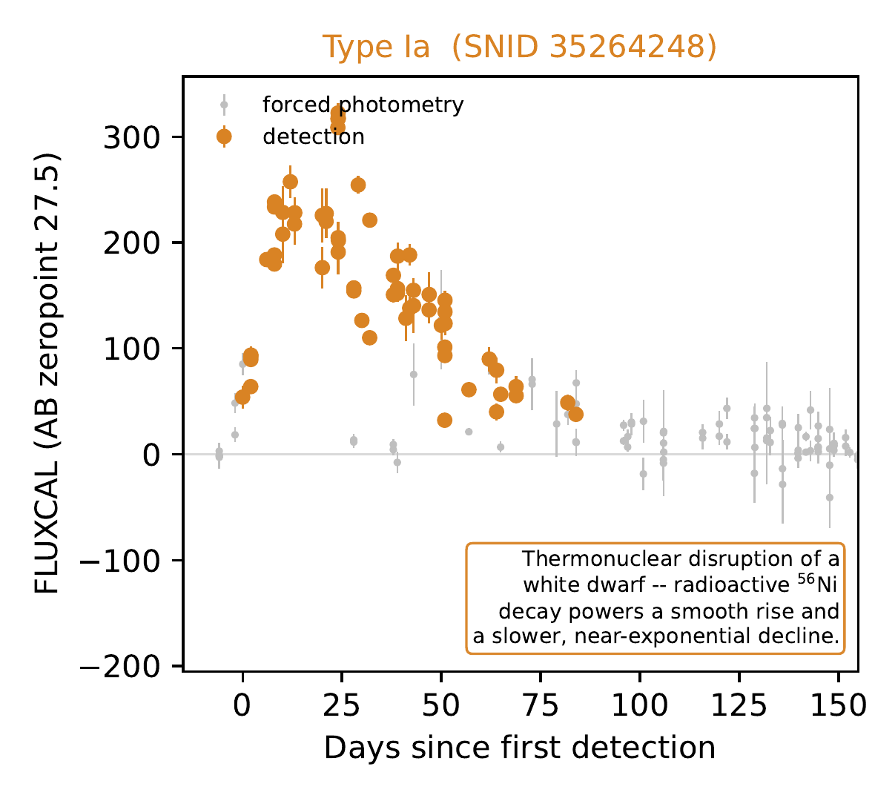
WHAT WE INVESTIGATED
Millions of transients, and no way to look at each one
1
Spectroscopy is definitive.
A spectrum reads the physics directly — elements, ionisation state, ejecta velocity. It is the only fully reliable way to assign a supernova's type.
2
It doesn't scale.
A spectrum needs a large telescope, a spectrograph, and dedicated time on one object at a time — not an option for millions of alerts a night.
3
Photometry is what scales.
Every survey produces a light curve automatically, for every object, every time it's observed — a sequence of brightness measurements over time.
A real light curve from our own training data — not a sketch
The question: how much of the spectroscopic answer — Ia, Ib/c, or II — can be recovered from a light curve's shape alone, before it has finished playing out?
Source: paper/sections/introduction.tex; figures/fig2_lightcurve_schematics.pdf (Tier A object 35264248)
2
Notes:
Every night, wide-field sky surveys already in operation, like the Zwicky Transient Facility, detect thousands of transient events: stars exploding, flaring, or otherwise changing brightness. The only fully reliable way to know what kind of event we're looking at is spectroscopy, splitting the object's light into a spectrum and reading off the physics directly from which elements are present and how fast the ejecta is moving. But spectroscopy needs a large telescope, a spectrograph, and dedicated observing time pointed at one object at a time. It does not scale to millions of alerts. What every survey produces automatically, for every object, every time it's observed, is a light curve: a handful of brightness measurements over time, in a few wavelength filters. The light curve you see here is real, an actual object from our training data, and the question this whole project asks is how much of the spectroscopic answer can be recovered from a shape like this alone, ideally early, before the transient has finished playing out.

Slide 3
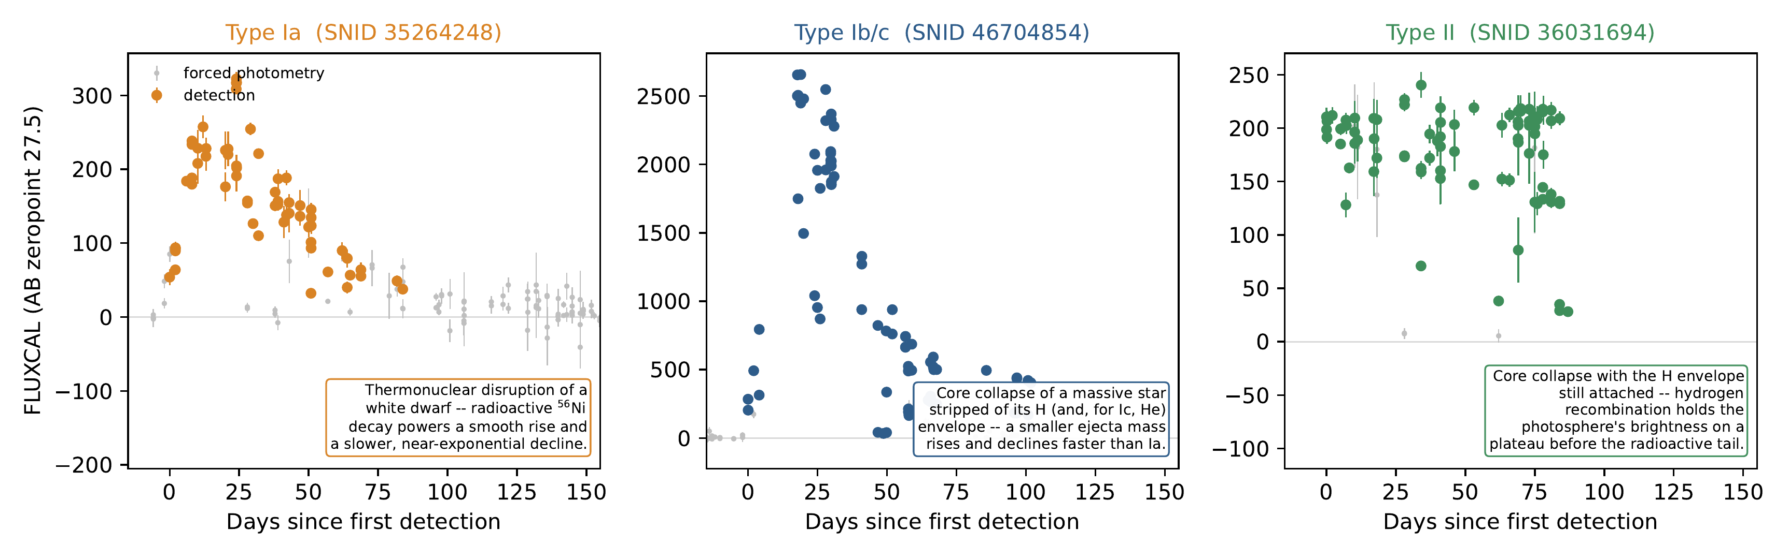
WHAT WE INVESTIGATED
Three classes, three physical mechanisms
Type Ia
Thermonuclear disruption of a white dwarf. Radioactive ⁵⁶Ni decay powers a smooth rise (~3–4 wk) and a slower, near-exponential decline.
Type Ib/c
Core collapse of a stripped-envelope massive star. A smaller ejecta mass rises and declines faster than Ia.
Type II
Core collapse with the H envelope still attached. Hydrogen recombination holds brightness on a plateau before the radioactive tail.
Ia
Ibc
II
Source: figures/fig2_lightcurve_schematics.pdf, real Tier A objects 35264248 / 46704854 / 36031694
3
Notes:
We target three supernova subtypes, and each has a distinct light-curve shape rooted in distinct physics. Type Ia, shown in amber, is the thermonuclear disruption of a white dwarf; radioactive nickel-56 decay powers a smooth, fairly standardized rise over about three to four weeks and a slower, near-exponential decline. Type Ib/c, in blue, is core collapse in a massive star that has already been stripped of its hydrogen, and for Type Ic, its helium too. With a smaller ejecta mass to power, it rises and declines noticeably faster than Ia. Type II, in green, is also core collapse, but the hydrogen envelope is still attached, and hydrogen recombination in that envelope holds the photosphere's brightness nearly constant for an extended period, the plateau you can see clearly in the right-hand panel, before it drops onto the same radioactive tail. All three of these are real light curves pulled directly from our own training data, not idealised textbook sketches.

Slide 4
WHY THIS TOPIC
The brief, and why the timing made it urgent
The programme brief
The timing
A multi-survey, multimodal pipeline that classifies transient alerts into supernova subtypes and flags whatever fits none of them — pretrained on simulated data, fine-tuned on real spectroscopically labelled data, served over a live alert stream, and refined by a human-in-the-loop review process.
30 June 2026
LSST's main ten-year survey began operations
up to ~7,000,000
transient and variable-source alerts per night, at full cadence — no follow-up programme can classify these object by object. ZTF, our fine-tuning source, is already straining manual triage today.
THE BRIEF, IN ONE LINE
Pretrain
→
Fine-tune
→
Serve
→
Review
simulated → real ZTF → live alerts → human-in-the-loop
Source: paper/sections/objectives.tex; paper/sections/introduction.tex (Ivezić et al. 2019; Bellm et al. 2019)
4
Notes:
The programme brief set the ambition for us: build a multi-survey, multimodal pipeline that classifies transient alerts into supernova subtypes and also flags whatever doesn't fit, pretrained on simulated data, fine-tuned on real spectroscopically labelled data, served over a live alert stream, and, ideally, refined by a human reviewing the anomalies it flags. The timing made this more than an academic exercise. The Vera C. Rubin Observatory's Legacy Survey of Space and Time, LSST, began its main ten-year survey on the 30th of June, 2026, and at full operational cadence it's designed to produce up to around seven million transient and variable-source alerts every single night. No spectroscopic follow-up programme, however well resourced, can look at each of those objects individually. ZTF, the survey we fine-tune on, is already straining manual and semi-automated triage at its current, much smaller scale. Automated, photometry-only classification isn't a convenience for this era, it's the only way a human follow-up programme can be pointed at the right handful of objects out of millions.

Slide 5
QUESTION & OBJECTIVES
One question, seven testable objectives
How much of a supernova's true spectroscopic type can be recovered from its light curve alone, early enough to be useful, by a model trained mostly on simulation and fine-tuned on a comparatively small amount of real data?
1
One canonical schema, one reader per source — sim, real ZTF, live Fink
2
Train on simulation alone; establish the ceiling and failure modes first
3
Fine-tune on real labelled ZTF data and measure the sim-to-real gap
4
Build an anomaly branch that flags what fits none of the three classes
5
Serve over Kafka — replay mode first, then an unmodified live feed
6
Validate every stage against gates written before any result existed
7
A results interface where every number traces to its source file
Source: paper/sections/objectives.tex (7 objectives, verbatim condensed)
5
Notes:
Our central question, in one sentence, is: how much of a supernova's true spectroscopic type can a model recover from its light curve alone, early enough to be useful, if it's trained mostly on simulation and only fine-tuned on a comparatively small amount of real data? From that question we set seven concrete, individually testable objectives at the very start of the project, before any code was written. Build one canonical data schema and one reader per source, so a model trained on simulation can be evaluated on real data without a source-specific code path. Train a causal classifier on simulated data alone first, and establish its ceiling and its failure modes before any real data enters the picture. Fine-tune on real, spectroscopically labelled ZTF data and actually measure the sim-to-real gap rather than assume fine-tuning works. Build a separate anomaly branch that can flag alerts resembling none of the three target classes. Serve the trained model over a Kafka pipeline, first in replay mode and then, unmodified, against a live broker feed. Validate every stage against acceptance criteria written down before we had any results to judge them against. And finally, produce a results and monitoring interface where every number is traceable back to the file that produced it. Everything for the rest of this talk is organized around reporting the outcome of each of these seven.

Slide 6
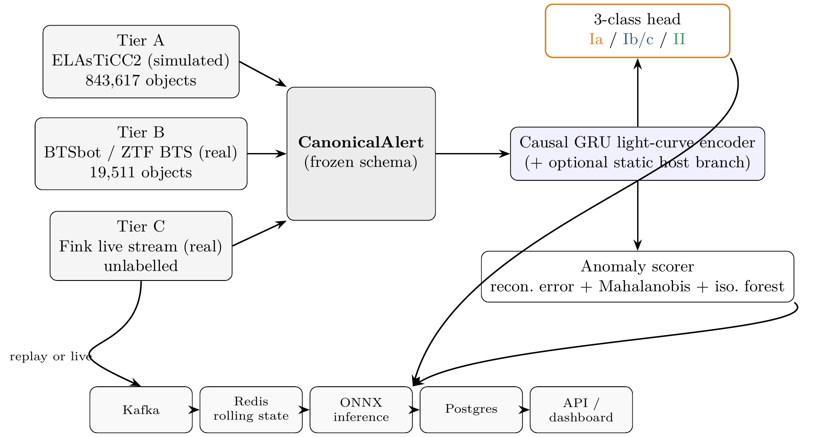
HOW WE BUILT IT
Pipeline architecture
Source: paper/figures/fig1_pipeline.tex — Figure 1 of the report
6
Notes:
This is the single diagram that explains the whole system, and it's worth spending a moment on. On the left are our three data tiers: simulated ELAsTiCC2 light curves for pretraining, real ZTF data from the Bright Transient Survey for fine-tuning, and Fink's live alert stream for serving. All three convert into one shared canonical alert record before anything downstream ever touches them, that funnel in the middle is what makes it possible to pretrain on one survey and fine-tune on a completely different one without writing survey-specific model code. That canonical record feeds a shared causal GRU light-curve encoder, which in turn feeds two separate heads: a flat three-class classifier, and a completely separate anomaly-scoring branch that combines three different signals. And on the bottom, the serving path, Kafka, a rolling state store in Redis, ONNX inference, Postgres, and an API, is the exact same consumer code whether the producer feeding it is an archived-data replay or the real live Fink stream. We'll see a dashboard reading from this exact pipeline in a few minutes.

Slide 7
HOW WE BUILT IT
Three data tiers, one shared schema
A
Tier A
B
Tier B
C
Tier C
ELAsTiCC2 (simulated)
BTSbot / ZTF BTS (real)
Fink live stream (real)
843,617
19,511
unlabelled
objects
objects
not a static corpus
Bands
ugrizy (6 bands)
Bands
g, r (2 bands)
Bands
varies
Cutouts
No cutouts
Cutouts
Real cutouts
Cutouts
Real cutouts
Role
Pretraining
Role
Fine-tuning
Role
Serving only
Tier A's class balance is a release artefact, not a sky-rate estimate — the model's raw output probabilities carry that training prior.
Source: paper/sections/data.tex, Table 1/3 (TierATotalObjects, TierBNObjTotal)
7
Notes:
Concretely, here's what those three tiers look like. Tier A is the ELAsTiCC2 training-sample release from the LSST Dark Energy Science Collaboration: eight hundred forty-three thousand, six hundred seventeen simulated objects across six LSST photometric bands, no image cutouts, used entirely for pretraining. Tier B is the public release from BTSbot and the ZTF Bright Transient Survey: nineteen thousand, five hundred eleven real objects in ZTF's two bands, green and red, each with real image cutouts, joined against an independently maintained spectroscopic classification database to get an actual Ia, Ib/c, or II label, this is what we fine-tune on. Tier C is Fink's live relay of real ZTF and LSST alerts, not a static corpus at all, unlabelled, with whatever bands and cutouts a given alert happens to carry, and it's used for serving only, never for training. One thing worth flagging now, because it matters later: Tier A's class balance is an artefact of how many simulation directories the release happened to include per class, not an estimate of the real sky rate. Our model's raw output probabilities inherit that simulated balance, and we'll come back to what that means for live predictions.

Slide 8
HOW WE BUILT IT
Three decisions made before any model existed
1
2
3
Wavelength, not band index
Causal models only
A frozen evaluation harness
ZTF r (633.9 nm) and LSST r (622.2 nm) land next to each other automatically. A categorical band index would make them unrelated integers — nothing learned on simulated LSST data would transfer to real ZTF data at all.
bidirectional=False everywhere, no future-timestep attention. On day 3 of a real alert, day 60 hasn't happened yet — enforced by a dedicated Gate B test, not just intention.
Metrics written and frozen before any model existed; touched once afterward, only to add a new metric (ROC-AUC), never to change an existing one's output.
Source: paper/sections/methodology.tex, decision log (Table 8)
8
Notes:
Three design decisions, made before any model was trained, turned out to matter more than anything we tuned afterward. First: every observation is represented by its filter's actual effective wavelength, a continuous number in nanometers, rather than a categorical band index. ZTF's r-band sits at 633.9 nanometers, LSST's r-band at 622.2, with wavelength conditioning, those land right next to each other in the model's input space automatically, because they're physically similar light. With a categorical index, ZTF's third band and LSST's third band would just be two unrelated integers, and nothing learned from simulated LSST data would transfer to real ZTF data at all. Second: every recurrent layer in this model runs in one direction only, with no way to attend to a future timestep, because on day three of a real alert, day sixty hasn't happened yet, and a bidirectional model evaluated offline would silently cheat by using information that doesn't exist yet in production, with no way to see that failure in an ordinary train-test split. We enforce this with a dedicated test, not just a design intention. Third: our evaluation code, the metrics themselves, were written and frozen before any model existed, and touched only once afterward, to add a new metric, never to change an existing one's output. A metric you can still edit is a metric that will eventually get adjusted to make a disappointing result look better, and then no result in this whole report could be trusted.

Slide 9
THE MODEL
A causal GRU, reading one observation at a time
2-layer causal GRU · hidden size 128
Why absolute flux, not just SNR
LayerNorm + dropout (p=0.2) before a linear head. Sequences are packed and masked so a padded timestep is never processed.
A Type Ia's absolute peak brightness clusters tightly near M ≈ −19.3 — real signal for the Ia / non-Ia boundary. But it's only recoverable as flux = SNR × flux_err, a multiplicative interaction a GRU is comparatively poor at learning. Supplying it directly removes that burden at no extra leakage cost.
Predicts at every timestep, not just the last
— what makes the phase-cutoff curves you'll see in the demo possible, without training a separate model per cutoff.
Six per-observation features:
Δt since first detection
signal-to-noise (flux / flux_err)
absolute flux (compressed)
flux uncertainty (compressed)
filter wavelength
detection vs. forced-photometry flag
Optional static branch
A small MLP over 7 host/extinction fields, fused before the head (“LC+static”). Each field carries its own missingness indicator, not a silent impute.
Source: paper/sections/methodology.tex §Model architecture
9
Notes:
The classifier itself is a two-layer causal GRU with a hidden size of 128, followed by layer normalization, dropout, and a linear head. It reads the light curve one observation at a time and predicts at every single timestep, not just at the end, that's deliberate, because it's what lets us plot accuracy as a function of how much of the light curve has arrived, which is our primary reported result throughout this project, not a single end-of-curve number. Each observation is represented by six features: time since the object's own first detection; a compressed signal-to-noise ratio; a compressed absolute flux value, carried separately from signal-to-noise because a Type Ia's standardized peak brightness is real discriminating signal that a GRU can't easily recover as a multiplicative combination of two other inputs; the uncertainty on the flux measurement; the wavelength we just discussed; and whether the point is an actual detection or forced photometry. There's also an optional branch that folds in host-galaxy features, photometric redshift, offset, extinction, fused in before the final head. We'll see in a few slides that this optional branch is exactly where one of our most interesting, still-unresolved findings comes from.

Slide 10
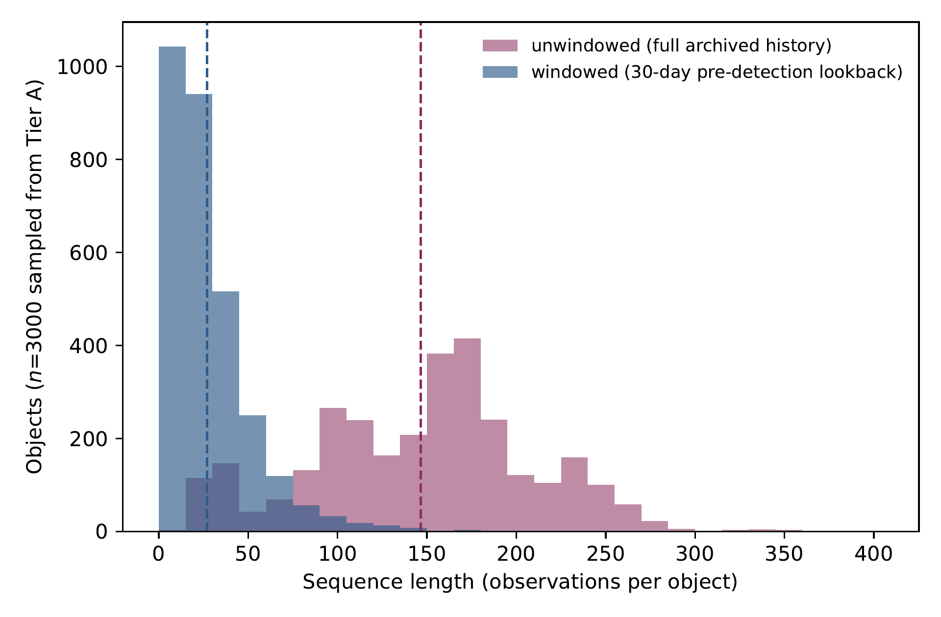
THE WINDOWING FINDING
Training data isn't shaped like a live alert
146.6 → 26.9
mean sequence length, unwindowed → windowed (observations/object)
81.6%
of a training sequence's observations fall outside the live window
7.8 vs. 138.8
mean detections vs. mean forced-photometry points per object
A live alert carries ~30 days of pre-detection forced photometry; the archived corpus carries full multi-year histories. Training must match what serving will ever actually see.
Source: paper/sections/analysis.tex §Windowing (3,000-object stratified sample); figures/fig3_windowing_histograms.pdf
10
Notes:
Here's a finding that surprised us. Our simulated training data gives every object its complete observation history, including, for a slow, recurring object, entire observing seasons before it ever became interesting. A real live alert never has that: it carries only the detections seen so far, plus a bounded window of forced photometry reaching back before the first detection. We measured this directly on a stratified three-thousand-object sample: the unwindowed mean sequence length is a hundred forty-six point six observations per object; a live alert stream would only ever accumulate about seven point eight detections and around a hundred thirty-eight forced-photometry points in that same bounded window. Applying our actual thirty-day pre-detection lookback collapses the mean sequence length from a hundred forty-six point six down to twenty-six point nine observations, an eighty-one point six percent reduction, shown in the histogram here. This is not a small correction; it means the vast majority of what the model saw during training literally cannot exist at the moment a real system would ever be asked to classify something. We had to build this windowing into training deliberately, rather than let the model learn on an input shape it would never actually see in production.

Slide 11

LIVE DEMO
The results dashboard
Overview
→
Results
→
Objects
→
Anomalies
→
Live
Full click-by-click script: paper/demo_script.md
11
Notes:
That's the setup, the data, the model, and one genuine finding about how training and serving data differ in shape. Now we're going to switch to the live dashboard itself, which is where our actual results live. We'll walk through five tabs in order: an overview of headline numbers and validation gates, the results tab with our phase curve and confusion matrix, an object-by-object detail view including one correct and one incorrect classification, the anomaly ranking tab, and finally the live monitor. When we come back afterward, we'll talk about what those results mean, and, just as importantly, what we still don't know.

Slide 12
AFTER THE DEMO
What the sim-to-real gap means
+0.186
macro-F1 recovered by fine-tuning over the zero-shot baseline (0.4483 → 0.6343)
0.50
deployed Ib/c F1 — inside the pre-registered 0.40–0.60 band
macro-F1 · a drop of −0.0454, the expected sim-to-real direction
The drop is read as a result, not a failure: simulated data has none of real data's instrument noise, artifacts, or host-catalogue error, so identical scores on both would signal a broken evaluation split, not a good model. Ib/c — the rarest class in the real sky, and the one this project's own test split supports least (35 objects vs. 488 for Ia) — scoring 0.50 is the expected outcome, not a surprise.
Source: paper/numbers.tex (TierLCStaticMacroFFull, LCOnlyMacroF, ZeroShotMacroF, WithStaticMacroF, TransferGain, LCOnlyFIbc, TierBSupportIbc/Ia)
12
Notes:
You just saw the numbers directly in the dashboard, so here's how to read them. Our simulated-data ceiling, the LC-plus-static configuration on Tier A, reaches a macro-F1 of 0.7169. Fine-tuned and deployed on real Tier B data, using the light-curve-only configuration we actually ship, that drops to 0.6716, a decline of about 0.045 macro-F1. We read that drop as a result, not a failure: simulated data carries none of real data's instrument noise, real-bogus artifacts, or host-catalogue errors, so it's strictly easier, and a model that scored identically on both would be much stronger evidence of a broken, leaking evaluation split than of a genuinely good model. The fact that fine-tuning matters at all is itself worth stating: a zero-shot model, Tier A weights, no adaptation, evaluated cold on Tier B, only reaches a macro-F1 of 0.4483; fine-tuning recovers point one eight six of that gap. And our Ib/c score, point five oh F1 on the deployed model, looks bad by ordinary standards, and it's supposed to: Ib/c is both this project's rarest class and, on top of that, is the class our own real test split supports the least, at only thirty-five objects. A model that suddenly nailed Ib/c despite that would be far more suspicious than one that struggles with it exactly as expected.

Slide 13
AFTER THE DEMO
Six silent failures — none of them crashed
!
Undocumented sentinel values
!
Three numbering schemes, one is real
!
Assumed-constant flux zeropoint
A raw “999” host magnitude reads as a real, very faint galaxy — legit values run 18–28.
Only SIM_TYPE_INDEX is the true label; the other two look identical from the outside.
magzpsci varies row to row — treating it as fixed miscalibrates faint, early-time flux.
!
A triage flag mistaken for a label
!
An inverted anomaly component
!
Undersized CCD-edge cutouts
BTSbot's real/reject flag sits next to the subtype — easy to train the wrong task.
Classifier entropy quietly made the anomaly ranking worse, with no symptom pointing at it.
Discarded an alert's entire light curve over an unrelated image-shape bug — found live.
None raised an error. Each would have produced a confident, plausible, wrong result.
Source: paper/sections/discussion.tex, Table 9 (silent-failure modes)
13
Notes:
This table is, in a real sense, the most useful thing we built, more than any single accuracy number. Every one of these six issues would have produced a plausible, confident, completely wrong result, and not one of them would have thrown an error or crashed anything. An undocumented sentinel value of nine-ninety-nine in a host-galaxy magnitude field looks exactly like a very faint, real galaxy instead of a missing measurement, legitimate host magnitudes run from about eighteen to twenty-eight, so nine-ninety-nine sits right in a plausible range if you don't know to treat it as a flag. A single object's raw data file carries three different, unrelated numeric identifiers, and only one of them is the actual class label, using the wrong one trains against scrambled targets that look, from the outside, exactly like the model isn't learning. Real ZTF photometry is calibrated against a zero-point we measured varying row to row on live data, treating it as a constant would have introduced a brightness-dependent error concentrated in exactly the faint, early-time regime this whole project is built to get right. One metadata column in our real-data release is a binary real-or-reject triage flag, easily mistaken for the spectroscopic subtype label it sits next to, training against it would have produced perfectly plausible-looking numbers for the wrong task entirely. We built a fourth anomaly-detection signal from classifier confidence and it turned out to be inverted, quietly making our anomaly ranking worse, with no symptom that pointed specifically at it until we checked directly. And a live ingestion run found that an undersized, CCD-edge image cutout could silently discard an alert's entire light curve, not just its image, something no amount of offline testing against archived data would ever have surfaced. None of these were caught by a crash. They were caught by checking by hand, before trusting the result.

Slide 14
AFTER THE DEMO
What's still unresolved
?
?
?
Static-encoder inversion
Gate D deferred
LSST unverified
Host features helped on Tier A but hurt Tier B fine-tuning. The leading hypothesis — missing photo-z — was tested directly and refuted: 67% of the Tier A gain survives without it. True cause unconfirmed; the deployed model sidesteps it by using no static branch.
Every eval population available (Tier B “weird” objects) was spectroscopically confirmed real — pre-filtered at two independent stages. There was no bogus/artifact candidate for the ranker to have possibly found.
avro_lsst.py is built and defensively tested, but two live observation windows found zero queued messages on every subscribed topic — despite genuine cumulative traffic in the hundreds of thousands. Two lulls, cause undiagnosed.
Source: paper/sections/discussion.tex; RESULTS.md §What remains unresolved (1–3)
14
Notes:
Three open questions we want to be direct about, because a project that only reports what worked isn't being fully honest about what it found. First: adding host-galaxy features helped substantially on simulated data but made our real Tier B fine-tune measurably worse, not just unhelpful. Our leading hypothesis was that host photometric redshift, which is completely absent from Tier B, was doing most of that simulated-data gain as a stand-in for distance, since Type Ia supernovae are standardized candles. We tested that directly by retraining without photometric redshift, and the hypothesis is refuted: sixty-seven percent of the original gain survives even with photo-z removed. So photo-z is a real contributor, but not the dominant one, and we do not have a confirmed explanation for why the static branch hurts on real data. Second: our fourth validation gate, which was supposed to manually inspect our top-ranked anomalies against a published real-bogus-artifact benchmark, could not actually be run as intended, every population we had access to had already been pre-filtered to spectroscopically confirmed real objects, at two independent stages, so there was no bogus or artifact candidate in the pool for the ranker to have possibly found. That gate is deferred, not passed or failed. Third: our LSST alert reader is built and defensively tested, but genuinely unverified against real traffic, across two separate observation windows, every LSST topic we subscribed to showed zero currently queued messages, even though cumulative message counts on those same topics run into the hundreds of thousands. We caught two lulls, for reasons we haven't further diagnosed, and whether our whole wavelength-conditioning transfer strategy actually works on real LSST data remains, honestly, still an open question.

Slide 15

FUTURE WORK & CLOSING
What comes next, and thanks
Future work
Data & acknowledgements
1
Close Gate D against a genuinely unfiltered (or reject/candidate) alert stream
LSST DESC
public ELAsTiCC2 training-sample release, pretraining
2
Verify the LSST reader once Fink's relay next carries real traffic
ZTF Bright Transient Survey / BTSbot
3
Isolate the static-encoder inversion with its own controlled ablation
real labelled light curves, fine-tuning
Fink broker
4
Revisit WHXE now that Tier B has real non-SN-like negatives to test against
live, credentialled ZTF and LSST alert access
5
Batch the serving layer's per-alert database round trips (the classifier itself is not the bottleneck)
SNAD
the coniferest anomaly-detection package
Thank you
15
Notes:
Looking forward, the most direct next steps follow straight from what we've just described. Close the anomaly validation gate properly, against a genuinely unfiltered alert stream that still contains bogus and artifact candidates, not a pre-cleaned one. Verify the LSST reader the next time Fink's relay actually carries live traffic during a session. Isolate the static-encoder inversion with its own controlled experiment, training the host-feature branch alone, at its own learning rate, on the same real data split. Revisit our hierarchical loss function now that real Tier B data finally gives us a population of genuine non-supernova objects for a hierarchy to be meaningfully tested against. And on the systems side, batch the serving layer's per-alert database writes, since our own benchmarking found the classifier itself takes a fraction of a millisecond per alert, the bottleneck is unbatched network round trips, not the model. We're grateful to the LSST Dark Energy Science Collaboration for the public ELAsTiCC2 release we pretrained on, to the Zwicky Transient Facility's Bright Transient Survey and the BTSbot team for the real labelled data we fine-tuned on, to the Fink broker team for live, credentialed access to real ZTF and LSST alerts, and to the SNAD team for the coniferest anomaly-detection package our anomaly branch is built on. Thank you.

