Slide 1
INTRODUCTION

Slide 2
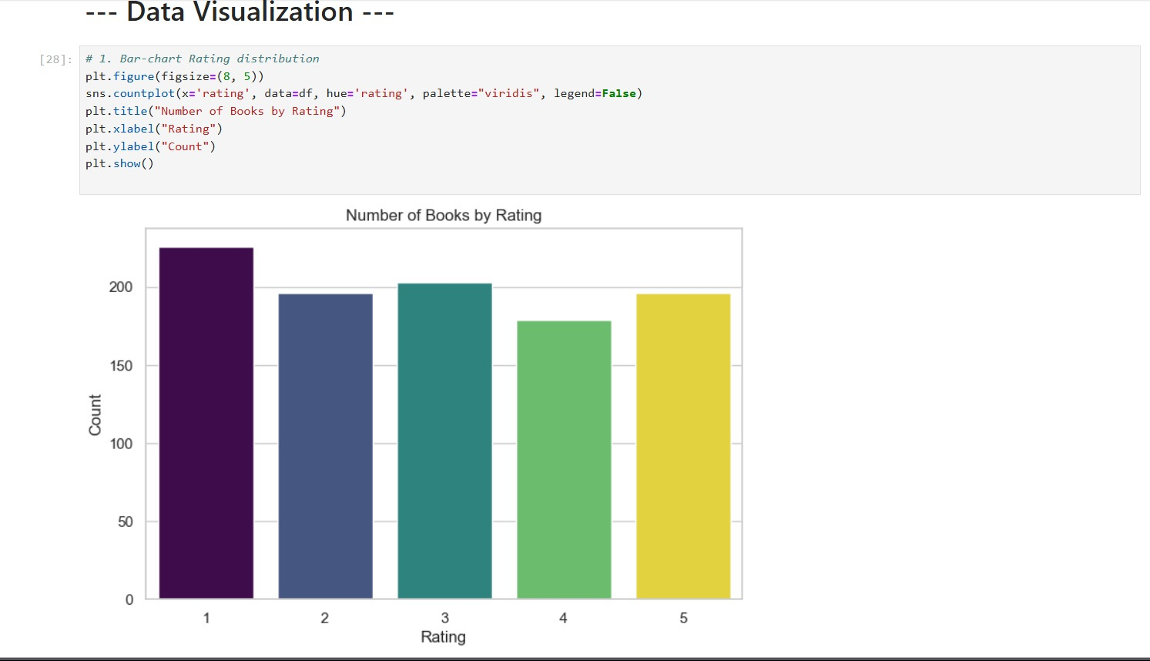
Key Insights:-
1. Rating 1 has the highest count of books, indicating a large number of books received poor ratings.
2. Rating 4 has the lowest count, suggesting fewer books are rated just below excellent.
3. Ratings 2, 3, and 5 are relatively close in count, showing a more balanced distribution in mid to high ratings.
4. There could be issues with book quality or reader dissatisfaction if Rating 1 dominates the dataset.
5. The fact that Rating 5 isn’t the highest suggests fewer books are perceived as outstanding by users.

Slide 3
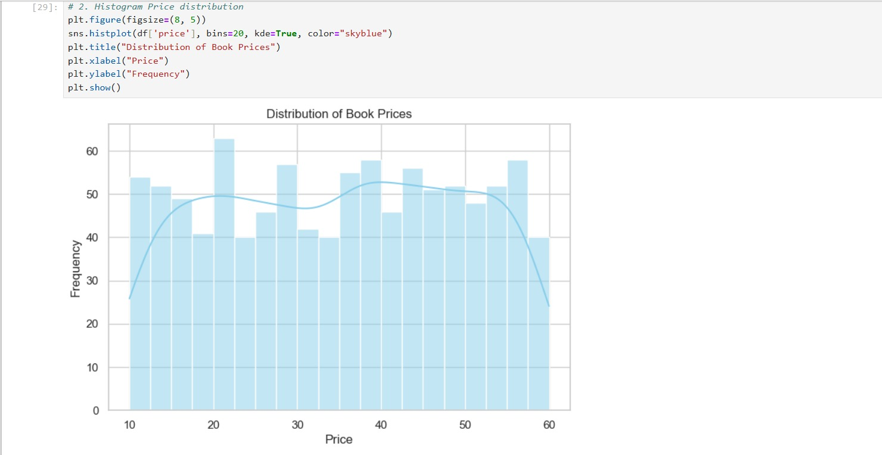
Key Insights:-
1. Majority of Book prices are concentrated between $0 to $50.
2. A few books are priced much higher ,indicating a long tails distribution.
3. Presence of outliers suggests premium books or collector editions.

Slide 4
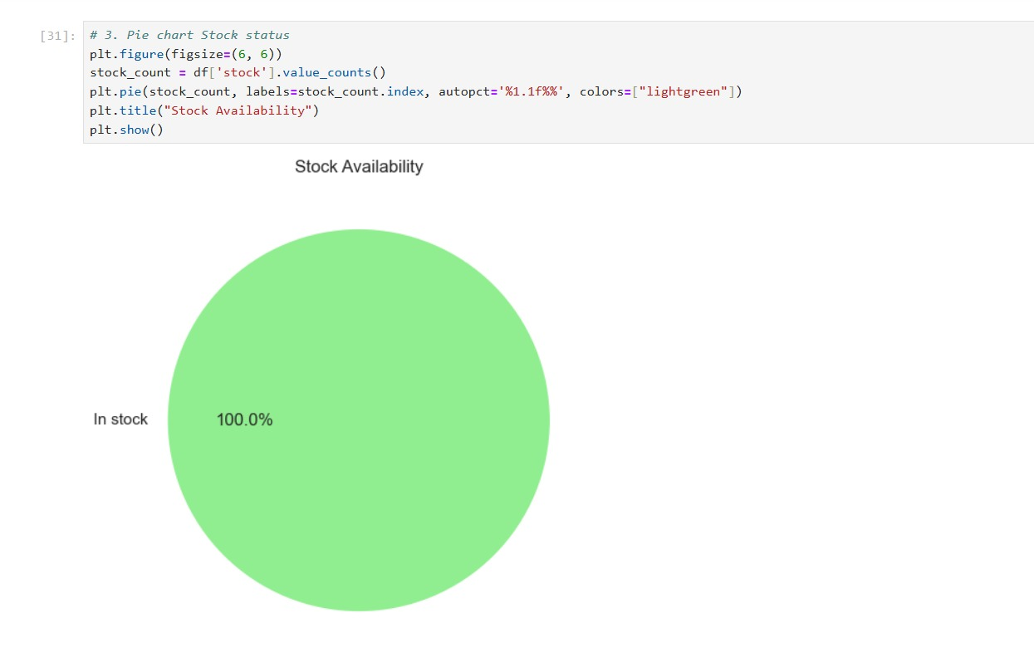
Key Insights:-
1.Majority of books are in stock.
2.A smaller proportion is out of stock ,indicating either high demand or limited availability.
3.There is no books which are not in stock(Present).

Slide 5
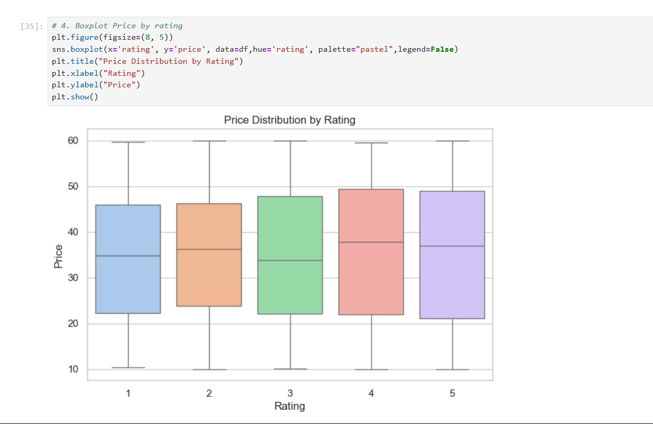
Key Insights:-
1.Higher-rated books tend to have a wider price range.
2.Some lower-rated books are surprisingly expensive.
3.Outliers observed across all ratings.

Slide 6
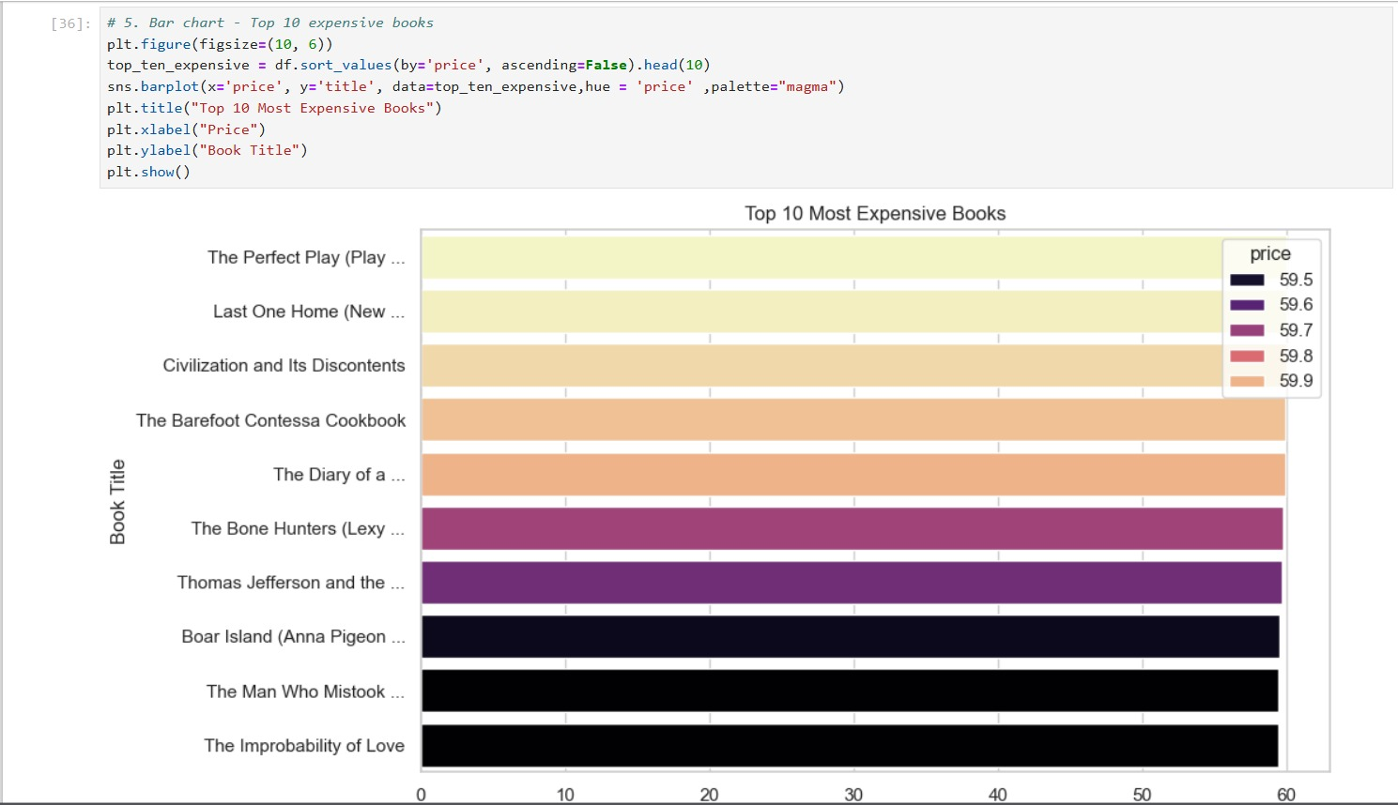
Key Insights:-
1.These books are priced significantly above average.
2.Useful for identifying premium titles or special editions.
3.Could be targeted for high-value customers or collectors.

Slide 7
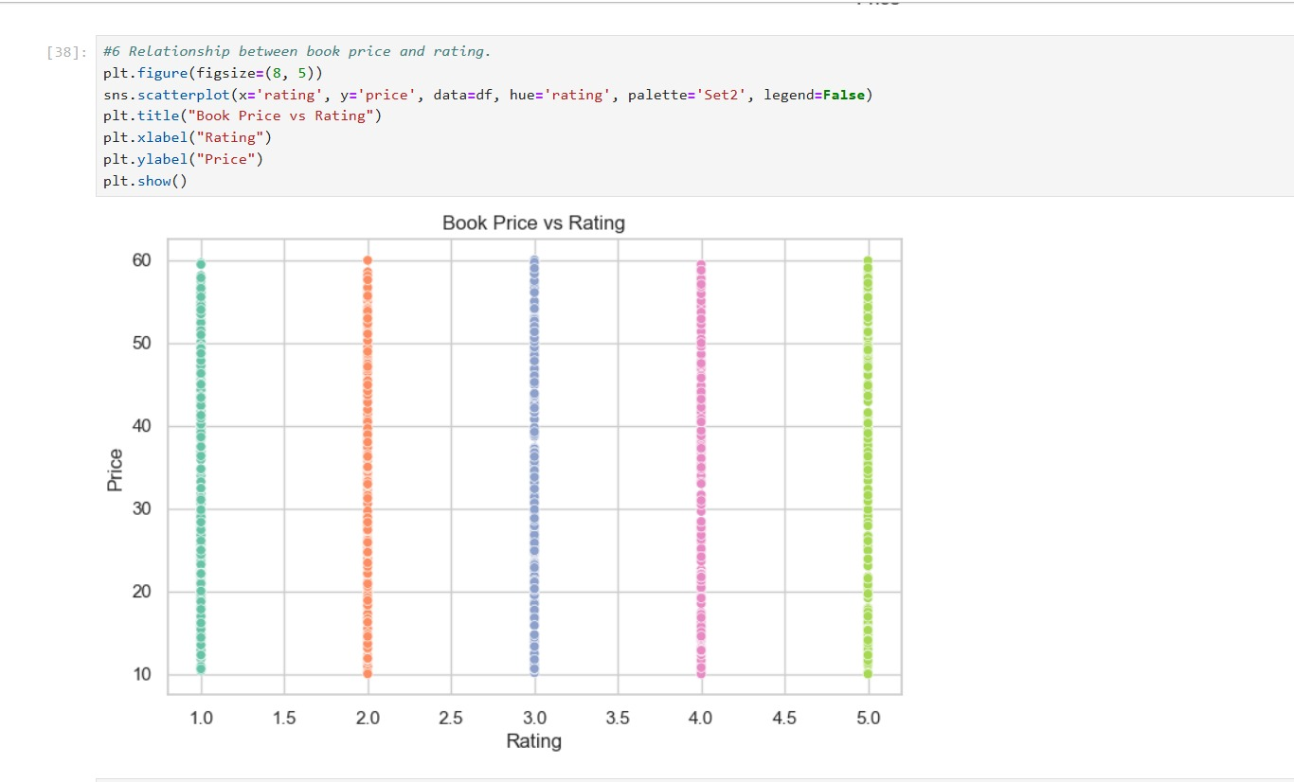
Key Insights:-
1.No strong trend observed between price and rating.
2.It shows that higher prices don’t always guarantee better services.

Slide 8
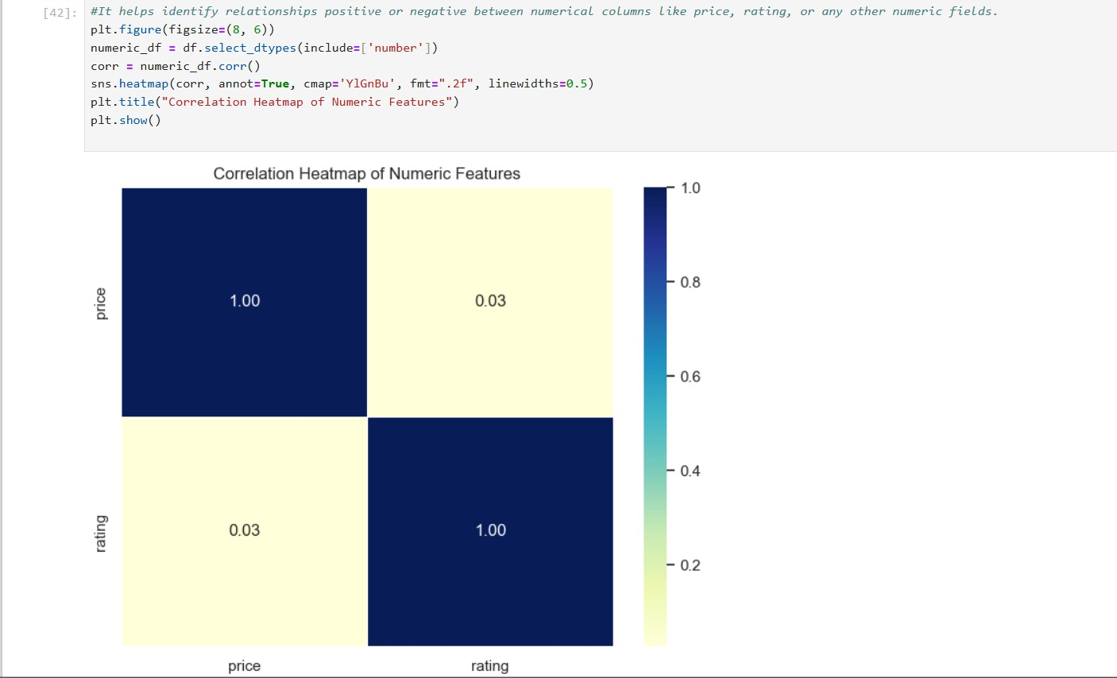
Key Insights:-
1.Weak correlation between most numeric fields.
2.Slight positive correlation may exist between rating and price or stock and price, but not strongly significant.
3.Reinforces that ratings and prices are largely independent.

Slide 9
Business and Data Insights:-
Focus marketing on high-rated, moderately-priced books.
Monitor top 10 expensive books for restocking and promotion.
Expand categories with fewer books to attract broader readership .Consider reviewing pricing for low-rated expensive books.
Top 5 books by Prices are :-
1. The Perfect Play…
2. Last One Home…
3. Civilization and Its Discontents…
4. The Barefoot Contessa Cookbook…
5. The Diary of a …
Top 5 Cheapest books are:-
1.An Abundance of Katherines ($10.00 )
2.The Origin of Species ($10.01)3.
3.The Tipping Point: How ... ($10.02)
4.Patience ($10.16)
5.Greek Mythic History ($10.23)

Slide 10
Books counts per rating are :-
Rating Counts
1 226
2 196
3 203
4 179
5 196
Average Price Per Rating:-
Rating AvgPrice(In $)
1 34.561195
2 34.810918
3 34.692020
4 36.093296
5 35.374490

Slide 11
Thank You

